Slide 1


VERSION CONTROL WITH GIT
2023

Slide 2
PURPOSE OF VERSION CONTROL
History Tracking: Maintain a record of changes made to a project, including who made them, when, and what changed i.e., Traceability.Collaborate with others and helps in reviewing the code.
Collaboration: Enable multiple developers to work on a project simultaneously, coordinating efforts and avoiding conflicts.
Code Backup: Provide secure backups of project files to prevent data loss.
Feature Development: Allow for the development of new features without impacting the main project.
Code Review: Facilitate peer code review to ensure code quality and identify issues early.
2023
VERSION CONTROL WITH GIT

Slide 3


GIT INTRODUCTION
Git is a source code management software.
Git is a command-line tool i.e., A software which is maintained by Linux.
Git is Software but Github, Gitlab, Bitbucket, etc…are all Services.
It is Distributed version control system, meaning that each user has a copy of the entire project history on their local machine.
2023
VERSION CONTROL WITH GIT

Slide 4
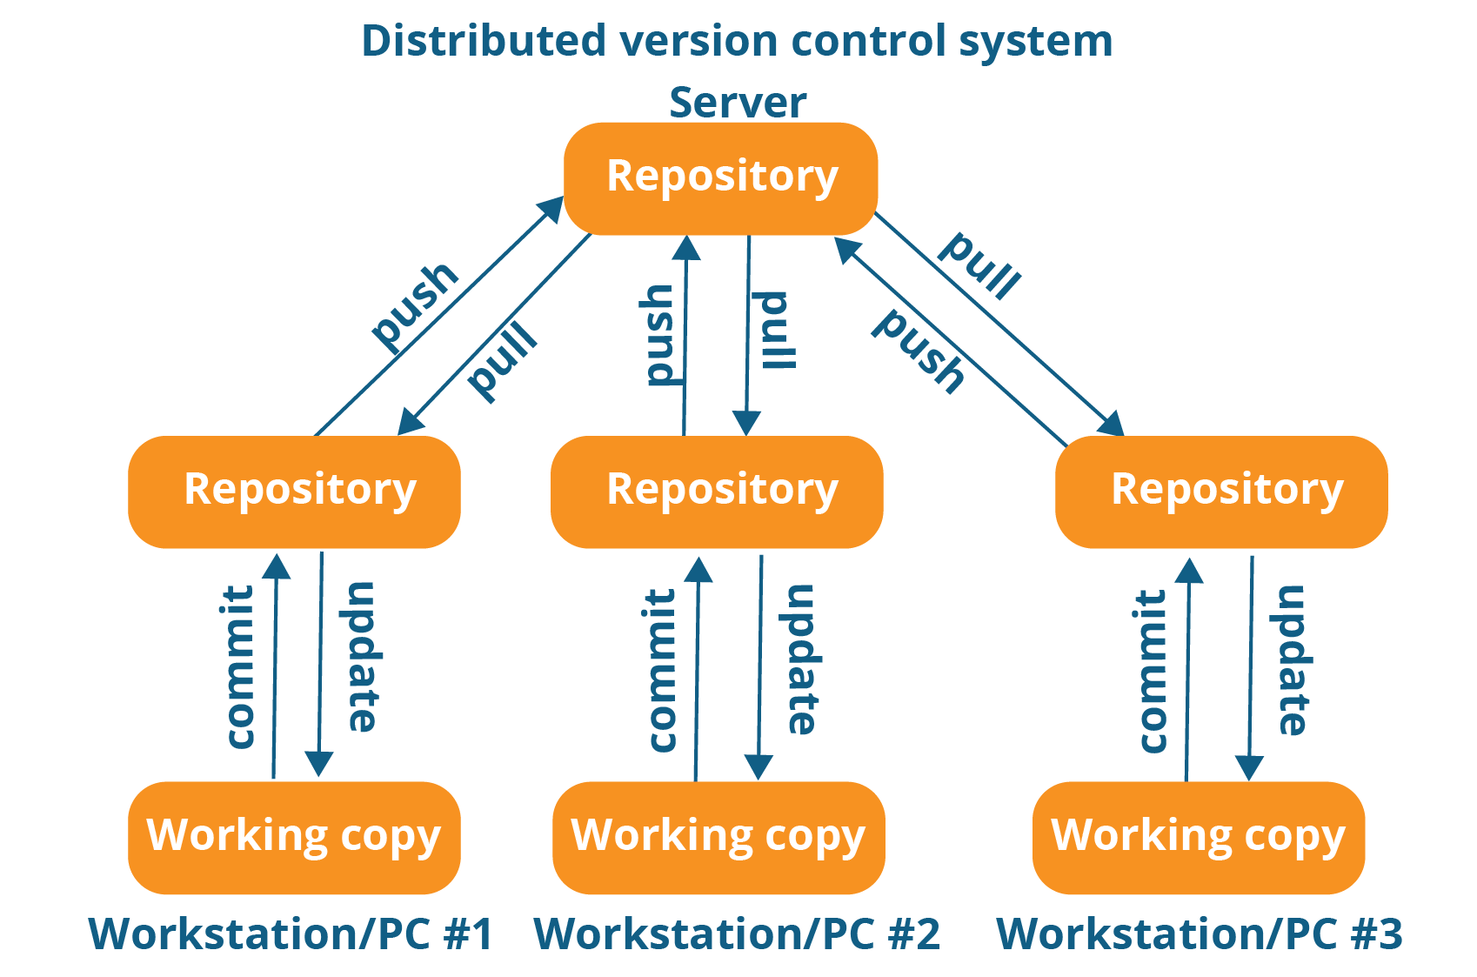
DISTRIBUTED VERSION CONTROL
2023
VERSION CONTROL WITH GIT

Slide 5
TERMINOLOGIES IN GIT
Repository: A Git repository is a place where Git stores all the versions of your project's files and directories.
Working Directory: Where you see files physically and can do modification.
Staging Area (Index): The staging area is an intermediate area where you can selectively choose which changes to include in your next commit.
Commit: A commit is a snapshot of your repository at a specific point in time. It records the changes made to the local repository.
Commit Id/Version-Id: Reference to identify each change.
Snapshot: Represent some data of particular time. It is always incremental i.e., It stores the changes only, not the entire data.
Tag: Tag assign a meaningful name with a specific version in the Repository. It's used to mark significant points in a project's history, such as releases or milestones.
2023
VERSION CONTROL WITH GIT

Slide 6
TERMINOLOGIES IN GIT
Pull: Pulling is the process of retrieving changes from a remote repository to a Local Machine.
Push: Pushing is the process of sending your local changes to a remote or Central (global)repository.
Server: It stores all Repositories.
Branch: A branch in Git is a parallel version of a codebase that enables multiple developers to work on different aspects of a project simultaneously.
Master (Main) Branch: The master (or main) branch is the default branch in Git, and it typically represents the latest stable version of the project.
Fork: Forking a repository creates a copy of it under your account, allowing you to make changes independently of the original repository.
HEAD: It is a symbolic reference to the currently checked out branch or commit. It represents your current working state.
2023
VERSION CONTROL WITH GIT

Slide 7
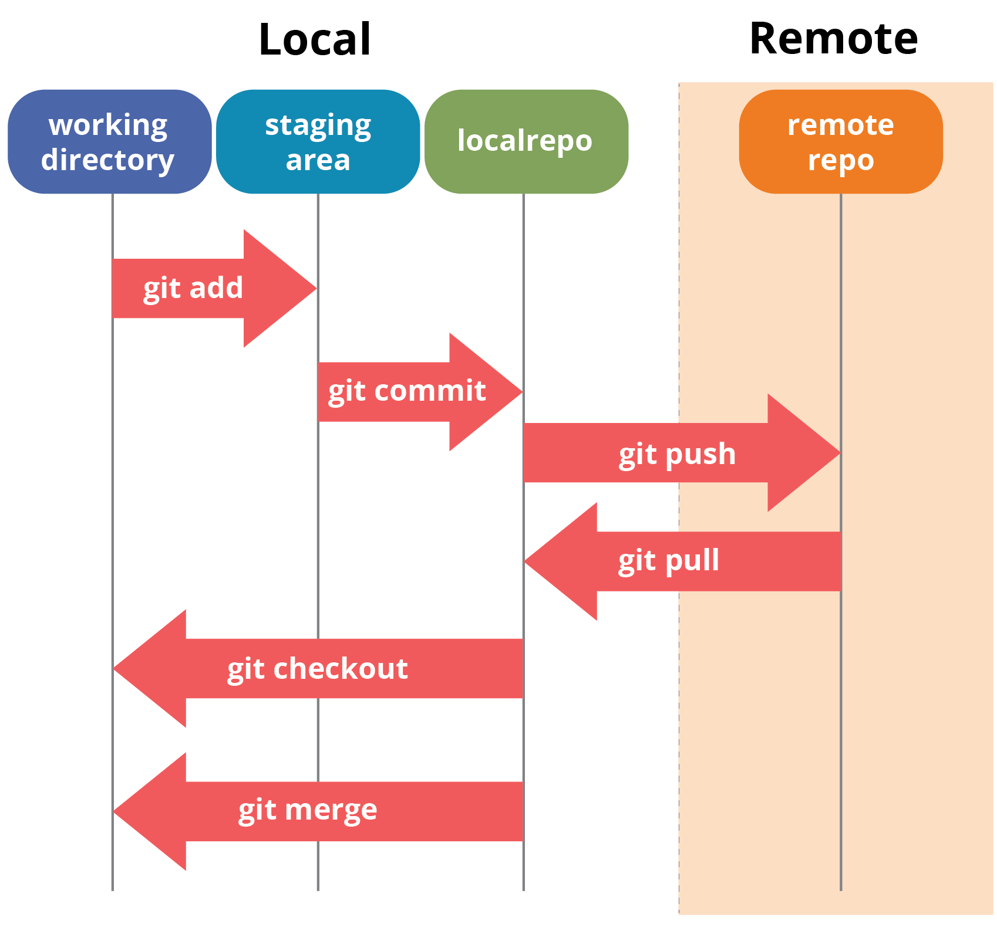
GIT WORKFLOW AND ARCHITECTURE
2023
VERSION CONTROL WITH GIT

Slide 8
IMPORTANT COMMANDS IN GIT
Git Config:- This command sets the author name and email address to be used with your commits.
Git init:- This command is used to initialize a local repository.
Git add:- This command is used to add one or more files to staging (Index) area.
Git commit -m:- This command create snapshots of the file permanently in the version history with a message.
Git Status:- The status command is used to display the state of the working directory and the staging area.
Git push:- This command is used to upload local repository content to a remote repository.
Git pull:- This command is used to receive data from GitHub. It fetches and merges changes on the remote server to your working directory.
2023
VERSION CONTROL WITH GIT

Slide 9
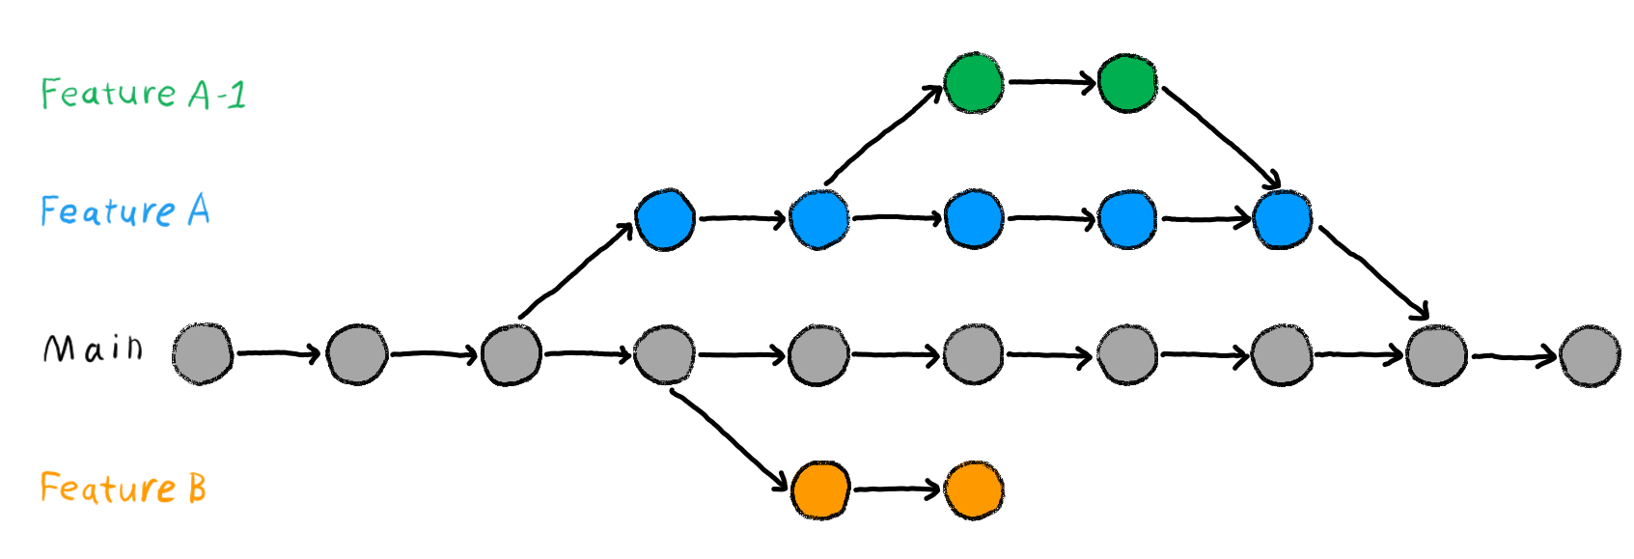
GIT BRANCHING, TAGGING AND MERGING
2023
VERSION CONTROL WITH GIT

Slide 10
GIT BRANCHING, TAGGING AND MERGING
Branching in Git allows you to create separate lines of development for features, bug fixes, or experiments, while keeping your main codebase (usually in the master branch) stable.
To Create a new branch: git branch new-feature
To Switch to the new branch: git checkout new-feature
Git tagging is a way to mark specific points in your Git history, often used to identify releases or important milestones in the project.
Merging in Git is the process of combining changes from one branch into another. This is commonly used to integrate feature branches into the main codebase i.e., to master branch.
2023
VERSION CONTROL WITH GIT

Slide 11
ADVANTAGES OF USING GITHUB
Free and Open Source:- Its free and Open Source Service.
Fast and Small:- As most of the operations are performed locally, therefore it is fast.
Security:- git uses a common Cryptographic hash function called Secure hash function(SHA1), So it’s very Secure.
No-need of Powerful Hardware:- With Git, we can easily work with large codebases, collaborate with other developers, and manage complex branching and merging workflows, all without needing a powerful machine.
2023
VERSION CONTROL WITH GIT

