Slide 1
Recitation 3
James Wei
Professor Peck
9/14/2013

Slide 2
Covered in this Recitation
Big-Oh
Debugging
Overview of the Workbench
Watching Expressions

Slide 3
Big-Oh
Complete question 2.7 from your textbook. For those of you who do not have a textbook, a copy of the question can be found in Sakai under “Resources.”
There are two files, 2.7(1) and 2.7(b).
Submit your answers using this form: http://goo.gl/woxizv
Notes:
Instructor: Write out Google form link on a board, or ask everyone to copy it off the slide now.

Slide 4
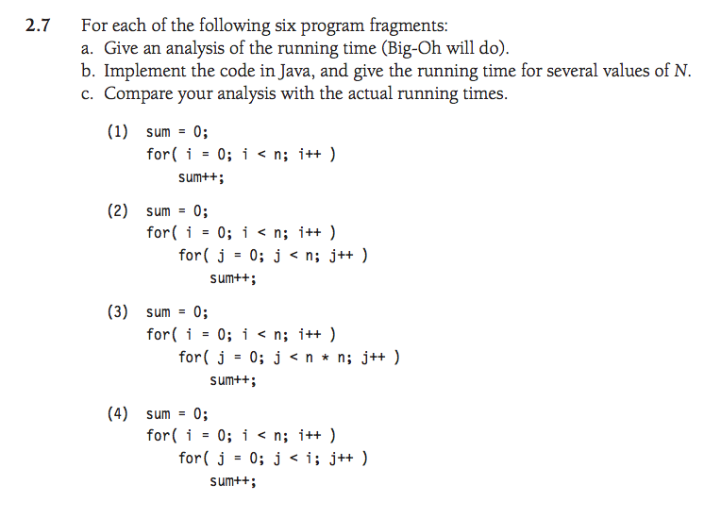
Big-Oh Questions
Notes:
Answers:
1) O(n)
2) O(n^2)
3) O(n^3)
4) O(n^2)

Slide 5
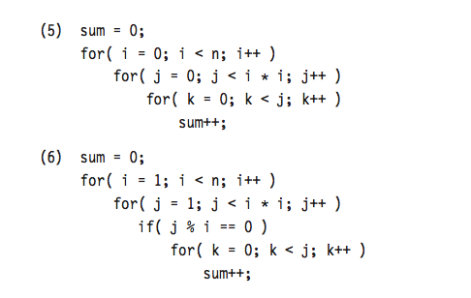
Big-Oh Questions
Notes:
5) O(n^5)
6) O(n^5)

Slide 6
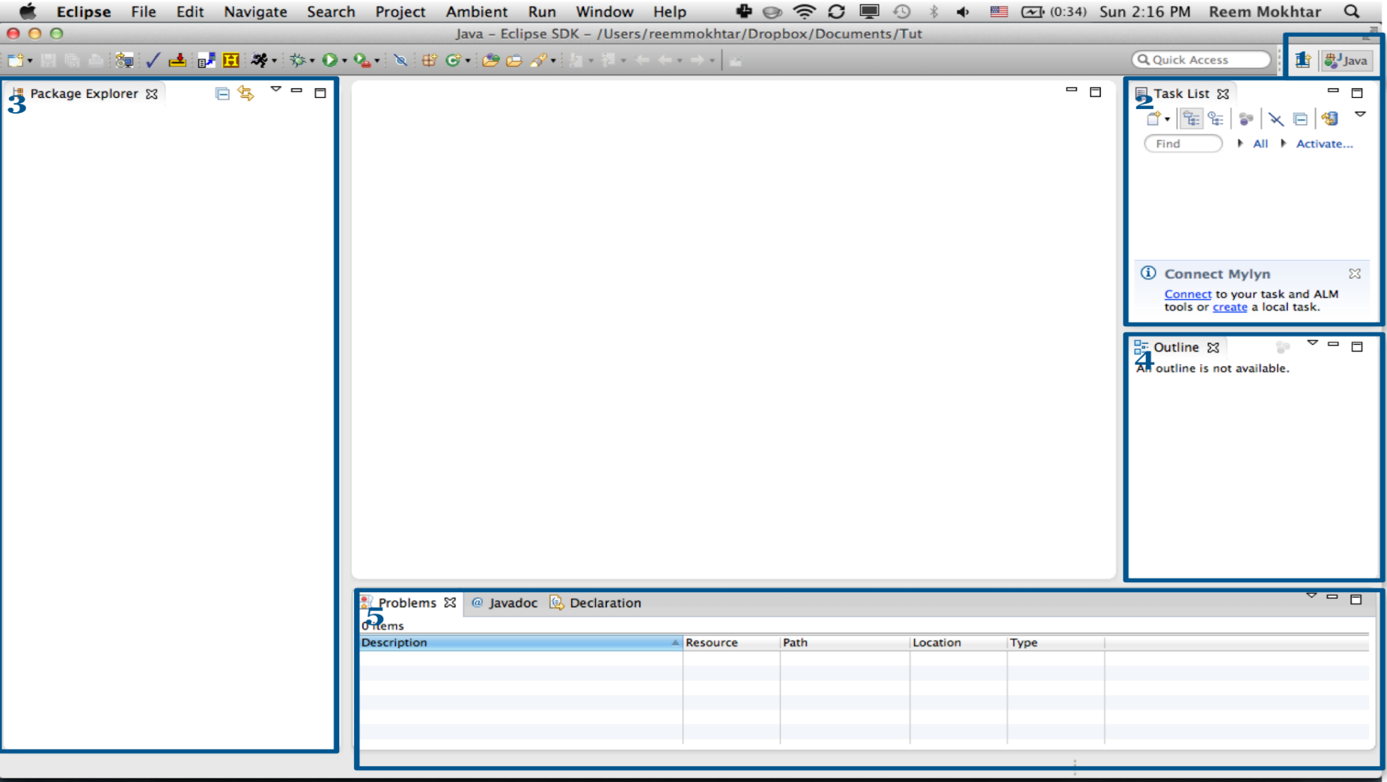
The Eclipse Workbench
Perspective
Task list
Project Explorer view
Outline
Problems view
Notes:
Perspective: Your current perspective, and other perspectives that are available to you.
Task list: Can be used to manage tasks. For the time being, you can close this. If you are interested in Mylyn: http://wiki.eclipse.org/Mylyn_User_Guide
Project Explorer view: contains a list of your active and closed projects. This will not reflect that actual state of your file system on disk, because there might be Eclipse projects on your disk that are not included here.
Outline: This shows you the outline of your current class.
Problems view: Displays compilation errors, warnings, and other messages eclipse thinks you should know about. These correspond to the symbols and red underlined text you would see within your program.

Slide 7
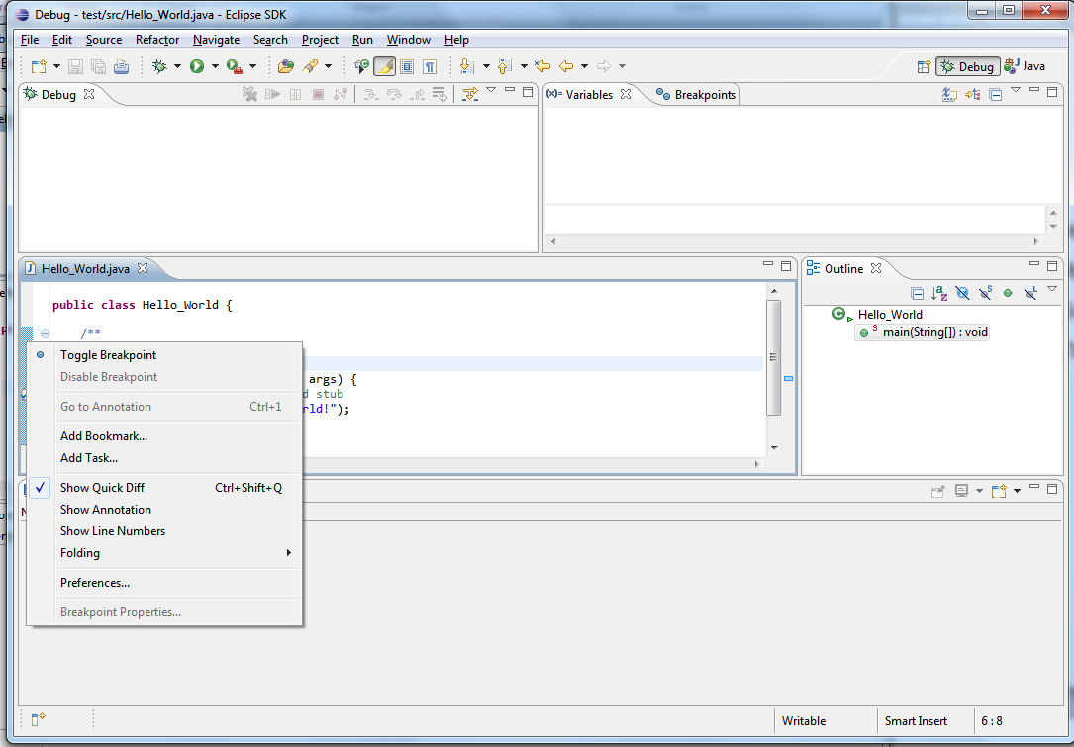

Debugging a Program
Debug perspective
Select the file
Make a breakpoint in your program
Double-click on the LHS
If you can’t see it, right click on the LHS ribbon and select Toggle Breakpoint
Click on the Debug icon.
Notes:
Note: Let them try doing this on the code they are currently working on. Most people have a hard time initially trying to find “the ribbon” on the LHS.
To debug a program, go to the Debug perspective (choose it from the top right corner)
Select the file that you want to debug from the Project Explorer (if you cannot see it, go to Window→Show View→ Project Explorer).
Make a breakpoint in your program (either you point to the ribbon and add it, or you right click on the left-hand side ribbon in your editor next to a line in your program that you want to stop at, and select Toggle Breakpoint
Click on the Debug icon . Your program should stop at the breakpoint that you selected.

Slide 8

Debugging a Program
Step Over
Step Into
Step Return
Resume
Terminate
Notes:
If you would like to step through the program, there are many commands that can help you in the Debug View:
Step Over if the statement you are on has any branching methods, you will step over (skip them, but still execute them) them to the next statement
Step Into if the statement you are on has any branching methods, you will enter them to step through statement-by-statement
Resume run the program until you encounter the next breakpoint, or until the program exits (if there are no subsequent breakpoints)
Terminate abort or end the program now.

Slide 9

Watching an Expression
1: public class MysteryClass {
2:
3: public static void main(String args[])
4: {
5: System.out.println(mysteryMethod(12));
6: }
7:
8: public static int mysteryMethod(int n) {
9: •••••••••
}
}
Notes:
We are going to step through parts of this code, and watch how variables change at each step.

Slide 10
Watching an Expression
8: public static int mysteryMethod(int n) {
9: boolean array [] = new boolean[n];
10:
11: for (int i = 0; i < n; i++)
12: {
13: array[i] = true;
14: }
15:
16: for (int i = 2; i < n; i++)
17: {
18: for(int j = 2*i; j<n; j=j+i)
19: array[j] = false;
20: }
21:
22: int count = 0;
23: for (int i = 2; i < n; i++)
24: if(array[i])
25: count++;
26:
27:
28: return count;
29: }
breakpoint
Notes:
Please add a breakpoint on line 22. It might not be line 22 in your code, but make sure it is the line with count being declared and instantiated.

Slide 11
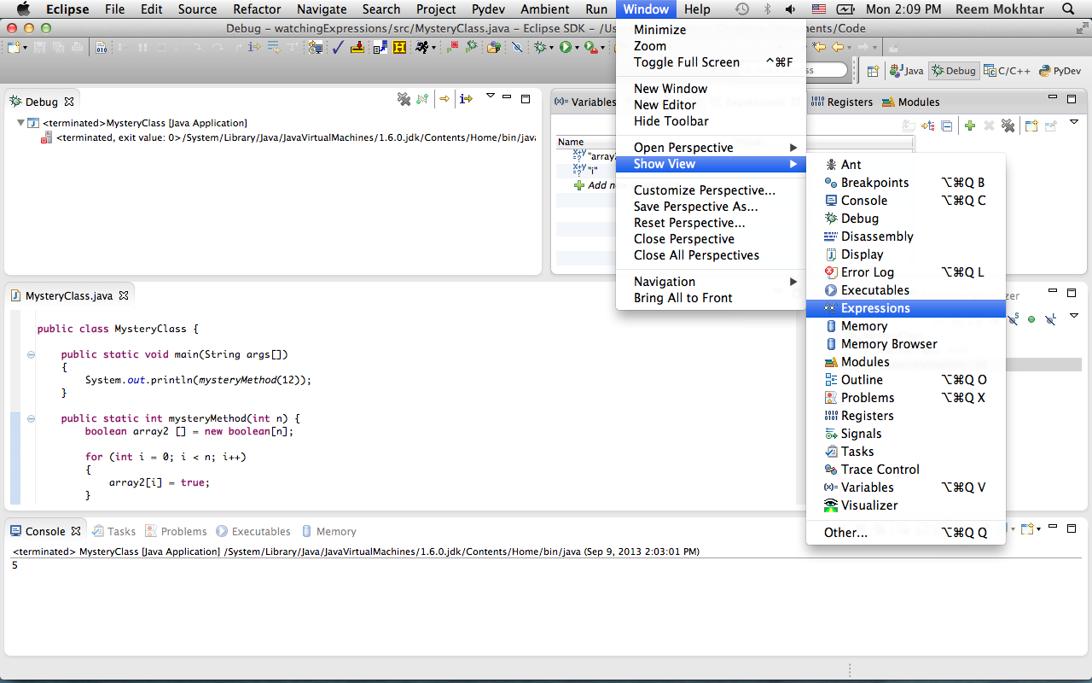
Watching an Expression
Go to Window → Show View → Expressions
Notes:
Go to Window → Show View → Expressions

Slide 12
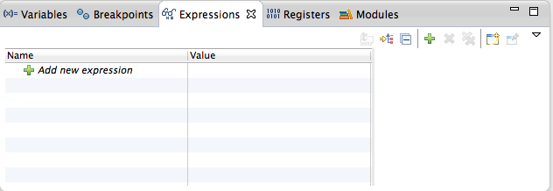
Watching an Expression
Add array[i] to the Expressions view.
Add i to the Expressions view.
Notes:
Click on “Add new expression”, or the + sign.

Slide 13
Watching an Expression
Step through: you can step over using
Each time you step over, watch what happens to the values in the Expressions view in each iteration
What is the value of array[i] when i = 6?
What is the value of array[i] when i = 3?
What is the value of array[i] when i = 5?
What do you think this program is doing?
Notes:
What is the value of array[i] when i = 6? Ans: false;
What is the value of array[i] when i = 3? Ans: true;
What is the value of array[i] when i = 5? Ans: true;
What do you think this program is doing? Ans: counting the number of primes up to the integer specified, in this case, 10.

Slide 14
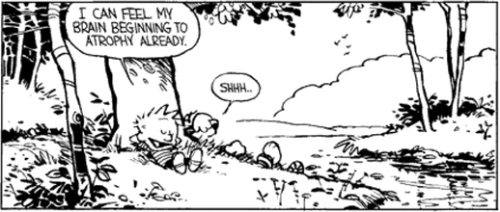
Enjoy the rest of your Friday!
Don’t forget to submit your answers to get credit for today!

