Slide 1
Compsci 201 Recitation 10
Professor Peck
Jimmy Wei
11/1/2013

Slide 2
In this Recitation
Boggle warmup!
Intro
Tries
Recursion
Submit via form: http://goo.gl/2s2ljP

Slide 3
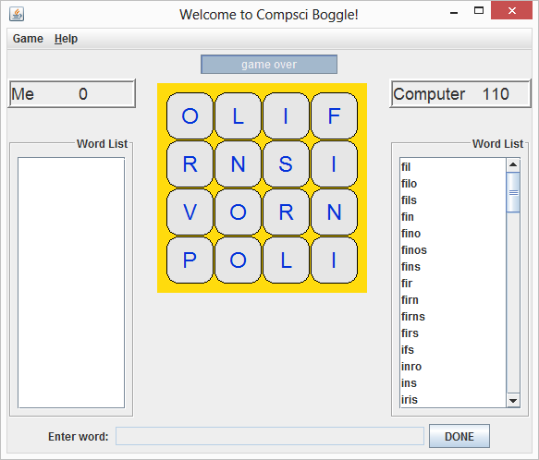
Boggle Intro
What is Boggle?
You will be writing recursive code to find all words on a Boggle Board which looks like this:
Notes:
- Player enters as many words as possible in time limit, then computer calculates all possible words

Slide 4
Boggle Intro
What’s in Boggle?
BoggleBoard: represents a 2D grid of board values
BoardCell: represents a single cell on the board—does NOT hold cell value, only its coordinates
LexStatus: enumeration representing if a String is a WORD, PREFIX, or NOT_WORD
ILexicon: represents a lexicon, i.e. all valid words; think of it as our dictionary
We will work with the TrieLexicon implementation today
IWordOnBoardFinder: searches for all valid words on a given board; used by computer after player completes turn
We will work with the GoodWordOnBoardFinder implementation today
Other classes not needed for this recitation but important for the actual assignment…
Notes:
Enumeration is essentially a collection of “enumerated” values that a variable can take—for instance with LexStatus we would create a LexStatus object that can have three possible values, WORD, PREFIX, or NOT_WORD
Don’t need to go over these in too much detail, just brief mention of what these are or even just listing out the classes on here, you can always recap as you progress through recitation and these classes come back up in questions

Slide 5
Boggle Intro
Two questions we will address:
How can we represent our lexicon, i.e. the list of all valid words?
How can we recursively search the board to find all valid words on the board?

Slide 6
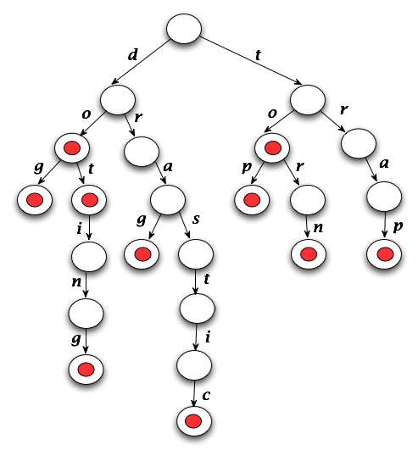
Boggle Tries
First question: How to represent the lexicon?
Consider a trie, utilized in TrieLexicon.java:
This trie represents:
Dog
Dot
Doting
Drag
Drastic
Top
Torn
Trap

Slide 7
Boggle Tries
This trie supports queries (add, contains, delete) in O(w) time for words of length w.
Each node in a trie has one subtrie for every letter than can possibly follow it
For instance, to add ‘duke’ we would add a ‘u’ child to the existing ‘d’ node
Red dots indicate nodes holding the final letter of a word
Notes:
- Trie add, contains, delete are O(w) because we only need to traverse through at most w levels of the trie

Slide 8
Boggle Trie Add
boolean add(String s) {
Node t = myRoot;
for (int k=0; k<s.length(); k++) {
char ch = s.charAt(k);
Node child = t.children.get(ch);
if (child == null) {
child = new Node(ch, t);
t.children.put(ch, child);
}
t = child;
}
if (!t.isWord) {
t.isWord = true; // mark as word
mySize++;
return true;
}
return false; //word already in trie
}

Slide 9
Boggle Trie WordStatus
LexStatus wordStatus(String s) {
Node t = myRoot;
for (int k=0; k<s.length(); k++) {
char ch = s.charAt(k);
t = t.children.get(ch);
if (t == null) {
return LexStatus.NOT_WORD;
}
}
if (t.isWord) {
return LexStatus.WORD;
} else {
return LexStatus.PREFIX;
}
}

Slide 10
Boggle Tries – Answer #1
LexStatus wordStatus(String s) {
Node t = myRoot;
for (int k=0; k<s.length(); k++) {
char ch = s.charAt(k);
t = t.children.get(ch);
if (t == null) {
return LexStatus.NOT_WORD;
}
}
if (t.isWord) {
return LexStatus.WORD;
} else {
return LexStatus.PREFIX;
}
}
boolean add(String s) {
Node t = myRoot;
for (int k=0; k<s.length(); k++) {
char ch = s.charAt(k);
Node child = t.children.get(ch);
if (child == null) {
child = new Node(ch, t);
t.children.put(ch, child);
}
t = child;
}
if (!t.isWord) {
t.isWord = true; // mark as word
mySize++;
return true;
}
return false; //word already in trie
}
Notes:
Explain in words why searching for a word or adding a word of w-characters is an O(w) operation for a word of w-characters and not an O(n) operation for a lexicion with n-words.
A: we traverse one Node per letter in the word, up to a max of w Nodes/letters

Slide 11
Boggle Tries – Answer #2
public class Node {
String info;
boolean isWord;
Map<Character,Node> children;
Node parent;
Node(char ch, Node p) {
info = “”+ch;
isWord = false;
children = new TreeMap<Character,Node>();
parent = p;
}
}
Notes:
2) The definition of the Node class in the Trie is below. The map children stores references to all the children of a node. Provide a reason as to why a map is used rather than an array of 52 characters (such an array would allow for upper and lower case characters).
A: Not necessary to allocate space for every possible child when we likely won’t need nearly that many

Slide 12
Boggle Tries – Answer #3
private Node copyTrie(Node root) {
if (root == null) {
return null;
}
Node copy = new Node(root.info.charAt(0), null);
copy.isWord = root.isWord;
// more code to copy rest of trie
return copy;
}
Notes:
3) Write a method that returns a copy of the entire trie rooted at a node. Trie nodes have parent pointers, though they're not shown in the diagram above. The second parameter to a Trie-Node constructor is the node's parent.

Slide 13
Boggle Tries – Answer #4
private int wordCount(Node root) {
if (root == null) {
return 0;
}
// more code to count words in trie
// use the isWord field to check each Node
}
Notes:
4) Write a method to traverse all nodes in a trie and return the number of words in the trie, by referencing the isWord field of each node.

Slide 14
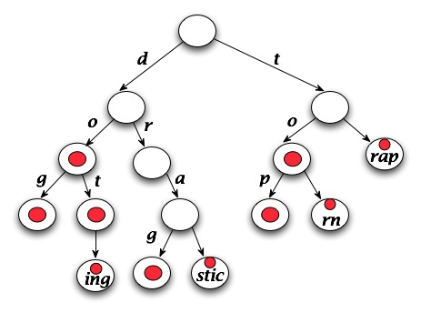
Boggle Tries – Answer #5
Look at the compressed trie to the right:
We have combined chains of single pointers into single Nodes
We want to figure out how to perform this compression
Notes:
5) Discuss at a high level how to collapse chains of nodes with single pointers in a trie into one node with a longer string labeling it. For example, the diagram above would be collapsed into the trie shown below. In your brief discussion remember that the nodes have parent pointers. For example, if you get to a leaf in a trie, how do you "back up" to a node that can represent more than one character as shown below? When does that "back up" process stop?
A: traverse over tree, for any node with only one child we take the value of its child and add it to the value of the node, then set the parent node’s children to be the children of its single child; any time we perform a compression we must recheck the same node until it no longer has only one child

Slide 15
Boggle Recursion
Second question: How to recurse over board?
Look at the following code for implementing GoodWordOnBoardFinder.java:
List<BoardCell> cellsForWord(BoggleBoard board, String word) {
ArrayList<BoardCell> list = new ArrayList<BoardCell>();
for (int r=0; r<board.size(); r++) {
for (int c=0; c<board.size(); c++) {
if (findHelper(word, 0, r, c, board, list)) {
return list;
}
}
}
list.clear();
return list;
}
Notes:
- GoodWordOnBoardFinder takes every given word in the lexicon and searches the board for each. Search has an iterative step and a recursive step—we first iterate over all possible starting points on the board (i.e. every cell) and then for each we recursively search for the given word with that cell’s value as the first letter

Slide 16
Boggle Recursion
Here is the header for the helper method:
/**
* Returns true if and only if the substring of word starting at index can be
* formed starting at (row, col) on the board provided without using any cells
* stored in list --- and extending list to include all cells on which substring is
* found when true is returned.
* @param word is searched for word (e.g. entered by user)
* @param index is where in word substring starts, e.g. all chars before index
* have been found and cells are in list
* @param row is starting point for search
* @param col is starting point for search
* @param board is board on which word is searched
* @param list is cells on board where word is found
* @return true if substring found on board without reusing board cells in list
*/
private boolean findHelper(String word, int index, int row, int col,
BoggleBoard board, List<BoardCell> list);

Slide 17
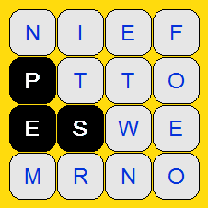
Boggle Recursion
An example:
Say we are searching for “PEST”
String word = “PEST”
Int index = 3
Int row = 2
Int col = 1
BoggleBoard board = [“NIEF”, “PTTO”, “ESWE”, “MRNO”]
This String array is held as an instance variable of a BoggleBoard object
List<BoardCell> list = [(1,0); (2,0); (2,1)]
Each item in this list is actually a BoardCell object with two instance variables, int row and int col

Slide 18
Boggle Recursion – Answer #6-11
// Returns true if and only if the substring of word starting at index can be formed
// starting at (row, col) on the board provided without using any cells stored in list
// Must extend list to include all cells on which substring is found when true
// @param word is searched for word (e.g. entered by user)
// @param index is where substring starts
// @param row is starting point for search
// @param col is starting point for search
// @param board is board on which word is searched
// @param list is cells on board where word is found
// @return true if substring found on board without reusing board cells in list
private boolean findHelper(String word, int index, int row, int col,
BoggleBoard board, List<BoardCell> list);
List<BoardCell> cellsForWord(BoggleBoard board, String word) {
ArrayList<BoardCell> list = new ArrayList<>();
for (int r=0; r<board.size(); r++)
for (int c=0; c<board.size(); c++)
if (findHelper(word, 0, r, c, board, list)) { return list; }
list.clear();
return list;
}

Slide 19
Have a good weekend!
Don’t forget to submit!

