Slide 1
Compsci 201 Recitation 11
Professor Peck
Jimmy Wei
11/8/2013

Slide 2
In this Recitation
Recurrence Relations!
Brief refresher
Practice
Submit via form: http://goo.gl/slUouq
Code available in snarf folder—if you JRE system library issues:
Right click project folder in side bar and select Build Path -> Configure Build Path
Go to Libraries tab and remove the JRE Library
Click “Add Library” and add the default JRE Library

Slide 3
Recurrence Relations
What are they?
Illustrates running time of a recursive algorithm with input of size n in terms of running time of its sub-problems
Goal is to get an expression for T(n), where T(n) is the time it takes to run the algorithm for an input of size n
Expression for T(n) can be matched with one in this chart to obtain big-Oh:
Recurrence Relation | Example | Big-Oh
T(n) = T(n/2) + O(1) | Binary Search | O(log n)
T(n) = T(n-1) + O(1) | Linear Search | O(n)
T(n) = 2T(n/2) + O(1) | Tree traversal | O(n)
T(n) = 2T(n/2) + O(n) | QuickSort | O(n log n)
T(n) = T(n-1) + O(n) | BubbleSort | O(n²)

Slide 4
Recurrence Relations
Consider the following class:
Now consider a tree formed of IntTreeNodes. The diameter of the tree is the number of nodes on the longest path between two leaves in the tree.
public class IntTreeNode {
public int value;
public IntTreeNode left;
public IntTreeNode right;
public int size; // size of subtree
public IntTreeNode(int val) {
value = val;
}
}

Slide 5
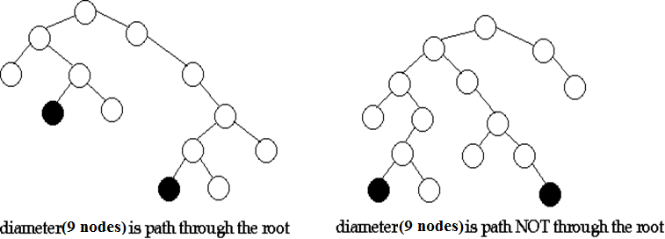
Recurrence Relations
The diameter is the largest of the following:
Diameter of the root’s left subtree
Diameter of the root’s right subtree
Longest path between leaves through the root
As an example:

Slide 6
Recurrence Relations – Answer #1-2
public int diameter(IntTreeNode t) {
if (t == null) return 0;
int rootD = height(t.left) + height(t.right) + 1;
int maxSubD = Math.max(diameter(t.left), diameter(t.right));
return Math.max(rootD, maxSubD);
}
public int height(IntTreeNode t) {
if (t == null) return 0;
return Math.max(height(t.left), height(t.right)) + 1;
}
Notes:
1) What is the recurrence relation for height? In writing the recurrence let T(n) be the complexity of calling height with an n-node tree. Assume trees are roughly balanced so that there are about n/2 nodes in each subtree. What is the recurrence if the tree is completely unbalanced, e.g., all nodes in the left sub-tree?
A: Recurrence relation for height is T(n) = 2*T(n/2) + O(1) = O(n) if tree is roughly balanced; if completely unbalanced recurrence relation for height is T(n) = T(n-1) + O(1) = O(n)
2) The method diameter as written above does not run in O(n) time. Write a recurrence for this implementation and what the solution to the recurrence is. Assume trees are roughly balanced in writing the recurrence.
A: T(n) = O(1) + 2*T(n/2) + 2*O(n) = O(n log n) -- balanced
T(n) = O(1) + T(n-1) + 2*O(n) = O(n^2) -- unbalanced

Slide 7
Recurrence Relations – Answer #3
Complete diameterHelper:
public int diameter(IntTreeNode t) {
int[] ret = diameterHelper(t);
return ret[1];
}
// returns an array of 2 ints, [height, diameter]
public int[] diameterHelper(IntTreeNode t) {
if (t == null) { return new int[]{0, 0}; }
int[] ret = new int[2]; // return this array
int[] left = diameterHelper(t.left);
int[] right = diameterHelper(t.right);
ret[0] = 1 + Math.max(left[0], right[0]); // height
// rest of code to calculate ret[1] here
}
Notes:
3) We can write a version of diameter that runs in O(n) time. The recursion must return both the diameter and height of the left and right subtree in one call. To get two values we'll use an array in which the height is stored at index 0 and the diameter at index 1. A helper method is used as shown below. This method is O(n) because there is O(1) work done in addition to the two recursive calls. Fill in the missing code in diameterHelper so that it works as intended.
A:
public int[] diameterHelper(IntTreeNode t) {
if (t == null) { return new int[]{0, 0}; }
int[] ret = new int[2]; // return this array
int[] left = diameterHelper(t.left);
int[] right = diameterHelper(t.right);
ret[0] = 1 + Math.max(left[0], right[0]); // height
// rest of code to calculate ret[1] here
ret[1] = Math.max(Math.max(left[1], right[1]), left[0] + right[0] + 1);
}

Slide 8
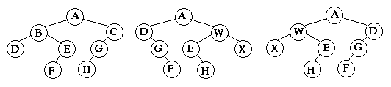
Recurrence Relations
We say two binary trees s and t are isomorphic if they have the same shape, regardless of the values of the nodes
Null trees are only isomorphic to other null trees; a null tree is never isomorphic to a non-null tree
In this example the trees on the left and right sides are isomorphic to each other, but the tree in the middle is not isomorphic to either

Slide 9
Recurrence Relations – Answer #4
Write isIsomorphic:
What is the runtime of the method, assuming the tree is roughly balanced?
Use a recurrence relation to justify your big-Oh
Express runtime in terms of number of nodes in both trees combined (n = nodes in s + nodes in t)
/**
* Returns true if s and t are isomorphic, i.e. have the same shape.
* @param s is a binary tree (not necessarily BST)
* @param t is a binary tree
* @return true iff s and t are isomorphic
*/
public boolean isIsomorphic(IntTreeNode s, IntTreeNode t);
Notes:
4) Two binary trees s and t are isomorphic if they have the same shape; the values stored in the nodes do not affect whether two trees are isomorphic. In the diagram below, the tree in the middle is not isomorphic to the other trees, but the tree on the right is isomorphic to the tree on the left.
Write a method isIsomorphic that returns true if its two tree parameters are isomorphic and false otherwise. You must also give the big-Oh running time (in the average case, assuming each tree is roughly balanced) of your method with a justification. Express the running time in terms of the number of nodes in trees s and t combined, i.e., assume there are N nodes together in s and t with half the nodes in each tree. Write a recurrence to justify the runtime complexity.
Hint: a null trees is not isomorphic to a non-null tree, but two null trees are isomorphic. That's most-to-all of the base case you'll need. If the two trees have isomorphic left subtrees and isomorphic right subtrees, then they must be isomorphic.
A:
public static boolean isIsomorphic(IntTreeNode s, IntTreeNode t) {
if (s == null && t == null) {
return true;
} else if (s == null || t == null) {
return false;
}
return isIsomorphic(s.left, t.left) && isIsomorphic(s.right, t.right);
}
Recurrence relation: T(n) = 2*T(n/2) + O(1) = O(n)

Slide 10
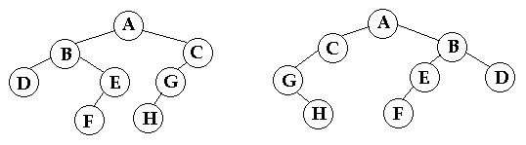
Recurrence Relations
We say two binary trees s and t are quasi-isomorphic if they have the same quasi-shape, regardless of the values of the nodes
In other words, s is quasi-isomorphic to t if s can be transformed into t by swapping the left and right children for some nodes in s
In this example swapping the children of A, B, and G in the left tree gives us the right tree

Slide 11
Recurrence Relations – Answer #5
Write isQuasiIsomorphic:
Give the runtime, assuming roughly balanced.
Write and solve a recurrence relation to justify your big-Oh; this is not one of the relations seen before so you will need to solve it yourself (CHALLENGING)
Express runtime in terms of number of nodes in both trees combined (n = nodes in s + nodes in t)
/**
* Returns true if s and t are quasi-isomorphic, i.e. have the same quasi-shape.
* @param s is a binary tree (not necessarily BST)
* @param t is a binary tree
* @return true iff s and t are quasi-isomorphic
*/
public boolean isQuasiIsomorphic(IntTreeNode s, IntTreeNode t);
Notes:
5) Two trees s and t are quasi-isomorphic if s can be transformed into t by swapping left and right children of some of the nodes of s. The values in the nodes are not important in determining quasi-isomorphism, only the shape is important. The trees below are quasi-isomorphic because if the children of the nodes A, B, and G in the tree on the left are swapped, the tree on the right is obtained.
Write a method isQuasiIsomorphic that returns true if two trees are quasi-isomorphic. You must also give the big-Oh running time (in the average case, assuming each tree is roughly balanced) of your method with a justification. Express the running time in terms of the number of nodes in treess and t combined as with the previous problem. Write a recurrence and solve it! You'll need to do this because the recurrence is not one of the five-to-six recurrences we've seen before.
The difference in quasi-isomorphism compared to isomorphism is that if the left subtree of one tree is quasi-isomorphic to the right subtree of the other, the trees might be quasi-isomorphic. Of course if the left subtrees are quasi-isomorphic the trees could be quasi-isomorphic as well.
A:
public static boolean isQuasiIsomorphic(IntTreeNode s, IntTreeNode t) {
if (s == null && t == null) {
return true;
} else if (s == null || t == null) {
return false;
}
return (isQuasiIsomorphic(s.left, t.left) && isQuasiIsomorphic(s.right, t.right)) ||
(isQuasiIsomorphic(s.left, t.right) && isQuasiIsomorphic(s.right, t.left));
}
Recurrence Relation:
T(n) = 4*T(n/2) + O(1)
= 4 * [4*T(n/2^2) + 1] + 1
= 4^2 * T(n/2^2) + 4 + 1
= 4^2 * [4 * T(n/2^3) + 1] + 4 + 1
= 4^3 * T(n/2^3) + 4^2 + 4 + 1
= SUMMATION(j=0 -> j=k-1) { 4^j + (4^k) * T(n/2^k) } where k = log n*
= [4^(k-1) – 1] / [4 – 1] + 4^(log n) * T(n/n)
= [2^(2 log n)] / 3 – 1/3 + 2^(2 log n)
= 2^(log n^2) + 2^(log n^2)
= n^2 + n^2
= O(n^2)
*we set n/2^k equal to 1 because we need to find where the summation terminates—that happens when we have
reached the base case where runtime is T(1); thus T(1) = T(n/2^k); 1 = n/2^k; n = 2^k; k = log n

Slide 12
Have a good weekend!
Don’t forget to submit!

