Slide 1

RON
Reach Out Now
Volunteer and Event Management System
Group 09

Slide 2
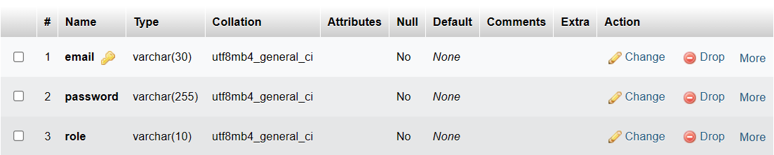
Login -Volunteer/Event Manager/Admin
Table Name - Login

Slide 3
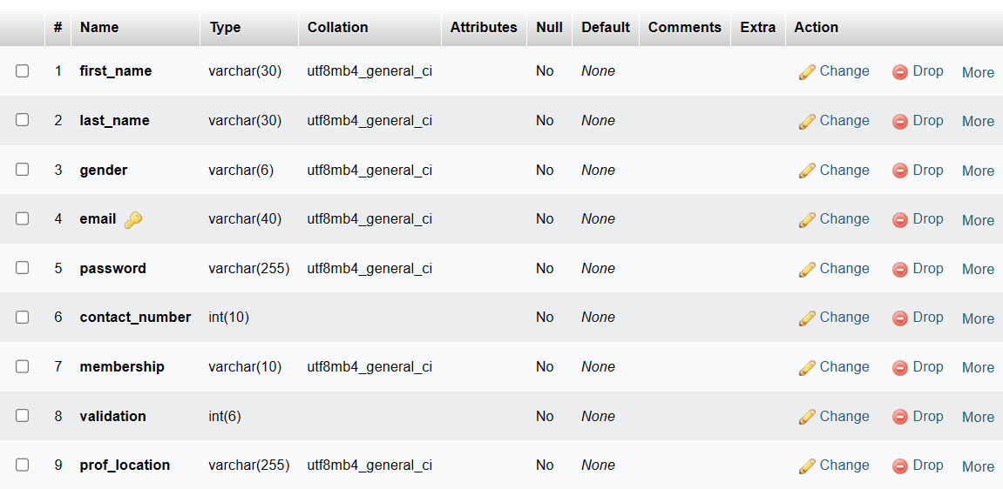
Register As
Table Name –
Manager details
-Event Manager

Slide 4
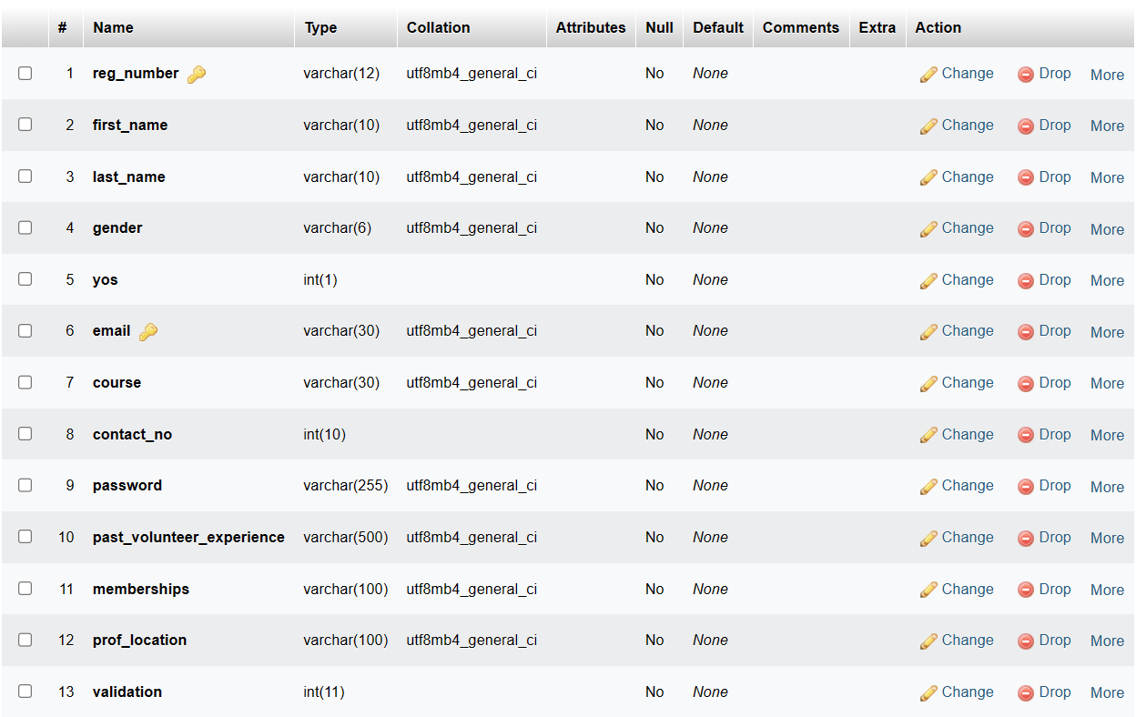
Register As -Volunteer
Table Name –
Member details

Slide 5
Event Manager
Dashboard-features

Slide 6
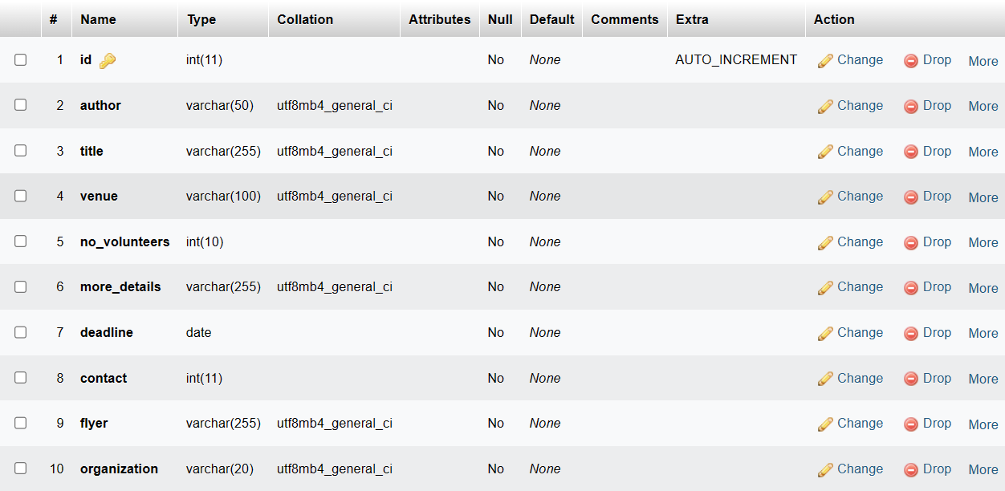
Add new event
Table Name - Event
-Event Manager

Slide 7
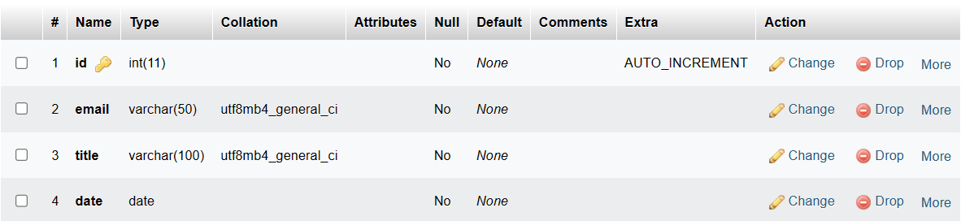
ToDo List
Table Name – to-do
-Volunteer/Event Manager

Slide 8
Volunteer
Dashboard-features

Slide 9
ToDo List
Table Name – to-do
-Volunteer/Event Manager

Slide 10
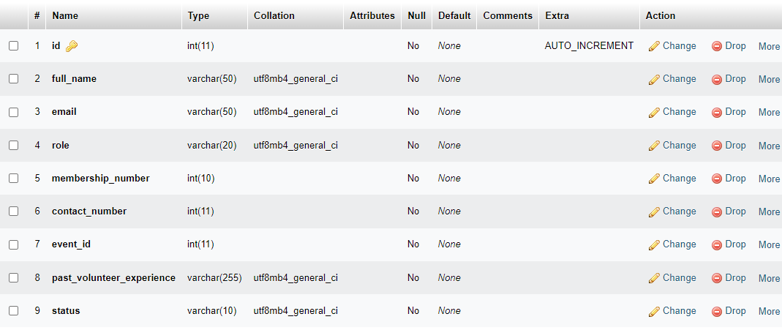
Event Applications
Table Name –
Event_applicatios
-Volunteer

Slide 11
Admin
Dashboard-features

Slide 12
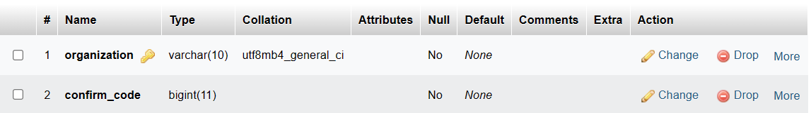
Organization Code
Table Name –
Organization
-Admin

Slide 13
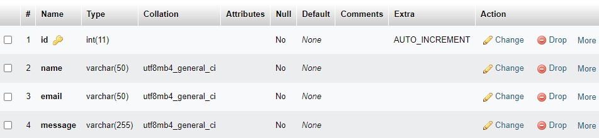
Contact Us
Table Name –
contact_us
-Admin

Slide 14
Group Members
2020/CSC/045 - Mr. R. P. Raveesha Vishwajith Pathirana
2020/CSC/063 - Miss. U. D. H. Hashini Unanthenna
2020/CSC/065 - Miss. K. Vieronicka
2020/CSC/070 - Miss. W. Janani Welipitiya
2020/CSC/076 - Miss. W. S. Nipuni Fernando

Slide 15
Thank You

