Slide 1
Courtesy : “Engineering a Compiler, Keith D Cooper & Linda Torczon.

Slide 3
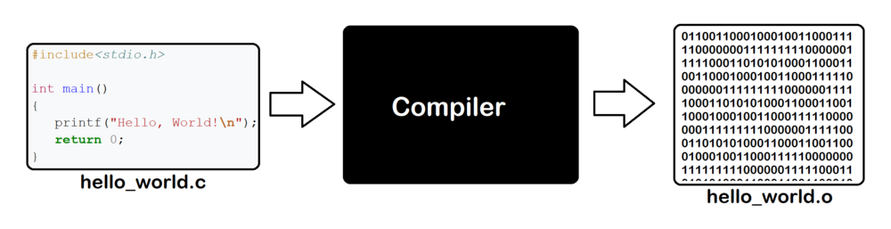
Overview of Compilation.
Introduction
Compilers are computer programs that translate a program written in one language into a program written in another language.
The Compiler has many internal components with complex interaction between them and a large set of algorithms.
Hence, studying compiler construction is a worthy software engineering exercise.

Slide 4
Overview of Compilation.
Introduction
Role of computing increases everyday.
There are many tools and apps in internet and mobile devices.
All of these tools and apps provide lower level abstraction of the underlying hardware, through suitable computer programs (software).
These software are translated by a tool called ‘compiler’.
Objective of CD course – is to present the fundamental techniques and underlying challenges of automatic translations to build compiler.
Compiler – is a computer program that translates other programs to prepare them for execution.

Slide 5
Overview of Compilation.
Introduction
A compiler is a tool that translates software written in one language into another language.
To translate text from one language to another, the tool must understand both the forms.
The syntax, and content, or meaning, of the input language.
The rules that govern syntax and meaning in the output language.
Finally, it needs a scheme for mapping content from the source language to the target language.
The structure of a typical compiler
A front end to deal with the source language.
A back end to deal with the target language.
Connecting the front end and the back end,
it has a formal structure for representing the program in an intermediate form whose meaning is largely independent of either language.
To improve the translation, a compiler often includes an optimizer that analyzes and rewrites that intermediate form.

Slide 6
Overview of Compilation.
Introduction
Computer programs are sequence of operations written, following a programming language.
The processors will executed these operations.
These operations are to be translated into hundreds of machine operations before its execution – this translation is done by Compiler.
In classic notion of a compiler, the output program is expressed in the operations available on some specific processor, called target machine. Called as source-to-target compilers.
Typical “source” languages might be c, c++, fortran and Java.
The “target” language is usually the instruction set of some processor.

Slide 7
Overview of Compilation.
Introduction
There are compilers that translate a program in one programming language to another human-oriented programming language they are called source-to-source compiler.
Example - In some research activities, a given program is converted to a C program and then the C compiler is used for converting that to a target program.
There is another type of translator called interpreter. It takes each operation of the input program, translate it and execute it before going to the next operation.
Example – Perl, Scheme and APL
Some languages includes both compilation and interpretation.
Example – Java
Compilation : Java Program to ByteCode.
Interpretation: by JVM, to run the ByteCode.
Some implementations of JVM include a compiler again that executes at runtime, called as Just-in-Time (JIT) compiler.

Slide 8
Overview of Compilation.
Introduction
Thus, compiler is a large and complex system – has many components – the components are interconnected.
Design and implementing a compiler is a good exercise in software engineering.
Building a successful compiler require expertise in algorithms, engineering and planning.

Slide 9
Overview of Compilation.
Introduction
The Fundamental Principles of Compilation
Compilers are large, complex, carefully engineered objects.
There are two fundamental principles that a compiler writer must keep in mind at all times.
The first principle – “The compiler must preserve the meaning of the program being compiled”
The second principle – “The compiler must improve the input program in some discernible way”

Slide 11
Overview of Compilation.
Compiler Structure
The design of a compiler is decomposed in to two major parts : a front end and a back end.
The front end focuses on understanding the source-language program.
The back end focuses on mapping programs to the target machine.
The front end must encode its knowledge of the source program in some IR structure for later use by the back end.
This intermediate representation (IR) is the compiler’s definitive representation for the code it is translating.

Slide 12
Overview of Compilation.
Compiler Structure
In a two-phase compiler, the front end maps the source code into the IR.
The back end must map the IR program into the instruction set of the target machine.
The back end only processes IR created by the front end, assuming the IR contains no syntactic or semantic errors.
The compiler can make multiple passes over the IR code before emitting the target program.
Study the code in phase I and record relevant details. In later phases, it can use these recorded facts to improve the quality of translation.

Slide 13
Overview of Compilation.
Compiler Structure
The two-phase structure support the concept of “retargeting the compiler”.
We can construct multiple back ends for a single front end to produce compilers that accept the same language but target different machines.
we can also design front ends for different languages producing the same IR and using a common back end.
Both scenarios assume that one IR can serve for several combinations of source and target; in practice, both language-specific and machine-specific details usually find their way into the IR.

Slide 14
Overview of Compilation.
Compiler Structure
Three-phase compiler
This middle section, or optimizer, takes an IR program as its input and produces a semantically equivalent IR program as its output

Slide 15
Overview of Compilation.
Compiler Structure
The optimizer can make one or more passes over the IR, analyze the IR, and rewrite the IR.
Objectives of doing multiple passes:
The new IR may produce a target program faster.
The new IR may produce a smaller target program.
To use less memory and energy.
Conceptually, the three-phase structure represents the classic optimizing compiler.

Slide 16
Overview of Compilation.
Compiler Structure
Each phase is divided internally into a series of passes.
The front end consists of two or three passes that handle the details of recognizing valid source-language programs and producing the initial IR.
The middle section contains passes that perform different optimizations.
The back end consists of a series of passes, each of which takes the IR program one step closer to the target machine’s instruction set.
The three phases and their individual passes
share a common infrastructure.
This structure is shown in Figure 1.1.

Slide 18
Overview of Compilation.
Overview of Translation
Let us understand the steps needed to generate executable code for the following expression:
where a, b, c, and d are variables, ← indicates an assignment, and × is the operator for multiplication.
Let us work out how Front End, Optimizer and Back end will work for this example

Slide 19
Overview of Compilation.
Overview of Translation
The Front End
The Front End
It must understand both the form, or syntax, and the meaning or semantics, of the given expression.
If it finds that the code is valid,
THEN it creates IR
if not, it reports diagnostic error messages
(1) Checking Syntax
To check the syntax of the input program, the compiler must compare the program’s structure against a definition for the language.
This requires
(1) an appropriate formal definition for the source language,
(2) an efficient mechanism for testing whether or not the input meets that definition, and
(3) a plan for how to proceed on an illegal input.
Frond end does two separate passes – scanner and parser – to check the given code is valid or not

Slide 20
Overview of Compilation.
Overview of Translation
The Front End
Every language has a grammar, including the programming languages.
For example, in English, many sentences have the form
where verb and endmark are parts of speech,
and Sentence, Subject, and Object are syntactic variables.
Sentence represents any string with the form described by this rule.
The symbol “→” reads “derives” and means that an instance of the right-hand side can be abstracted to the syntactic variable on the left-hand side.

Slide 21
Overview of Compilation.
Overview of Translation
Consider a sentence like “Compilers are engineered objects.”
The first step is to identify distinct words
and to classify each word with a part of speech. …. This task in compiler is called ‘scanning’ – by scanner
The scanner takes a stream of characters and converts it to a stream of classified words—pairs of the form (p,s), where p is the word’s part of speech and s is its spelling.
A scanner would convert the example sentence into the following stream of classified words:

Slide 22
“Compilers are engineered objects.”
The Front End
In the next step, the compiler tries to match the stream of categorized words against the grammatical rules:
By inspection, we can discover the following derivation for our example sentence:
The derivation starts with the syntactic variable Sentence. At each step, it rewrites one term in the prototype sentence, replacing the term with a righthand side that can be derived from that rule.
At last, the prototype sentence generated by the derivation matches the stream of categorized words produced by the scanner.
The derivation proves that the sentence “Compilers are engineered objects.” belongs to the language described by Rules 1 through 6. The sentence is grammatically correct. The process of automatically finding derivations is called parsing.

Slide 23
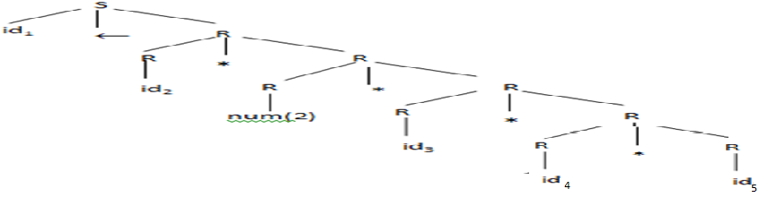
Overview of Compilation.
Overview of Translation
The Front End
a←a * 2 * b * c * d
Scanner [Lexical Analyzer]
Stream of Tokens
<id,a><assign, ← > <id,a> <mul,*> <num,2> <mul,*> <id,b> <mul,*> <id,c> <mul,*> <id,d>
Parser [Syntax Analyzer]
Concrete Parse tree( CPT/ CST)

Slide 24
Overview of Compilation.
Overview of Translation
The Front End
Type checking - it is a compiler pass that checks for type-consistent uses of names in the input program.
A compiler builds mathematical models that detect specific kinds of inconsistency in a program.
Example:
this expression syntactically well-formed.
But if suppose b and d are strings, it is an invalid expression.
Hence, type checking is an important task for the compiler.
a←a * 2 * b * c * d

Slide 25
Overview of Compilation.
Overview of Translation
The Front End
Intermediate Representations
The final task handled in the front end of a compiler is the generation of an IR form of the code.
Compilers use a variety of different kinds of IRs based on the source language, target language and the transformation procedure followed.
Some IRs are graph, tree, or assembly code etc.
For our example
the IR is a low-level sequential code
Recall…

Slide 26
Overview of Compilation.
Overview of Translation
The Optimizer
The Optimizer - analyzes the IR form of the code to discover facts about that context and uses that contextual knowledge to rewrite the code so that it computes the same answer in a more efficient way.
Efficiency - reduce the running time, reduce the size of the compiled code, reduce the energy that the processor consumes evaluating the code.
Example:

Slide 27
Overview of Compilation.
Overview of Translation
The Optimizer
Analysis & Transformation - Most optimizations consist of an analysis and a transformation.
Analysis
The analysis determines where the compiler can safely and profitably apply the technique.
Compilers use several kinds of analysis to support transformations.
Data-flow analysis reasons, at compile time, about the flow of values at runtime.
Dependence analysis reason about the values that can be assumed by subscript expressions. It is used to disambiguate references to array elements.

Slide 28
Overview of Compilation.
Overview of Translation
The Optimizer
Analysis & Transformation - Most optimizations consist of an analysis and a transformation.
Transformation
To improve the code, the compiler must go beyond analyzing it.
The compiler must use the results of analysis to rewrite the code into a more efficient form.
Countless transformations have been invented to improve the time or space requirements of executable code.
Eg. Discovering loop-invariant computations and moving them to less frequently executed locations - to improve the running time of the program.

Slide 29
Overview of Compilation.
Overview of Translation
The Back End
The Back End – it traverses the IR form of the code and emits code for the target machine, known as code generation.
It selects target-machine operations to implement each IR operation.
The steps done by the back end are
(1) Instruction Selection
(2) Register Allocation and
(3) Instruction Rescheduling.

Slide 30
Overview of Compilation.
Overview of Translation
The Back End
Instruction Selection
Instruction selection maps each IR operation, in its context, into one or more target machine operations
Rewriting our example expression into code for the ILOC virtual machine to illustrate the process.
This code assumes that a, b, c, and d are located at offsets @a, @b, @c, and @d from an address contained in the register rarp

Slide 31
ABOUT ILOC
"intermediate language for an optimizing compiler.“, -- assembly language.
It has a standard set of operations. Most operations take arguments that are registers.
The memory operations, loads and stores, transfer values between memory and the registers. (To simplify - assume that all data consists of integers.)
Each operation has a set of operands and a target. Has in five parts: an operation name, a list of operands, a separator, a list of targets, and an optional comment.
The instruction to add registers 1 and 2, leaving the result in register 3, the programmer would write
add r1,r2 => r3 // example instruction
rarp - a register that contains the start of data storage also known as the activation record pointer.

Slide 32
Overview of Compilation.
Overview of Translation
The Back End
The instruction selection uses the support of the register allocator to map the symbolic register names, or virtual registers, to the actual registers.
The instruction selector can use special operations on the target machine.
Example:
Replacing mult ra, r2 => ra with multI ra, 2 => ra, this avoids the loadI 2 => r2 instruction.
Replacing mult by successive add

Slide 33
Overview of Compilation.
Overview of Translation
The steps done by the back end are
(1) Instruction Selection
(2) Register Allocation and
(3) Instruction Rescheduling.
(2) Register Allocation
During instruction selection, the compiler uses virtual registers assuming that “enough” registers will be available in the target machine.
There may be more virtual registers used than what the hardware can support.
The register allocator must map those virtual registers onto actual target-machine registers.
Thus, the register allocator decides, at each point in the code, which values should reside in the target-machine registers.
It then rewrites the code to reflect its decisions.
This sequence uses 3 instead of 6 registers.

Slide 34
Overview of Compilation.
Overview of Translation
The steps done by the back end are
(1) Instruction Selection
(2) Register Allocation and
(3) Instruction Rescheduling.
(3) Instruction Scheduling
To produce code that executes quickly, the code generator may need to reorder operations to reflect the target machine’s specific performance constraints.
The execution time of the different operations can vary. Memory access operations can take tens or hundreds of cycles, while some arithmetic operations, particularly division, take several cycles.
Assume, that a loadAI or storeAI operation requires three cycles, a mult requires two cycles, and all other operations require one cycle.
This table shows how the previous code fragment performs under these assumptions. The Start column shows the cycle in which each operation begins execution and the End column shows the cycle in which it completes.
This nine-operation sequence takes 22 cycles to execute.

Slide 35
Overview of Compilation.
Overview of Translation
The steps done by the back end are
(1) Instruction Selection
(2) Register Allocation and
(3) Instruction Rescheduling.
(3) Instruction Scheduling
Many processors have a property by which they can initiate new operations while a long-latency operation executes.
The instruction scheduler reorders the operations in the code.
- to minimize the number of cycles wasted waiting
- ensuring that the new sequence produces the same result as the original.
- improves the performance of “naive” code.
For our example, a good scheduler might produce the following sequence:
This version of the code requires just 13 cycles to execute.
The code uses one more register than the minimal number.
It starts an operation in every cycle except 8, 10, and 12.

Slide 36
Overview of Compilation.
Overview of Translation
a←a * 2 * b * c * d
Scanner [Lexical Analyzer]
Stream of Tokens
<id,a><assign, ← > <id,a> <mul,*> <num,2> <mul,*> <id,b> <mul,*> <id,c> <mul,*> <id,d>
Parser [Syntax Analyzer]
Concrete Parse tree( CPT/ CST)

Slide 37
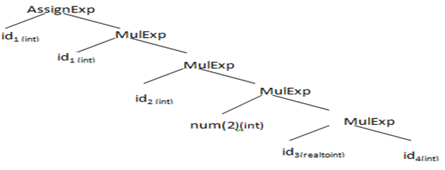
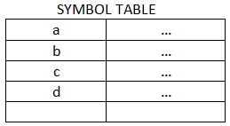
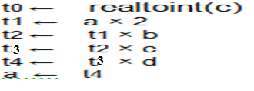
Overview of Compilation.
Overview of Translation
Annotated Abstract Syntax Tree (AST)
Semantic Elaboration [Semantic analyzer]
Semantic Elaboration
Intermediate Code Generator
Non-optimized Intermediate Representation

Slide 38
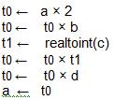
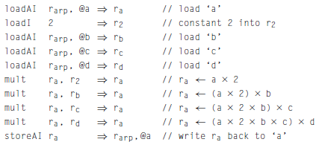
Overview of Compilation.
Overview of Translation
Code Optimizer
Optimized Intermediate Code with Symbolic registers
Instruction Selection
Target ILOC code with Virtual Registers

Slide 39
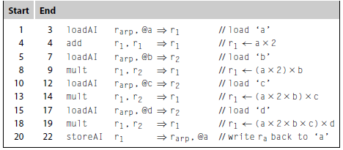
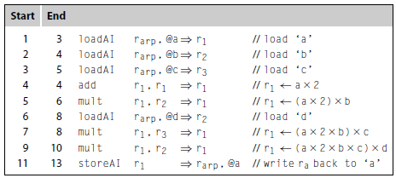
Overview of Compilation.
Overview of Translation
Register Allocation
Target ILOC code with Permanent Registers
Instruction Scheduling
Optimized Target ILOC code with Permanent Registers

Slide 40
Another Example

Slide 41
Thank you….

