Slide 1

NoSQL DATABASE
DATA BASE MANAGEMENT SYSTEMS
CASE STUDY
Group-10

Slide 2

Team Members
1. CB.EN.U4CSE19453- ABHINAV
2. CB.EN.U4CSE19459 - SHANTHAN
3. CB.EN.U4CSE19405 - HEMANTH
4. CB.EN.U4CSE19449 - KOUSHIK

Slide 3
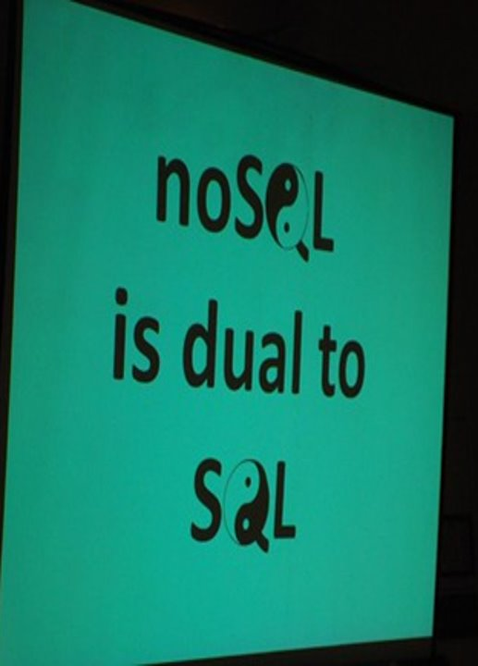
INTRODUCTION:
It is a non-relational database
NOSQL means Non-SQL
Also called as "Not only SQL" as it supports SQL- like query languages.
In NOSQL you can insert, update data on the fly.
It deals with large amount of data and these are much faster and easy to scale in doing so.
Used by Google, Facebook, Amazon...

Slide 4

HISTORY
At the time of 1970's the data storage was not organised and was also not safe, then came relational database that arranged data into rows and columns with specific key to each row.
Relational databases use SQL query language.
But in Mid-1990's when internet gained more popularity relational database could not keep up with the flow , Non-relational databases were used.
in 1998 by Carlo Strozzi named his open source relational database as NOSQL as it did not use SQL.

Slide 5
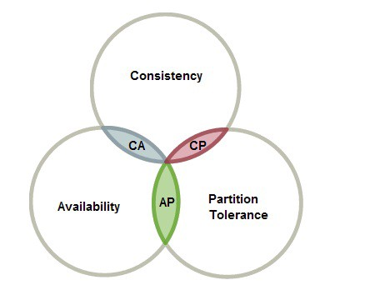
CAP THEOREM
The CAP Theorem is an important part of non-relational databases.
It states that a distributed data store “cannot” simultaneously offer more than “two of three” guarantees.
Consistency
Availability
Partition Tolerance

Slide 6


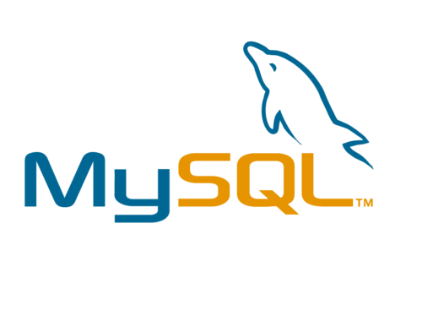
Relational Databases:
A relational database typically stores information in tables containing specific pieces and types of data
Relational databases use Structured Query Language (SQL).
Mostly used in large enterprise scenarios.
Relational databases work best when the data they contain doesn’t change very often
Examples: Microsoft SQL, PostgreSQL, MySQL

Slide 7


Non-relational Databases (NoSQL databases)
A non-relational database is any database that does not use the tabular schema of rows and columns like in relational databases
Non-relational databases are often used when large quantities of complex and diverse data need to be organized.
Non-relational databases often perform faster
Types: Document- oriented databases, Key-Value Stores ,Wide-Column Stores ,Graph Stores
Example: MongoDB, Redis

Slide 8

Relational Databases Vs Non-Relational Databases
The main difference between these is how they store their information.
A non-relational database stores data in a non-tabular form, and tends to be more flexible than the traditional, SQL-based, relational database structures.
It does not follow the relational model provided by traditional relational database management systems.

Slide 9

Benefits of Introducing NoSQL Databases
Store heap of data that might not have a structure
Speed up the development process
Reap the benefits of cloud computing and storage
Elevate horizontal scalability

Slide 10
ACID (RDBMS) Vs BASE (NoSQL)
Atomicity: All data and commands in a transaction succeed or all fail and roll back
Consistency: All committed data must be consistent with all data rules including constraints, triggers, cascades, atomicity, isolation and durability
Isolation: Other operations cannot access data that has been modified during a transaction that has not been completed
Durability: Once a transaction is committed, data will survive system failures and can be recovered
Basically Available: Guaranteed Availability
Soft-state: State of the system may change, even without a query (because of a node updates)
Eventually consistent: System will become consistent over time
ACID | BASE
Strong consistency | Weak consistency
Isolation | Last write wins
Transaction | Programmer Managed
Available / Consistent | Available / Partition Tolerant
Robust Database / Simpler Code | Simpler Database / Harder Code

Slide 11


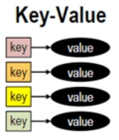
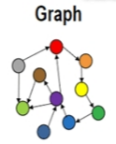
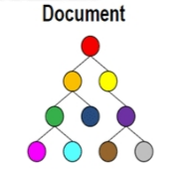
Types of NoSQL Databases:
Key-value Pair Based
Column-oriented Graph
Graphs based
Document-oriented

Slide 12
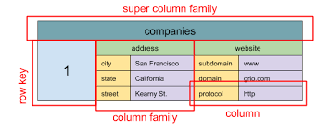
Column Based
It store data as Column families contain in grows that have many columns associated with a row key. Each row can have different columns.
Column families are groups of related data that is accessed together.
Example: Cassandra, HBase, Hypertable, and Amazon DynamoDB.
It is a tuple that contains a name, value,timestrap.
We use it for content management systems, blogging platform.
We would avoid it for systems that are linearly development, changing query patterns.

Slide 13
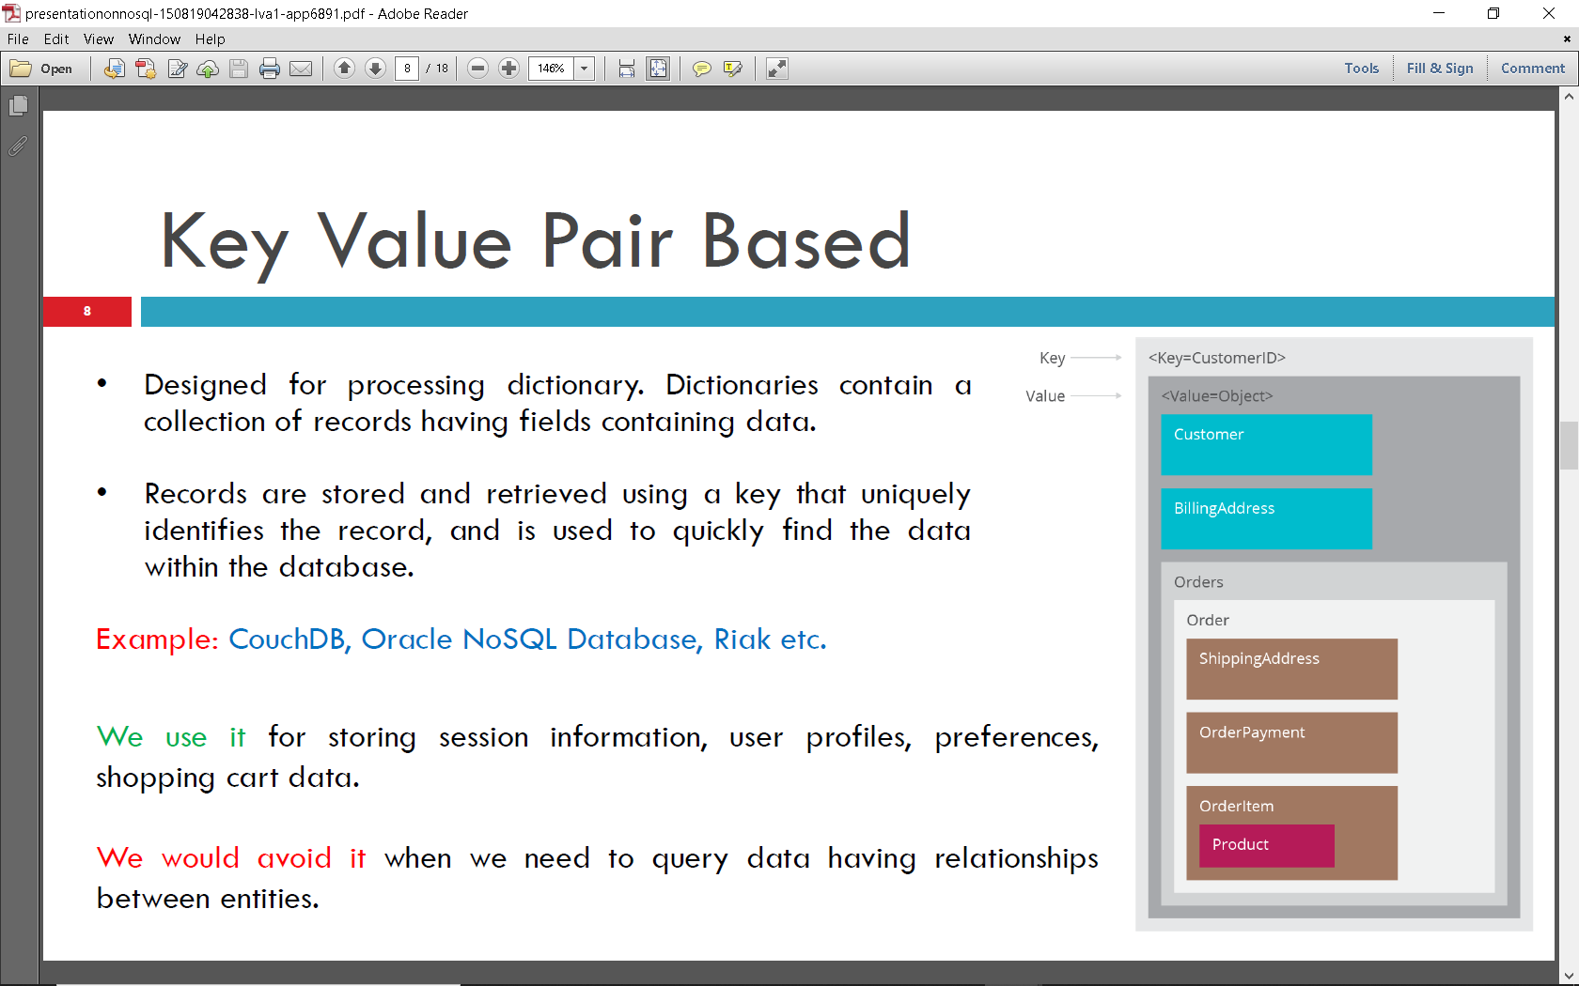
Key Value Pair Based
Simplest Nosql databases
The main idea is the use of a hash table
Access data by strings called keys
Data has no required format data may have any format.
Data model: (key,value)
Basic operations:
Insert(key,value)
Fetch(key)
Update(key)
Delete(key)

Slide 14
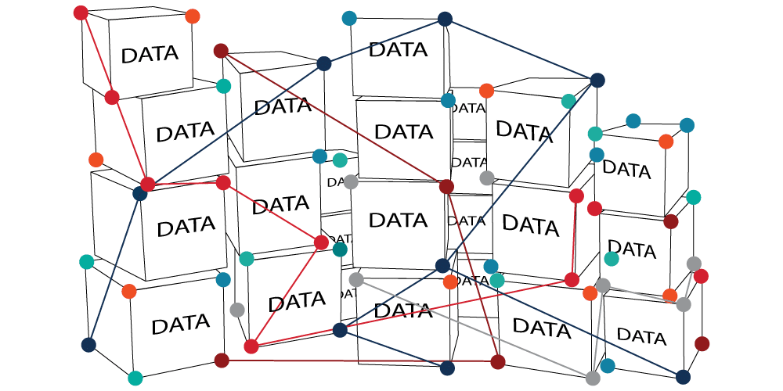
Graph Based
Store entities and relationships between these entities as nodes and edges of a graph respectively. Entities have properties.
Traversing the relationships is very fast as relationship between nodes is not calculated at query time but is actually tells as a relationship.
Example:Neo4J,InfiniteGraph,OrientDB,FlockDB.
It is well suited for connected data, such as social networks, spatial data, routing information for goods and supply.

Slide 15

Document Based
The database stores and retrieves documents. It Stores documents in the value part of the key-value store.
Self-describing, hierarchical tree data structures consisting of maps, collections, and scalar values.
Example: LotusNotes, MongoDB, CouchDB, OrientDB, RavenDB.
Documents can contain many different key- value pair or key- array-pair.
We use it for content management systems, blogging platforms, web analytics, real-time analytics, e-commerceapplications.
We would avoid it for systems that need complex transactions spanning multiple operations or queries against varying aggregate structures.
Indexes willl be done via B- Trees.

Slide 16
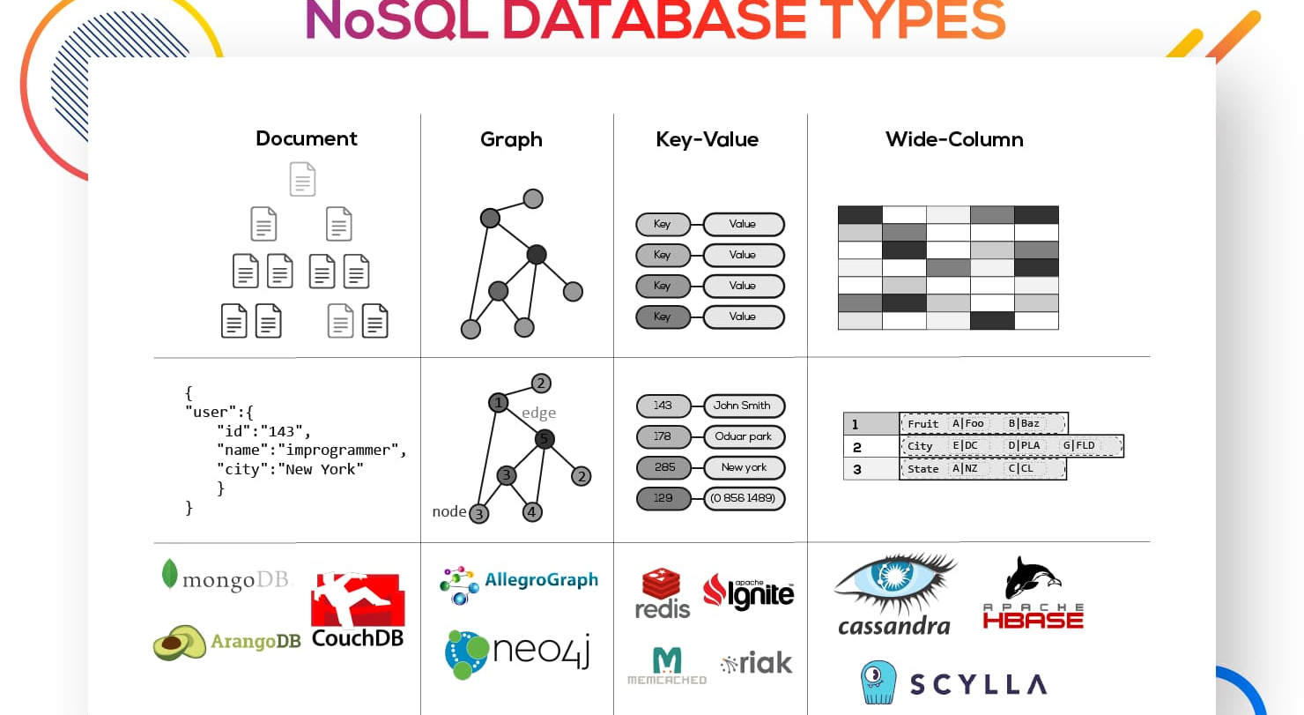

Slide 17

Advantages of NoSQL
Can be used as Primary or Analytic Data Source
High scalability
High availability
No Single Point of Failure
NoSQL databases don't need a dedicated high-performance server
Support Key Developer Languages and Platforms
Simple to implement than using RDBMS
It can serve as the primary data source for online applications.
It provides fast performance and horizontal scalability.
Can handle structured, semi-structured, and unstructured data with equal effect

Slide 18
Disadvantages of NoSQL
No standardization rules
Limited query capabilities
It does not offer any traditional database capabilities, like consistency when multiple transactions are performed simultaneously.
Doesn't work as well with relational data
Open source options are not so popular for enterprises.

Slide 19

THANK YOU

