Slide 1

Design and implementation of a cloud-based IDS Phase 2, June 2023
Project Advisor : Dr. T Senthil Kumar
S. No | Roll No | Student Name | Section
1. | CB.EN.U4CSE19030 | Kunduru Nikunj | A
2. | CB.EN.U4CSE19449 | Penugonda Koushik | E
3. | CB.EN.U4CSE19453 | Ravella Abhinav | E
4. | CB.EN.U4CSE19459 | Singadi Shanthan Reddy | E

Slide 2

IBM Mentors
Kartik Srinivasan, Sr. Architect, IBM Security. IBM India Pvt Ltd kartiksr@in.ibm.com
Anjali Tibrewal, Sr. Architect, IBM Security. IBM India Pvt Ltd anjtibre@in.ibm.com
Sulakshan Vajipayajula, STSM & Architect, IBM Security, IBM svajipay@in.ibm.com

Slide 3

Approval from Guide

Slide 4
Objectives
The primary objective of an IDS is to detect potential security threats, such as unauthorized access, malware infections, or other malicious activity, in real-time. The system should be able to identify threats quickly and accurately to prevent or minimize the damage caused by an attack.
To design and implement a flexible and configurable system that can adapt to evolving security threats
To create a user-friendly and intuitive interface for the IDS, making it easy for security professionals to monitor and manage the system.

Slide 5
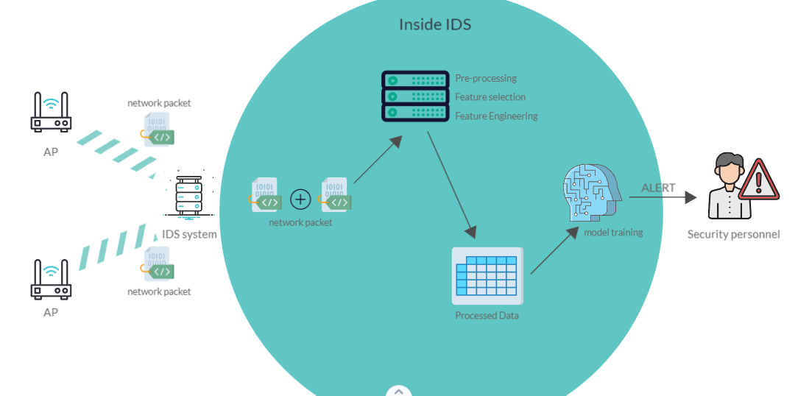
Inside IDS

Slide 6
Why NIDS over HIDS?
Network visibility: A NIDS has the ability to monitor all traffic on the network, including traffic between different hosts and subnets.
Centralized management: A NIDS can be managed from a central location, making it easier to deploy and manage across multiple hosts and locations.
Scalability: NIDS can scale to monitor larger networks.
Detection of network-based threats: NIDS can detect threats such as network scans, port scans, and other network-based attacks.
Less overhead on individual hosts: Installing a HIDS on every host can be resource-intensive and impact system performance.

Slide 7
Data Set - CSE-CIC-IDS2018
The CSE-CIC-IDS2018 dataset is a publicly available dataset of network traffic for use in Intrusion Detection System (IDS) research. It was created by the Canadian Institute for Cybersecurity at the University of New Brunswick in Fredericton.
The dataset contains over 10 million rows of network traffic, representing a diverse range of traffic patterns and attack scenarios. It includes both benign traffic and traffic generated by a variety of attacks, such as File Transfer Protocol (FTP) exploit, Remote code execution exploit, SQL injection exploit, Reverse shell exploit with both the attacker and victim machines running on a virtual environment.
The dataset contains 87 columns or features that include source and destination IP addresses, source and destination ports, protocol, packet and byte counts, duration, flags, and various statistical measures. The dataset also includes labels for each record indicating whether the traffic is benign or malicious, and if malicious, the specific type of attack that was detected(Signature Dataset).

Slide 8
Different types of attacks
Distributed denial-of-service (DDoS) attacks, Man-in-the-middle (MitM) attacks, Ransomware attacks
Common Exploits in the field of Medicine
File Transfer Protocol (FTP) exploit: Attackers can use this exploit to gain unauthorized access to healthcare facility's servers, steal sensitive data, and potentially compromise patient care.
Remote code execution exploit: This type of exploit allows attackers to execute code on a healthcare facility's server, giving them complete control over the system.
SQL injection exploit: Attackers can use SQL injection to bypass authentication controls, access sensitive data, and potentially compromise the integrity of patient data.
Reverse shell exploit: This type of exploit involves creating a shell on a healthcare facility's server that allows attackers to execute commands remotely.

Slide 9
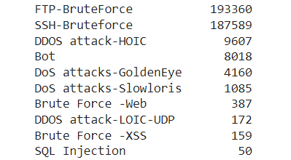
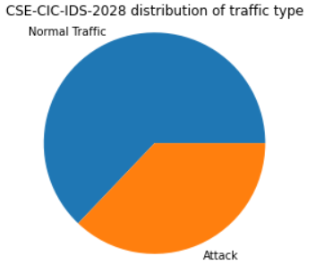

Analyzing and Understanding Dataset
Different types of attacks in our dataset:
Distribution of network traffic:

Slide 10
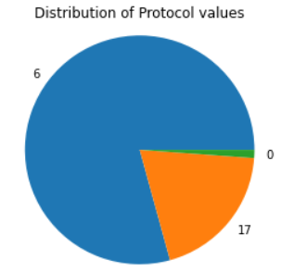
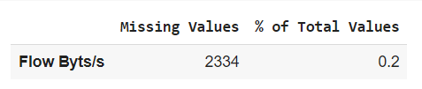

Analyzing and Understanding Dataset
Distribution of protocol values:
HTTP – 6
FTP - 17
(application layer protocols)
Missing values and their percentage:
Impute missing values
Remove missing values
Feature Selection
Ensemble learning
Domain Knowledge

Slide 11
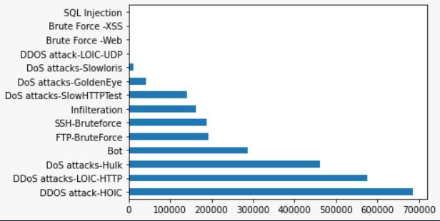
Analyzing and Understanding Dataset
Since the objective of this contact is the analysis to distinguish between normal and malicious traffic. Therefore, the labels will be transformed to perform a binary classification:
Normal: 0.
Malicious: 1.

Slide 12
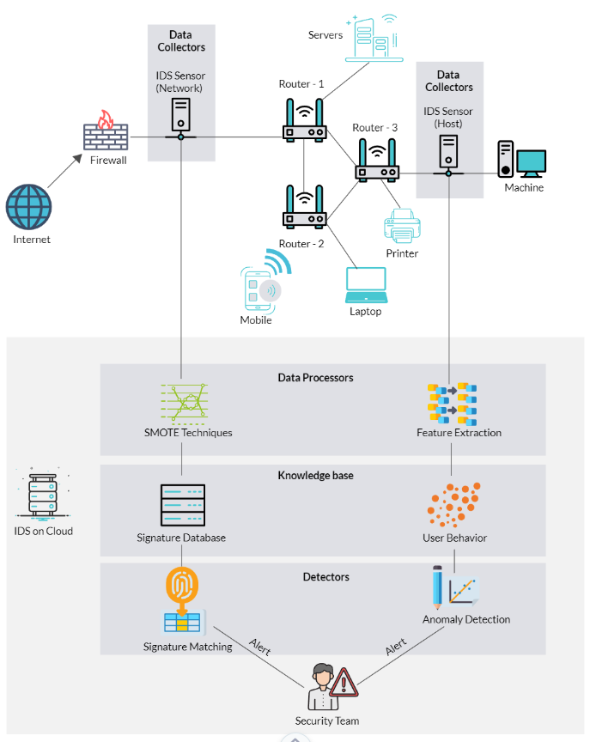
Security Architecture Diagram

Slide 13
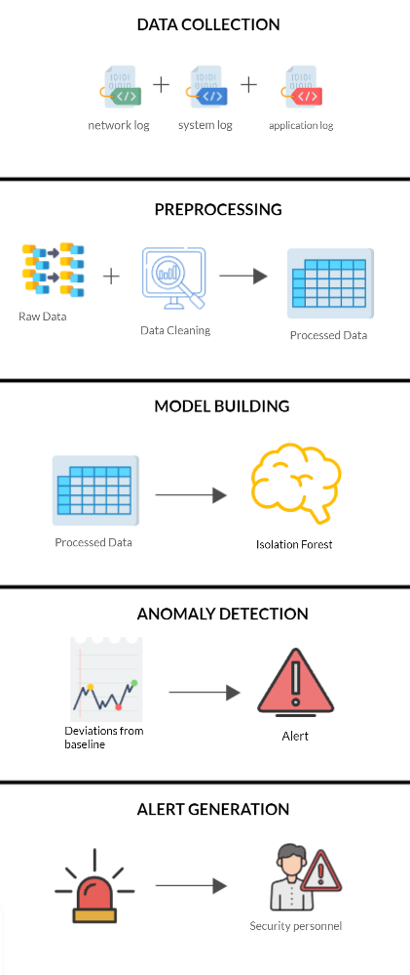
Working of Anomaly based IDS
Data Collection: The first step is to collect data from various sources such as network traffic, system logs, or application logs.
Preprocessing: The collected data is then preprocessed to remove noise, irrelevant information, or any other unwanted data.
Model Building: In this step, the IDS builds a model of the normal behavior of the system using statistical models or machine learning algorithms.
Anomaly Detection: Once the model of the normal behavior of the system is built, the IDS uses it to detect any deviations or anomalies from the normal behavior.
Alert Generation: If an anomaly is detected, the IDS generates an alert to notify the system administrator or security team.

Slide 14
Why do Feature Selection then proceed to ensemble learning?
Helps to identify the most important features in the data and remove the less important ones. This can help to reduce the impact of missing values and improve the accuracy of the model.
Inference: KNN imputation can be computationally expensive for large datasets, and it may not always be the best imputation method depending on the characteristics of the data.
The Random Forest Regressor algorithm works by constructing a multitude of decision trees at training time and outputting the average prediction of the individual trees as the final prediction. Each tree is constructed using a random subset of the features and a random subset of the data samples. This randomness helps to reduce the risk of overfitting and improves the performance of the model.

Slide 15
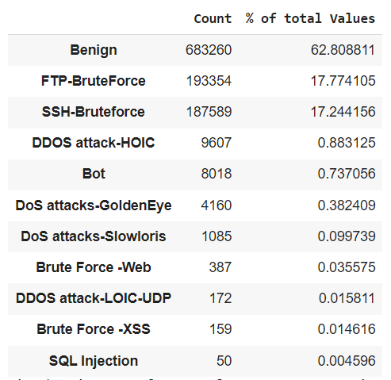
Constant Characteristics
Columns in a dataset that have the same value for all observations or samples. These features provide no useful information to the model and can negatively impact the model's performance.
What are the available options:
Remove the constant features
Feature selection
correlation-based
recursive feature elimination
Use domain knowledge

Slide 16
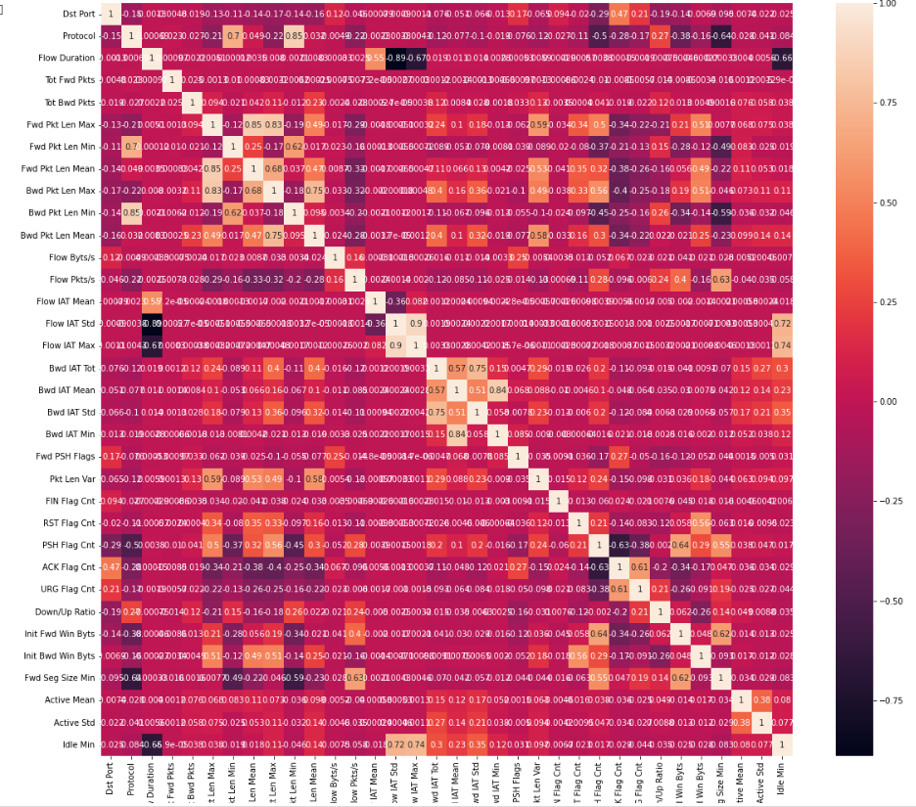
Constant Characteristics
Correlation-based:
Pearson correlation coefficient.

Slide 17
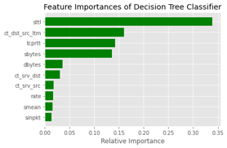
Constant Characteristics
Recursive feature elimination:
ranking the importance of features in RFE, such as using coefficients from linear models, feature importance scores from decision trees, or weights from neural networks.

Slide 18
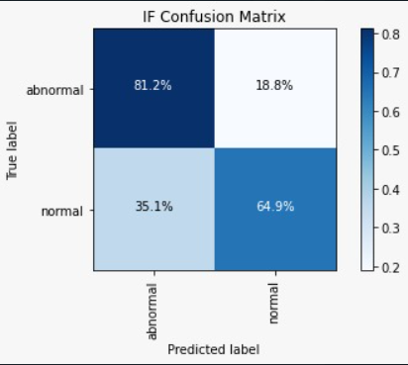
ML algorithms used and why Isolation Forest
The algorithm is trained on a dataset of normal or benign network traffic, and then used to identify anomalies in incoming network traffic. Any traffic that is identified as an anomaly can be further analyzed to determine whether it represents a security threat, and appropriate action can be taken to mitigate the threat if necessary.
computationally efficient i.e can handle high-dimensional data
point anomalies individual data points that are unusual
contextual anomalies data points that are unusual in the context of their surrounding data

Slide 19
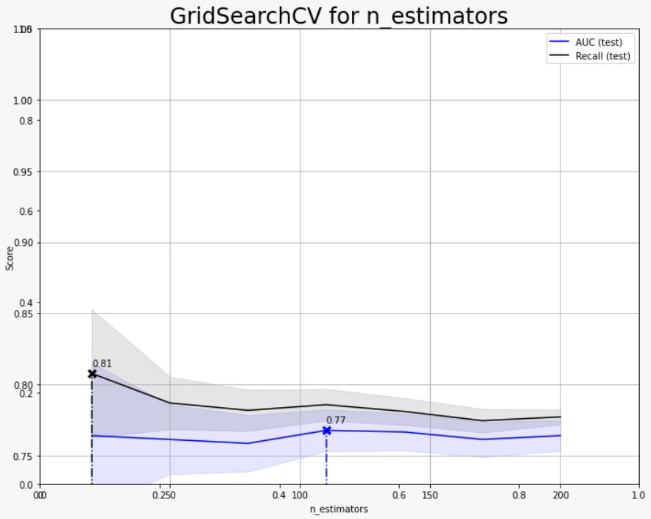
ML algorithms used and why Isolation Forest
First, the code creates a new column in the dataframe called 'anomaly'. The code then selects the rows where the 'anomaly' column is equal to -1 and filters these outliers to only include those with a label value less than 12.
The resulting 'outliers' dataframe contains the index values of the outlier data points. The 'outlier_index' variable is a list of these index values.
The 'value_counts()' method is then used to count the number of predicted anomalies (-1) and non-anomalies (1) in the 'anomaly' column. Finally, the 'anomaly' column is dropped from the dataframe, as it was only used for the prediction and post-processing steps.

Slide 20
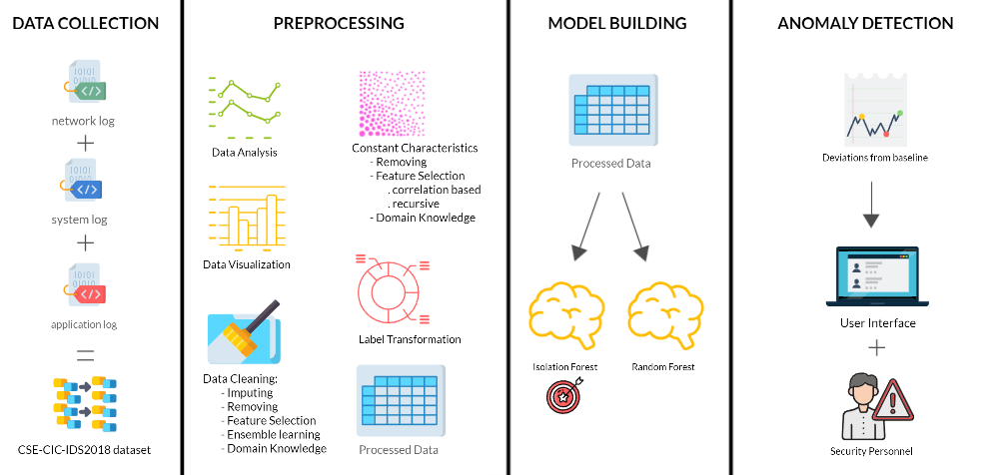
Summary of work done for Anomaly-based IDS

Slide 21
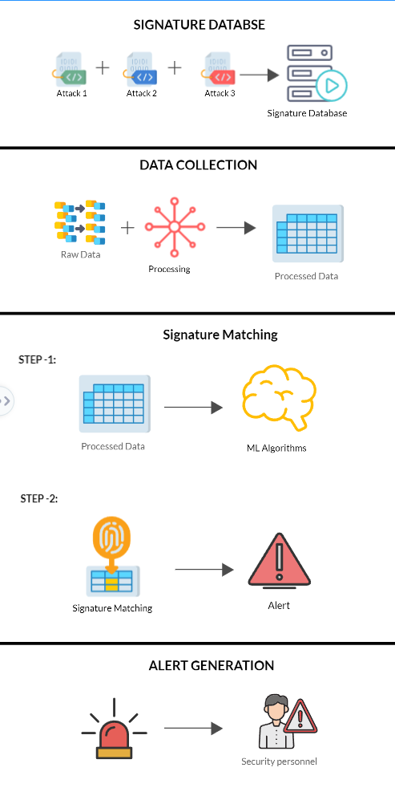
Working of Signature based IDS
Signature Database: The first step is to create and maintain a database of signatures of known attacks or malicious activities.
Data Collection: The second step is to collect data from various sources such as network traffic, system logs, or application logs.
Signature Matching: Once the data is collected, the IDS matches the signatures of known attacks against the data to detect any matches.
Alert Generation: If a match is found, the IDS generates an alert to notify the system administrator or security team.

Slide 22
Commonly used algorithms for Signature Matching
Decision Trees: They use a tree-like model of decisions and their possible consequences to make predictions about new data. Decision trees can be easily interpretable and can handle both categorical and numerical features.
Random Forest: Random Forest is an ensemble learning algorithm that combines multiple decision trees to improve the accuracy and robustness of the model. It can handle large datasets with a high number of features and can handle missing values.
k-Nearest Neighbors (KNN): KNN is a non-parametric machine learning algorithm that classifies new data based on the closest labeled data points in the training set. It can work well with small datasets and can handle both categorical and numerical features.
Feed Forward Neural Network (FFNN): FFNN can be trained on a signature database of known attacks and benign traffic to detect new attacks in real-time. The network learns to recognize patterns in the network traffic data and classify it as benign or malicious. Once trained, the FFNN can be used to detect unknown attacks that are not present in the signature database.

Slide 23
FFNN algorithm for Signature Matching ?
The FFNN learns to recognize patterns in the network traffic data and classify it as benign or malicious. Once trained, the FFNN can be used to detect unknown attacks that are not present in the signature database.
However, FFNNs are computationally intensive and require a large amount of training data to achieve high accuracy. They can also be vulnerable to overfitting, where the model becomes too specific to the training data and performs poorly on new data.
Therefore, FFNNs can be used as a complementary approach to other machine learning algorithms
** SMOTE (Synthetic Minority Oversampling Technique), Random Under Sampling

Slide 24
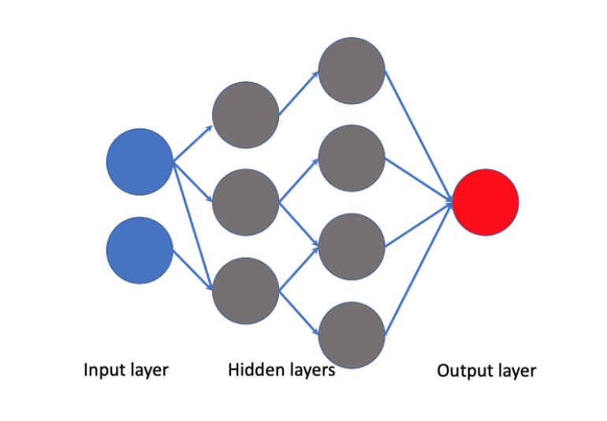
Working of FFNN algorithm for Signature Matching
Building the Neural Network: FFNN architecture consists of an input layer, one or more hidden layers, and an output layer.
Training the Neural Network: It is trained on a dataset of known attack signatures and benign traffic signatures. During the training process, the network adjusts the weights of the neurons to minimize the error.
Testing the Neural Network: FFNN is tested on a separate dataset of attack signatures and benign traffic signatures to evaluate its performance.
Evaluating Performance: The performance of the FFNN is evaluated based on its ability to correctly classify the input data as benign or malicious. The evaluation metrics typically include accuracy, precision, recall, and F1 score.

Slide 25

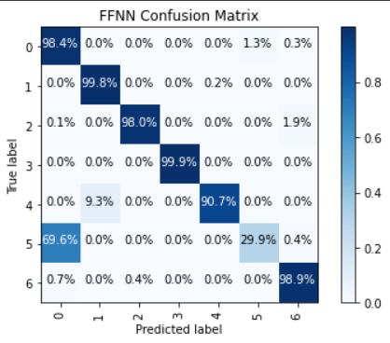





Results of FFNN algorithm for Signature Matching
Confusion Matrix for 6 types of attacks

Slide 26
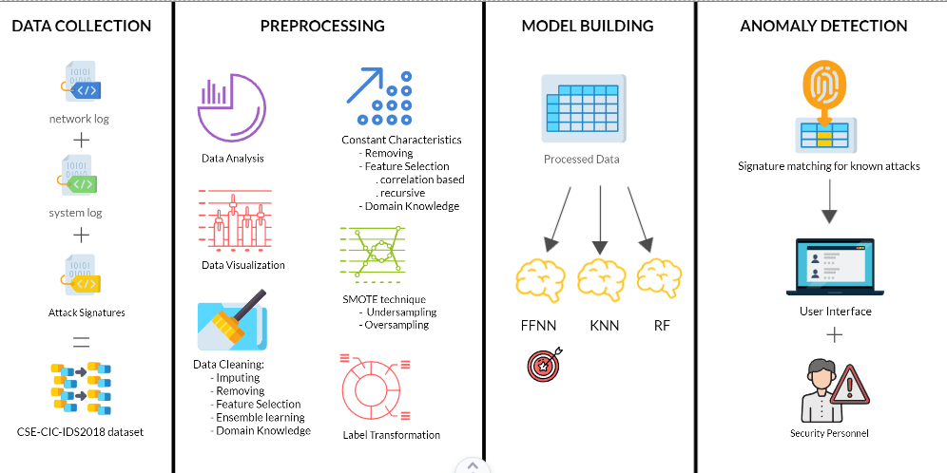
Summary of work done for Signature-based IDS

Slide 27
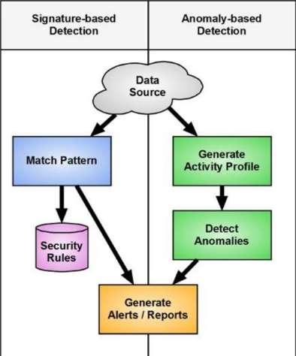
Working of Hybrid IDS
Signature Database
Data Collection
Signature Matching: Once the data is collected, the IDS matches the signatures of known attacks against the data to detect any matches.
Preprocessing
Anomaly Detection: In this step, the IDS builds a model of the normal behavior of the system using statistical models or machine learning algorithms.
Signature Matching: Once the system detects an anomaly, it then matches the observed behavior against a database of signatures of known attacks.
Alert Generation

Slide 28
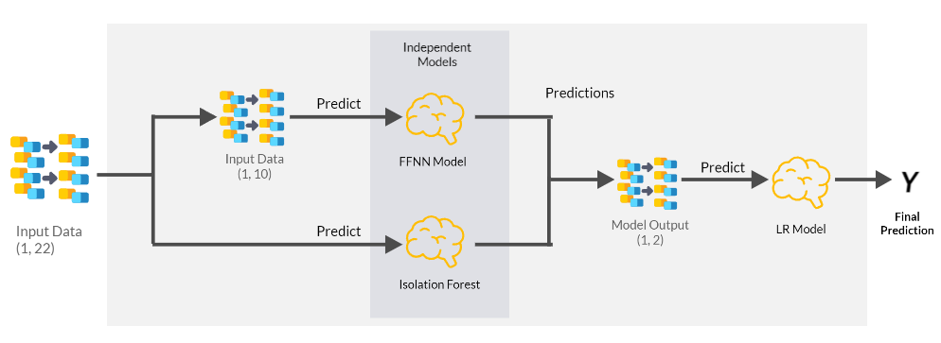
Approach for Hybrid Model
The system gets the already preprocessed (22 features) as the input for both models, with the difference that the Auto Encode performs one more preprocessing stage in which it eliminates 12 features of the input. Then, both make their prediction, and these will be taken as input to the final model. This will be the one that determines if there is an anomaly or not.

Slide 29
Results and Analysis of Hybrid Model
Techniques | Normal | DDos | Bot | Brute force | Infiltration | Web
IF | 62.6 | 78.9 | - | - | - | -
AE | 69.9 | 54.3 | 49.6 | 100 | 27.7 | 61
RF | 88.4 | 78.9 | 99.9 | 91.8 | 58.9 | 98.6
FFNN | 98.4 | 99.8 | 99.9 | 90.7 | 29.8 | 98.8
Hybrid | 96.4 | 100 | 99.9 | 99.1 | 38.6 | 98.2

Slide 30
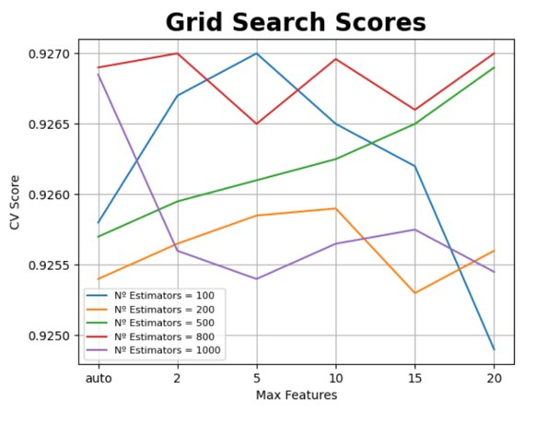
Signature Matching RF Algorithm Result

Slide 31

User Interface

Slide 32
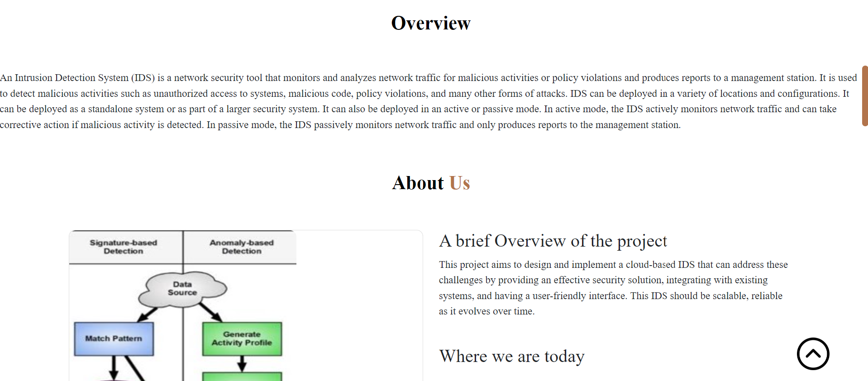
User Interface

Slide 33
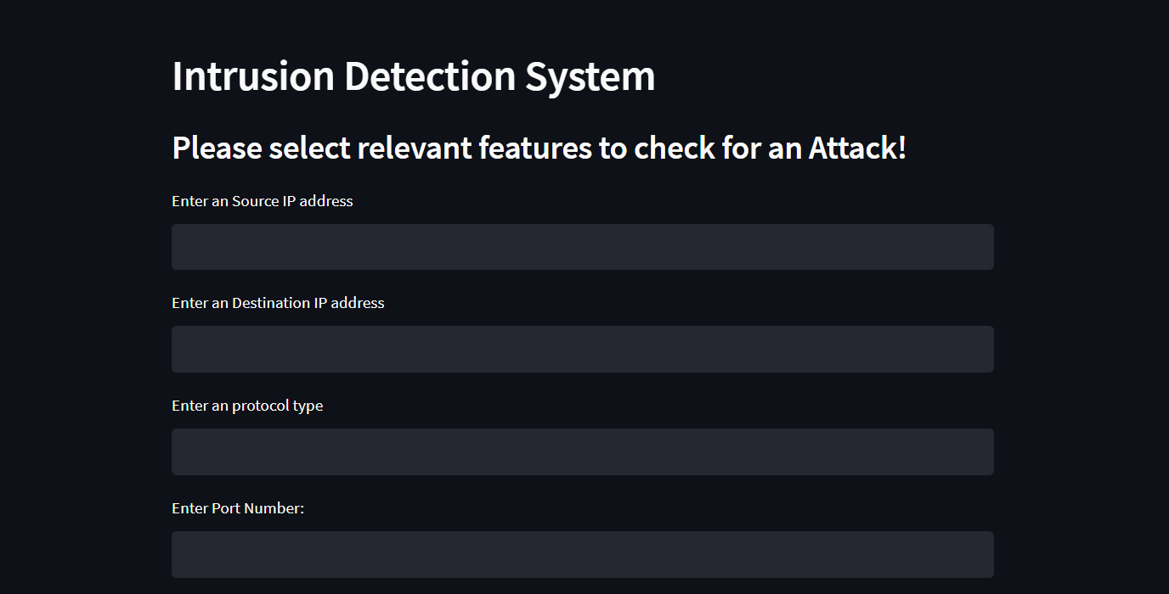

Slide 34
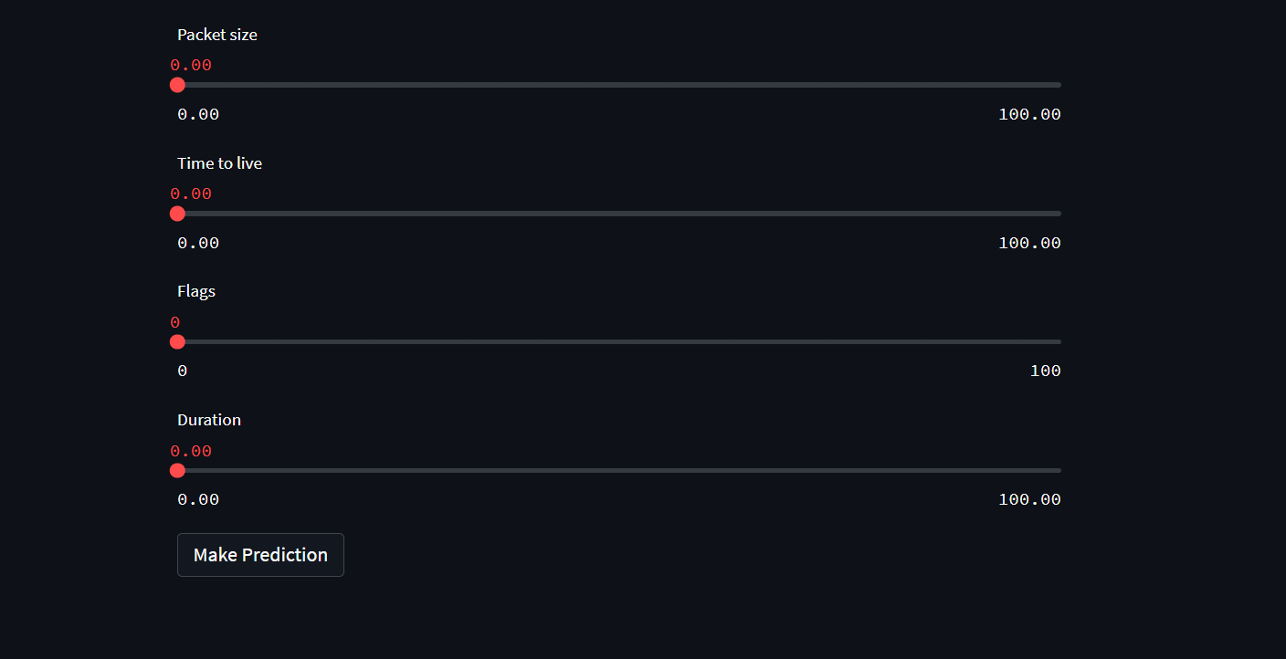

Slide 35
Publication status
Our manuscript entitled "A Cloud-Based Intrusion Detection System for Advanced Threat Detection and Prevention using Machine Learning Techniques" has been successfully submitted 14th ICCCNT 2023 at IIT Delhi.
Authors: Dr. T. Senthil Kumar, Nikunj Kunduru, Abhinav Ravella, Shanthan Reddy, Sai Koushik, Kartik Srinivasan, Anjali Tibrewal, Sulakshan Vajipayajula

Slide 36
THANK YOU

