Slide 1

HKBU CAMPUS ASSISTANT BOT
A Cloud-Powered Academic Companion
COMP7940 CLOUD COMPUTING PROJECT | GROUP H
Notes:
Welcome to our presentation on the HKBU Campus Assistant Bot. We've developed a cloud-powered academic companion designed to truly enhance the student experience. This project showcases how intelligent automation can transform daily academic tasks. We'll explore its innovative features and the robust cloud architecture that makes it all possible. Let's dive into the overview of what this bot can do.

Slide 2
Project Overview
CORE FEATURES
CORE PURPOSE
/
🤖 Course Helper, Query course info from cloud PostgreSQL database
/
Efficiently query course information from cloud databases.
/
🖼️ Image-to-Video, AI-powered video generation from static images
/
Summarize academic documents (PDFs/Images) via OCR.
/
Generate short videos from static images using cloud AI.
/
📄 PDF Analysis, Auto-extract & summarize academic documents
"Empowering students with a unified, cloud-powered academic assistant."
Notes:
The HKBU Campus Assistant Bot is an intelligent chatbot, combining academic support with advanced generative AI. It's built specifically for the HKBU student community, aiming to simplify their academic journey. Our core purpose is clear: to help students query course information, summarize documents, and even generate media. This bot empowers students with a unified, cloud-powered academic assistant, making complex tasks straightforward. Next, we'll look at the smart academic support features that drive this convenience.

Slide 3
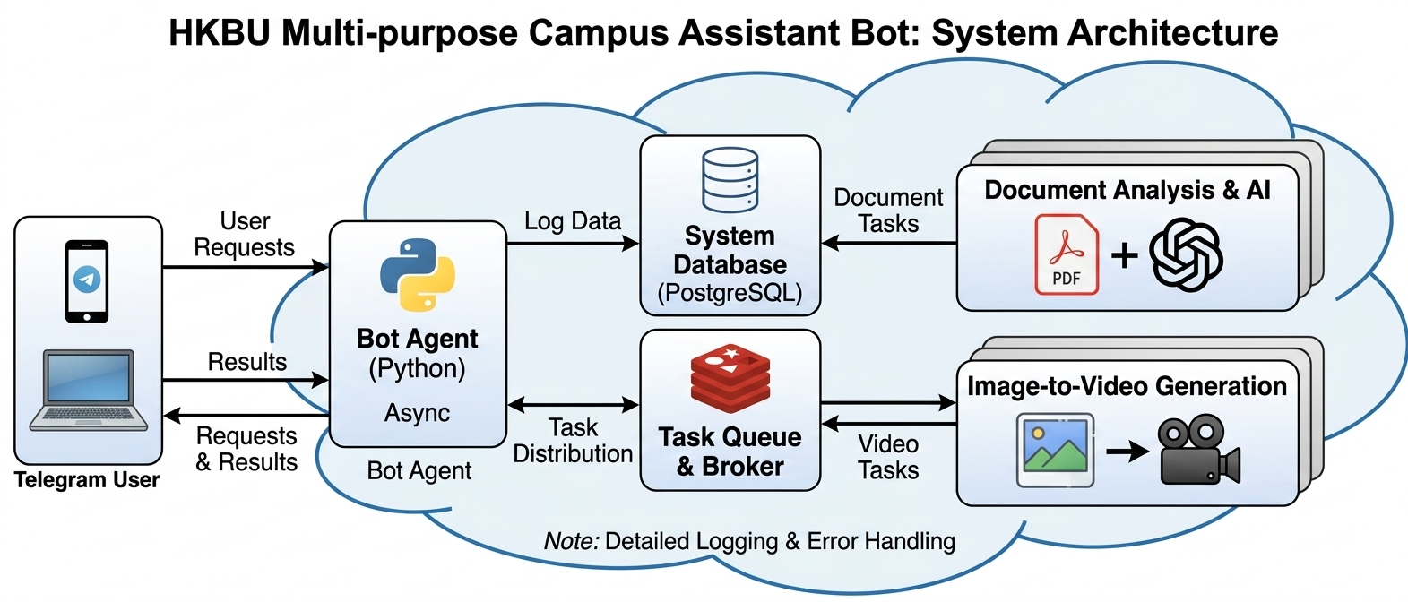
Notes:
With performance in mind, we then moved to cloud deployment and scaling. Our entire system lives on AWS EC2 instances, giving us high availability and reliability. We use Docker and Docker Compose for containerized deployment, which means one-click deployment and consistent environments every time. This setup allows for elastic scaling; we can dynamically add more workers for compute-heavy tasks like video generation. And of course, security is paramount, with API tokens managed securely through environment variables. This robust deployment strategy helps us tackle any challenges head-on.

Slide 4

Robust Technology Stack
CATEGORY
TECHNOLOGY
DESCRIPTION
Language
Python 3.12
Modern async features for efficient I/O.
Bot Framework
python-telegram-bot
Asynchronous framework for Telegram.
LLM API
HKBU GENAI (GPT-5) + Azure OpenAI (GPT-4)
Conversation and document summarization.
Video Generation
SiliconFlow API
Image to video Analysis and generation.
Database
PostgreSQL (asyncpg) + Redis
High-performance async data storage.
Deployment
Docker + AWS EC2
Containerization for environment consistency.
Notes:
Now, let's dive into the specific tools that power this system. We've carefully selected a robust technology stack to ensure both performance and future scalability. We built this bot using Python 3.12, leveraging its modern async features for efficient operations. For the chatbot interface, we chose python-telegram-bot, which provides a seamless and asynchronous way to interact with Telegram. And for the brain of our bot, we rely on Azure OpenAI's GPT-4, handling all our complex conversations and document summarization. This foundation allows us to build a truly responsive and intelligent assistant. Let's explore how we optimize its performance.

Slide 5
Performance & Optimization
ASYNC WORKFLOW
RESOURCE LIMITS
TIMEOUT PROTECTION
/
Non-blocking processing allows users to continue chatting.
/
CPU limits strictly enforced (0.5 - 2.0 cores).
/
ChatGPT API: 60s limit for rapid response.
/
Connection pooling for HTTP and Database (asyncpg).
/
Memory allocation capped (512MB - 2GB).
/
PDF Analysis: 180s for complex documents.
/
Efficient task distribution via Redis message broker.
/
Containerized isolation ensures system stability.
/
Video Generation: 3000s for heavy compute.
ZERO IDLE WAITING
DOCKER MANAGED
FAIL-SAFE DESIGN
Notes:
Building on that robust stack, performance and optimization were key considerations from day one. We designed a non-blocking workflow, so users can keep chatting even while background tasks are processing. This means zero idle waiting for our users. We also implemented strict resource limits using Docker, capping CPU and memory to ensure stability and prevent any single task from hogging resources. Finally, we built in timeout protection for different task types, from quick ChatGPT responses to longer video generations, ensuring a fail-safe design. This careful management leads us directly to how we deploy and scale this solution.

Slide 6

CONCLUSION
"A scalable, cloud-powered solution successfully bridging the gap between academic needs and advanced AI capabilities for the HKBU community."
SCALABLE
PRACTICAL
INNOVATIVE
Microservices architecture ready for growth.
Real-world utility for students and faculty.
Cutting-edge Image-to-Video integration.
PROJECT COMPLETE
Notes:
In conclusion, we've successfully created a scalable, cloud-powered solution that truly bridges the gap between academic needs and advanced AI capabilities for the HKBU community. This bot is not just scalable, thanks to its microservices architecture, but it's also incredibly practical, offering real-world utility for students and faculty. We've built an innovative tool, featuring cutting-edge image-to-video integration. This project is complete, and we're proud of the robust and intelligent academic companion we've delivered.

Slide 7
Demonstration
COMP7940 CLOUD COMPUTING PROJECT | GROUP H
Notes:
Welcome to our presentation on the HKBU Campus Assistant Bot. We've developed a cloud-powered academic companion designed to truly enhance the student experience. This project showcases how intelligent automation can transform daily academic tasks. We'll explore its innovative features and the robust cloud architecture that makes it all possible. Let's dive into the overview of what this bot can do.

