Slide 1

INVESTIGATE MODULE ADC REPORT BY EPs
Base on fspv5.2.0
Date: MAR/6/2023
Name: Huy PHam
Position: software developer
Department: FSP1 - EPAP
Renesas Electronics Corporation

Slide 2
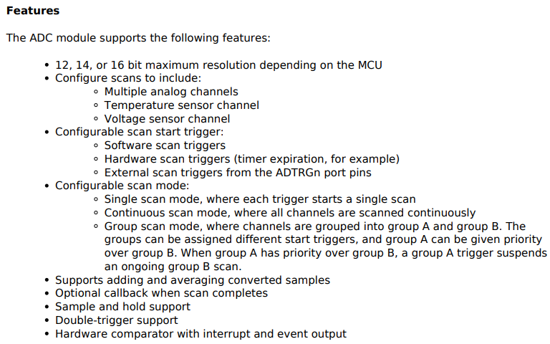
INVESTIGATE MODULE ADC
ADC : Analog to Digital Convert
1. OVERVIEW

Slide 3
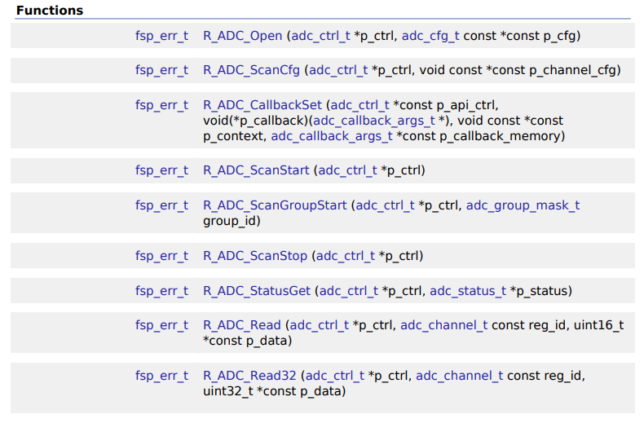
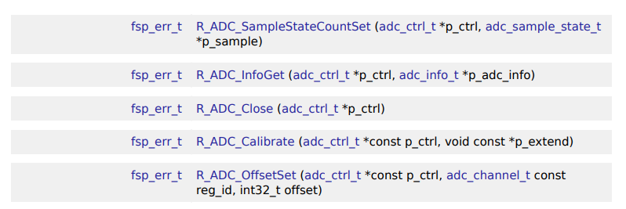
INVESTIGATE MODULE ADC
2. FSP_API_FUNCTION:

Slide 4
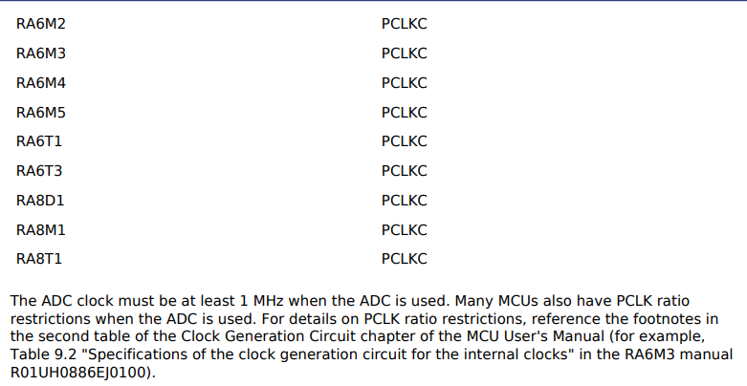
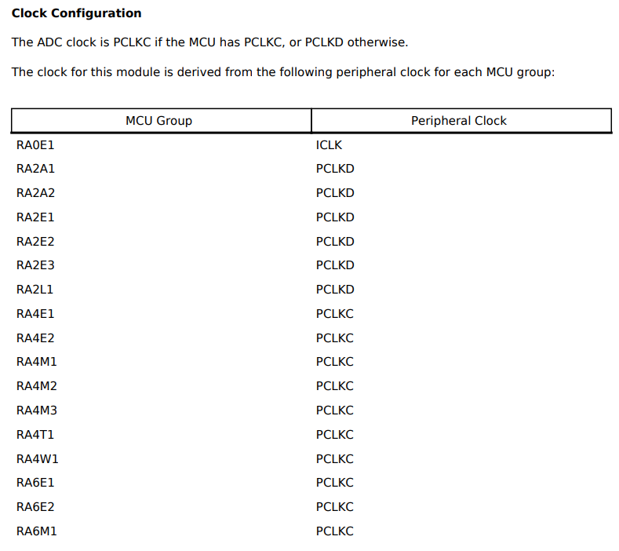
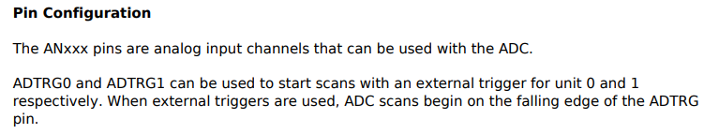
INVESTIGATE MODULE ADC
3. CLOCK AND PIN

Slide 5
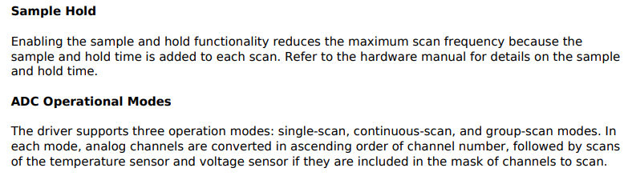
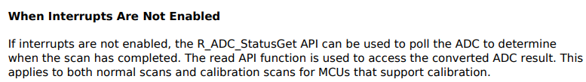

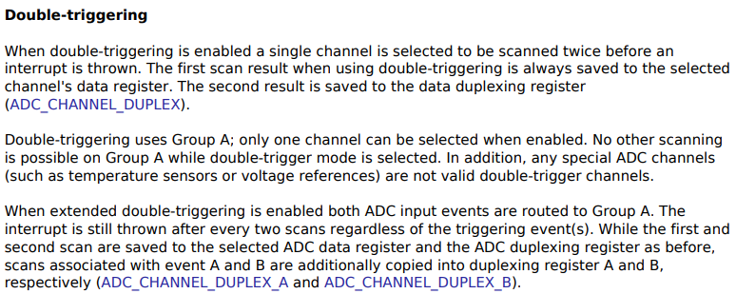


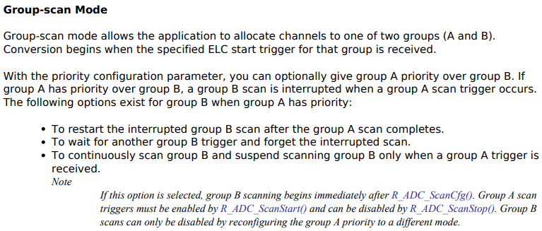
INVESTIGATE MODULE ADC
4. SOME RELATIVE CONCEPTS

Slide 6
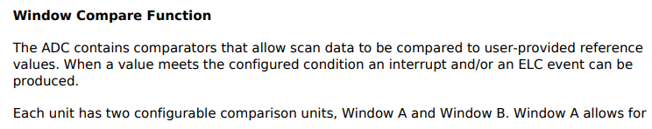
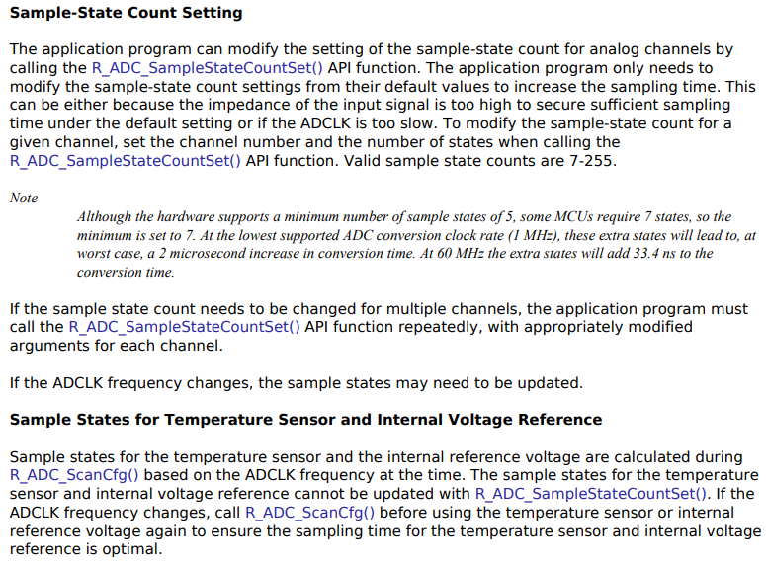
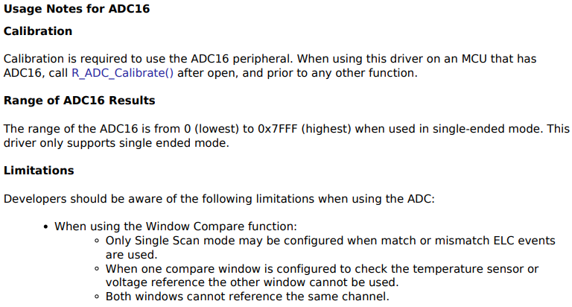
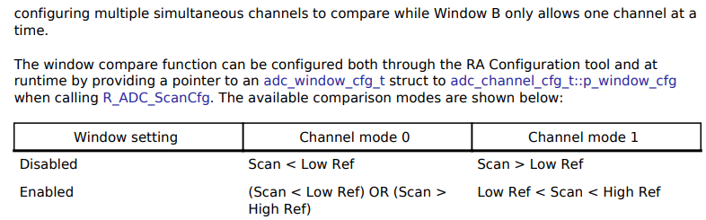
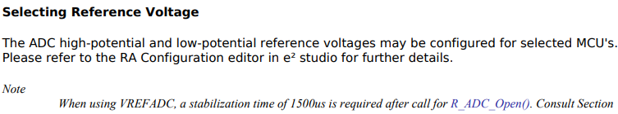

INVESTIGATE MODULE ADC
4. SOME RELATIVE CONCEPTS

Slide 7
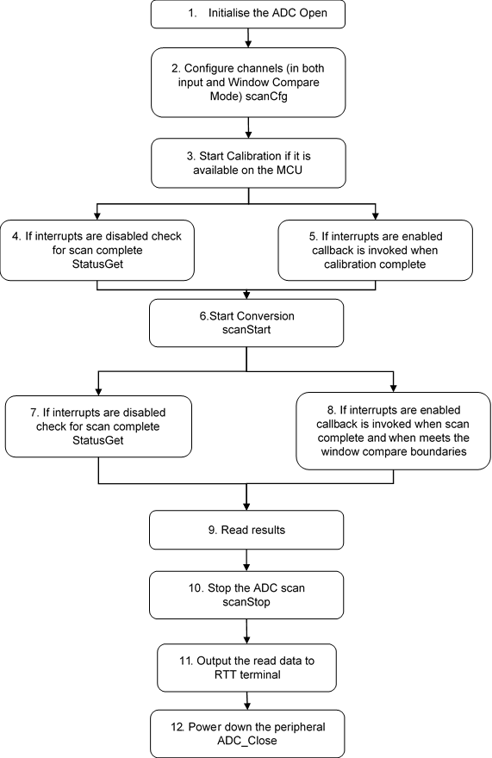
INVESTIGATE MODULE ADC
5. FLOWCHART OF MODULE ADC_EP

Slide 8
Overview setup

Slide 9
Renesas.com

