Slide 1

INVESTIGATE MODULE GPT REPORT BY EPs
Base on fspv5.2.0
Date: MAR/6/2023
Name: Huy PHam
Position: software developer
Department: FSP1 - EPAP
Renesas Electronics Corporation

Slide 2
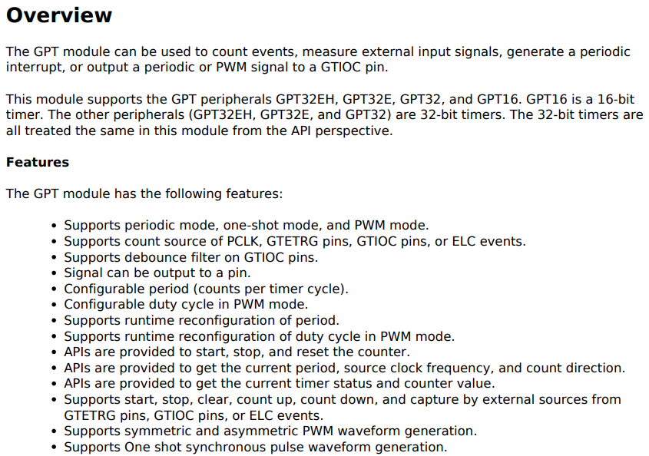
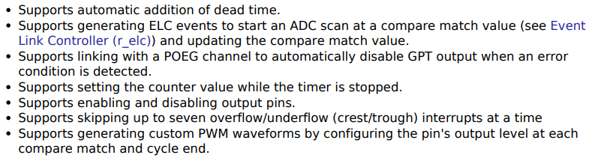
INVESTIGATE MODULE GPT
GPT : General Periodic Timer
1. OVERVIEW

Slide 3
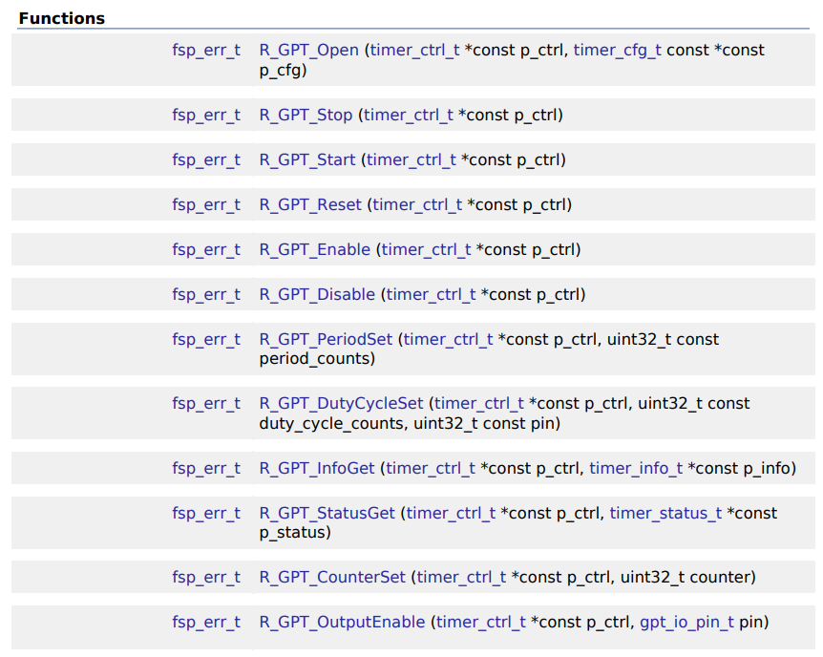
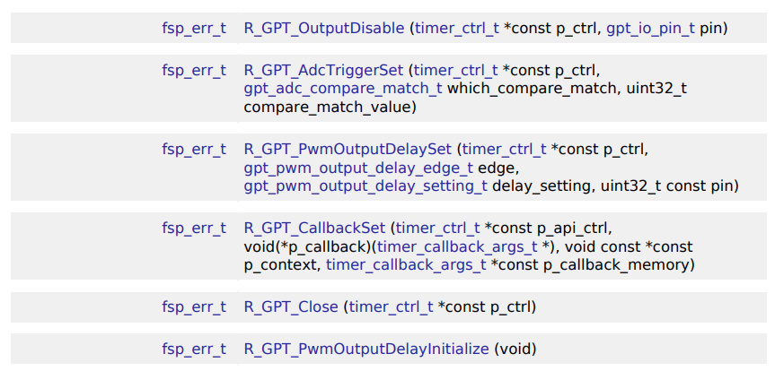
INVESTIGATE MODULE GPT
2. FSP_API_FUNCTION:

Slide 4
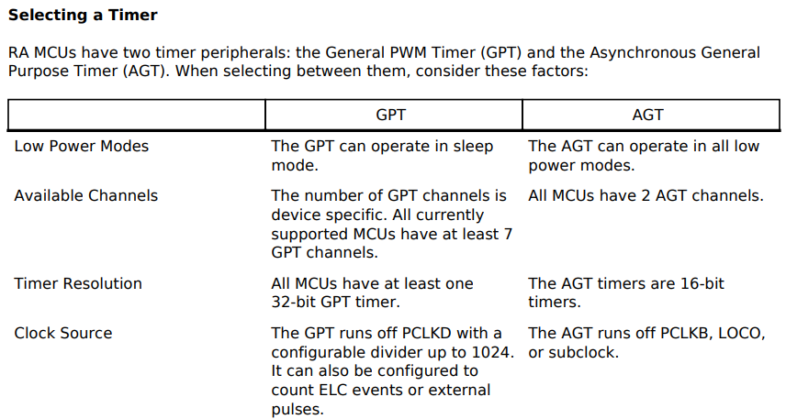
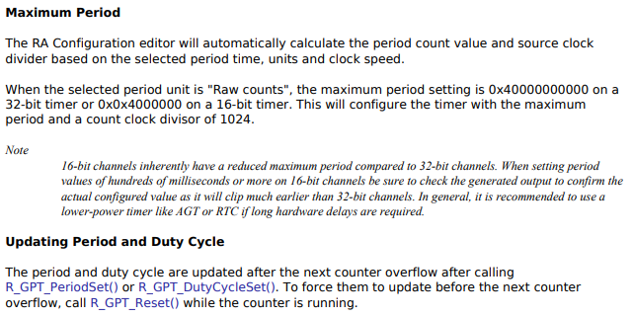
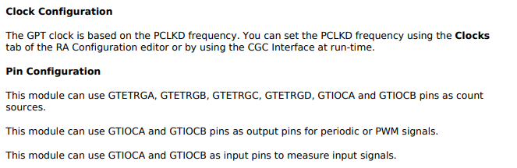
INVESTIGATE MODULE GPT
3. CLOCK AND PIN

Slide 5
INVESTIGATE MODULE GPT
4. SOME RELATIVE CONCEPTS

Slide 6
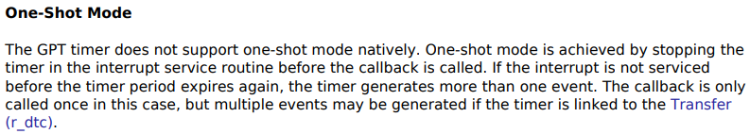
INVESTIGATE MODULE GPT
4. SOME RELATIVE CONCEPTS

Slide 7
INVESTIGATE MODULE GPT
5. FLOWCHART OF MODULE ADC_EP

Slide 8
Overview setup

Slide 9
Renesas.com

