Slide 1
IDS Assignment 2018-19
Ravendra Singh PES1201700706
Hrishikesh V PES1201700276
Topic : California state Residential Stats of 2010

Slide 2
Dataset
Land Plot Sales record based on :
Square footage
location (Lat and Longt)
price
Amenities
Type of residence
Localities in and around Sacramento

Slide 3
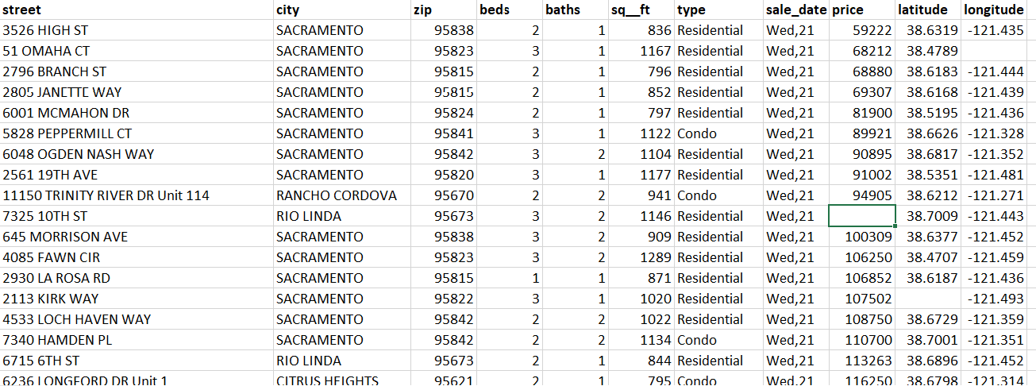
Dataset

Slide 4
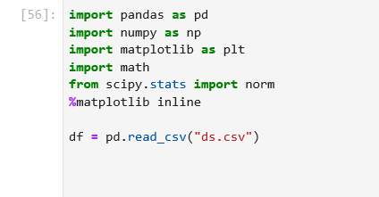
MODULES USED

Slide 5
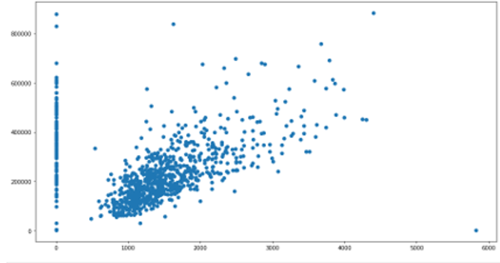
Pre-Data Cleaning
Scatter plot of square feet vs price

Slide 6
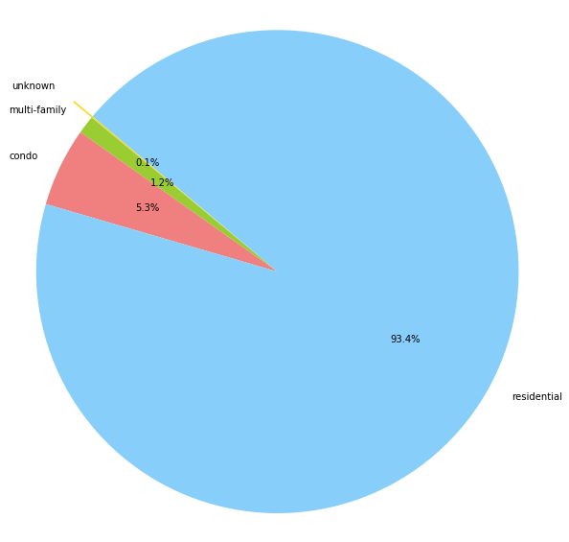
Visualization

Slide 7
Data Cleaning
Removing missing attributes by replacing them with the most suitable values, obtained by the most suitable method

Slide 8
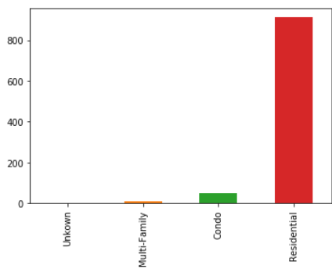
Data Cleaning
Cleaning the Data is particularly difficult when outliers are present. As indicated below, it is hard to determine a method that gives accurate values which can be substituted for missing attributes.

Slide 9
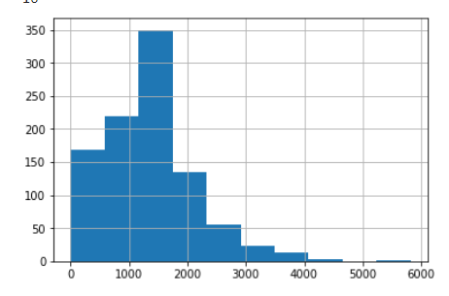
Data Cleaning
This is the graph of the square footage of the house plots. It has a relatively better distribution. The central tendency method used to approximate missing values are somewhat accurate if not completely. The main reason for this is that the distribution behaves as a gaussian distribution when the population size is huge.

Slide 10
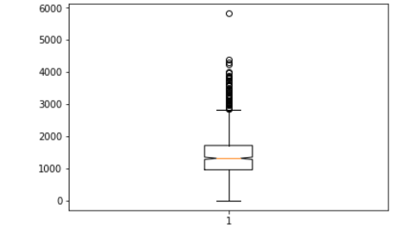
Data Cleaning
However, this distribution is not normal because, as evident by the box plot done for the square footage, there are a number of outliers, making central limit theorem invalid and data cleaning inaccurate

Slide 11
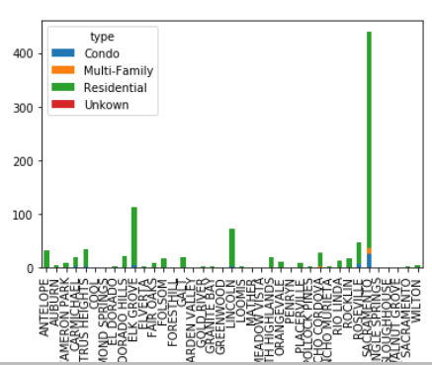
Visualization
One of the major parameter is the city in which the houses are sold. Here is a stacked graph which depicts both the number and the type of the residential houses sold

Slide 12
Visualization
It is easier to conclude that most of the houses were sold or rather, there are more number of houses in Sacramento as opposed to the areas lying along its perimeter. One simple conclusion would be that people prefer metropolitan areas. It’s quite obvious
Interestingly though, most houses that were sold were residential and not Condos or multi family residences. Both of these types of houses were mostly sold in Sacramento and not in the adjacent leading one to believe that they are completely residential and not commercial

Slide 13
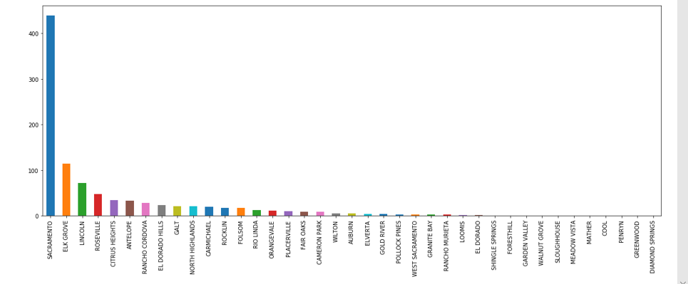
Visualization
Total plots sold in each of the cities

Slide 14
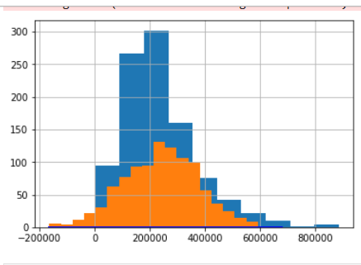
Visualization
Here’s a graph of price versus number. It is interesting to note that the shape of this histogram is not unlike that of the square footage.

Slide 15
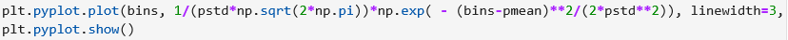
Visualization
The first graph is merely a plot of price versus number of houses that were sold at that price.
The second graph(Orange) is the normalized version of the first. As you can see, the second graph has minimized outliers and is quite symmetrical.
This graph was achieved by using a predefined formula.

Slide 16
Hypothesis Testing
The main challenge of hypothesis testing is random sample generation
In order to obtain a sample that is completely random, a random number to denote the sample size is determined.
This number is further used to generate random samples from the population. The repeated values are removed by appending the sample to a set. The cardinality of the set serves as the sample size

Slide 17
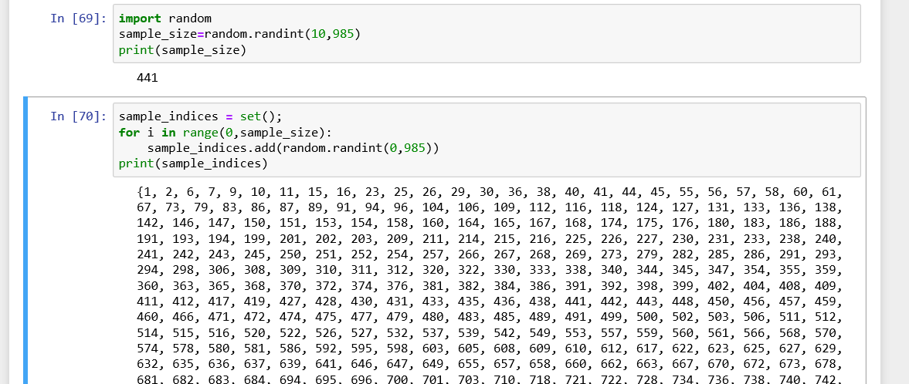
Hypothesis Testing
The Hypothesis is determined based on the comparison between the sample mean and population mean. This can be one or two sided

Slide 18
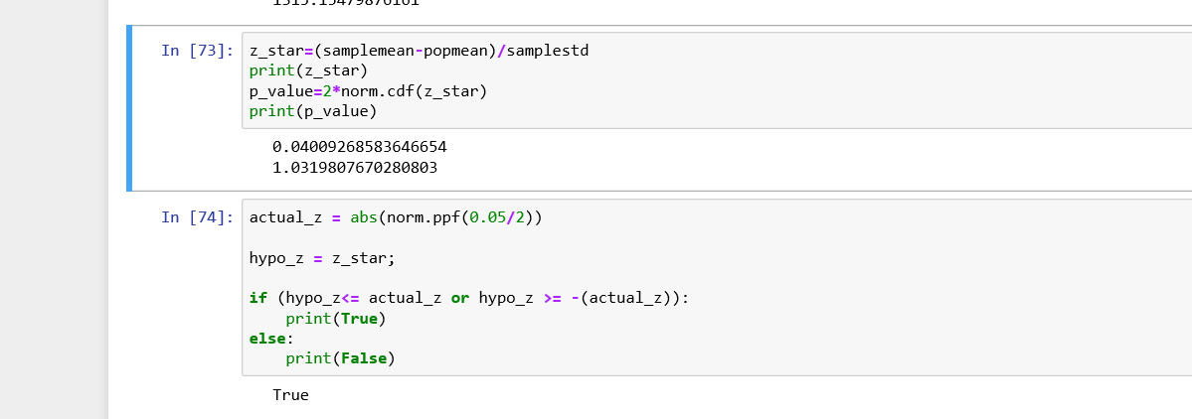
Hypothesis test

Slide 19
Hypothesis Test
Sample size: 441
Sample mean: 1347.9 population mean: 1315.15
H0: population mean = sample mean
Ha: population mean not equal to sample mean
Conclusion: Hypothesis cannot be rejected

Slide 20
Questions?

