Slide 1
Continuous Auditing with DevSecOps for NIST Cybersecurity Framework 2.0 on AKS
A deep dive into integrating security assessments into Azure Kubernetes Service.
by Victor Karamalis
c

Slide 2
The Agile Manifesto: A 20-Year Retrospective
Agile Principles
Methodologies
Common Challenges
The Agile Manifesto's core principles still resonate. These promote adaptive planning and continuous improvement.
LEAN
Accountability gaps
SAFe
Too Many Rituals
SCRUM
Scope Creep
XP
Quality Testing is an Afterthought
KANBAN
Security as a Blackbox
Feature Driven Development
c

Slide 3
DevSecOps Lifecycle
Planning
1
Define goals, requirements, and security considerations.
2
Coding
Developers write secure code.
Build
3
Integrate security scans.
4
Test
Automated security tests are run.
Release
5
Code is prepared for deployment with compliance checks.
6
Deploy
Applications are deployed securely.
Operate
7
Application runs with continuous monitoring.
c
Security is integrated into every phase. From planning to operation, it's a continuous loop.

Slide 4
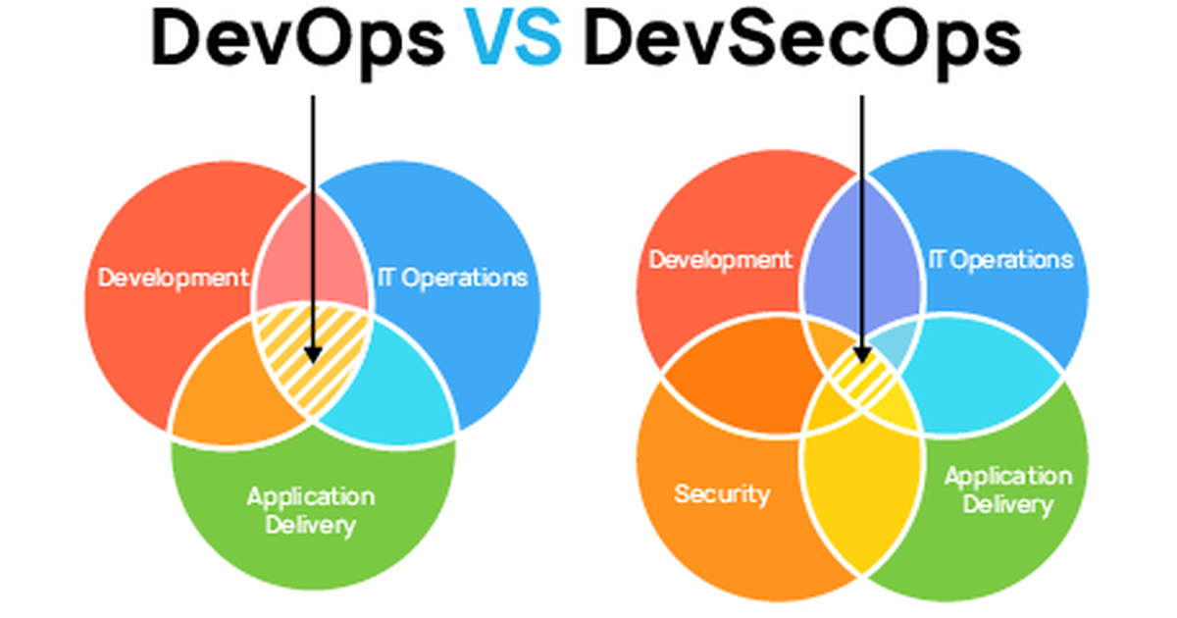
This Photo by Unknown Author is licensed under CC BY-NC

Slide 5
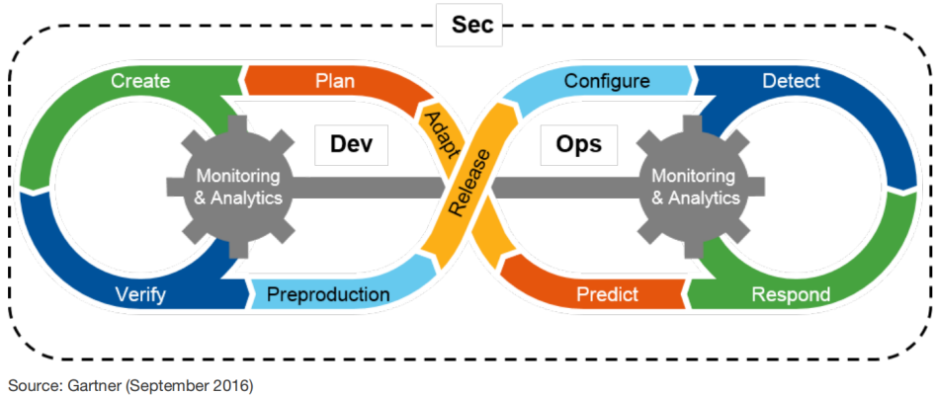
Opportunities To Add AI Assistants

Slide 6
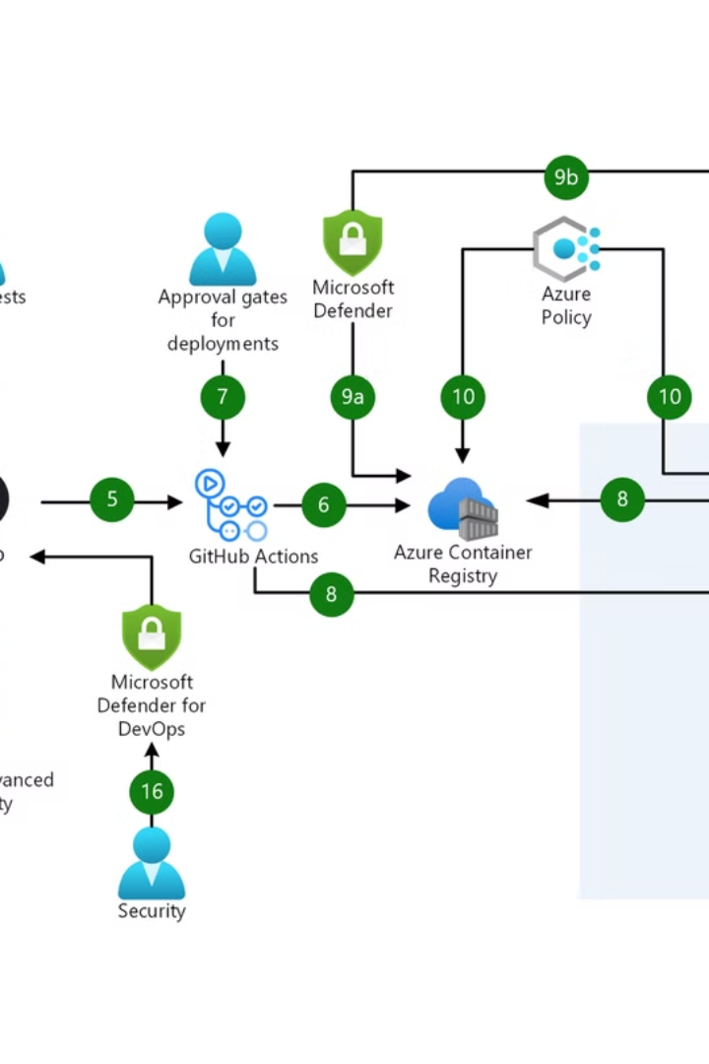



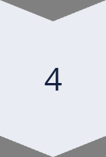
DevSecOps on AKS
Secure Configuration
Harden AKS clusters using CIS benchmarks and Azure Security Center.
Identity and Access
Implement RBAC and integrate with Azure AD for authentication.
Network Security
Use Network Policies and Azure Firewall for traffic control.
Monitoring and Logging
Collect and analyze security logs with Azure Monitor and Sentinel.

Slide 7
Audit vs. Assessment: Key Differences
Audit
Assessment
Formal & structured
Flexible & adaptable
Independent
Internal or external
Compliance-focused
Focus on improvement
Risk-oriented
May not be compliance-driven
Provides assurance and recommendations for improvement.
Offers insights into IT optimization and alignment.
c

Slide 8




NIST CSF 2.0 KPIs
Risk Management
Incident Response
Business Continuity
Identified vulnerabilities
Mean time to detect
Recovery Time Objective
Risk assessment coverage
Mean time to respond
Recovery Point Objective
Incidents handled
DR test success rate
Mitigation controls
KPIs measure the effectiveness of controls. Focus areas are risk, response, and recovery.

Slide 9
Compliance Frameworks vs. Regulations
Framework
Regulation (Is A Law)
NIST Cybersecurity Framework 2.0
U.S. FFIEC
AI Risk Management Framework
EU DORA
Frameworks are guidelines for best practices.
EU AI ACT
EU GDPR
Regulations are mandatory legal requirements.
c

Slide 10
Governance in SOx 404
Access Control
IT Security
Data Backup & Recovery
Change Management
Testing Internal Controls
Documentation
SOx 404 governance mandates stringent controls. Areas include access control, IT security, data handling, and testing.
c

Slide 11
EXTRA:
Post-Quantum Cryptography on Azure
1
FIPS 205
2
FIPS 204
3
FIPS 203
SLH-DSA (SPHINCS+)
ML-DSA (CRYSTALS-Dilithium)
ML-KEM (CRYSTALS-Kyber)
Azure is preparing for post-quantum threats. It is adopting new cryptographic standards.
c

Slide 12
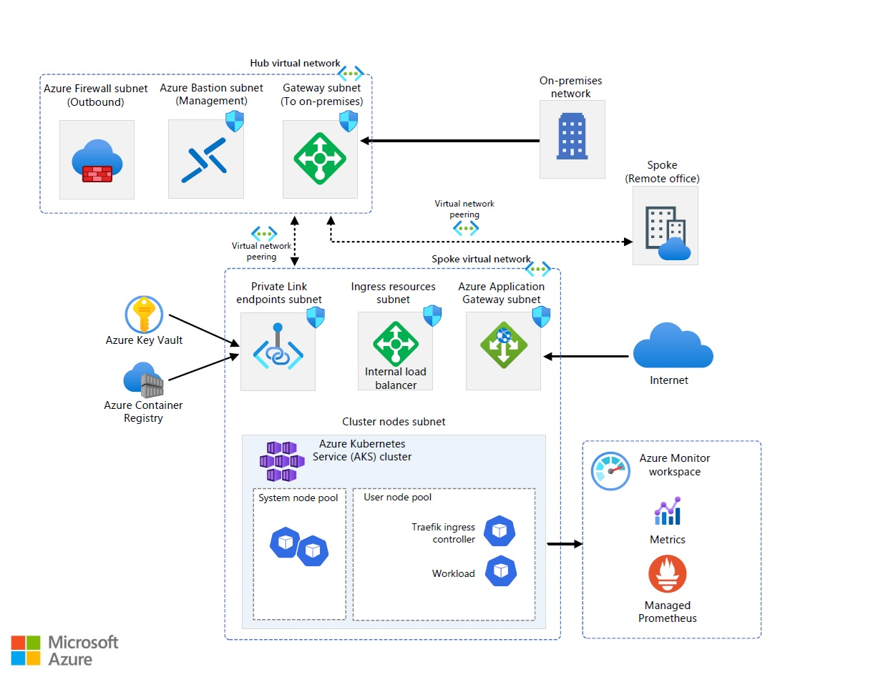

Slide 13

Key Takeaways
1
Shift-Left Security
2
Automate Compliance
Integrate security early in the development lifecycle.
Use tools to automate security checks and reporting.
3
Continuous Monitoring
Continuously monitor and improve security posture.
DevSecOps on AKS ensures security and compliance. It automates processes and improves continuously.
c

Slide 14
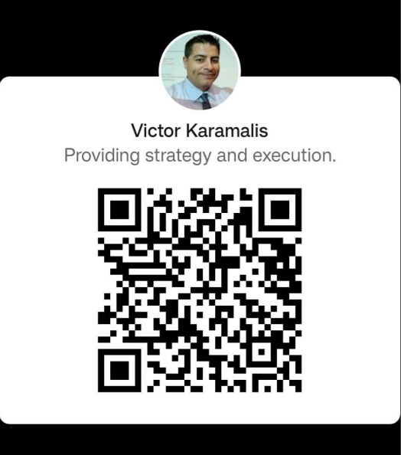
Thank You
https://www.linkedin.com/in/professionalvek
c

