Slide 1


Angry Ghosts
GUI Programming Project

Slide 2
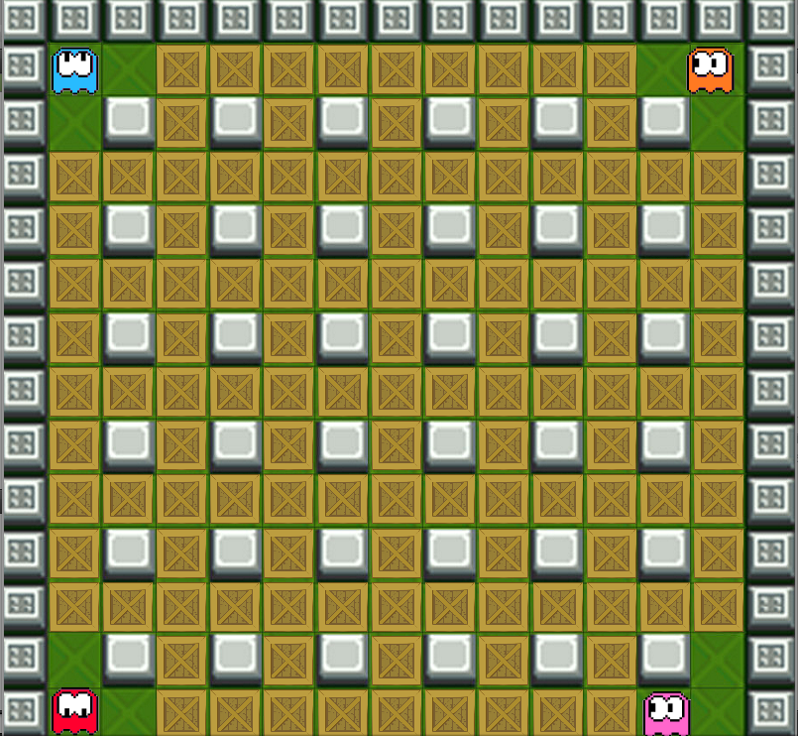
The Idea:
Blinky and his other ghost friends had had a serious argument and are very angry at each other. Unfortunately, the Ghostbusters have locked then up in this ghost fortress. The only way to regain freedom is to blow up all the brown crates.

Slide 3
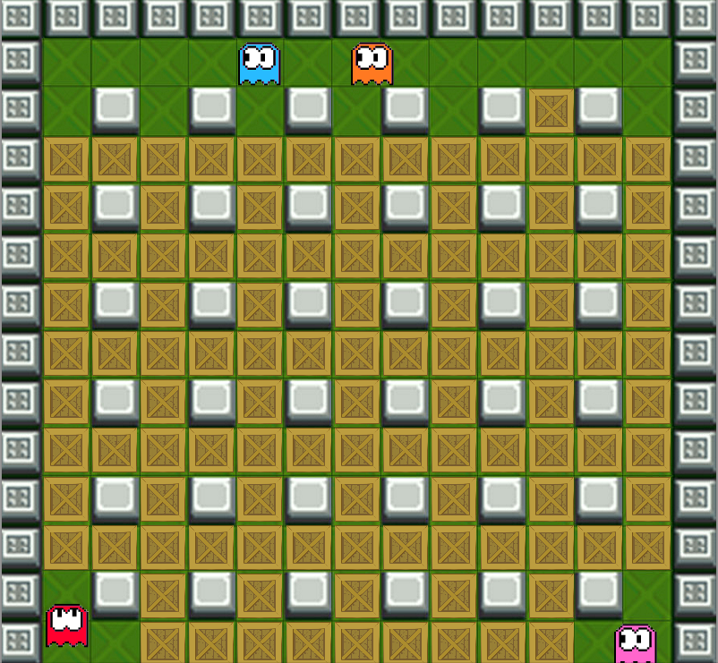
The Idea:
Unfortunately, meeting one of your peers will affect in an instant argument, causing you to lose the game. You mustn’t kill other ghosts either as they are your friends. This makes the game very difficult.

Slide 4
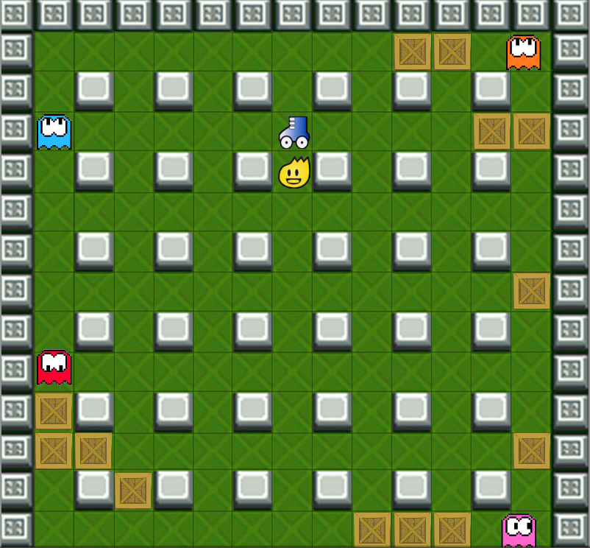



Bonuses:
The game is indeed very difficult, but to help you, we randomly hid bonuses under the crates.
There 3 kinds of bonuses:
Increases your speed
Omnidirectionaly expands the range of bomb explosion. Don’t worry, you can hide safetly behind grey blocks.
Increases the number of bombs that can be planted at once.

Slide 5
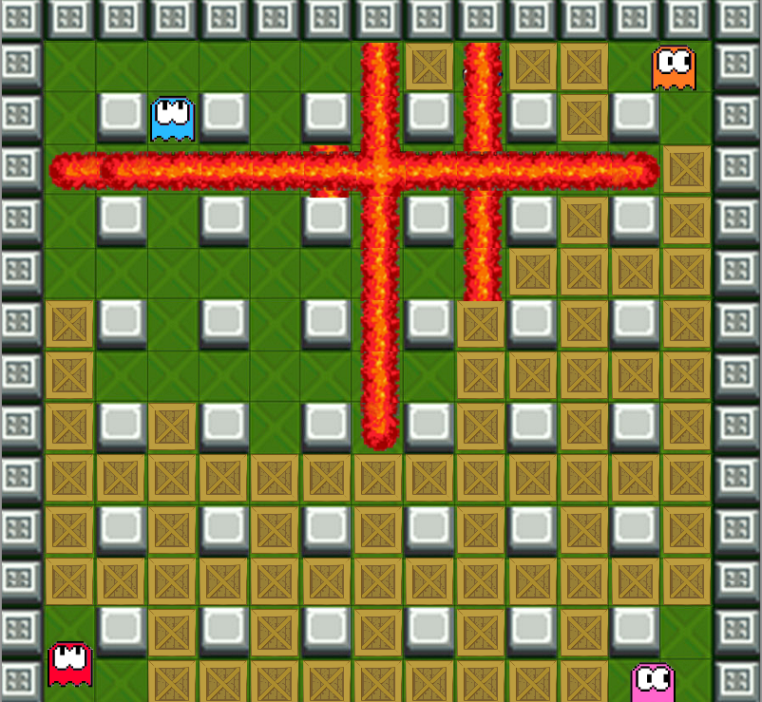
The bombs:
Your only tool in this game are the bombs.
When the game begins, you can plant only one bomb at a time but that number can be increased. The bomb destroys only the first crate it meets in each direction, regardless of the range. Grey blocks cover explosions and cannot be destroyed.

Slide 6
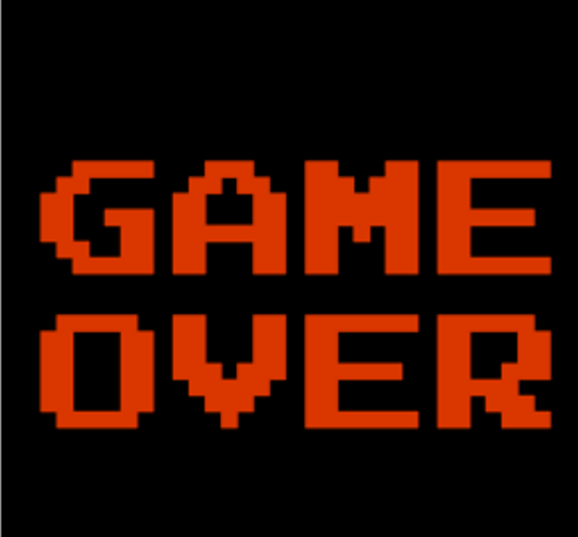
Game Over
The game can be either lost or won.
You win when you don’t lose and manage to blow up all the crates.
You lose when:
You kill one of the ghosts with you bomb,
You kill yourself.

Slide 7
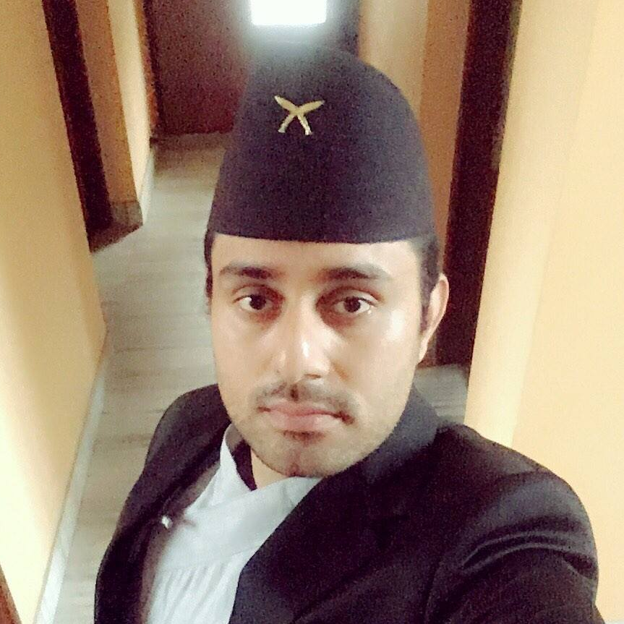
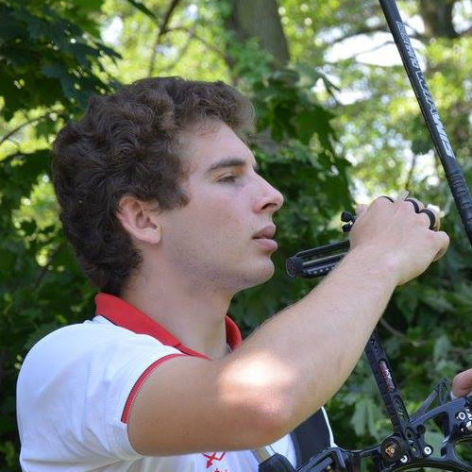

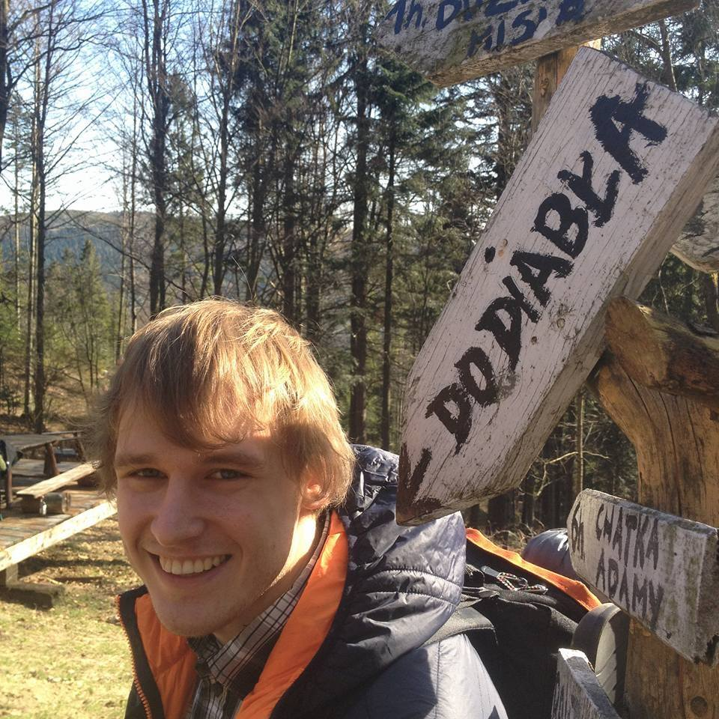
The Team
Avista R-Rizal
Team Leader
Responsible for managing time, communication and motivating the team to work.
Michał Basiuras
Main developer
Responsible for creating the base of the game in Qt environment and implementation of game logic.
Marcin Laubich
Assist. Developer
Responsible for implementing sprite graphics and other features.
Rafał Gębski
Logic Designer
Responsible for designing game logic, testing and bug fixing.

Slide 8
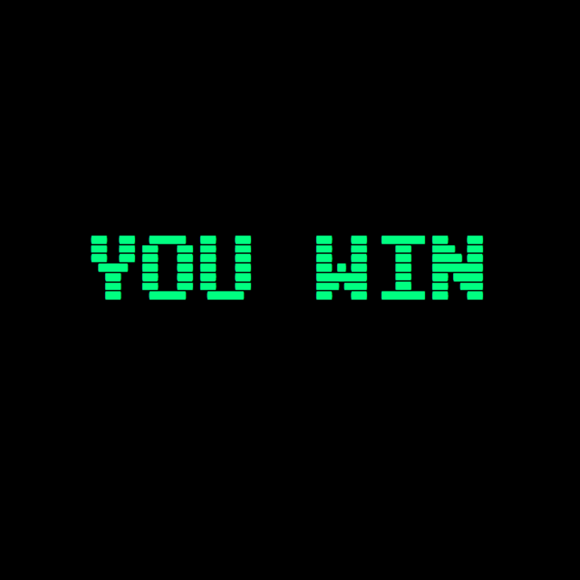
Thank you for your attention

