Slide 1
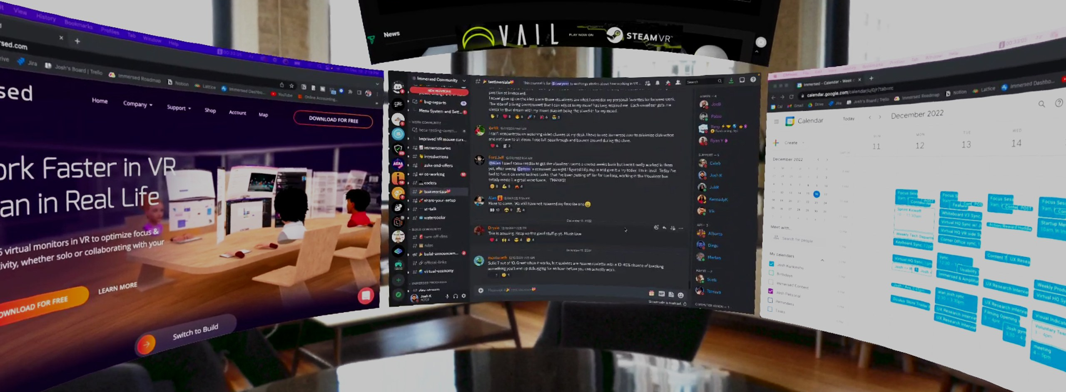
Save Capture
Filtered
Project Draft
Ravil Goetzke | Human Computer Interaction | 23. Juli 2024

Slide 2
Take a save (privacy) picture of what you see
You are working on your AR Workplace
You want to take a picture of your view
PW: 1337

Slide 3
Adjust the size of your picture
You are working on your AR Workplace
You want to take a picture of your view
you can decide what size and where
Capture
PW: 1337

Slide 4
Scanning for private information
You are working on your AR Workplace
You want to take a picture of your view
you can decide what size and where
The image is scanned for private information
Filtering
PW: 1337

Slide 5
Covering private informations
You are working on your AR Workplace
You want to take a picture of your view
you can decide what size and where
The image is scanned for private information
if the filter found any, the Information will be covered and saved
Save Capture
PW: 1337

Slide 6
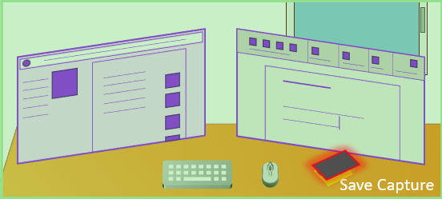
Push-Notification of the filtered image
You are working on your AR Workplace
You want to take a picture of your view
you can decide what size and where
The image is scanned for private information
if the filter found any, the Information will be covered and saved
you get then a push notification of the filtered image
PW: 1337
The Picture you want to save contains private Information. The filter covered these.
save with auto filter
edit filter
save without filter

Slide 7
Edit the cover
You are working on your AR Workplace
You want to take a picture of your view
you can decide what size and where
The image is scanned for private information
if the filter found any, the Information will be covered and saved
you can edit the Filter
PW: 1337
Done

