Slide 1

Data Lake Value Proposition
Medical Data Processing Company
QUANG HUY CHU
Udacity IPS Version 1.0

Slide 2
Agenda
What is a Data Lake
Components of a Data Lake
Data Lake vs Data Warehouse
Business Value of Data Lake Solution
Proposed Data Lake Architecture for Medical Data Processing system
Udacity IPS Ver. 1 2/2020

Slide 3


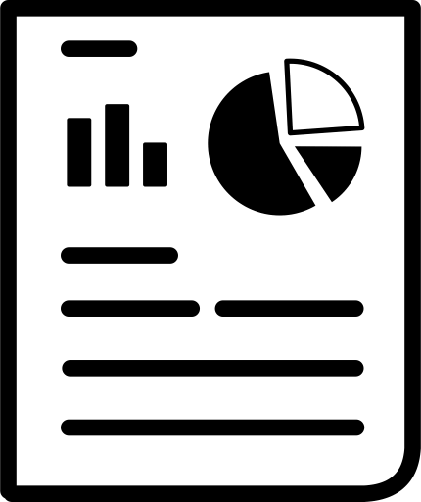
What is a Data Lake
Executive summary
A central repository storage designed to store, process, secure a large amount of structured, semi-structured, and unstructured data. Data Lake is mainly used to break data silos, centralizing all the data of an individual business to be able to provide decisive insights. Data Lake helps C-level executives have a more holistic view so they can improve the business by making data-driven decisions.
Semi-structured
Real-time monitoring
Data Lake
Structured
Machine Learning
Un-
structured
Reporting

Slide 4
Components of Data Lake
Ingestion layer: Take on the role of ingest data from multiple sources with various formats into the Data Lake system.
Processing layer:Clean and process a large amount of data with fast and accurate. Ensure both batch processing and real-time data analysis.
Storage layer: Where all the data of Data Lake is stored. Storage layer ensure that data is not loss in the even of failure or process error.
Governance and Security layer: Administer and manage all components in the Data Lake, ensure each component operates as planned, and also guarantee data security.
Orchestrations layer: Monitoring all the operation tasks in the Data Lake system, ensure that all the taks is operated on planned and responsible for restart error taks.
Use-case specific layer: Quality, Catalog, Audit, Lineage,..

Slide 5
Data Lake vs Data Warehouse
Why is Data Lake and not Data Warehouse?
First we should consider the differences between the two systems in the following table:

Slide 6
Data Warehouse
Data Lake
Refined/structured/relational data
Schema designed at the beginning
Used by mainly business analysts
Used for historical analytics, visualizations, BI
Collects similar data from multiple resources
Unstructured, unrefined, not relational data
Schema designed at the end
Use by data scientists and data developers, business analysts
Used for predictive analytics, machine learning
Connecting various types of data from a wide variety of sources
Udacity IPS Ver. 1 2/2020

Slide 7
Data Warehouse
Data Lake
Refined/structured/relational data
Schema designed at the beginning
Used by mainly business analysts
Used for historical analytics, visualizations, BI
Collects similar data from multiple resources
Unstructured, unrefined, not relational data
Schema designed at the end
Use by data scientists and data developers, business analysts
Used for predictive analytics, machine learning
Connecting various types of data from a wide variety of sources
➞Data Lake is a better choice over Data Warehouse
Udacity IPS Ver. 1 2/2020

Slide 8
Business Value of Data Lake
Data Lake architecture break data silos, which make data inconsistent, overcome the lack of consistency across the enterprise
Data Lake provide new insight not only beside reporting dashboard
Data Lake can handle big data in real time
Overcome the difficulty of handling big data with vertical scale hardware
Improve flexibility and fault-tolerance os system, ensure data still flow even in the cases of failure or process error

Slide 9
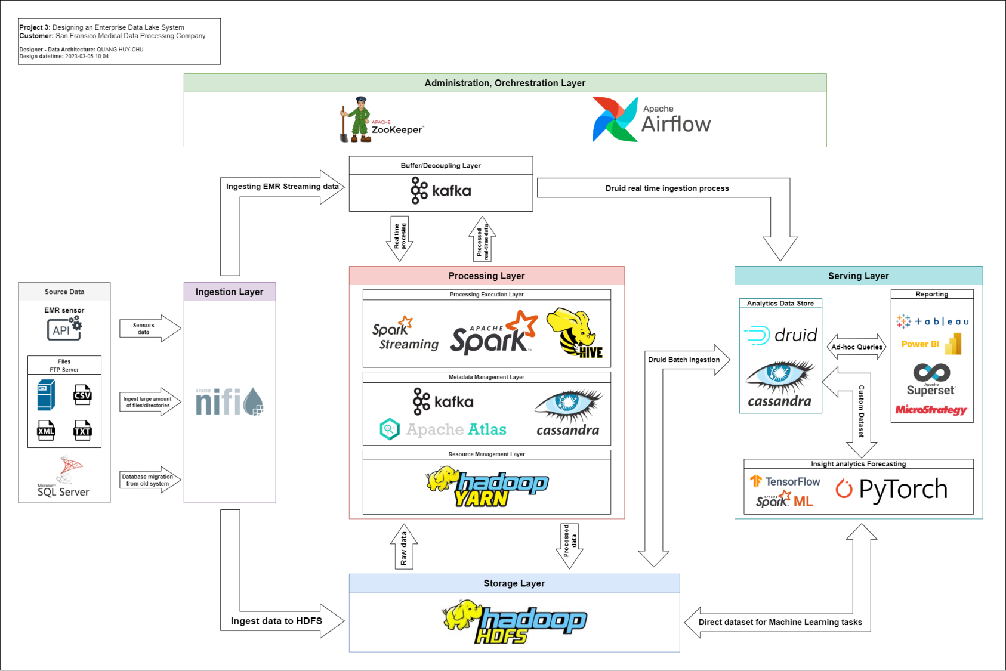
Data Lake Architecture

Slide 10
THANK YOU
Udacity IPS Version 1.0

