Slide 1


Data Governance @ SneakerPark
Prepared by:
Submitted on:

Slide 2

How to use this Template
Theses slides are provided as a guide to ensure that you submit all the required components to successfully complete your project. For detailed instruction, please read the instruction in the classroom.
When presenting your project, please only think of this as a guide. We encouraged you to use creative freedom when making changes as long as the required information is present.
Remember to delete this and all of the other example slides before you submit your project.
Remember to add your name and the date to the cover slide
Remove this slide

Slide 3
What you are required to submit:
What we provide:
This Starter Slides Template
Sheets Template with 4 Tabs - Data Dictionary, Data Quality Issues, Standard Naming Convention, and Business Glossary
Workspace with an instance of Postgres and code that will create and populate the database you will be working with.
Grading rubric you can use to ensure you have submitted everything that is required.
Filled out Slides template.
Filled out Sheets template.
Remove this slide

Slide 4
Background
SneakerPark is an online shoe reseller that allows people to buy and sell used and new shoes. Buyers can bid for shoes or buy them outright, and sellers can set a price or sell to the highest bidder.
Each buyer and seller must have an active account in order to sell, bid, or purchase sneakers using SneakerPark’s website.
SneakerPark authenticates the shoes before shipping them to the buyer, so before listing an item, the seller must ship it to SneakerPark’s warehouse. Upon receipt, SneakerPark assigns an item number to each pair of sneakers and notifies the seller that they are now free to list their item. If the item is not listed within 45 days, SneakerPark returns it to the seller and sends an invoice to the seller for the shipping cost.
If the item is found to be inauthentic or in an unacceptable condition, it is also returned back to the seller in a similar fashion.
When the item sells, the buyer’s account is credited with the purchase price minus the SneakerPark service fee and shipping fees to deliver the item to the buyer.
Currently, SneakerPark only supports sales within the United States.

Slide 5
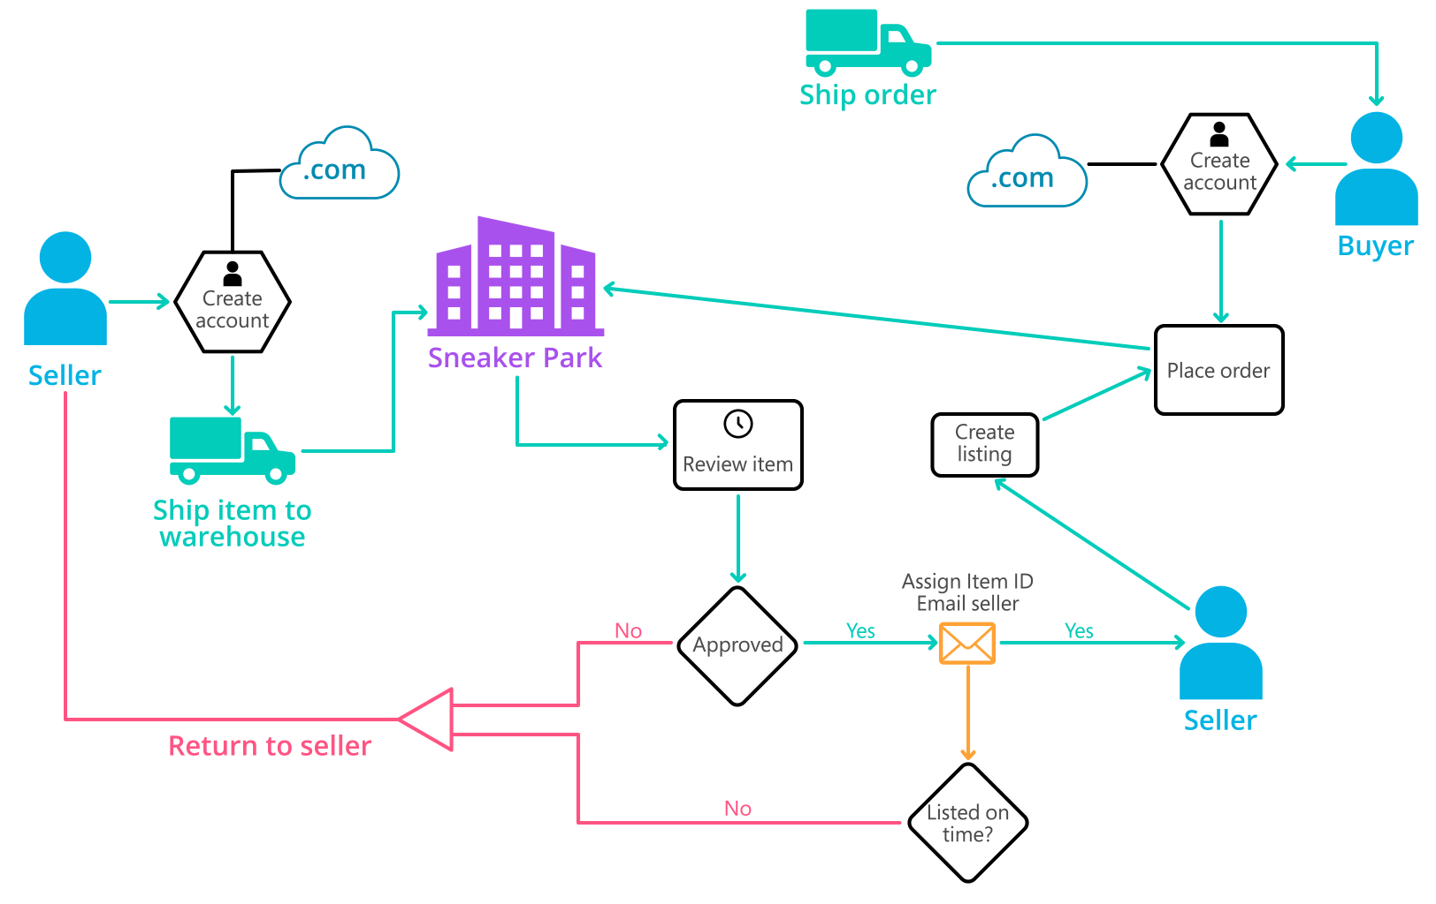
Background (cont’d)
Below you can see a diagram that will hopefully help you visualize some of SneakerPark's business processes. Keep in mind that it does not capture ALL processes and every nuance, but simply serves as another artifact to use in your project.

Slide 6
Step 1
Enterprise Data Catalog Part 1: Enterprise Data Model

Slide 7
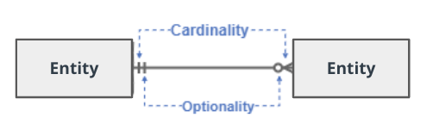
Create a conceptual data model that will provide SneakerPark with a holistic view of its data systems and help you grasp the organization's important entities and relationships, which will be instrumental as you move further in the project. You can use Lucidchart or any other diagramming tool of your choice, but please use the Crow’s Foot/IE Notation and please be sure to indicate both cardinality (the type of a relationship such as 1:N or N:N) and optionality (whether the relationship is optional or mandatory).

Slide 8
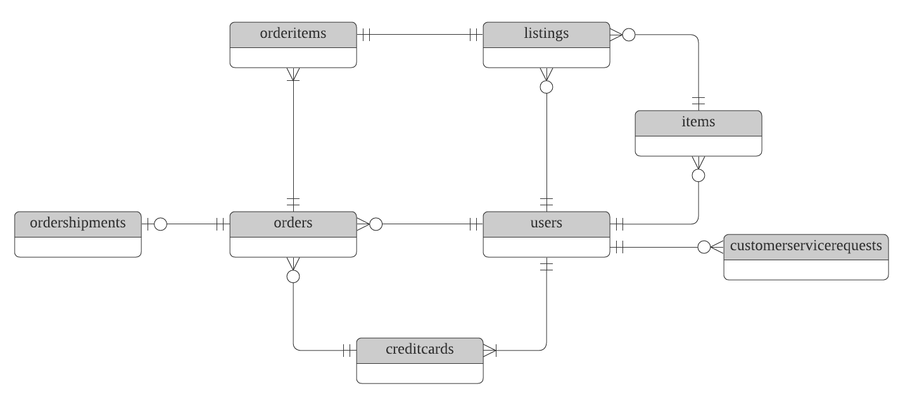
Replace the example below with your own solutions (obviously feel free to take more space):

Slide 9
Step 2
Enterprise Data Catalog Part 2: Metadata

Slide 10
Create the first version of the Metadata Catalog by documenting the metadata from all systems in the "Data Dictionary" and the “Enterprise Data Catalog” tabs of the provided Sheets template.
Please note that you are required to fill out all fields in both tabs.

Slide 11
Step 3
Data Quality
Part 1: Profiling and Cleansing

Slide 12
Profile the data to identify at least 3 data quality issues you see in the data. Also provide at least 1 data quality issue that you haven’t yet seen in the data, but can foresee occurring in the future. Based on the issues you’ve identified, come up with the data quality rule for each data quality issue, including for the one that you foresee.
Make sure you fill out all columns in the "Data Quality Issues" tab with your answers in the provided Sheets template.

Slide 13
Step 4
Data Quality
Part 2: Monitoring

Slide 14
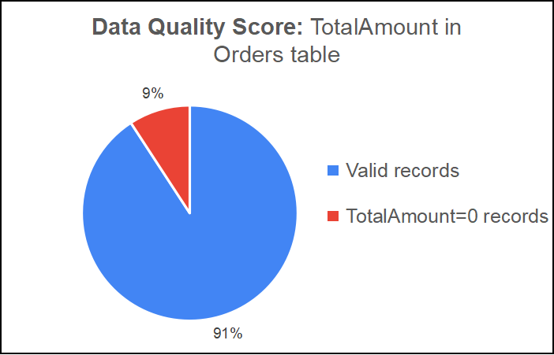
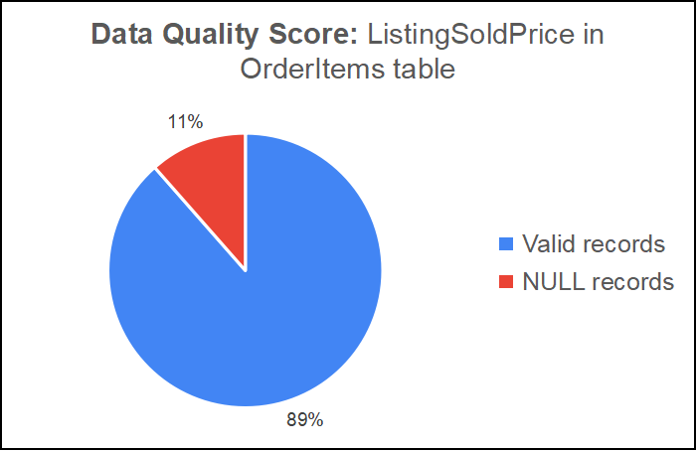
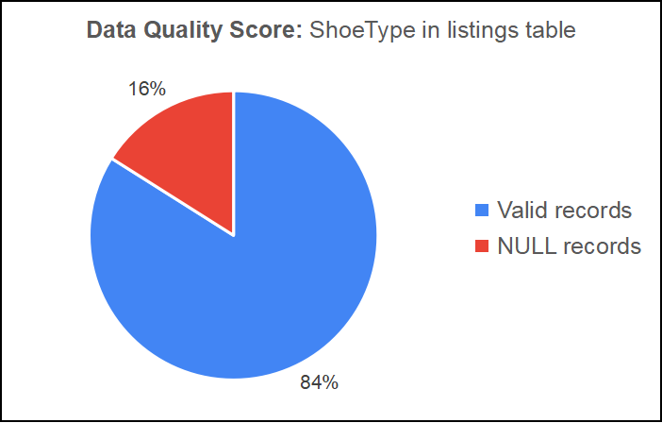
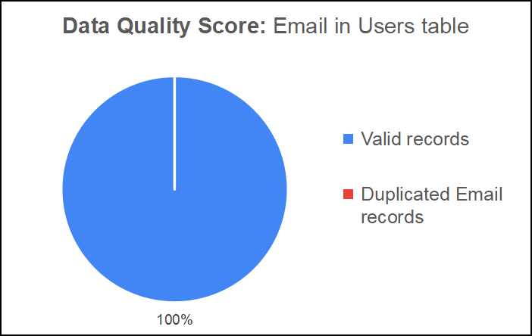
Using the metrics you've created in the last step, please create a mock-up of a data quality monitoring dashboard that will be used to monitor the data to ensure compliance with your data quality rules.
Please make sure to label your metrics clearly on your mock-up.

Slide 15
Step 5
Master Data Management
Part 1: MDM Architecture

Slide 16
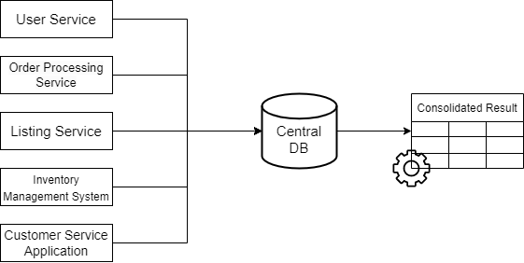
Registry Master Data Management Architecture
Key | Attributes | Source System | Identifiers
UserID | FirstName, LastName, Email, Address, ZipCode | User Service | FirstName, LastName, Email
CreditCardID | CreditCardNumber, CreditCardExpirationDate, UserID | User Service | CreditCardNumber
OrderID | BuyerID, CreditCardID, ShippingCost, TaxRatePercent, TotalAmount, ShippingAddress, ShippingZipCode, OrderDate, Status | Order Processing Service | BuyerID (UserID), CreditCardID
ShipmentID | OrderID, Carrier, TrackingNumber, OrderShipDate | Order Processing Service | TrackingNumber
ListingID | SellerID, ProductID, ShoeType, Brand, Color, Gender, Size, Condition, ListingPrice, ListingType, ListingCreateDate, ListingEndDate | Listing Service | SellerID (UserID), ProductID (ItemID)
ItemID | ItemName, SellerID, Type, BrandName, Color, Size, Sex, Condition, ItemStatus, ArrivalDate | Inventory Management System | SellerID (UserID), ItemName
ID | UserID, FirstName, LastName, ContactReason, Email, Phone, OrderID, Resolution, ContactMethod | Customer Service Application | UserID, FirstName, LastName

Slide 17
Explanation:
Since this is the first time Sneaker Park apply the Master Data Management Program to their system, the Registry Master Data Management architecture (or Registry MDM) is a considerable approach. This architecture provide low cost and complexity, easy to maintance, and have a low lovel of intrusion.
With Regsitry MDM, SneakerPark can stores their important key data such as customer or order information in a central repository (central database) to make data consistent and easy to manage.
One more important thing is that Registry MDM can later be upgrade into more efficient and complex architecture to gain better performance in master data management like Consolidated/Analytical Master Data Management for Data Warehousing, suitable for Reporting and Analytics purpose.

Slide 18
Step 6
Master Data Management
Part 2: Master Record

Slide 19
In this step, you will define a set of matching rules that will be used by the SneakerPark's MDM Hub to match item and customer entities between the company's different systems.
Please come up with 4 rules - 2 for Items and 2 for Customers and list them below.
Matching customer data across systems:
users table, CustomerServiceRequests table, and creditcards table share the same UserID.
Rule 1 for Customer: Match the user’s information (such as Firstname, Lastname, Address, Email, etc.) from the users table with the OrderID, phone from the CustomerServiceRequests table on the UserID key.
Rule 2 for Cusomters: Match the user’s information (such as Firstname, Lastname, Address, Email, etc.) from the users table with the CreditCardNumber, CreditCardExpirationDate from the creditcards table on the UserID key.
Matching item data across systems:
Both items table, and listings table share the same ItemID (ItemID is ProductID in istings table).
Both items table, and users table share the same UserID (UserID is SellerID in items table).
Rule 1 for Items: Match the ItemName from the items table with the item (or product) information from the listings table on the ItemID (or ProductID) key.
Rule 2 for Items: Match the user’s information (such as Firstname, Lastname, Address, Email, etc.) from the users table with the user’s registered items from the items table on the UserID (or SellerID) key.

Slide 20
Step 7
Data Governance:
Roles and Responsibilities

Slide 21
For this new approach, it is crucial to perform the Data Governance task carefully. First is Metadata Management task, in this step, Enterprise Data Model and Enterprise Data Catalog should be documented precisely to ensure capturing the latest and exact system architecture for a better management.
Next, Data Quality Management should be considered, in this step, data profiling, data quality dimensions, and remediation (if necessary) should be measure and monitoring in order to keep data always consistent.
Master Data Management is the next step to be applied, using proper MDM architecture help company to capture the latest and precise data across system in one single central repository to better management and consistent. MDM architecture can evolve based in the need of business or the complexity of the system, but all MDM atchitecture is to commit a single source of truth.
At this moment, with Registry MDM, the current staff with Jake and Jessica can easily handle the system. Since Jessica is a senior BA then her skill should fit the data quality management as she can understand the business. Jake in another hand familiar with database system and experience with fixing data issues. With a litte traning, they both should works together flawlessly to handle this new architeture. In short, in my opinion, we should not hire any new members now, but in case the architecture got complex, some addition members can be considered.

