Slide 1
Job Monitoring Data & Dashboard

Slide 2
Agenda
Objective of the project
Flow chart
Counts captured from Different layers
Demo
Data population in Power BI.
Next Steps

Slide 3
Challenges and Solution
High level flow chart
Project Introduction

Slide 4
Challenges and Solution
CHALLENGES
SOLUTION
Complex sources
PowerBI dashboard
Multiple layers
Daily refresh
Time consuming
Break down number
Adhoc requests
Includes Hist number
Team AC Internal use in Phase1
4

Slide 5
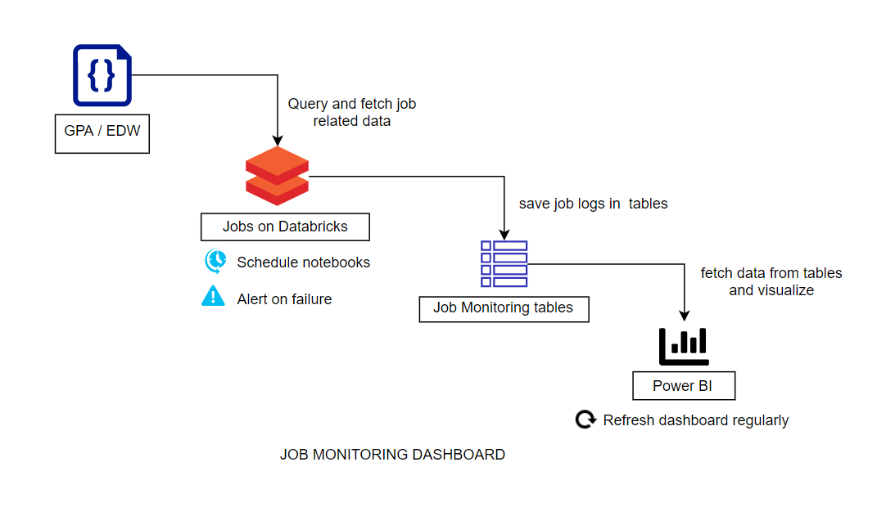
Flow Chart

Slide 6
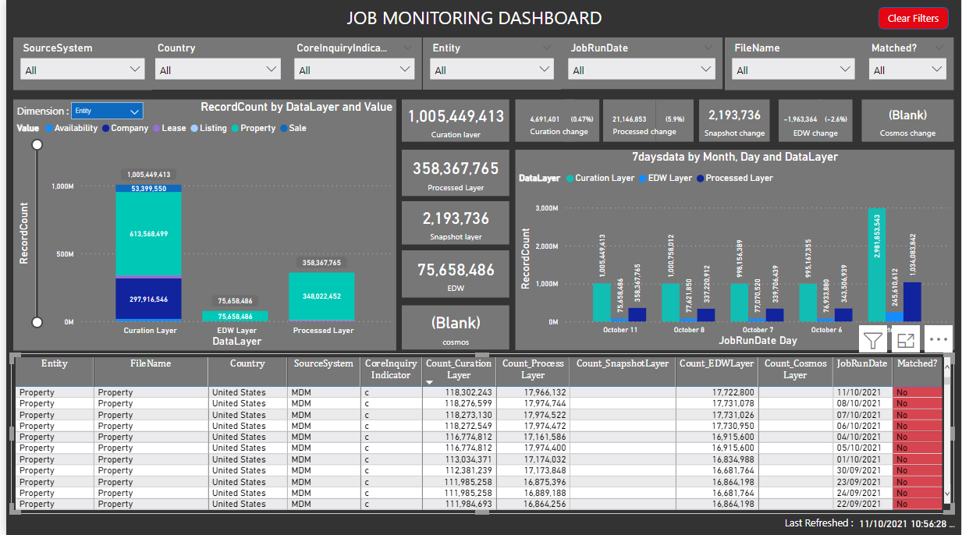
Dashboard Components
Count of records that
are present on latest date
for different layers
Change in record count
compared to previous day
Slicer to check
matching status of
Transposed table
Slicers to filter the data
Based on dimension
Values will change
That gives different
Data counts
Bar chart to show
Record count by
Data layer and dimension
Stacked bar chart to
Show last 7 days record
Count for data layers
Transposed table
In order compare
The counts of different
layers
6

Slide 7
Data tables Involved:
Jobmonitoring :
2. ref_maincountry
col_name | data_type
DataLayer | string
FileName | string
Attribute | string
Country | string
SourceSystem | string
CoreInquiryIndicator | string
RecordCount | int
MaxEtlCreatedOn | string
MaxHistoryStartDate | string
JobRunDate | string
id | string
Entity | string
col_name | data_type
ID | string
CountryName | string
LastUpdateDate | string
ID | CountryName | LastUpdateDate
1 | Australia | 6-Jul-21
2 | United States | 6-Jul-21
3 | United Kingdom | 6-Jul-21
4 | India | 6-Jul-21
5 | China | 6-Jul-21
6 | Japan | 6-Jul-21
7 | France | 6-Jul-21
8 | Germany | 6-Jul-21
9 | Singapore | 6-Jul-21
10 | Hong Kong | 6-Jul-21
11 | Canada | 6-Jul-21
7

Slide 8
Get Data from sources.
Clean and transform data if needed.
Data modelling.
Visualizing the data.
Deploy and maintain dashboard
Solution Detail - PowerBI

Slide 9
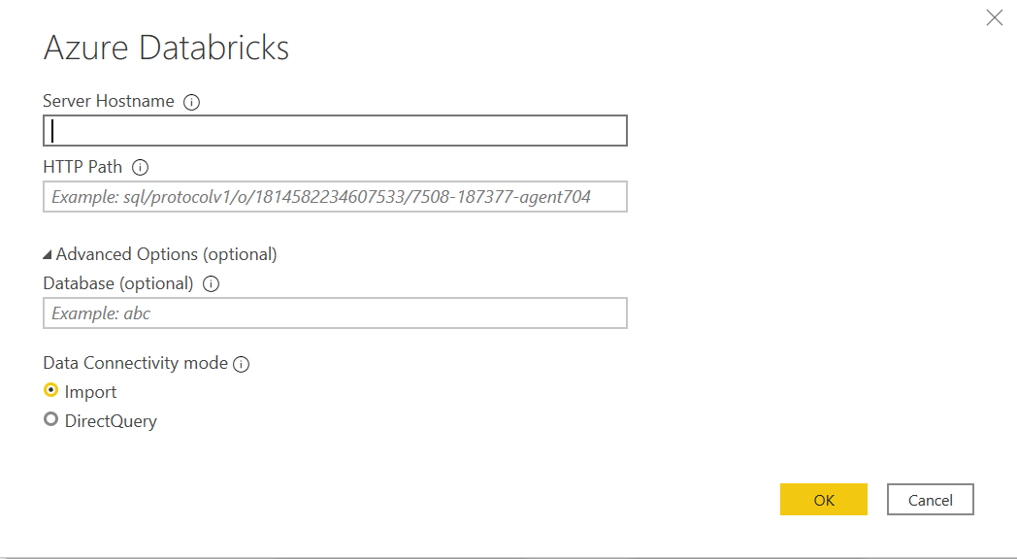
1. Get Data from sources.
Connect to azure databricks environment.
Need databricks server name and http path.
Authentication is done through Azure active directory
Select database and table that needed.
Database : DManalytics
Table : jobmonitoring
3. Load data into power BI

Slide 10
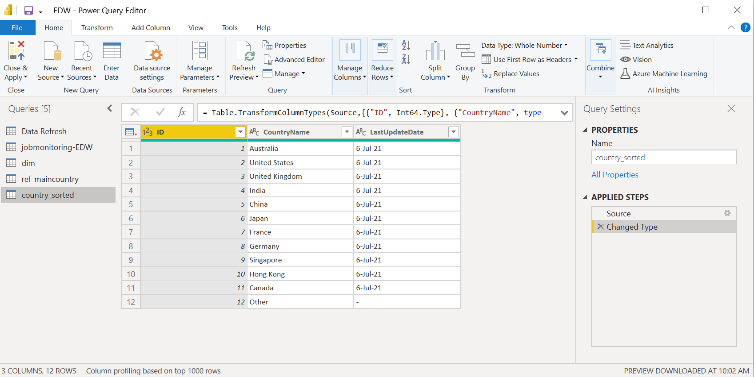
2. Clean and transform data if needed.
Using power query editor in power BI we can
identify and create appropriate keys for joins
valuate and transform column data types
apply data shape transformations to table structures
Remove and add columns.
apply user-friendly naming conventions to columns and queries

Slide 11
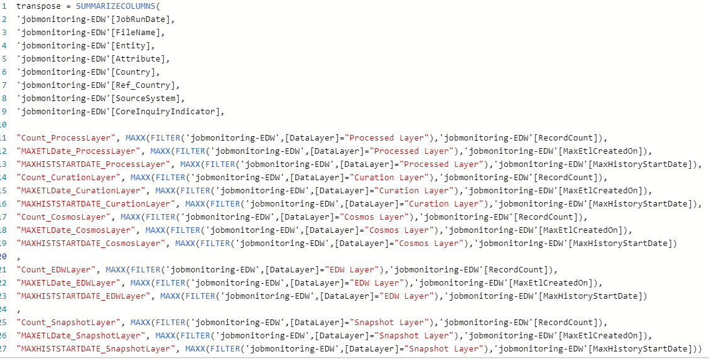
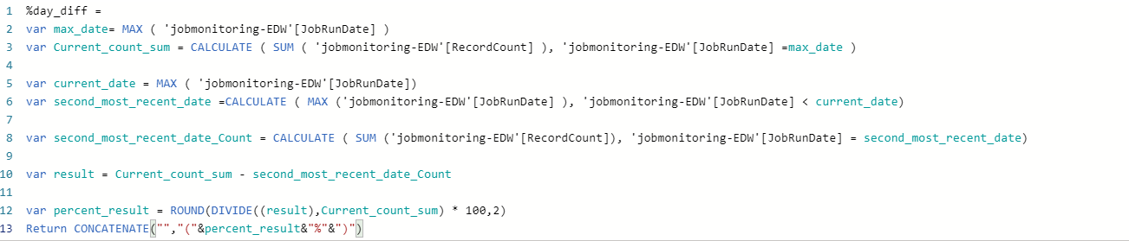
3. Data modelling
Create calculated tables and columns using DAX (data analytics expression) or power Query
Create measures using DAX
Transpose tables
Maintain relationship between tables if required

Slide 12
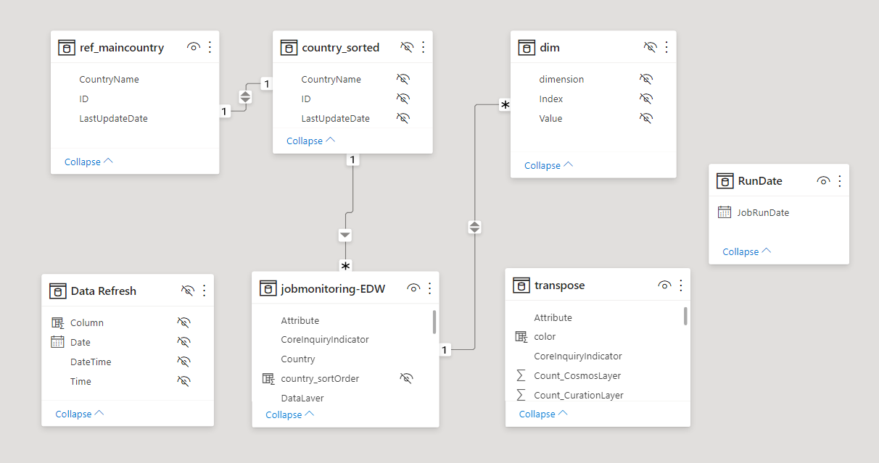
Data Model
12

Slide 13
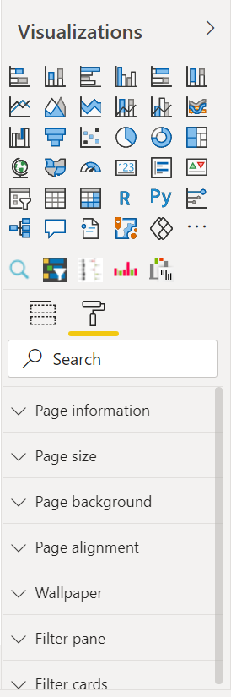
4. Visualizing the Data
Visualize data using various charts available in power BI visualization panel
To filter the data use slicers
In order to maintain slicers of different tables in sync use sync slicers
Use conditional formatting to give colors to data based no condition
Use cards to show measure or calculated values.
Use text and tooltips to give information about tiles
Use format panel to design report or dashboard

Slide 14
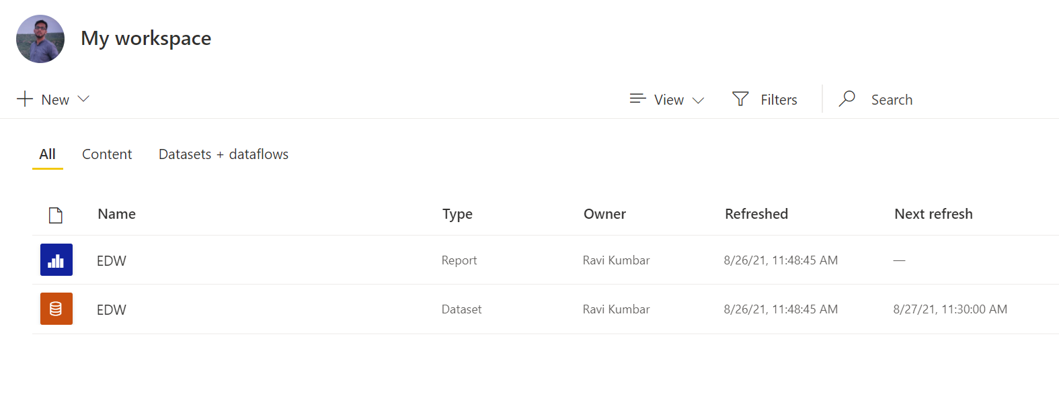
5. Deploy and Maintain dashboard
Once development is completed, we need to publish dashboard to workspace in power BI service.
We can schedule dataset of dashboard in power BI service in order to refresh data regularly.
Incase of refresh failure power BI service send email to mentioned developers mail id.
We can regularly update dashboard in power BI desktop and publish it to workspace.
We can provide read or write access to dashboard to different teams and developers .

Slide 15
Thank you!

