Slide 1

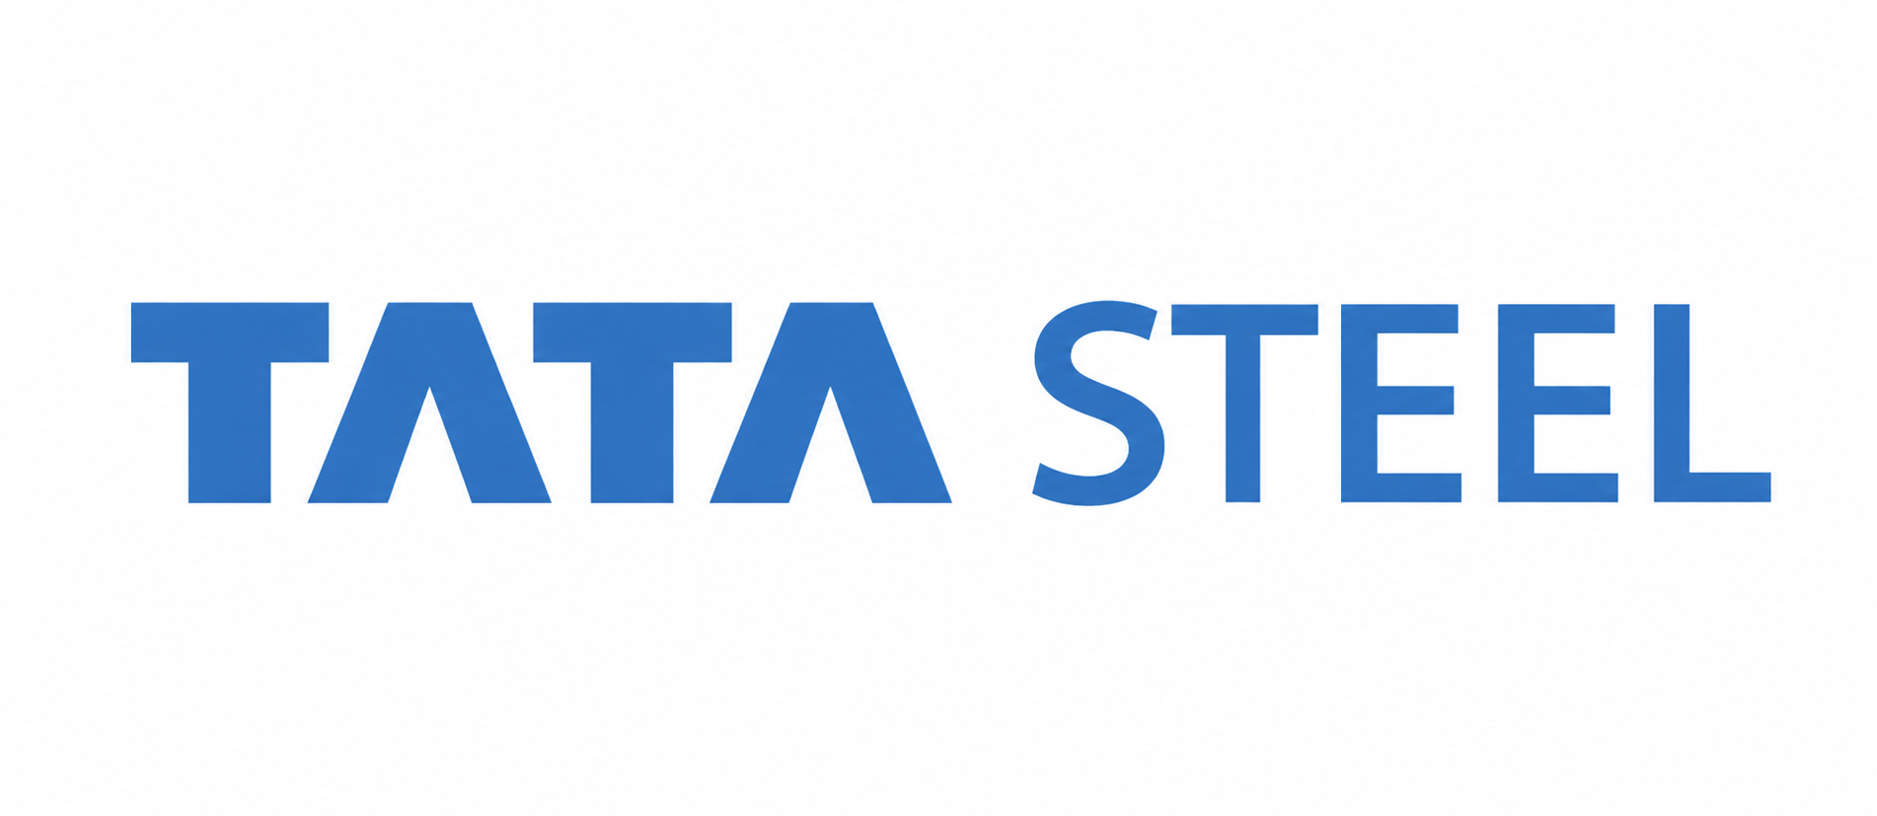
SUMMER INTERNSHIP PRESENTATION
Future Workforce at Tata Steel
TataBot — An AI-Powered Knowledge Assistant for Learning & Development
Presented By :
Ravi Raushan Singh
B.Tech - Computer Science
& Engineering (4rd Year)
Roll No: BTECH/60311/23
Under the Guidance of
Ms. Anita Kushwaha
Internal Guide, BIT Mesra
Industry Mentor :
Mr. Abhinav Ashish
Tata Steel
Internship Duration : May 19, 2026 – July 14, 2026

Slide 2
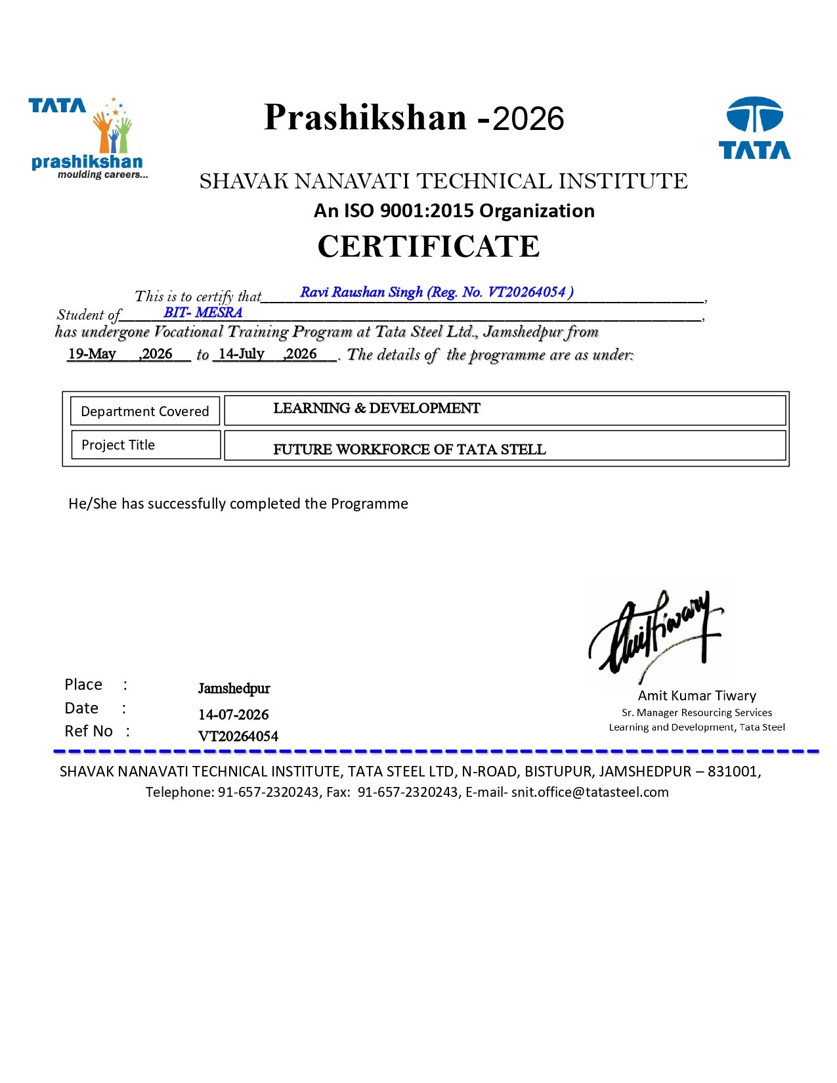
INTERNSHIP CERTIFICATE
Ravi Raushan Singh | BTECH/60311/23 | BIT Mesra Deoghar | Tata Steel Internship 2026

Slide 3
PROFILE OF THE ORGANISATION — TATA STEEL LIMITED
In 1907 Founded by Jamsetji Tata
One of India's leading steel producers
🏭 Founded:
🌍 Global Presence:
Operations across 26 countries
Serving 50+ markets
80,000+ employees globally
Large workforce across India
👥 Workforce:
35+ MTPA crude steel capacity
One of the world's largest producers
⚙️ Capacity:
🎓 L&D Department:
Supports employee development through training, skills and leadership programmes
Ravi Raushan Singh | BTECH/60311/23 | BIT Mesra Deoghar | Tata Steel Internship 2026

Slide 4
OBJECTIVES OF THE INTERNSHIP
1
Understand key Learning & Development challenges at Tata Steel.
2
Design an AI-based solution for personalised, on-demand learning.
3
Develop TataBot, an AI Knowledge Assistant prototype.
4
Use RAG and role detection to provide relevant and reliable answers.
5
Study the business impact of TataBot, including scalability and potential benefits.
6
Prepare a business case and future roadmap for the solution.
Ravi Raushan Singh | BTECH/60311/23 | BIT Mesra Deoghar | Tata Steel Internship 2026

Slide 5
INTRODUCTION TO TECHNOLOGY
Python 3.14
Groq API
Flask
Used to develop the core chatbot logic and backend.
Used to generate natural language responses.
Connects the chatbot logic with the web-based chat interface.
RAG
HTML/CSS/JS
Retrieves relevant information from the knowledge base before generating an answer.
Used to create the user-friendly chatbot interface.
Ravi Raushan Singh | BTECH/60311/23 | BIT Mesra Deoghar | Tata Steel Internship 2026

Slide 6
PROBLEM STATEMENT
Shopfloor workers and new joiners often need quick and personalised training support. However, current training is mostly scheduled and general, making it difficult to meet individual learning needs at the right time.
WHO IS AFFECTED?
Shopfloor operators, New joiners and Maintenance technicians
CURRENT GAP
Training is mostly scheduled, Information is not always available on demand, Employees may depend on supervisors for quick guidance
BUSINESS IMPACT
Time lost in finding information, Higher dependency on experienced employees, Possible impact on productivity and safety
SECONDARY ISSUE
Experienced employees may retire
Valuable knowledge can be difficult to preserve and share
Ravi Raushan Singh | BTECH/60311/23 | BIT Mesra Deoghar | Tata Steel Internship 2026

Slide 7
REQUIREMENT ANALYSIS — USER PERSONAS
👷
🔧
📊
Ramesh, 22
Suresh, 31
Priya Sharma, 40
New Shopfloor Operator
Maintenance Technician
L&D Manager
Problem:
Problem:
Problem:
· 200-page manual
· Guidance for daily tasks · Supervisor unavailable
Quick access to trouble-shooting information
Faster support during issues
Access to training information
Better understanding of employee learning progress
Goal:
Goal:
Goal:
Learn safety rules and job-related tasks quickly
Find technical information quickly and reduce downtime
Use knowledge and training information to make better L&D decisions
Ravi Raushan Singh | BTECH/60311/23 | BIT Mesra Deoghar | Tata Steel Internship 2026

Slide 8
METHODOLOGY — TATABOT SOLUTION DESIGN
USER INPUT
AI PROCESS
OUTPUT
Employee asks a question
Step 1: Understand query and user role
Clear and direct answer
User role is identified
Step 2: Search knowledge base
Step-by-step guidance
→
→
Query is sent to the AI pipeline
Step 3: Generate clear response
Relevant information
Step 4: Personalise
by role
Source document cited
Ravi Raushan Singh | BTECH/60311/23 | BIT Mesra Deoghar | Tata Steel Internship 2026

Slide 9
TATABOT — TECHNICAL ARCHITECTURE
INPUT LAYER
EMPLOYEE
1
User-facing interface & intent capture
New Operator • Technician • L&D Manager
▼
FLASK WEB INTERFACE
2
Chat interface • User query
▼
3
ROLE DETECTION
Identifies the user's role by matching keyword
INTELLIGENCE LAYER
▼
RAG retrieves real documents before answering
4
RAG PIPELINE + KNOWLEDGE BASE
Retrieves docs: Safety · Training · Troubleshooting
▼
5
GROQ API (LLAMA 3.3 70B)
OUTPUT LAYER
Generates a clear, role-specific response
Grounded, role-aware answer with source
▼
6
PERSONALISED RESPONSE + SOURCE
Provides a role-based answer with the source document
Ravi Raushan Singh | BTECH/60311/23 | BIT Mesra Deoghar | Tata Steel Internship 2026
Notes:
9

Slide 10
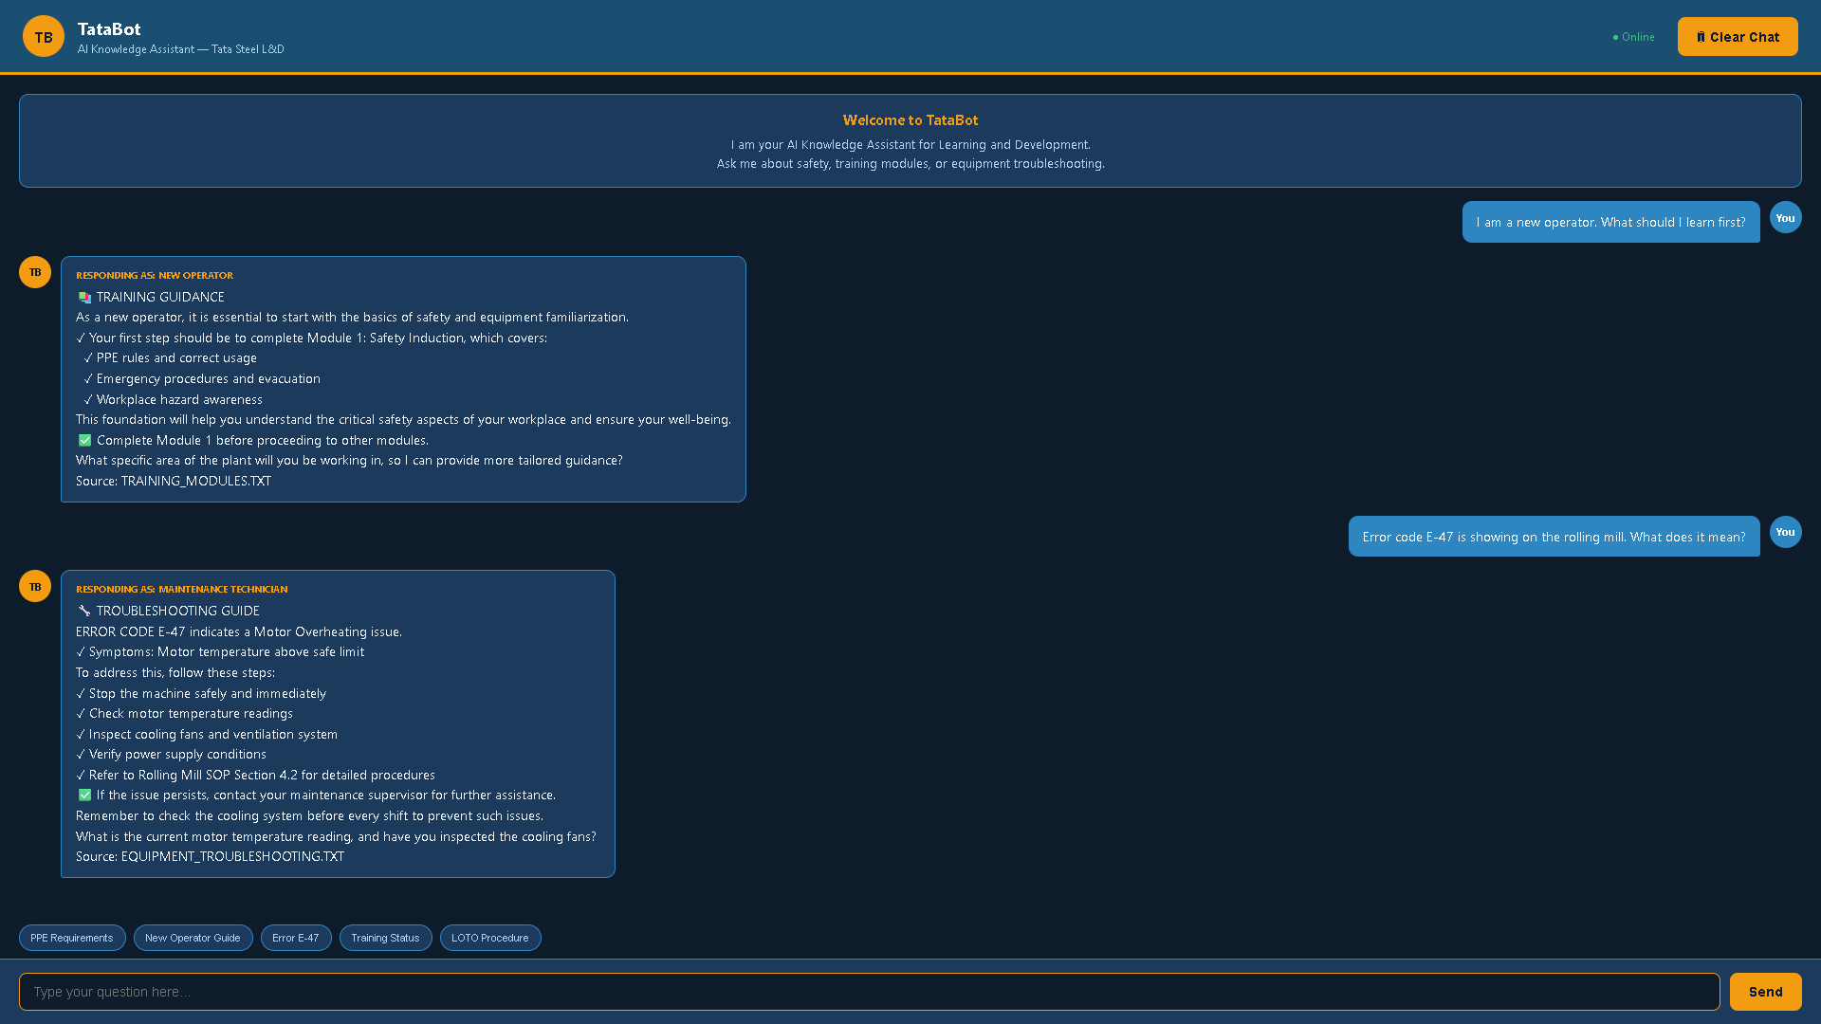
RESULTS — TATABOT LIVE DEMO (Training + Troubleshooting)
Ravi Raushan Singh | BTECH/60311/23 | BIT Mesra Deoghar | Tata Steel Internship 2026

Slide 11
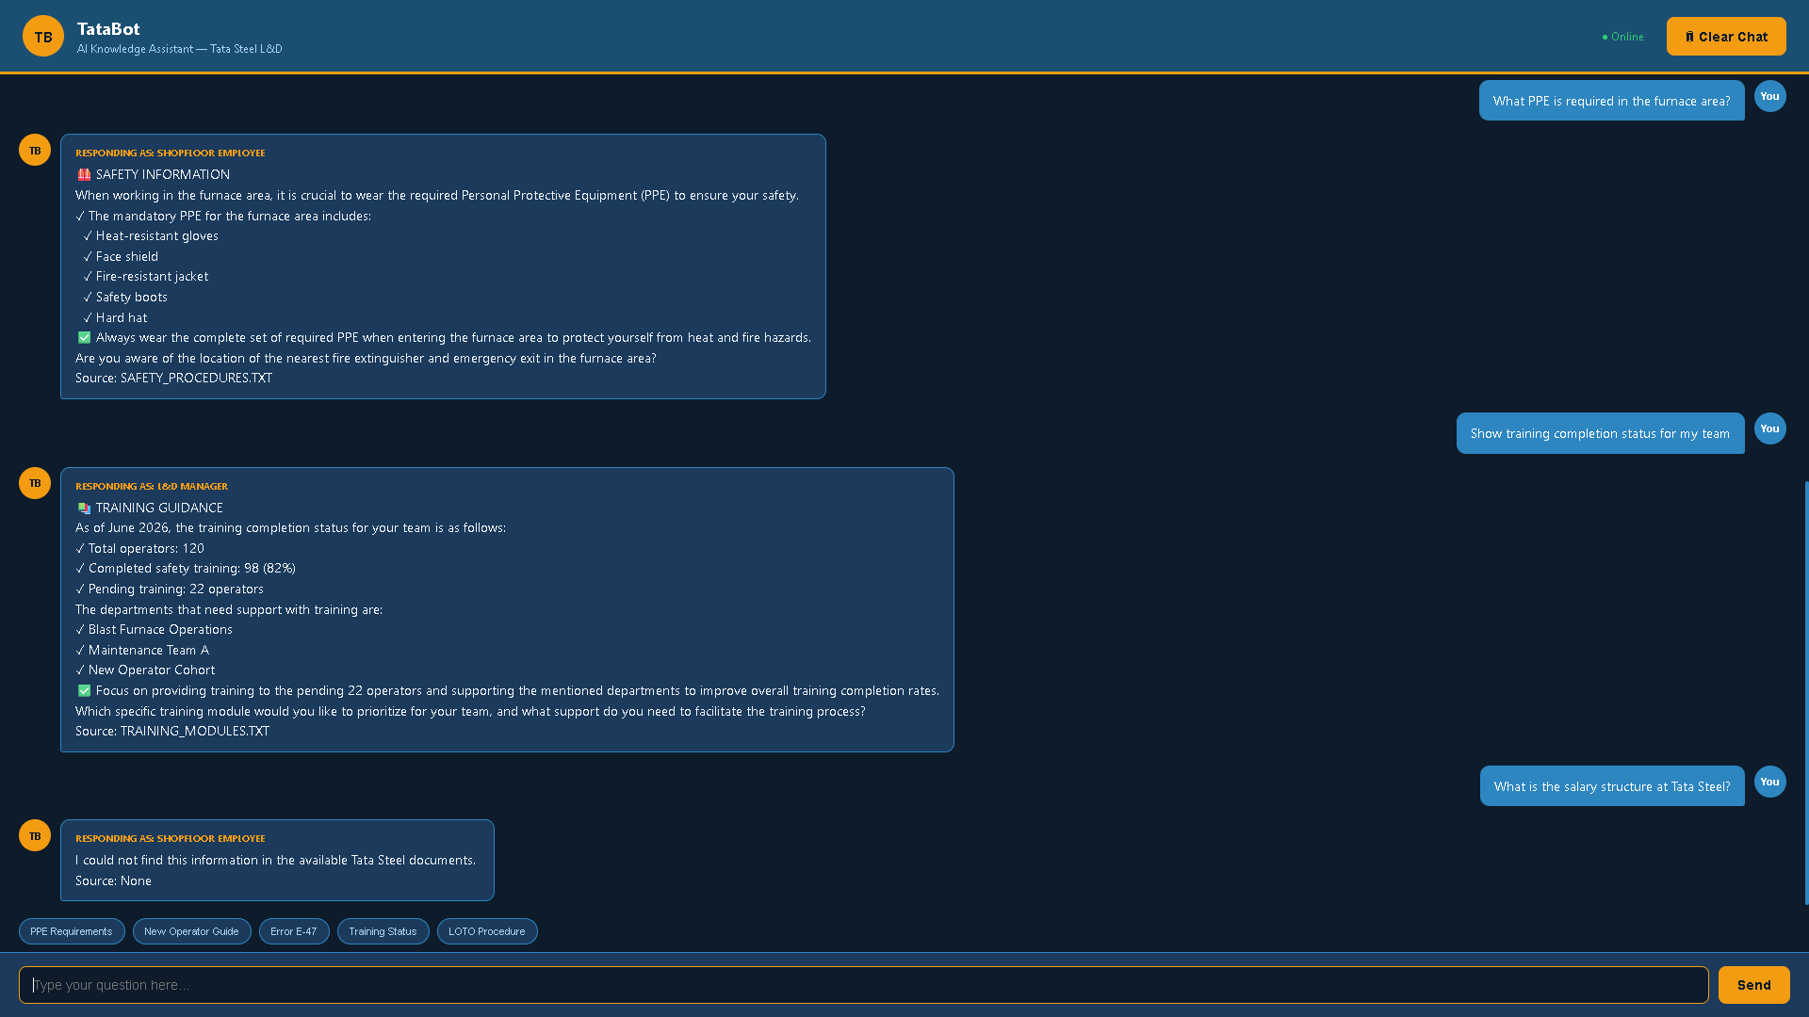
RESULTS — TATABOT (Safety + Reporting + Knowledge Boundary)
Ravi Raushan Singh | BTECH/60311/23 | BIT Mesra Deoghar | Tata Steel Internship 2026

Slide 12
BUSINESS CASE — ROI & IMPACT ANALYSIS
METRIC
WITHOUT TATABOT
WITH TATABOT
IMPACT
Query Resolution Time
2–4 Hours
< 5 Seconds
Faster access to information
Training Completion
82% (98/120)
95%+ target
Improved completion
Supervisor Dependency
High
Reduced
More time for critical tasks
Knowledge Loss Risk
High
Reduced
Better knowledge preservation
Scalability: TataBot can support a large number of employees and provide knowledge access 24/7

Slide 13
TESTING & VALIDATION
Query
Detected Role
Source Document
Result
"I am a new operator. What should I learn first?"
New Operator
training_modules.txt
✓
"Error code E-47 on rolling mill. What does it mean?"
Maintenance Technician
equipment_troubleshooting.txt
✓
"What PPE is required in the furnace area?"
Shopfloor Employee
safety_procedures.txt
✓
"Show training completion status for my team"
L&D Manager
training_modules.txt
✓
"What is the salary structure at Tata Steel?"
Out of Scope
None — correctly refused
✓
TataBot successfully handled role-based queries and refused unsupported questions.

Slide 14
CONCLUSION & FUTURE ROADMAP
CONCLUSION
FUTURE ROADMAP
✓ TataBot provides personalised,
on-demand L&D support.
Phase 1 ✅
• Web chatbot
✓ RAG helps generate responses
using the available knowledge base.
• 3 knowledge documents
• Role detection
Phase 2
✓ Role detection supports different
types of users.
• Real PDF integration
• Voice input
✓ Source citation improves
transparency and trust.
• Hindi support
Phase 3
✓ The prototype demonstrates
training, safety and
troubleshooting support.
• LMS integration
• Skill gap assessment
• Learning paths
Ravi Raushan Singh | BTECH/60311/23 | BIT Mesra Deoghar | Tata Steel Internship 2026

Slide 15
REFERENCES
[1] Tata Steel, Annual Report 2024–25. Available: Tata Steel Official Website.
[2] P. Lewis et al., Retrieval-Augmented Generation for Knowledge-Intensive
NLP, NeurIPS, 2020.
[3] Meta AI, The Llama 3 Herd of Models: Technical Report, 2024.
[4] Groq Inc., Groq API Documentation.
[5] Pallets Projects, Flask Documentation.

Slide 16
SUMMER INTERNSHIP PROJECT | TATA STEEL LIMITED
Thank You
TataBot — An AI-Powered Knowledge Assistant for Learning & Development
"The right knowledge, to the right employee, at the right time."
Presented By
Ravi Raushan Singh | BTECH/60311/23
College
BIT Mesra
Mentor
Mr. Abhinav Ashish, Tata Steel Limited
Guide
Ms. Anita Kushwaha, BIT Mesra
Duration
May 19, 2026 — July 14, 2026 (8 Weeks)

