Slide 1
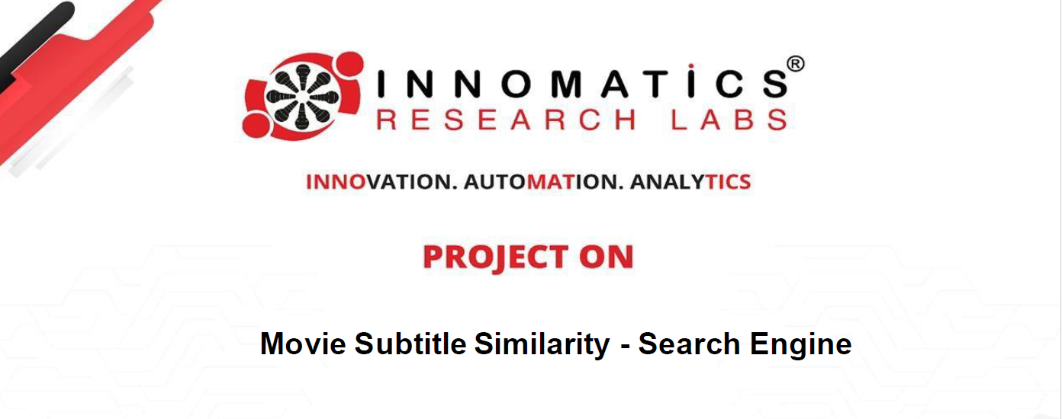
By , Ravi Singh (Data Science Intern)
Partner name : Rohit Sahu

Slide 2
Objective:
Develop an advanced search engine algorithm that efficiently retrieves subtitles based on user queries, with a specific emphasis on subtitle content. The primary goal is to leverage natural language processing and machine learning techniques to enhance the relevance and accuracy of search results.

Slide 3
Aspects of Subtitles Search Engine:
This guide is designed to provide insights for developers on building a semantic search engine for movie subtitles. The search engine will enable users to find relevant subtitles for movies by searching with natural language queries. The challenging part of creating such a search engine is the need to understand not only the user's search query but also the movie's content to ensure accurate results.
This guide will cover the fundamental steps in developing the search engine and the key techniques involved.
Core Logic:
To compare a user query against a video subtitle document, the core logic involves three key
steps:
Preprocessing of data:
If you have limited compute resources, you can take a random 30% of the data.
Clean: A possible cleaning step can be to remove time-stamps (Note: Cleaning the Text data is crucial before vectorization)
Vectorize the given Subtitle Documents
Take the user query and vectorize the User Query.
Cosine Similarity Calculation:
Compute the cosine similarity between the vector of the documents and the vector of the user query.
This similarity score determines the relevance of the documents to the user's query.
Return the most similar documents

Slide 4
Importing Libraries:
Pandas
Numpy
Re
Nltk
Sqlite
Gensim
Sentence_transformer
Chromadb
Flask

Slide 5
Preprocessing Text Data:
Step 1: Lowercasing
Convert text to lowercase for consistency.
Step 2: Tokenization
Break text into smaller units (tokens).
Step 3: Removing Punctuation
Eliminate punctuation marks.
Step 4: Removing Stopwords
Discard common, uninformative words.
Step 5: Stemming or Lemmatization
Reduce words to base or root form for normalization.

Slide 6
Understanding Text Vector :
Text vectors are numerical representations of text that machine learning models can understand.
By converting text into vectors, we can perform various mathematical operations to analyze and compare the textual data.
There are different techniques to generate text vectors, and the choice of technique can impact the performance ,
and capabilities of the search engine.
Two key text vector generation methods are: Bag of Words (BOW) and Term Frequency-Inverse Document Frequency .
The final one I used is a sentence transformer using bert model.

Slide 7
Implementing BERT-based Vectors:
With the advancement in NLP, models like BERT have shown significant improvements in understanding the context and meaning of text. By leveraging BERT and other deep learning models, we can generate text vectors that capture the semantic meaning more accurately. This is particularly useful for handling the nuances and context in movie dialogues and subtitles.

Slide 8
Document chunking for large text:
Movie subtitles are usually large documents, and handling the search and retrieval of relevant subtitles from such large text files can be challenging. Implementing a document chunking strategy, where the large documents are broken down into smaller parts for indexing and searching, can help tackle this challenge and improve the efficiency of the search engine.

Slide 9
Chroma db for storage:
As the search engine deals with and processes large volumes of movie subtitles and associated data, a well-organized and efficient storage system is key to the search engine's performance. Storing the preprocessed subtitles and their vectors in a Chroma database allows the search engine to retrieve and present the results to users quickly and accurately.
Chroma database provides a high-performance, column-oriented data storage solution that is ideal for the fast read and complex search processes required by the semantic search engine for movie subtitles.

Slide 10
Building the Flask Web App:
The main function of the application involves building a Flask web app for interactive movie and series subtitle similarity search. The app allows users to enter a query text, which is then compared against the subtitle corpus to find similar subtitles. The top matching subtitles, along with their similarity scores and snippets of content, are displayed to the user in the result page.

Slide 11
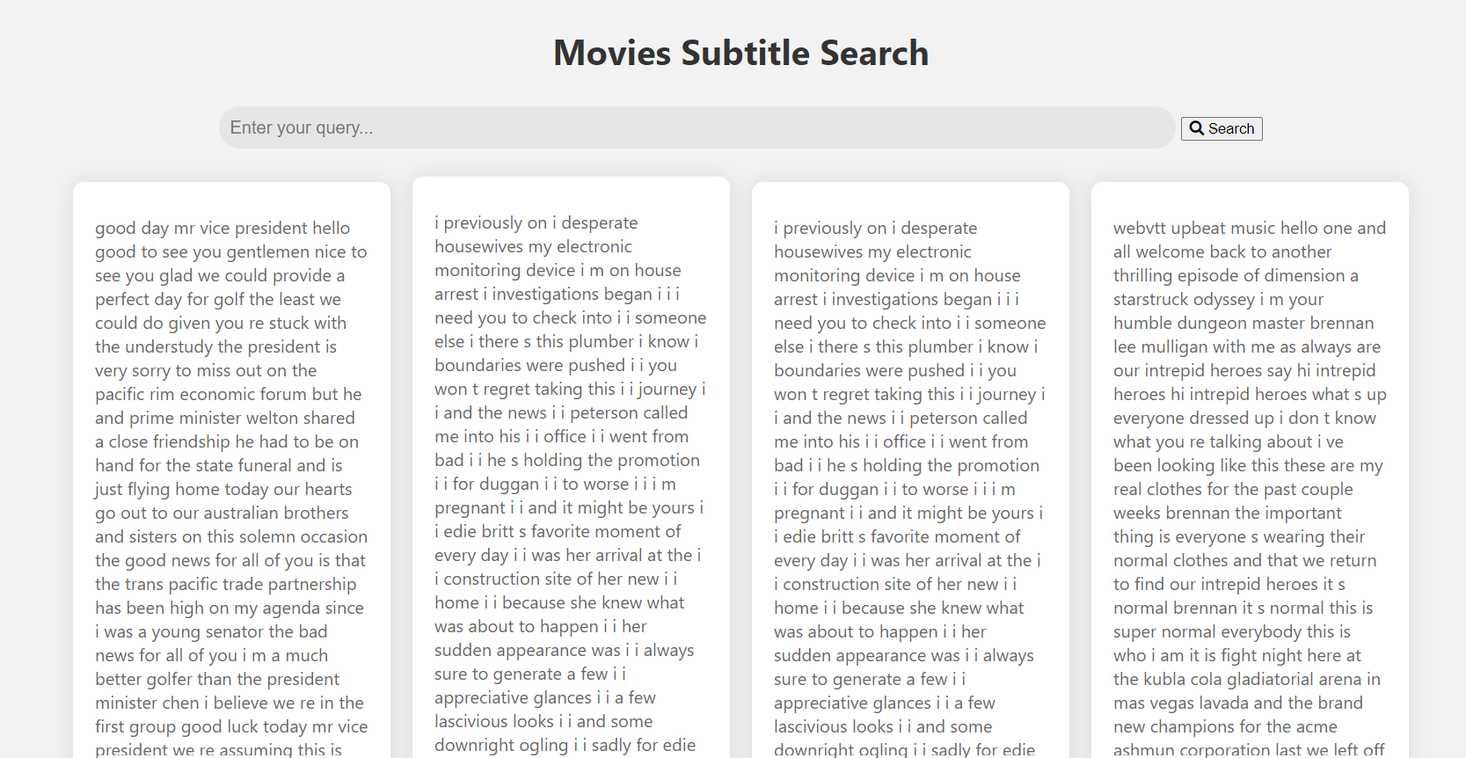
The webapp:

