Slide 1
Lyric analysis & Music genre classification using nlp in R
Disha Mehra
Ravi Teja Sunkara
Notes:
The topic for a presentation is Lyric Analysis and Music Genre Classification using Natural Language Processing Techniques in R.

Slide 2
Lyric analysis of prince
The goal of this is to use text mining and Exploratory data analysis (EDA) to shed insight on the Artist’s career.
Musical lyric analysis is no easy task.
The data is unstructured and requires caution with assumptions and a uniquely discriminant choice of analytic techniques.
The Artist Prince was chosen to celebrate his inspiring and diverse body of work.

Slide 3
Dataset Description
The dataset used was obtained from Billboard chart information and Prince lyrics from various websites.
The remixes, extended versions, club makes, remakes, unoriginal versions, etc. were removed.
Albums of historical collections of his Hit songs were also removed to avoid repetition.
Libraries Used
dplyr for data transformation
ggplot2 for visualizations
tidytext for tokenization

Slide 4
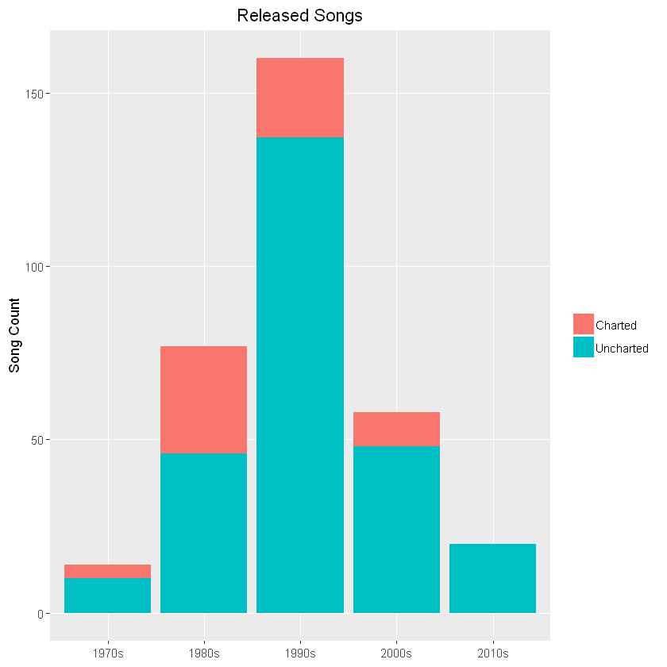
Notes:
Using dplyr's filter(),group_by() and summarise() functions we plotted the number of songs released in a given decade and the count of charted and uncharted songs. The plot clearly shows that his most active decade was 1990. Till now, we used descriptive statistics to find insights into artist’s career. Now, we will go on to Text Mining.

Slide 5
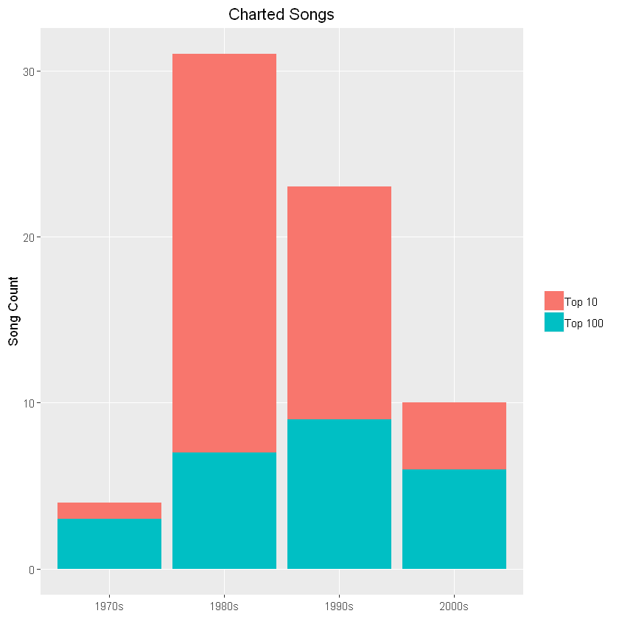
Notes:
Out of all the charted songs, how many were in Top 10. We can see that majority reached Top 10. A interesting thing that we can observe from the plot is is even though his most prolific decade for new songs was the 1990s, more chart hits occurred in the 1980s.

Slide 6
Text Mining
Text mining can be thought of as text analytics in which we try to discover relevant information that is possibly unknown or buried beneath the obvious.
Natural Language Processing (NLP) is one methodology used in mining text.
NLP tries to decipher the ambiguities in written language by tokenization, clustering, extracting entity and word relationships, and using algorithms to identify themes and quantify subjective information.
The process of breaking lyrics into individual words is called tokenization.
Tidy Text format uses a table with one token per row (here a token = word). unnest_tokens() function was used to do this.

Slide 7
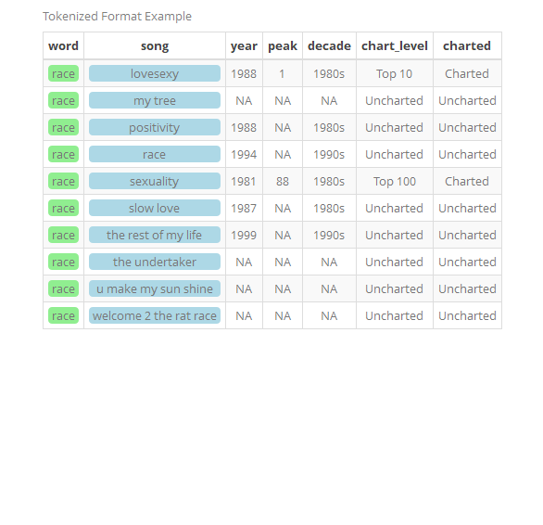
You can see that each row contains an individual word which would be repeated for each song in which it appears.

Slide 8
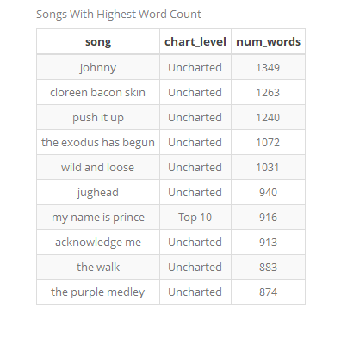
Songs with highest word count

Slide 9
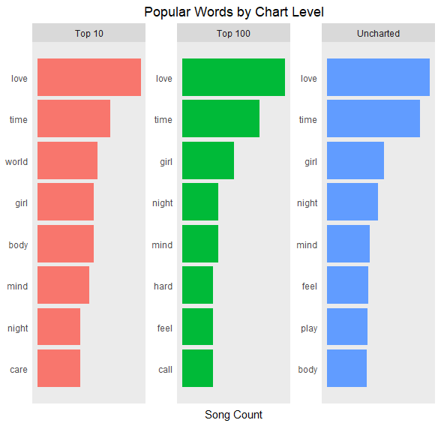
Notes:
Well, the top words across the chart levels are very, very similar. This doesn't look good for predicting whether a song will succeed based on lyrics. But using text mining techniques and NLP we can predict with good accuracy.

Slide 10
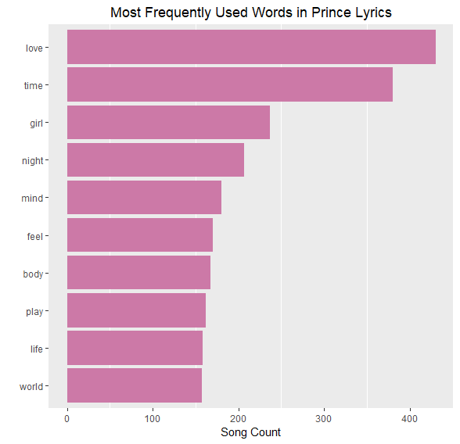
Most frequently used words in Prince’s Lyrics

Slide 11
Topic Modelling
A technique of text mining to automatically identify topics present in a text object and to derive hidden patterns exhibited by a text corpus.
It is an unsupervised approach used for finding and observing the bunch of words (called “topics”) in large clusters of texts.
Topics can be defined as “a repeating pattern of co-occurring terms in a corpus”. A good topic model should result in – “health”, “doctor”, “patient”, “hospital” for a topic – Healthcare, and “farm”, “crops”, “wheat” for a topic – “Farming”.
Topic Models are very useful for the purpose for document clustering, organizing large blocks of textual data, information retrieval from unstructured text and recommendation systems.
For Example – New York Times are using topic models to boost their user – article recommendation engines.

Slide 12
Latent Dirichlet Allocation for Topic Modeling
There are many approaches for obtaining topics from a text such as – Term Frequency and Inverse Document Frequency. NonNegative Matrix Factorization techniques.
Latent Dirichlet Allocation is the most popular topic modeling technique.
LDA assumes documents are produced from a mixture of topics. Those topics then generate words based on their probability distribution.
Given a dataset of documents, LDA backtracks and tries to figure out what topics would create those documents in the first place.
We can then use the probability that a document belongs to a particular topic to classify it accordingly.

Slide 13
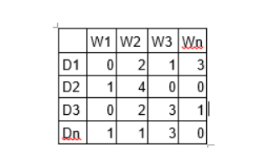
Since you know the writer of the document from the original data, you can then recommend an artist/author based on similar topic structures.
LDA is a matrix factorization technique. In vector space, any corpus (collection of documents) can be represented as a document-term matrix.
The following matrix shows a corpus of N documents D1, D2, D3 … Dn and vocabulary size of M words W1,W2 .. Wn. The value of i,j cell gives the frequency count of word Wj in Document Di.

Slide 14
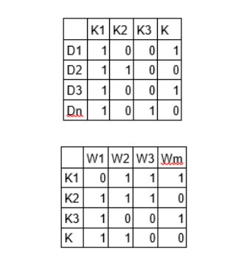
LDA converts this Document-Term Matrix into two lower dimensional matrices – M1 and M2.
M1 is a document-topics matrix and M2 is a topic – terms matrix with dimensions (N, K) and (K, M) respectively.
N is the number of documents, K is the number of topics and M is the vocabulary size.
Notes:
Notice that these two matrices already provides topic word and document topic distributions, However, these distribution needs to be improved, which is the main aim of LDA. LDA makes use of sampling techniques in order to improve these matrices.

Slide 15
For every topic, two probabilities p1 and p2 are calculated.
P1 – p(topic t / document d) = the proportion of words in document d that are currently assigned to topic t.
P2 – p(word w / topic t) = the proportion of assignments to topic t over all documents that come from this word w.
The current topic – word assignment is updated with a new topic with the probability, product of p1 and p2*. (how much a document likes a topic x how much a topic likes a word)
After a number of iterations, a steady state is achieved where the document topic and topic term distributions are fairly good. This is the convergence point of LDA.
You can then use the probability that a document belongs to a particular topic to classify it accordingly.
Libraries: topicmodels (LDA algorithm), tm (document-term-matrix)
Notes:
In this step, the model assumes that all the existing word – topic assignments except the current word are correct. This is essentially the probability that topic t generated word w, so it makes sense to adjust the current word’s topic with new probability.

Slide 16
Dataset
For the purpose of Genre classification, we are using a dataset obtained from Kaggle.
The dataset is a collection of 380,000 lyrics from songs scraped from metrolyrics.com
The structure of the data is index/song/year/artist/genre/lyrics.
Some irrelevant data was removed like index, year and artist.
Extracted 5000 songs from each of five genres – Pop, Rock, Jazz, Metal, Country to get a balanced and practical dataset.
We used tidytext library to generate tokens data as described previously.

Slide 17
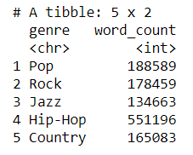
Preprocessing
Special words like won’t, can’t etc., are converted to will not, can not etc., using gsub function.
Special characters were removed and all the words were converted to lowercase.
Tokens were generated and word count of each genre was obtained.

Slide 18
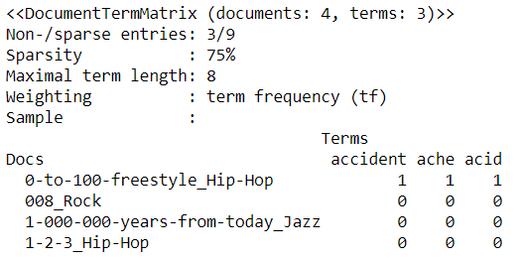
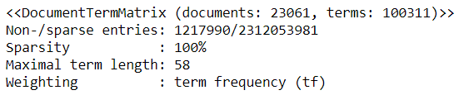
The Model
LDA algorithm requires data in document-term matrix (DTM) format, in which each document(song) is a row, and each column is a term.
To achieve this we used cast_dtm() function.
The matrix tells about how many documents and terms we have and from the obtained result we can see that it is a very sparse matrix.
Notes:
The second diagram displays document-term-matrix of 4 documents and 3 terms.

Slide 19
To fit the model, we set k = 5 (because the dataset contains 5 distinct genres), seed, and method = GIBBS.
The default is VEM but GIBBS sampling method is performing better.
GIBBS sampling performs a random walk that starts at some point which can be initialized (we use the default of 0) and at each step moves plus or minus one with equal probability.

Slide 20
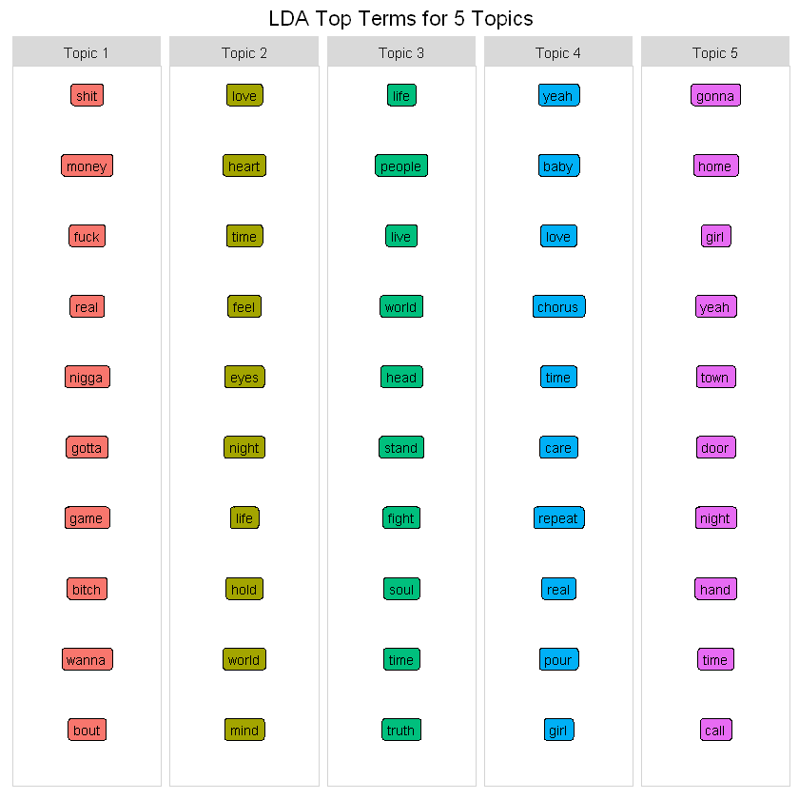
Notes:
We can see that different words occur under different topics and differentiate the 5 topics.

Slide 21
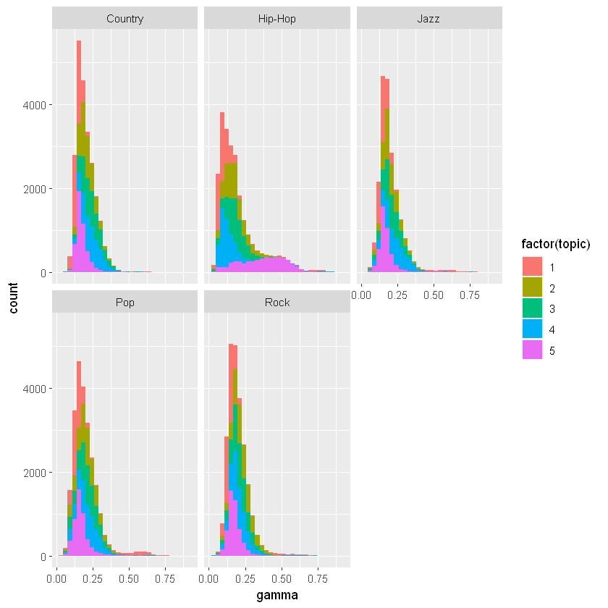
We examine the fraction of genres the model predicted correctly.
Notes:
We can observe the predictions under a particular topic are overlapping with other topics. Each genre is overlapping with multiple topics.

Slide 22
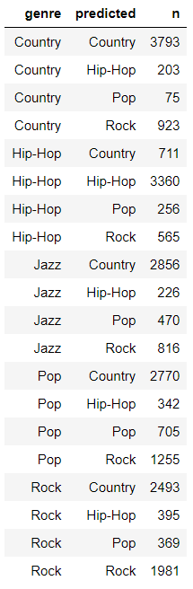
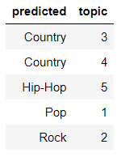
Actual and predicted number of songs under each genre.
Mapping topic model number with the ‘genre’
Notes:
We can see that there is NO ‘Jazz’ in the predicted topics.

Slide 23
Observations
From the predictions we can see that a lot of songs are misclassified.
Misclassification rate: 59.99%

Slide 24
Future Work
We would like to annotate the dataset using cleanNLP package. We can use lemmatized or stemmed words after tokenizing.
We can further improve the model by applying LDA after Principal Component Analysis.

Slide 25
references
https://www.kaggle.com/gyani95/380000-lyrics-from-metrolyrics
https://www.analyticsvidhya.com/blog/2016/08/beginners-guide-to-topic-modeling-in-python/
https://cran.r-project.org/web/packages/tidytext/vignettes/topic_modeling.html
https://courses.edx.org/courses/course-v1:MITx+15.071x+2T2017/course/
https://www.datacamp.com/community/tutorials/ML-NLP-lyric-analysis

Slide 26
Questions
How can we improve the model accuracy?
What would happen if you chose a different number of topics?
What would be next steps to build a simple recommender system after Topic Modelling?

