Slide 1
Photo-Realistic Single Image Super-Resolution Using a Generative Adversarial Network

Slide 2
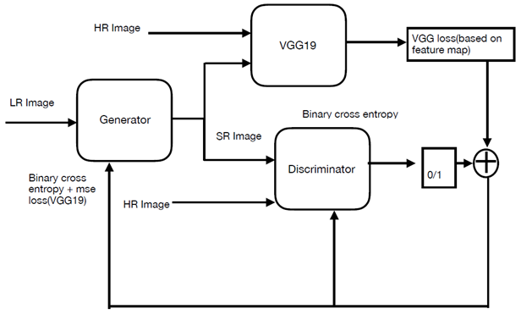

Slide 3
Training Procedure Steps
We read the original image using cv2.imread() function and resize it to (224, 224) using bi-cubic interpolation to get High Resolution (HR) images.
We process the HR (High Resolution) images to get down-sampled (by a factor of 4) LR (Low Resolution) images of shape (56, 56). Now we have both HR and LR images for training data set.
The weights for VGG19 are loaded and the vgg_model.trainable is made false with loss function as mean squared error.
Generator and discriminator models are built using the architectures explained in the following sections.
Combined GAN model is constructed.
Compile the combined GAN model & discriminator network with VGG + binary cross entropy and Binary Cross Entropy respectively.

Slide 4
For each epoch datagen function is called which gives LR and HR images of specified batch size.
We pass LR images through Generator, which generates an up-sampled image (by a factor of 4) resulting in Super Resolution (SR) images of shape (224, 224).
Target label for HR images is set as 1 with some randomness and for SR images zero (0). Discriminator model with this as input is trained by setting discriminator.trainable = True
Once the discriminator is trained the generator is trained by using the combined model and also by setting discriminator.trainable = False i.e. freezing the discriminator.
The above procedure is repeated until the model converges.
Once the model is trained, the weights are saved and these weights are further used to generate images from Validation dataset and to calculate PSNR values. This is performed on 3 different datasets.

Slide 5
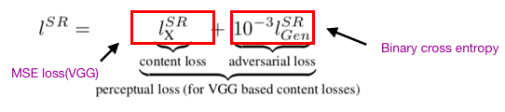


Preceptual loss function
Calculates the loss by comparing two images based on high level representation from a pre trained convolution
Content loss: euclidean distance between feature map representation of the SR and HR image
Adversarial loss: binary cross entropy loss obtained from the discriminator network is added to the content loss

Slide 6
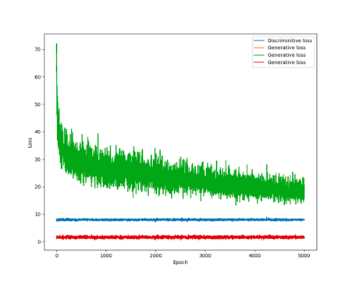
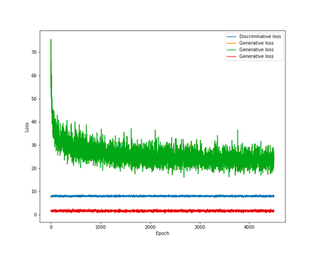
SR-GAN Loss:
DiV2K dataset
Flickr dataset

Slide 7
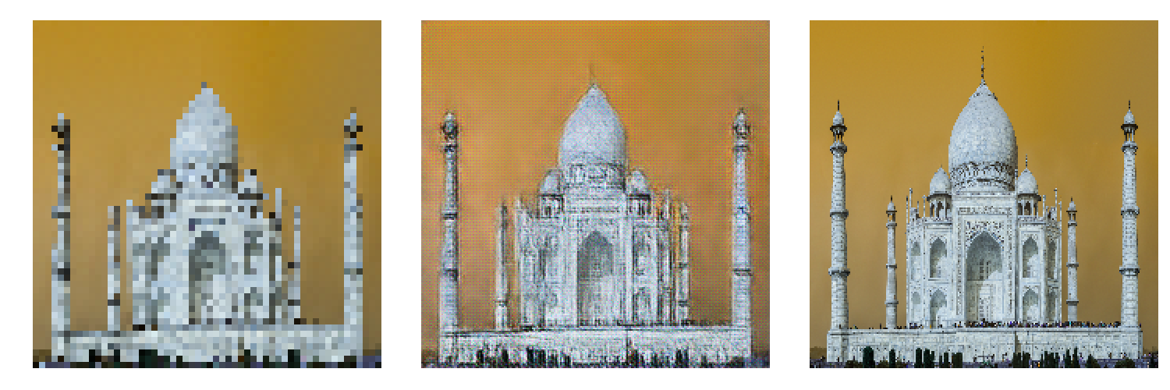
Results
Qualitative Performance on DIV2K using Pixel Shuffler:
Notes:
Generated image from training data at 10000 epoch

Slide 8
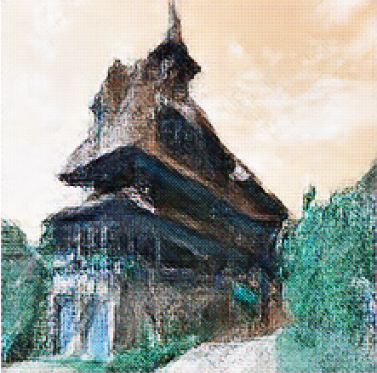
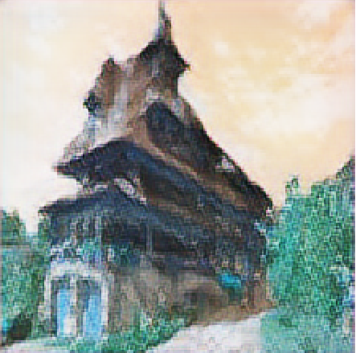
Pixel Shuffler vs Upsampling (12000 epoch)
Notes:
Left image generated image from validation data of DIV2k for Pixel Shuffler
Right image generated image from validation data of DIV2k for Pixel Shuffler

Slide 9
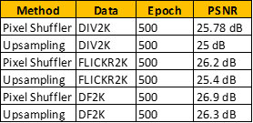
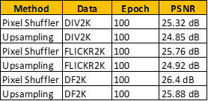
Quantitative Measurements

Slide 10
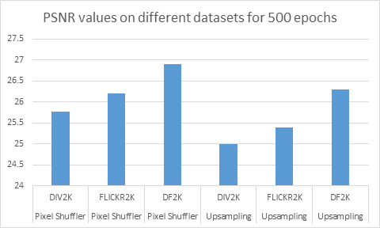

Slide 11
Quantitative Observations
The combined dataset (DF2K) increases the PSNR performance by a large margin.
The pixel shuffler has better PSNR values when compared to Upsampling method.
Flickr2K performs better than DIV2K.
More number of epochs result in better PSNR values.

Slide 12
By Vidya, Disha and Ravi

