Slide 1
Water Quality Prediction
Team-
E-ADA-085-Anchuri Yamuna
E-ADA-087-Ankam Ravi Varma
E-ADA-114-Lokesh Sonwani
E-ADA-123-Muddada Anusha
E-ADA-135-Prerna Sahu
E-ADA-164-Vallepu Prabhu Das

Slide 2
Machine learning is a subfield of artificial intelligence (AI) that focuses on creating algorithms and models capable of learning and making predictions or decisions without being explicitly programmed. It involves developing computer systems that can automatically learn and improve from experience, allowing them to analyze data, identify patterns, and make informed decisions or predictions.
The core idea behind machine learning is to enable computers to learn from examples and data, rather than relying on explicit instructions. This is done by training models on large datasets, where the models use statistical techniques to find patterns and relationships within the data. Once trained, these models can make predictions or take actions on new, unseen data.

Slide 3
Problem Statement:
The problem at hand is to develop a machine learning model that can accurately predict water quality based on various parameters and features. The objective is to leverage historical data on water samples and associated measurements to create a predictive model that can assess water quality in real-time, enabling early detection of potential contaminants or anomalies.
We have to predict the quality of water based on the pH, Hardness, and other properties.

Slide 4
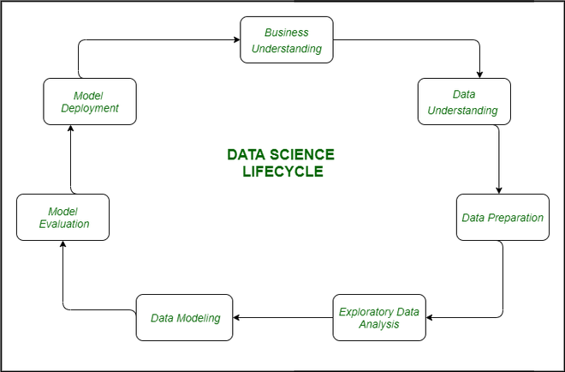
Steps in Machine Learning :-

Slide 5
1. Gathering and acquiring relevant data for the project:-
Used Data from Kaggle Website
Data set : https://www.kaggle.com/datasets/adityakadiwal/water-potability
Column Description
1. ph: pH of 1. water (0 to 14).
2. Hardness: Capacity of water to precipitate soap in mg/L.
3. Solids: Total dissolved solids in ppm.
4. Chloramines: Amount of Chloramines in ppm.
5. Sulfate: Amount of Sulfates dissolved in mg/L.
6. Conductivity: Electrical conductivity of water in μS/cm.
7. Organic_carbon: Amount of organic carbon in ppm.
8. Trihalomethanes: Amount of Trihalomethanes in μg/L.
9. Turbidity: Measure of light emiting property of water in NTU.
10. Potability: Indicates if water is safe for human consumption. Potable -1 and Not potable -0
Data preprocessing
data cleaning
handling missing values
feature scaling.

Slide 6
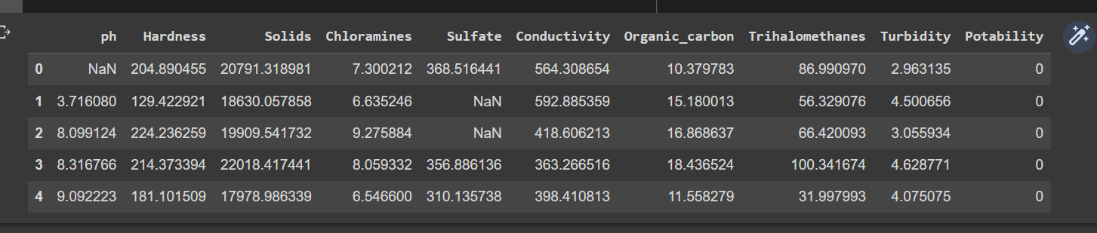
Sample Data
df.head(5)

Slide 7
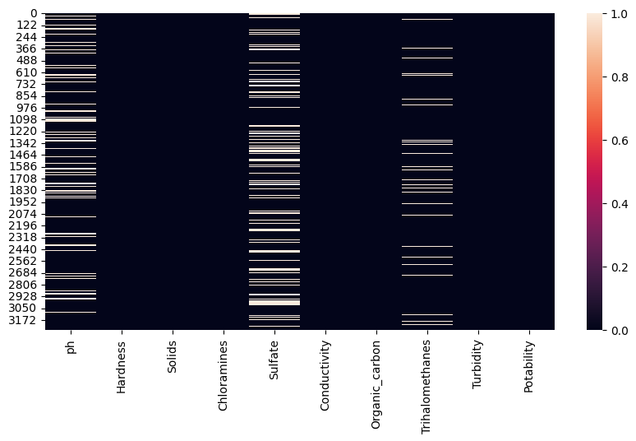
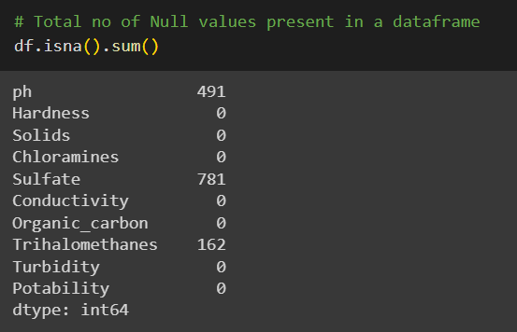
Handling Missing Values
Null values which are present in data
These null Values are filled with mean of their columns

Slide 8
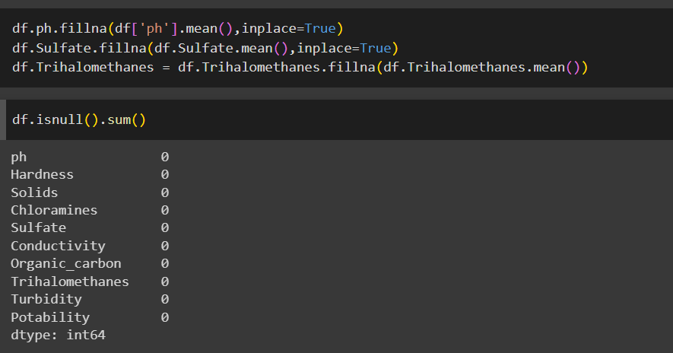

Slide 9
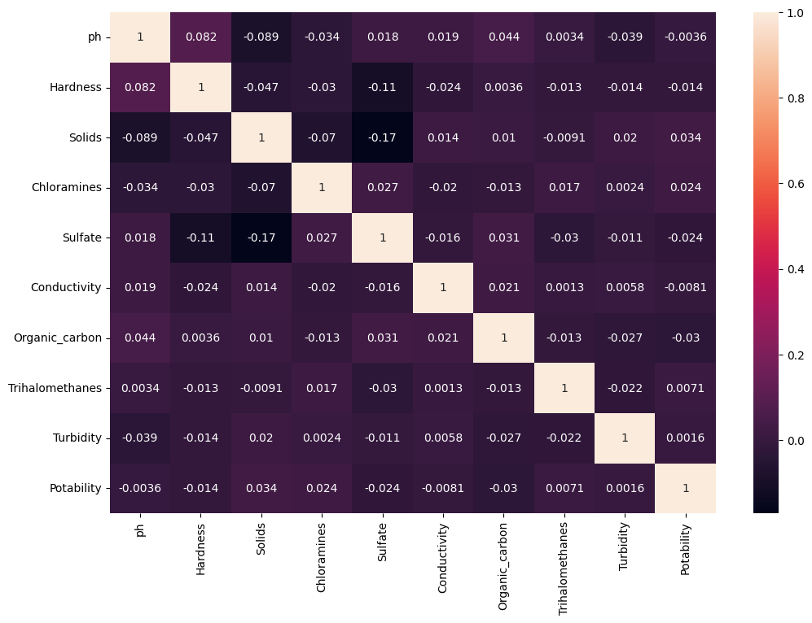
2. Data Exploration and Analysis :-

Slide 10
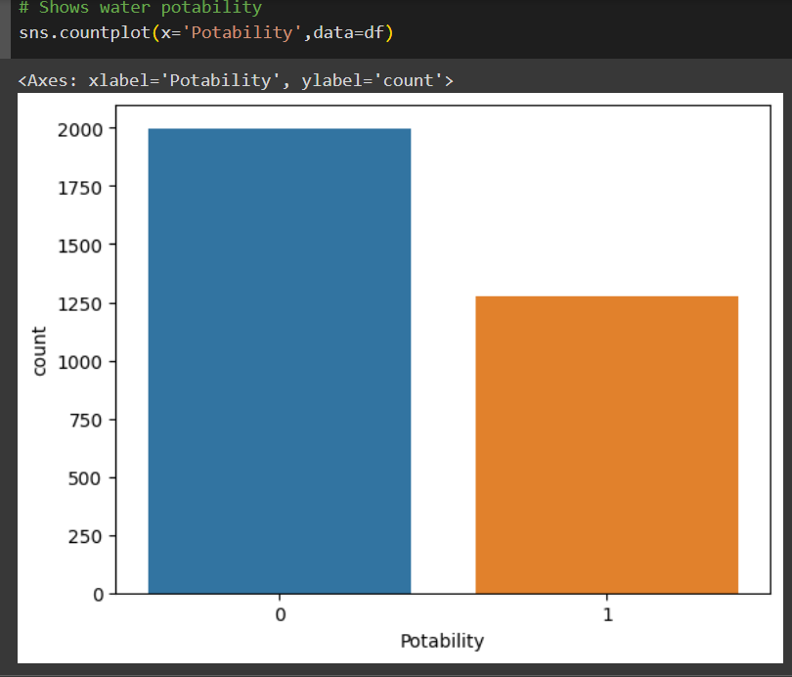
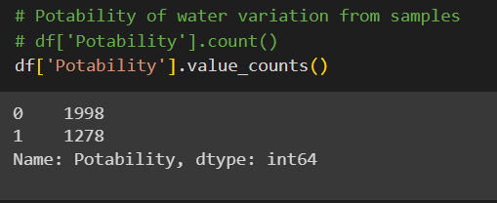

Slide 11
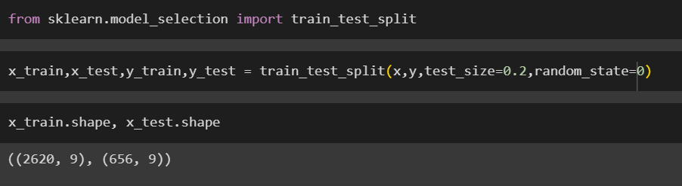
3. Feature Engineering:
Input features
'ph', 'Hardness', 'Solids', 'Chloramines', 'Sulfate', 'Conductivity', 'Organic_carbon', 'Trihalomethanes', 'Turbidity’
Target
‘Potability’
Dividing the dataset into Training and Testing

Slide 12
4. Model Selection, Training and Evaluation:
ML models or algorithms which we have used
Logistic Regression
Decision Tree
Random Forest
KNN (k nearest neighbours)
SVM (support vector machine)

Slide 13
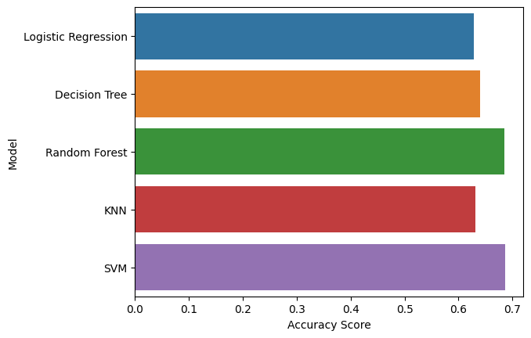
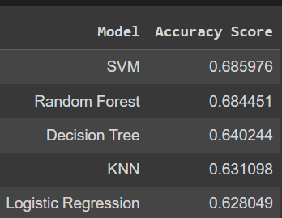
Based on accuracy value of each model, we will select the model for further iterations

Slide 14
5. Model Optimization:
GridSearchCV is a technique for finding the optimal parameter values from a given set of parameters in a grid. It's essentially a cross-validation technique. The model as well as the parameters must be entered.
Grid search builds a model for every combination of hyperparameters specified and evaluates each model.
Gridsearchcv finds the optimal parameters to increase model performance

Slide 15
Conclusion:
We conclude that we predict the water quality with machine learning models. Here we trained the data in various models like logistic regression, k nearest neighbors, support vector machine, random forest classifier and decision tree. Here we get most accuracy in svm(suppport vector machine) as explained above with the mentioned bar graph. There we get accuracy of 0.685976 in svm compared to other models.

