Slide 1
Predictive Analysis of Cardiovascular Disease Risk Using Machine Learning
Ravi Kiran Deevi
MSc Data Science | University of Hertfordshire
7PAM2002 | Semester A 2025/2026
GitHub: https://github.com/ravi1563/FYP-RAVI

Slide 2
Introduction & Motivation
• Cardiovascular disease (CVD) is the leading cause of death globally, responsible for ~17.9 million deaths annually (WHO, 2021).
• Early and accurate prediction of CVD risk can enable timely intervention, potentially saving millions of lives.
• Machine learning offers a data-driven approach to identify high-risk individuals from clinical biomarkers.
• This study evaluates multiple ML classifiers, applies explainability techniques, and assesses class imbalance handling.
Research Questions
• RQ1: Which classification algorithm (LR, SVM, RF) achieves the highest F1-score for CVD diagnosis?
• RQ2: Which risk factors are most critical drivers of heart disease prediction (SHAP values)?
• RQ3: Does SMOTE or ADASYN significantly improve model sensitivity for the minority class?
Ravi Kiran Deevi | MSc Data Science | 7PAM2002

Slide 3
Related Work / Literature Review
Mohan, S., Thirumalai, C. and Srivastava, G. (2019) 'Effective Heart Disease Prediction Using Hybrid Machine Learning Techniques', IEEE Access, 7, pp.81542-81554.
Finding: Combined hybrid RF with linear model; achieved 88.7% accuracy on Cleveland dataset.
Javeed, A. et al. (2019) 'An Intelligent Learning System Based on Random Search Algorithm and Optimized Random Forest Model for Improved Heart Disease Detection', IEEE Access, 7, pp.180235-180243.
Finding: Used random search optimized RF achieving 93.33% accuracy for heart disease detection.
Ali, M.M. et al. (2021) 'Heart Disease Prediction Using Supervised Machine Learning Algorithms', Informatics in Medicine Unlocked, 24, p.100529.
Finding: Compared six classifiers; RF achieved best recall of 90.16% on UCI Heart Disease dataset.
Lundberg, S. and Lee, S. (2017) 'A Unified Approach to Interpreting Model Predictions', Advances in Neural Information Processing Systems, 30.
Finding: Introduced SHAP for model-agnostic feature importance; foundational for explainable AI.
Ravi Kiran Deevi | MSc Data Science | 7PAM2002

Slide 4
What This Project Adds
Multi-Model Comparison with Bayesian Optimization
• Systematic evaluation of LR, SVM, and RF using Optuna Bayesian hyperparameter tuning (20 trials, 5-fold CV) rather than manual or grid search.
SHAP-Based Explainability
• Application of SHAP values to identify the most critical risk factors (Troponin, CK-MB) driving CVD predictions, moving beyond black-box models.
Class Imbalance Evaluation
• Rigorous comparison of SMOTE and ADASYN oversampling on all three models, demonstrating that oversampling does not always improve performance.
Erbil Healthcare Dataset
• Validation on a real-world clinical dataset (1,319 patients) from Erbil, Iraq, extending research beyond commonly used UCI/Cleveland datasets.
Ravi Kiran Deevi | MSc Data Science | 7PAM2002

Slide 5
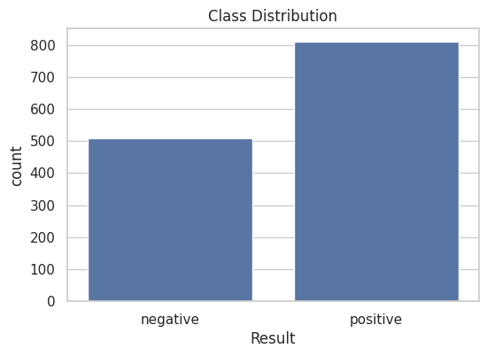
Dataset Overview
• Name: Erbil Cardiovascular Health Dataset (Medicaldataset.csv)
• Rows: 1,319 | Columns: 9 | Type: Binary Classification
• Features (8): Age, Gender, Heart rate, Systolic BP, Diastolic BP, Blood sugar, CK-MB, Troponin
• Target: Result (negative=0 / positive=1, label-encoded)
• Collected: Prof. Ibrahim Hamarash & Dr. Shwan Amen, Erbil Iraq (Nov 2018 – Apr 2019)
• Source: https://data.mendeley.com/datasets/wmhctcrt5v/1
Ravi Kiran Deevi | MSc Data Science | 7PAM2002

Slide 6
Ethical Implications
Data Ethics
• Dataset is publicly available under open license (Mendeley Data)
• No personally identifiable information (PII) in the dataset
• Data collected with appropriate medical ethics approval
• All patient records anonymized before publication
Model Ethics
• ML predictions should supplement, not replace, clinical judgment
• Model bias evaluation essential before clinical deployment
• Transparent SHAP explanations support responsible AI use
• False negatives in CVD detection carry life-threatening risks
GDPR & Regulatory Compliance
• Research adheres to University of Hertfordshire ethical guidelines (UPR RE01)
• No direct patient interaction; secondary analysis of published data only
• Findings intended for academic research purposes; clinical deployment would require further validation
Ravi Kiran Deevi | MSc Data Science | 7PAM2002

Slide 7
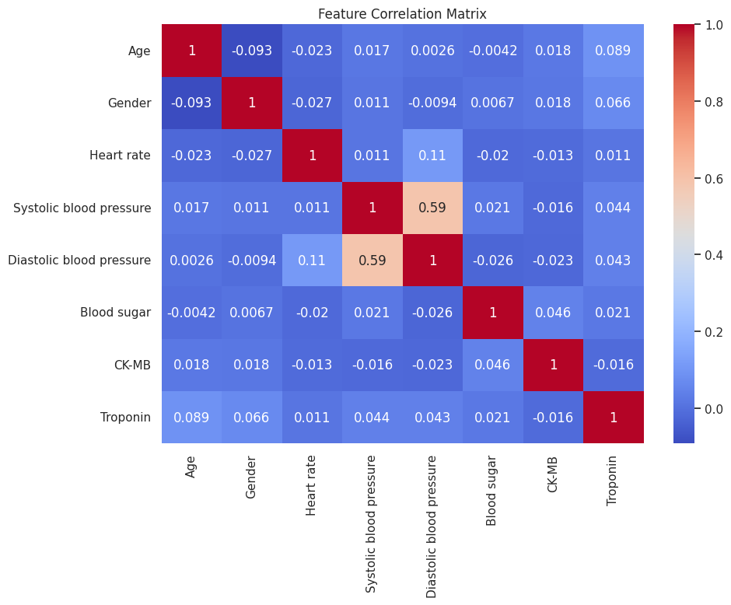
Exploratory Data Analysis – Correlations
• Troponin and CK-MB show strongest correlation with the target (Result)
• Systolic and Diastolic BP are correlated with each other (~0.5+)
• Most features show low inter-correlation, reducing multicollinearity concerns
• Age has weak correlation with target, but contributes in ensemble models
Ravi Kiran Deevi | MSc Data Science | 7PAM2002

Slide 8
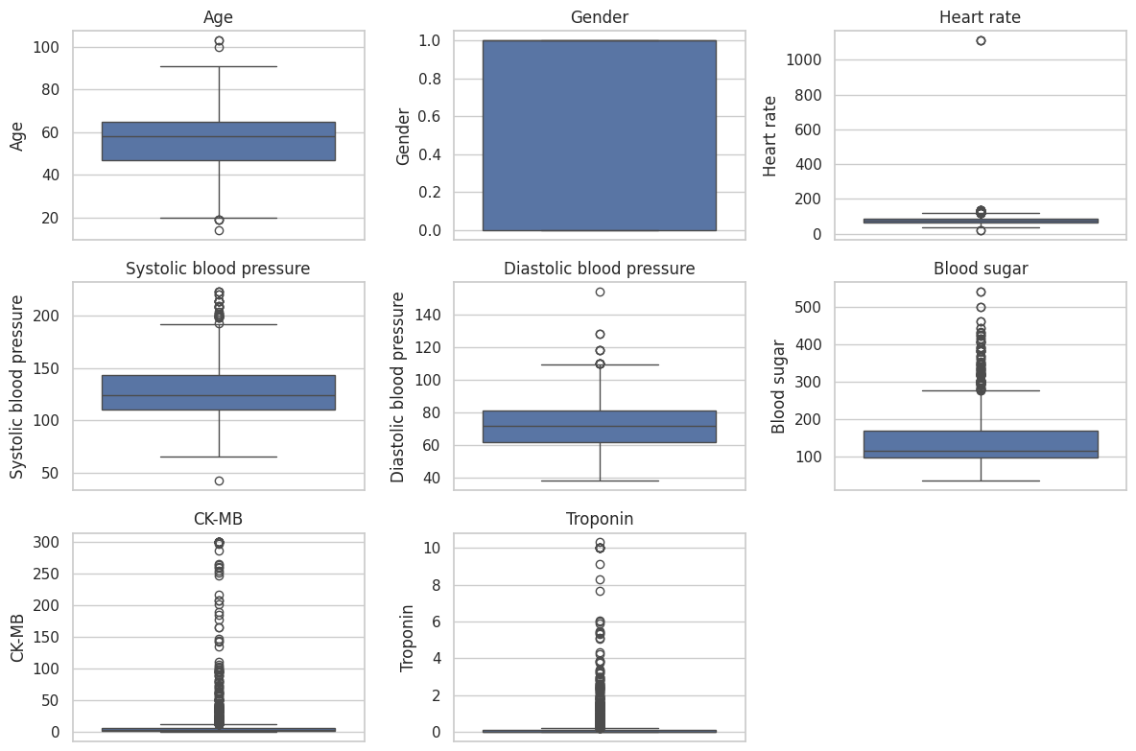
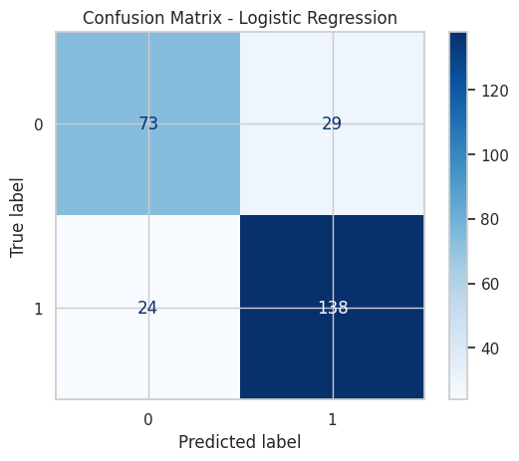
EDA – Feature Distributions & Outliers
• Heart rate: max = 1,111 (extreme outlier, possibly erroneous)
• CK-MB: max = 300 (clinical outlier, possible acute MI marker)
• Troponin: highly skewed distribution; strong positive class separator
• Blood sugar: wide range indicating diverse patient profiles
Ravi Kiran Deevi | MSc Data Science | 7PAM2002

Slide 9
Preprocessing Pipeline
1. Data Inspection
No missing values detected in 1,319 records across 9 features.
2. Label Encoding
Gender: Male/Female → 0/1; Result (target): Negative/Positive → 0/1.
3. Feature Scaling
StandardScaler applied to features for LR and SVM (zero mean, unit variance).
4. Train/Test Split
80/20 stratified split (random_state=42): Training = 1,055, Test = 264 samples.
Ravi Kiran Deevi | MSc Data Science | 7PAM2002

Slide 10
Machine Learning Models
Logistic Regression (LR)
• Linear model for binary classification using sigmoid function
• Regularized via C parameter; interpretable coefficients
• Optimal for linearly separable data; baseline classifier
Support Vector Machine (SVM)
• Finds optimal hyperplane maximizing margin between classes
• Kernel trick enables non-linear decision boundaries
• Effective in high-dimensional spaces; robust to outliers
Random Forest (RF)
• Ensemble of decision trees with bagging (bootstrap aggregation)
• Reduces overfitting through averaging; handles non-linearity
• Built-in feature importance; robust to noise and outliers
Ravi Kiran Deevi | MSc Data Science | 7PAM2002

Slide 11
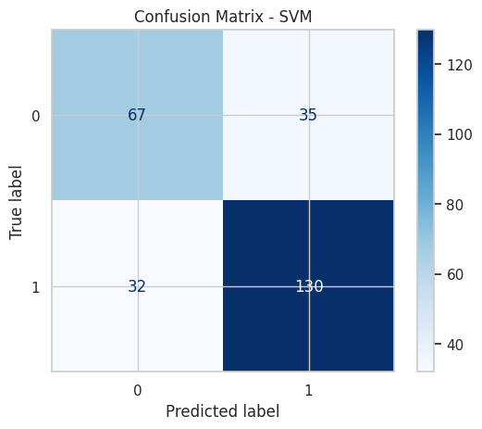
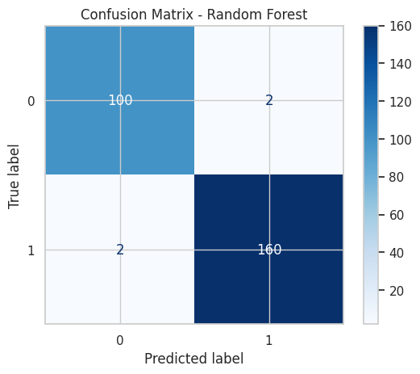
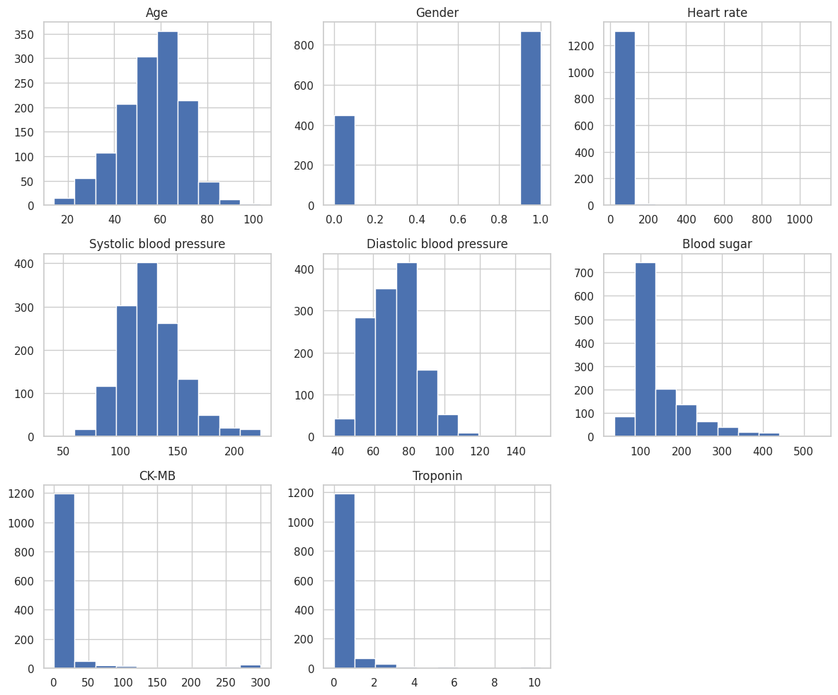
Model Results – Before Tuning
Model | Accuracy | Precision | Recall | F1-Score
Logistic Regression | 0.7992 | 0.7978 | 0.7992 | 0.7982
SVM | 0.7462 | 0.7449 | 0.7462 | 0.7455
Random Forest | 0.9848 | 0.9848 | 0.9848 | 0.9848
Ravi Kiran Deevi | MSc Data Science | 7PAM2002

Slide 12
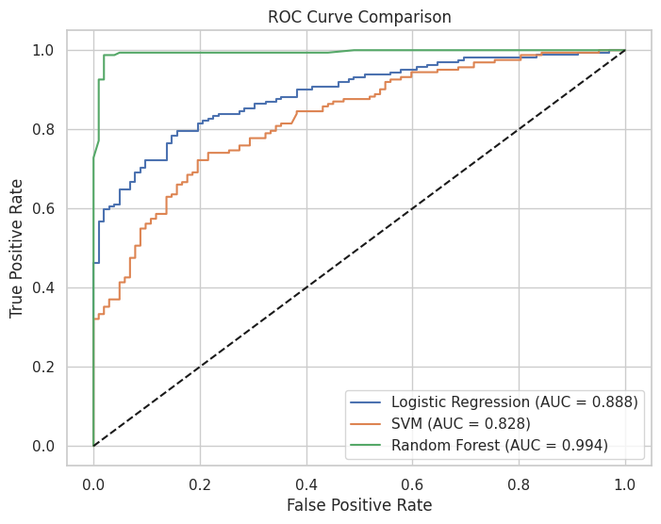
ROC Curves & AUC Comparison
• ROC-AUC Before Tuning:
LR = 0.888 | SVM = 0.828 | RF = 0.994
• ROC-AUC After Tuning: RF = 0.987
• RF achieves near-perfect discrimination
• LR and SVM show moderate improvements post-tuning
Ravi Kiran Deevi | MSc Data Science | 7PAM2002

Slide 13
Hyperparameter Tuning (Optuna Bayesian)
Method: Bayesian Optimization | 20 Trials | 5-Fold Cross-Validation
Model | Best Parameters
LR | C = 3.164
SVM | C = 6.719, kernel = 'linear', gamma = 'scale'
RF | n_estimators=226, max_depth=3, min_samples_split=2
After Tuning Results:
Model | Accuracy | Precision | Recall | F1-Score
Logistic Regression | 0.8258 | 0.8265 | 0.8258 | 0.8261
SVM | 0.8333 | 0.8382 | 0.8333 | 0.8346
Random Forest | 0.9811 | 0.9811 | 0.9811 | 0.9811
Ravi Kiran Deevi | MSc Data Science | 7PAM2002

Slide 14
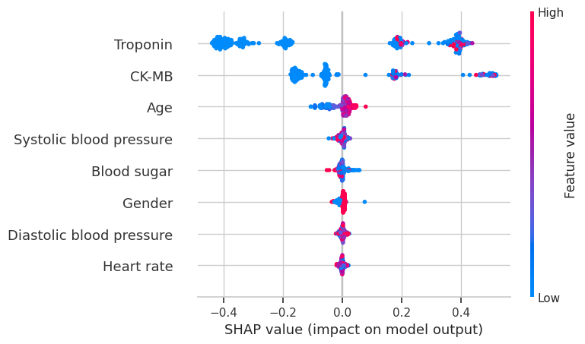
Cross-Validation Results (5-Fold)
Model | Mean Accuracy | Std Dev | Mean F1-Score
Random Forest | 0.9848 | 0.0054 | 0.9849
Logistic Regression | 0.7923 | 0.0222 | 0.7922
SVM | 0.7377 | 0.0182 | 0.7366
• Random Forest dominates with 98.48% mean accuracy and lowest variance (0.0054)
• RF shows exceptional stability and generalization across all folds
• LR and SVM show moderate accuracy (~79% and ~74%) with higher variance
• Low standard deviation for RF confirms robustness, not overfitting
Ravi Kiran Deevi | MSc Data Science | 7PAM2002

Slide 15
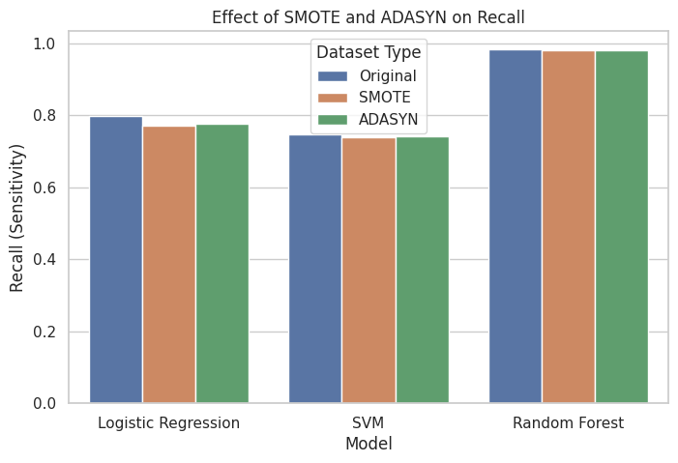
Class Imbalance Analysis (SMOTE / ADASYN)
Model | Dataset | Accuracy | Precision | Recall | F1
LR | Original | 0.7992 | 0.7978 | 0.7992 | 0.7982
LR | SMOTE | 0.7727 | 0.7890 | 0.7727 | 0.7755
LR | ADASYN | 0.7765 | 0.8010 | 0.7765 | 0.7794
RF | Original | 0.9848 | 0.9848 | 0.9848 | 0.9848
RF | SMOTE | 0.9811 | 0.9811 | 0.9811 | 0.9811
RF | ADASYN | 0.9811 | 0.9811 | 0.9811 | 0.9811
Key Finding: SMOTE and ADASYN did NOT improve performance. Original dataset performed best across all models.
Ravi Kiran Deevi | MSc Data Science | 7PAM2002

Slide 16
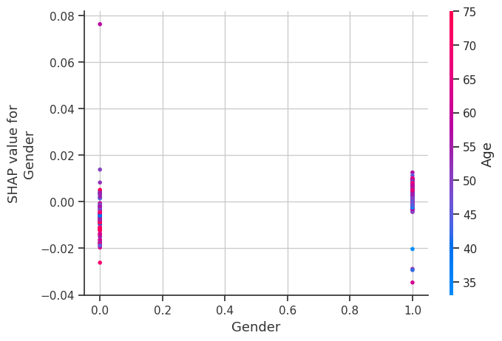
SHAP Feature Importance Analysis
Rank | Feature | Mean |SHAP|
1 | Troponin | ~0.33
2 | CK-MB | ~0.17
3 | Age | ~0.03
4 | Systolic BP | ~0.01
5 | Blood Sugar | ~0.01
6 | Gender | ~0.01
7 | Diastolic BP | ~0.005
8 | Heart Rate | ~0.003
• Troponin is by far the strongest predictor of CVD (SHAP ~ 0.33)
• CK-MB is the second most important cardiac biomarker
• Clinical biomarkers dominate over demographic features
Ravi Kiran Deevi | MSc Data Science | 7PAM2002

Slide 17
Analysis & Discussion
Strengths
• RF achieves 98.48% accuracy with near-perfect AUC (0.994)
• SHAP provides transparent, clinically meaningful explanations
• Optuna Bayesian tuning is efficient (20 trials vs. exhaustive search)
• 5-fold CV confirms RF stability (std = 0.0054)
• Real-world clinical dataset from Erbil, Iraq
Limitations
• Small dataset (1,319 records) may limit generalizability
• Extreme outliers in heart rate (max=1111) not removed
• Single-center data (Erbil) may not represent global population
• Only three classifiers evaluated; no deep learning models
• Binary classification only; no severity staging
Future Work
• Extend to deep learning (ANN, CNN on ECG data)
• Multi-center, larger datasets for external validation
• Feature engineering (e.g., BMI, cholesterol, smoking status)
• Deployment as clinical decision support web application
• Longitudinal study for temporal risk prediction
Ravi Kiran Deevi | MSc Data Science | 7PAM2002

Slide 18
Summary & Conclusions
RQ1: Best Classifier
• Random Forest achieved the highest F1-score of 0.9848
• Significantly outperformed LR (0.7982) and SVM (0.7455)
• Near-perfect ROC-AUC of 0.994
RQ2: Critical Risk Factors (SHAP)
• Troponin is the dominant predictor (SHAP ~ 0.33)
• CK-MB is the second most important (SHAP ~ 0.17)
• Cardiac biomarkers far outweigh demographic features
RQ3: Class Imbalance
• SMOTE and ADASYN did NOT improve performance
• Original dataset yielded best results across all models
Best Model: Random Forest — 98.48% Accuracy | 0.9848 F1-Score | 0.994 ROC-AUC
Ravi Kiran Deevi | MSc Data Science | 7PAM2002

Slide 19
References
• Ali, M.M. et al. (2021) 'Heart Disease Prediction Using Supervised Machine Learning Algorithms', Informatics in Medicine Unlocked, 24, p.100529.
• Javeed, A. et al. (2019) 'An Intelligent Learning System Based on Random Search Algorithm and Optimized Random Forest Model for Improved Heart Disease Detection', IEEE Access, 7, pp.180235-180243.
• Lundberg, S. and Lee, S. (2017) 'A Unified Approach to Interpreting Model Predictions', Advances in Neural Information Processing Systems, 30.
• Mohan, S., Thirumalai, C. and Srivastava, G. (2019) 'Effective Heart Disease Prediction Using Hybrid Machine Learning Techniques', IEEE Access, 7, pp.81542-81554.
• Hamarash, I. and Amen, S. (2019) 'Erbil Cardiovascular Health Dataset', Mendeley Data, V1. Available at: https://data.mendeley.com/datasets/wmhctcrt5v/1.
• World Health Organization (2021) Cardiovascular Diseases (CVDs) Fact Sheet. Available at: https://www.who.int/news-room/fact-sheets/detail/cardiovascular-diseases-(cvds).
• Akiba, T. et al. (2019) 'Optuna: A Next-generation Hyperparameter Optimization Framework', Proceedings of the 25th ACM SIGKDD, pp.2623-2631.
• Chawla, N.V. et al. (2002) 'SMOTE: Synthetic Minority Over-sampling Technique', Journal of Artificial Intelligence Research, 16, pp.321-357.
Ravi Kiran Deevi | MSc Data Science | 7PAM2002

Slide 20
Thank You!
Ravi Kiran Deevi
MSc Data Science | University of Hertfordshire
7PAM2002 | Semester A 2025/2026
Questions & Discussion
Ravi Kiran Deevi | MSc Data Science | 7PAM2002

