Slide 1
Graphical User Interface for Canvas Print
Ravi Jain
2013167
CSE

Slide 2
GUI
We take the points of irregular polygon as input
This is accomplished by two methods
The readme file “ravi.txt” is used to enter (x,y) co-ordinates of all the points
The button “enter text file” is used to plot the polygon using the co-ordinates given in text file “ravi.txt”

Slide 3
GUI
The second method is by using mouse click to enter the points in the given area.
On each click points get mapped onto the given x-y co-ordinate plane.
Using above mentioned two methods we plot the Graph in matlab file.
Command plot([x(i) x(i+1)],[y(i) y(i+1)],'-.og') is used for plotting lines between the given co-ordinates.

Slide 4
GUI
ginput(1); command is used to take points input on graph.
The tool diameter is entered using matlab commands, using which the irregular polygon is to be filled.

Slide 5
First Approach
Here we move the nozzle in such a way that it keeps moving in right and left directions as per the given points.
We find the first point using the intersection of line 1 with the tool radii.
We then find the next higher y co-ordinate among the given points.
We intersect this line with the tool radii to obtain further points.

Slide 6
First Approach
This way we keep moving upwards by adding the diameter of the tool till the point with maximum y co-ordinate.
And accordingly fill the polygon.

Slide 7
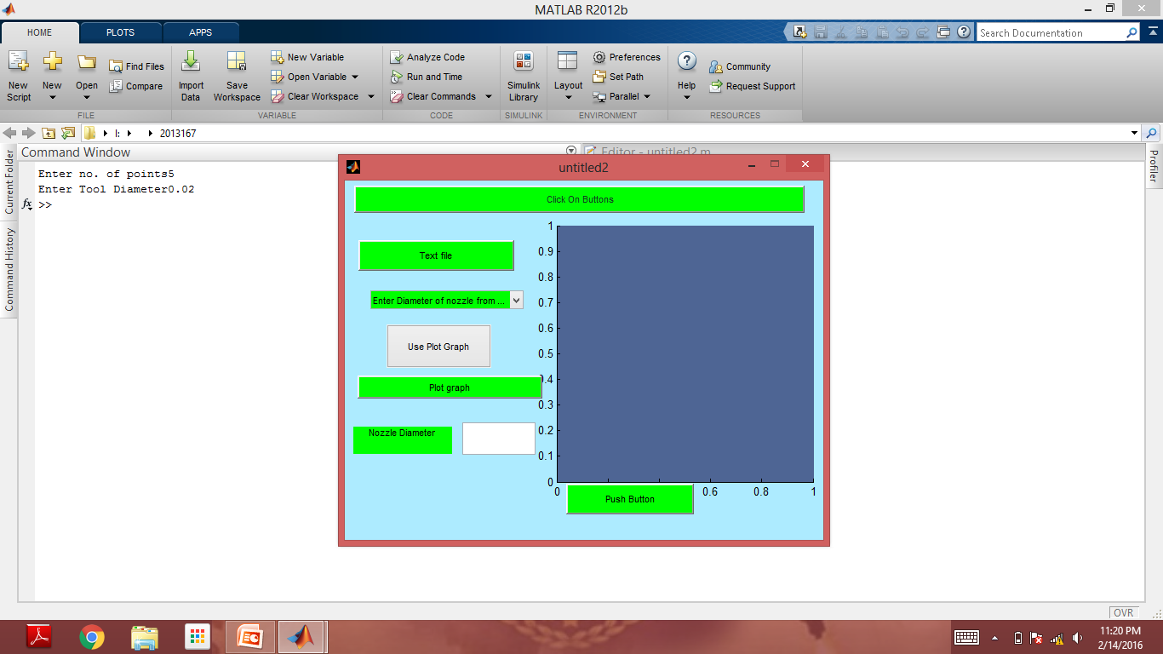
Screenshots

Slide 8
Parameters
We give number of points input as 5, and tool diameter as 0.02

Slide 9
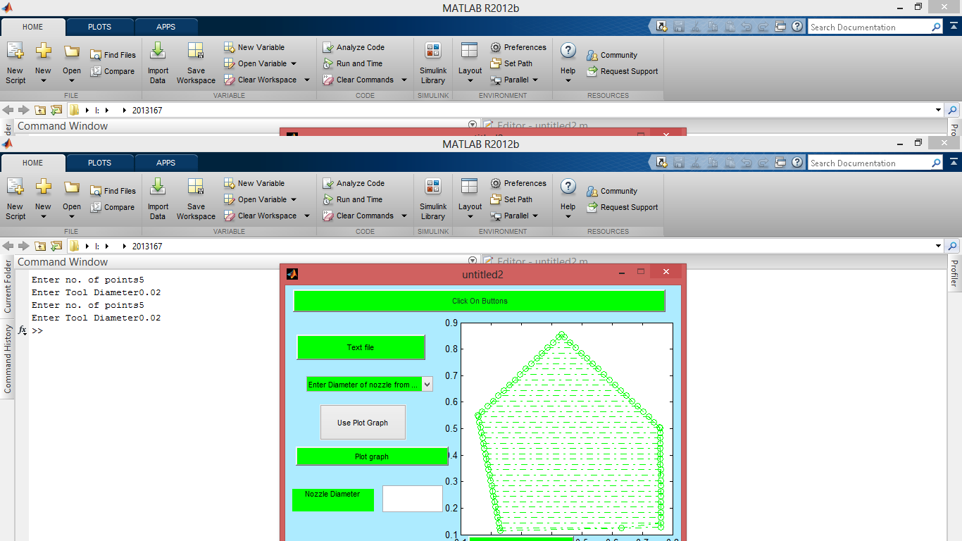
Screenshots

Slide 10
Result
The irregular polygon was successfully filled

Slide 11
Second Approach
In this method we use offset technique to fill the area between the polygon.
After we get the tool diameter, we draw perpendiculars from each point of length = tool radius and find the equations of lines between these perpendiculars.
For the nozzle path, we find intersection of these lines between the perpendiculars.

Slide 12
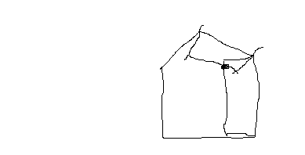
Second Approach
The point of intersection of lines joining perpendiculars drawn from each vertex is obtained.

Slide 13
Second Approach
For finding the co-ordinates of points, we use the property of perpendicular lines that product of their slopes = -1
m1 * m2 = -1
Using this equation we get the required points.
After we get the intersection points, we store the (x,y) co-ordinates in an array.
The same steps are then repeated for this array of points.

Slide 14
Second Approach
We keep repeating these steps, until we reach a point where the distance between any two points in the pentagon is not greater than the nozzle radius.
The points that are stored in the array are the points through which nozzle should move in order to traverse the whole polygon.

Slide 15
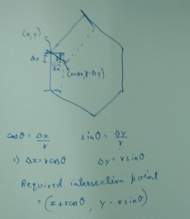
Second Approach

Slide 16
Thank You

