Slide 1
Advertisement

Slide 2
About
This presentation contains a set of some of the creative ads that we have come across.
An effort has been made to accumulate a few good ads at one place.
These ads have drastically affected the popularity of these products.
The world of advertisement has come a far way from where it began.
Hope you all enjoy the coming slides.

Slide 3


Slide 4
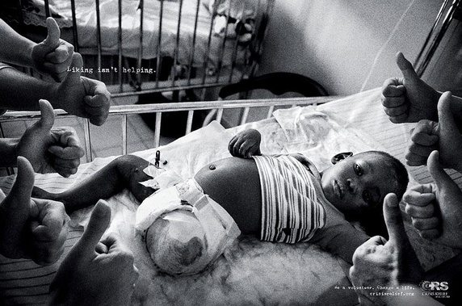

Slide 5
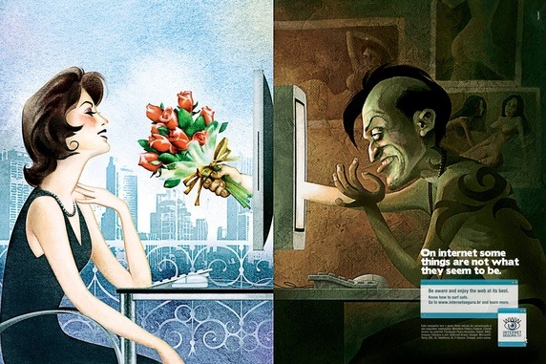

Slide 6


Slide 7
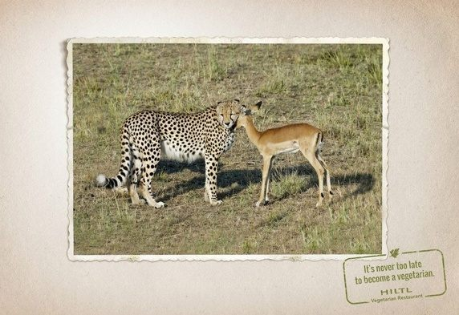

Slide 8
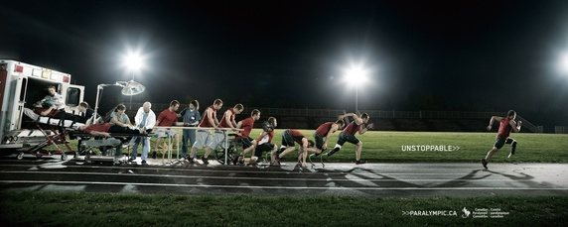

Slide 9
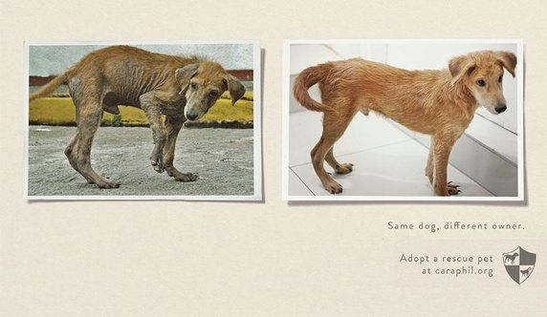
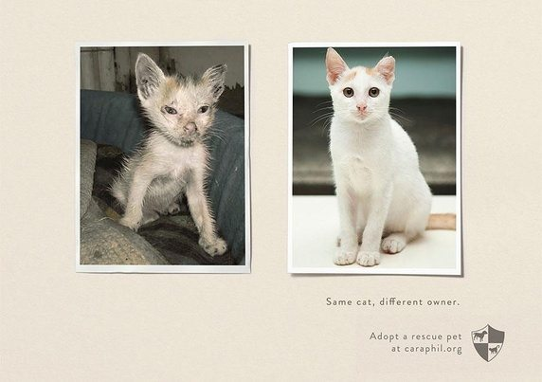

Slide 10
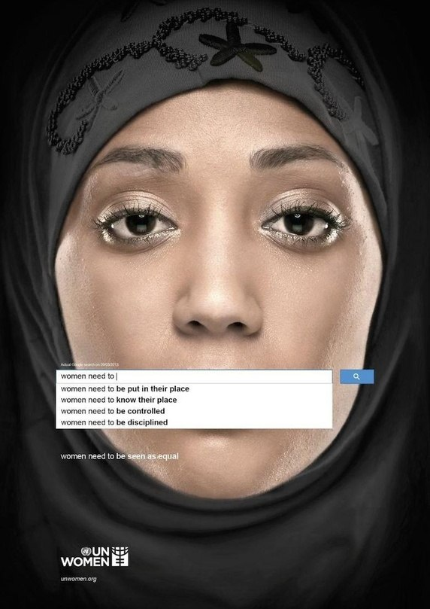

Slide 11
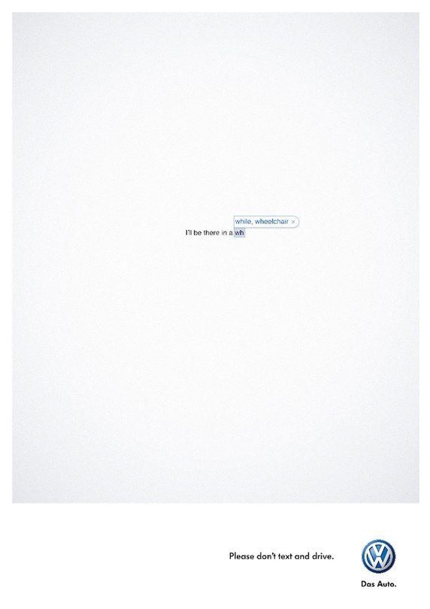

Slide 12


Slide 13
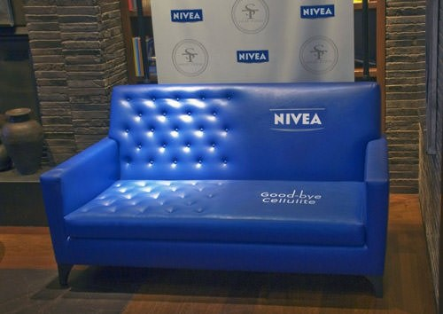

Slide 14
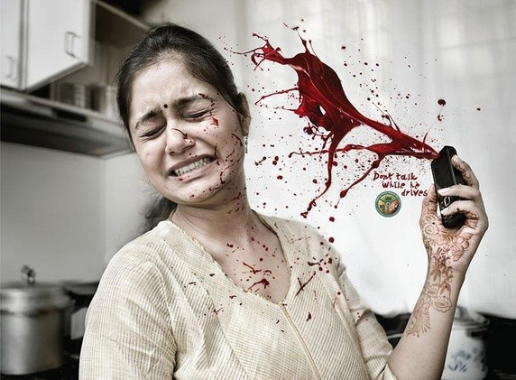

Slide 15
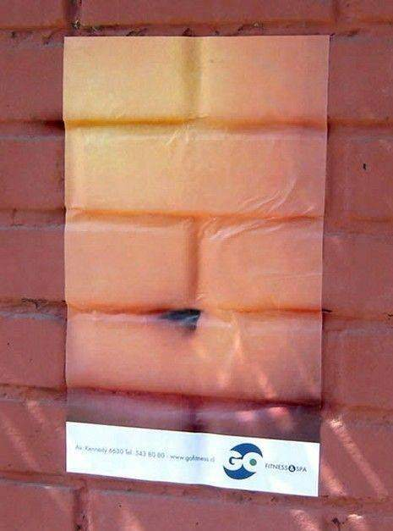

Slide 16
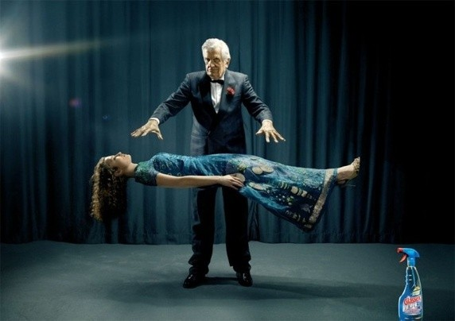

Slide 17
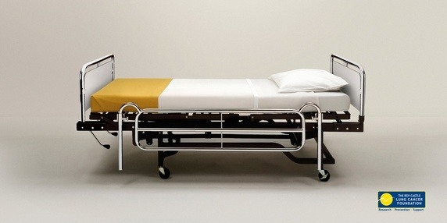

Slide 18


Slide 19


Slide 20


Slide 21
