Slide 1
Vehicle Brochures Print files - Download link

Slide 2
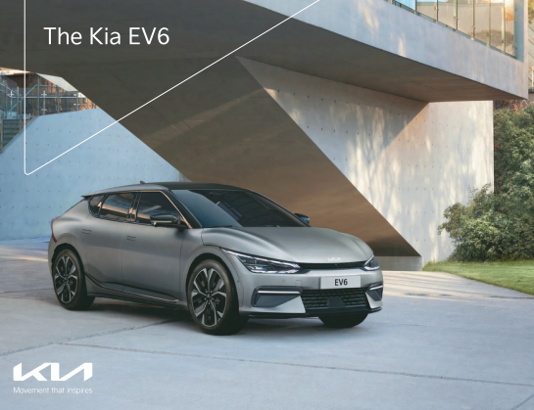



Brochures
EV6 Brochure 9th April
KIA Seltos 9th April
KIA Sonet 9th April

Slide 3
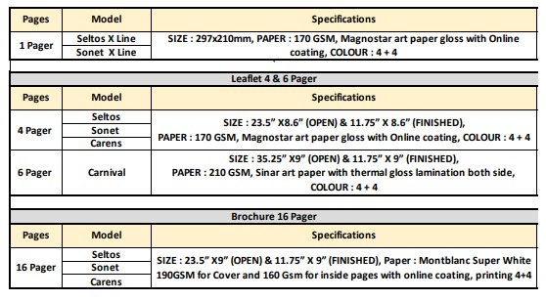
Brochures Printing Specs

