Slide 1
Emotion Classification
- Teaching a Computer to read feelings
Name: Ravisankar

Slide 2
The big Problem: Text has no tone
“I’m fine.” -> (Angry)? (Sad)? (Happy)?
Why does this matter?
Understanding customers (customer support)
Mental Health (spotting crisis)
Content moderation (finding harmful content)

Slide 3
Goal
To build a program that can read a short message and classify it into one of six emotions.
Data:
A collection of over 400,000 text messages.
Each message was already labeled by a human with one of these feelings
Labels: Sadness, Joy, Love, Anger, Fear, and Surprise.

Slide 4
What’s in the Data
Total Messages: 416,809
Duplicates Found: 686
Missing Data: None
Example Messages:
Label 0 (Sadness): “I dont know I feel so lost”
Label 1 (Joy): “ive enjoyed being able to slouch about relax”
Label 4 (Fear): ”I just feel really helpless and heavy hearted”

Slide 5

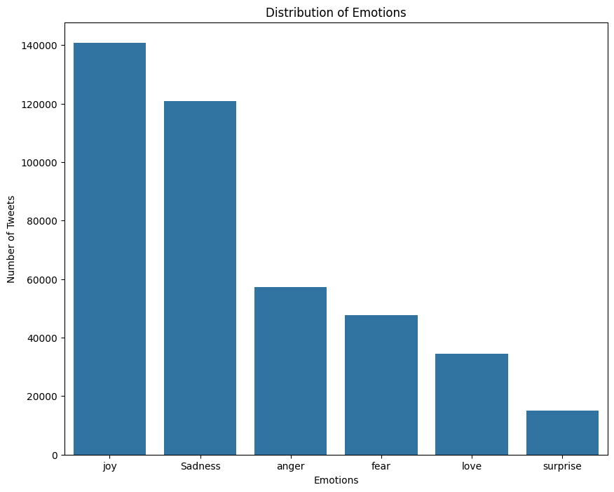
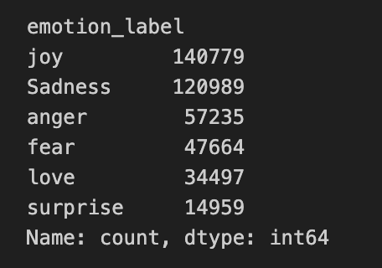
A big problem

Slide 6
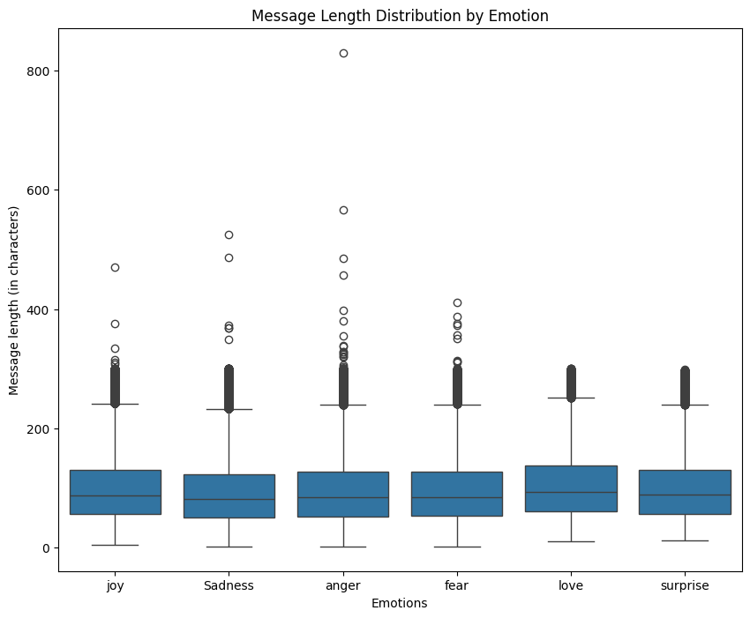
How long are the messages?
Most messages are between 50 and 130 characters.
The average is pretty similar for all emotions.
”Fear” and ”Sadness” seem to have really long messages.

Slide 7
Cleaning Up the messy Text
Computers are very literal. They don’t know that ”running”, “ran”, and “run” are basically the same word.
Cleaning Checklist:
Make everything Lowercase (“Hello” -> “hello”)
Remove all punctuation (“lost!” -> “lost”)
Remove Stopwords (like ’the’, ’is’, ‘a’)
Get the root of each word

Slide 8
The ‘not’ problem
Sentence 1: “I am feeling happy” -> (Joy)
Sentence 2: “I am not feeling happy” -> (Sadness/Anger)
Most ‘stopword’ lists include words like ’not’, ‘no’, ‘never’.
Solution:
Took the standard stopword list
Removed all the negative words from the list.

Slide 9
Finding the ‘Root’ word
We want the model to know that ‘love’, ‘loving’, and ‘loved’ are all the same idea.
This is called Lemmatization.
It’s like a smart dictionary lookup.
But it needs help!
Is ‘studying’ a verb or a noun?
Used a tool called Part-of-Speech (POS) Tagger to find out.
lemmatizer.lemmatize(word, pos=pos)

Slide 10


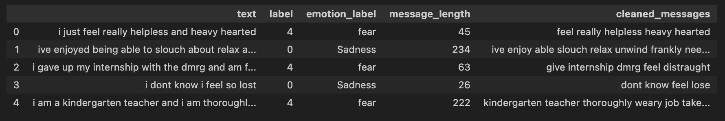
“Before” and “After”

Slide 11
Turning words into numbers
Computers don’t read words, they read numbers.
The Idea: A “Smarter” Bag of Words (TF-IDF)
TF (Term Frequency): How often does a word appear in one message?
IDF (Inverse Domain Frequency): How often does the word appear in all messages?
Result: Important, rare words get the highest scores.

Slide 12
Turning words into numbers
Computers don’t read words, they read numbers.
The Idea: A “Smarter” Bag of Words (TF-IDF)
TF (Term Frequency): How often does a word appear in one message?
IDF (Inverse Domain Frequency): How often does the word appear in all messages?
Result: Important, rare words get the highest scores.

Slide 13
Splitting the data
Split:
Training Set (70%): The model learns from this (~291k messages).
Validation Set (15%): I use this to tune the model (~62k messages).
Test Set (15%): The model only sees this once at the very end (~62k messages).

Slide 14
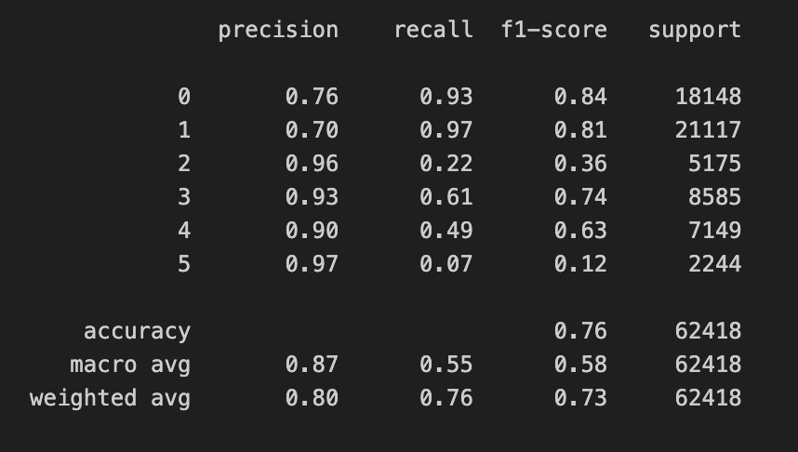
Attempt 1a: Naïve Bayes
Naïve Bayes (The Simple Baseline)
A simple model that just looks at how often words (like “helpless”) appear with emotions (like “fear”).
Accuracy: 76.0%

Slide 15
Attempt 1a: Naïve Bayes
Naïve Bayes (The Simple Baseline)
A simple model that just looks at how often words (like “helpless”) appear with emotions (like “fear”).
Accuracy: 76.0%

Slide 16
Attempt 1B: logistic regression
Logistic Regression (Smarter & Balanced)
A more robust model that’s great for this kind of problem.
Used a setting called class_weight=‘balanced’
Accuracy: 88.7%

Slide 17
Attempt 1c: support vector
Support Vector (The “Line Drawer”)
This model is really good at finding the ‘line’ that best separates the different groups of emotions.
Also used class_weight=‘balanced’
Accuracy: 88.6%

Slide 18
What’s missing
TF-IDF is smart, but it has a big weakness: it completely ignores word order and context.
It sees these two sentences as identical:
”I love that you are not sad.”
“I am sad that you are not in love.”
(It just counts ‘I’, ‘am’, ‘love’, ‘sad’, ‘not’, ‘that’, ‘you’, ‘are’)
To get better, we need a model that can read the sentence word by word.

Slide 19
A new way of “reading”
New Plan:
Word Embeddings: A smarter dictionary that knows “happy” is closer to “joyful” than it is to “angry”.
Recurrent Neural Networks (RNNs): A type of model that reads a sentence one word at a time, remembering what came before.

Slide 20
A new Cleaning process
These new models are so smart, they can learn from more data.
Old way (for ML): Removed punctuation, stopwords, and found root words.
New way (for DL):
Make everything lowercase.
Remove punctuation.
We keep the stopwords. We keep the original words (‘loving’ instead of ‘love’). We let the model figure it out.

Slide 21
Attempt 2a & 2b: Simple RNN and LSTM

Slide 22
Attempt 2c: the ”Two-way reader”
The “Two-Way” Reader (Bidirectional-LSTM)
The Idea: What if the model could read the sentence twice?
Once from Left-to-Right (“i am feeling happy”)
And once from Right to Left (“happy feeling am i”)
Accuracy: 94.0%

Slide 23
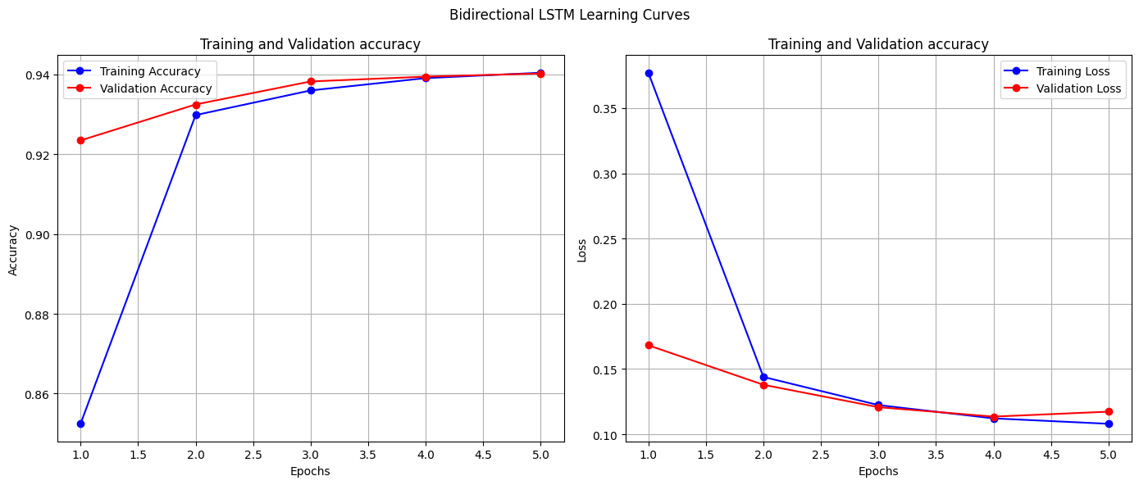
Attempt 2c: the ”Two-way reader”

Slide 24
Attempt 2d: the “big league”
The “Big League” (DistilBERT)
A type of “Transformer” model. This is the same technology behind things like ChatGPT.
It’s pre-trained on all of Wikipedia and a huge library of books.
It doesn’t just know word meanings; it understands grammar, context, and sarcasm before we even start.

Slide 25
Attempt 2d: the “big league”
Trained it for 3 cycles.
Final Test Accuracy: 94.1%

