Slide 1
Personalized news recommendation system
Team members:
Ann Rose Joju Edakkalathur
Dong Gyu Noh
Ravisankar Chengannagari

Slide 2
The Problem
Thousands of articles are published daily.
Users spend limited time on apps.
Generic feeds fail to engage users.
News articles have short lifespans, relevance fades quickly
Users rarely rate articles, personalization must rely on implicit feedback (clicks)
Interests shift dynamically; models must adapt to changing behavior
The Goal: Build a system that suggests articles based on personal interests.

Slide 3
Project Objective
To analyze user reading behavior.
To build different types of recommendation models (Traditional vs Deep Learning).
To compare which model predicts user clicks the best.
Handle implicit feedback and class imbalance
Capture both short-term and long-term user interests
Evaluate models using ranking metrics (AUC, MAP, NDCG)

Slide 4
Dataset overview
Source: Microsoft News Dataset (MIND)
News Data: 50,000+ articles
User Data: 150,000+ interactions
Two files: news.tsv (article metadata), behaviors.tsv (user logs)
Rich textual fields: title, abstract, entities
Impression logs encode click vs non-click behavior

Slide 5
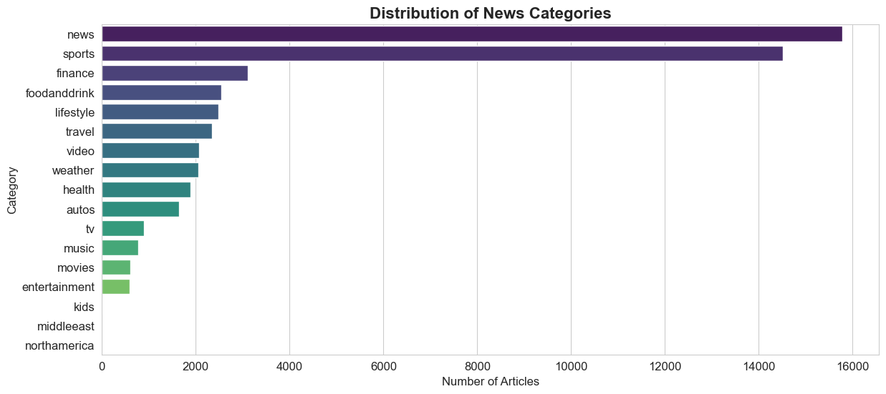
Data Analysis - Categories
Most popular categories: News, Sports, Finance.
Least popular: Kids, Middle East.

Slide 6
Data Preprocessing
Text Cleaning
    Removed punctuations,
    lowercase conversion
Tokenization
Padding: Made all titles the same length for models.

Slide 7
Methodology
Baseline
    Popularity Based
Traditional
    Content-Based
    Collaborative Filtering
Advanced (Deep Learning)
    RNN, LSTM, Bi-LSTM
    Transformer

Slide 8
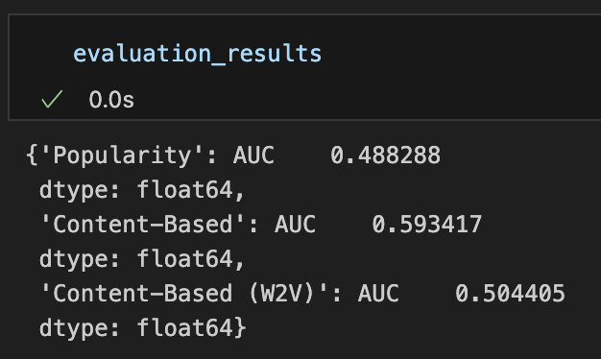
Model 1&2: Popularity and Content-based
Popularity: Recommends what everyone else is clicking. (Simple, but not personalized)
Content-Based: ‘If you read sports, we show you sports.’
    Technique: Used TF-IDF and Word2Vec

Slide 9
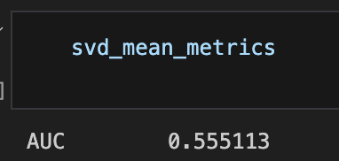
Model 3: Collaborative Filtering
Idea: “Users similar to you liked this.”
Method: Singular Value Decomposition (SVD).
Result: Good at finding hidden patterns but struggles with new articles.

Slide 10
Deep Learning
Treats reading history as a sequence.
Order matters: What you read yesterday impacts what you want today.
Used “Word Embeddings” to represent news titles.

Slide 11
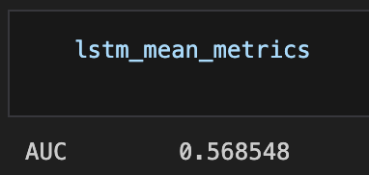
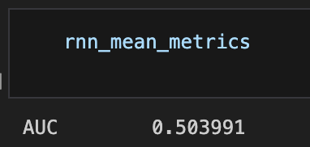
Model 4 & 5: Hybrid RNN AND LSTM
RNN (Recurrent Neural Network): Basic memory of past clicks.
LSTM (Long Short-Term Memory): Can remember long-term interests (e.g., you always like Politics) and short-term interests (e.g., you are following the Olympics right now).

Slide 12
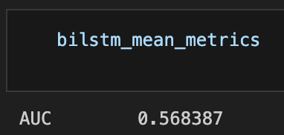
Model 6: Hybrid Bi-LSTM
Bi-Directional LSTM: Reads the history forwards and backwards.
Benefit: Understands the context better than the standard LSTM.
Result: Almost same result as LSTM

Slide 13
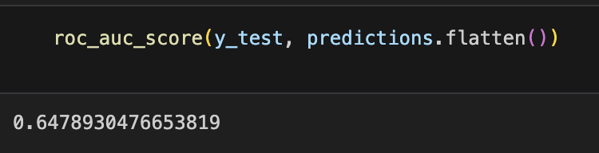
Model 7: Transformer (NRMS)
Neural News Recommendation with Multi-Head Self-Attention
It weighs which past articles are most important for the current prediction.
Performance: The strongest model in our experiment.

Slide 14
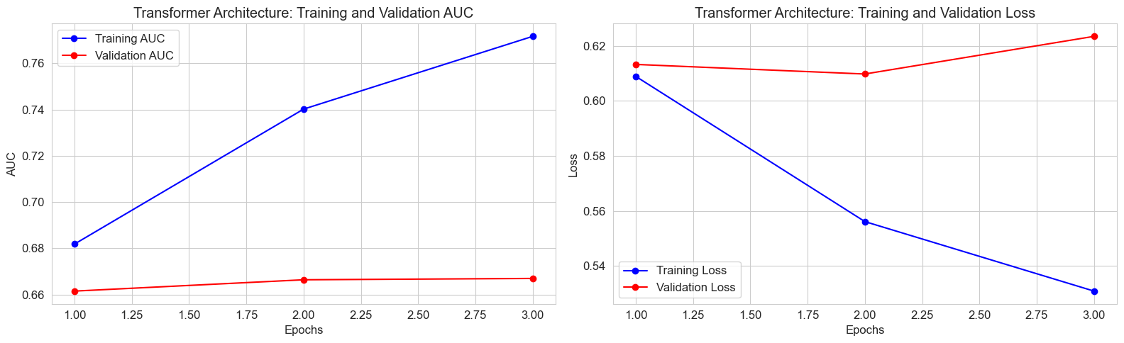
Model 7: Transformer (NRMS)

Slide 15
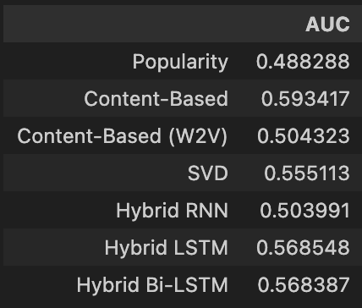
Results comparison
NRMS got 0.65 approx.

Slide 16
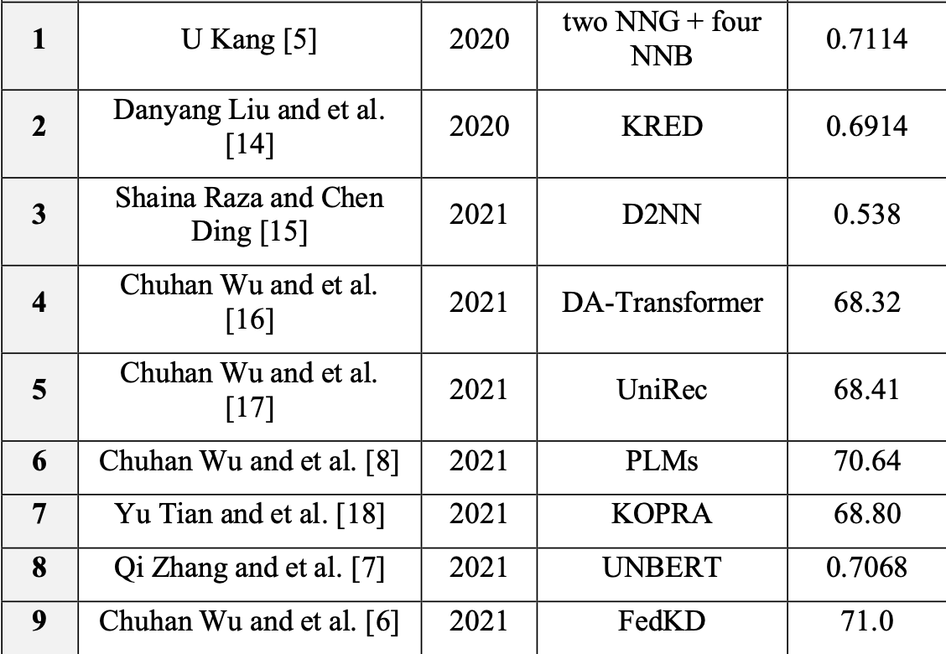
Results comparison
Our model got 0.65 approx.
Paper: User Recommendation System based on MIND Dataset, Niran A. Abdulhussein, Ahmed J. Obaid

Slide 17
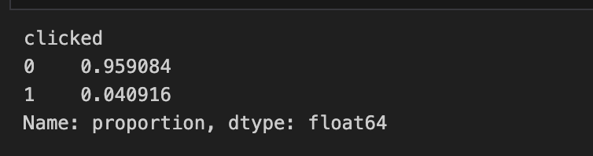
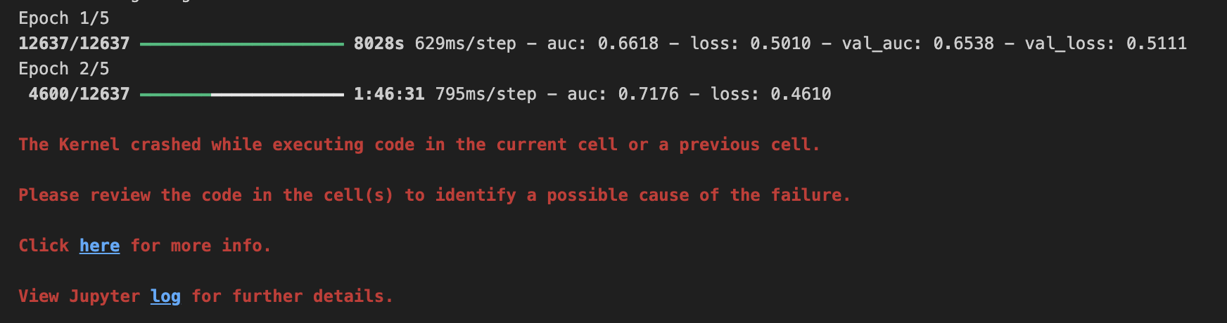
Challenges faced
Data Imbalance
    More non-clicks than clicks.
Computation
    Deep learning models take a long time to train.

Slide 18
Questions?

Slide 19

Thank you

