Slide 1
FACILITATING COMMONING WIREFRAME
Along with the presentation please find below the link to the initial draft of the
Web Repository Design for your reference.
https://canva.link/etnv6b7t4xbphva

Slide 2
Facilitating Commoning Component of Commons Platform:
The Philosophy behind the Web Repository
Purpose: a learning system that enables ecosystem actors to understand and facilitate the Commoning of Commons.
USER JOURNEY Learn the approach – Understand Commoning → Choose a resource system → Follow the process → Access learning resources
1. ORIENT
What is this repository?
[Users understand what the Karyashala Repository is and what it can help them do]
2. UNDERSTAND
What is Commoning?
[The meaning of Commoning of Commons]
3. LEARN
How does capacity building work?
- Understand how capacity building and continuous learning support Commoning and two methods of doing it
4. CHOOSE
Pastureland / Forest / Water
- Select the natural-resource system or theme they are interested in—Pasturelands, Forests or Water
5. ACT Use resources in sequence
- Based on he need users can access resources in a logical sequence and use them to facilitate processes on the ground
Design principle: The repository will be organized around the learner’s task and the Commoning process—not around file types. Each resource-system page should show the process/ pathway first, then the resources needed at each step.
Notes:
This slide establishes the basic philosophy of the website. The repository should not function simply as a digital library where users arrive and see folders, PDFs, videos and training materials. Instead, it should guide on understanding how the learning journey is designed.

Slide 3
1. Proposed information architecture
Top navigation stays simple; deeper content is reached through guided pathways.
HOME
LEARNING APPROACH (CB Approach and design)
COMMONING OF COMMONS
RESOURCE SYSTEMS AND THEMES
Pastureland | Forest | Water
RESOURCE LIBRARY
HELP
PASTURELAND
FORESTS
WATER
THEME 1
Each resource system → Commoning pathway (process) → stages/steps → learning modules/ tools/ resources
Notes:
At the top is Home, from where the user can access six broad areas:
About → Commoning of Commons → Learning Approach → Resource Systems → Resource Library → Help

Slide 4
1- HOMEPAGE -1
Facilitating Commoning/ PoC Logo
Home
Commoning of Commons
Learning Approach
Resource Systems and Themes
Resource Library
Help
Search
ABOUT THE REPOSITORY
[2–3 lines: Introduce the purpose - Web Repository as a learning system that supports ecosystem actors to build capacities and facilitate the Commoning of Commons. Explain what users can learn and access here.]
Know More →
COMMONING OF COMMONS
CAPACITY BUILDING APPROACH
[2–3 lines: Explain that Commoning involves communities collectively securing, governing, restoring and sustainably managing their shared natural resources, with community agency at the center.]
Explore More →
[2–3 lines: Explain the learning design—Modular Learning and LDHF—and how continuous learning, field application and guided support help translate training into action.]
Explore More →
EXPLORE BY RESOURCE SYSTEM OR THEME (Marquee)
[Choose the natural-resource system you are working with to understand its Commoning process and access the relevant learning pathway.]
PASTURELANDS
FORESTS
WATER
[1–2 lines: What Commoning of pasturelands involves- community institutions, tenure/recognition, collective rules, restoration and sustainable use.]
[1–2 lines: What Commoning of Forest Commons involves - community rights, institutions, collective governance, conservation and sustainable management.]
[1–2 lines: What Commoning of water resources involves - collective institutions, equitable access, planning, management and stewardship.]
Explore More →
Explore More →
Explore More →
RESOURCE LIBRARY
[Latest Resource 1] [Type • Resource system]
[Latest Resource 2] [Type • Resource system]
[Latest Resource 3] [Type • Resource system]
Latest updates / recently added resources
Read More →
On the Home Page – Include Take a Tour or Get Started - Kind of pop-up on the landing page.
Notes:
Navigation logic: About → Commoning → Learning Approach → Resource System pathway → Resources. Direct Resource Library access remains available, but the homepage first explains the repository and its learning logic.

Slide 5
1- HOMEPAGE - 2
Facilitating Commoning/ PoC Logo
Home
Commoning of Commons
Learning Approach
Resource Systems and Themes
Resource Library
Help
Search
The first element –
Commoning of Commons: Learn. Facilitate. Act.
(1-2 line explainer for about the repository - on why and what this repository enables)
CALL TO ACTION (Clicking guides user to the relevant page)
Start Learning
Choose a Resource System or Theme
INTRODUCTORY BLOCK 1
What is Commoning?
INTRODUCTORY BLOCK 2
How Learning Enables Action?
INTRODUCTORY BLOCK 3
Choose Your Commons
[gives a very short explanation and allows interested users to learn more.]
[gives a very short explanation and allows interested users to learn more.]
[gives a very short explanation and allows interested users to learn more.]
Learn More → (Guides user to relevant page)
Learn More →
Learn More →
RESOURCE LIBRARY
[Latest Resource 1] [Type • Resource system]
[Latest Resource 2] [Type • Resource system]
[Latest Resource 3] [Type • Resource system]
Latest updates / recently added resources
Quick Access →
On the Home Page – Include Take a Tour or Get Started - Kind of pop-up on the landing page.
Notes:
Navigation logic: About → Commoning → Learning Approach → Resource System pathway → Resources. Direct Resource Library access remains available, but the homepage first explains the repository and its learning logic.

Slide 6
Alternatively ideas – to make the site more engaging and to add some interesting elements on the homepage:
Featured learning resource — Instead of only showing “Latest Resources,” periodically one useful resource may be highlighted, For e.g.: Featured this month: Facilitator Guide for… … with a short explanation of what it helps one do. (homepage will feel active and curated)
A very simple callout saying - “New to Commoning of Commons? Start with this 5-minute introduction.” Add link to an existing video here from YouTube.
For Commoning of Commons - An interactive “Commoning Journey” strip - where instead of explaining the entire Core Model in text, show a simple visual pathway such as Build collective institutions → Secure tenure → Plan to Restore & manage = Ecological heath, social well-being and resilient livelihoods. A user could hover or click each stage for a one-line explanation and then select - Explore the Commoning Process.
“Commoning in Action” — A visually engaging section with 2–3 short field stories, photographs or examples showing what Commoning looks like on the ground. For example: “How a Gram Sabha strengthened governance of its Forest Commons” or “How communities developed rules for managing pasturelands.” Each could have a Read the Story → link. This would make the fairly conceptual idea of Commoning more tangible. BUT THIS MAY BE REPETETIVE as other sections may also have some thing similar.

Slide 7
4. Learning Approach — from information to action
Home
Learning Approach
Commoning of Commons
Resource Systems and Themes
Resource Library
Search
COMMON PURPOSE: build stakeholder capacities + handhold learners as they translate training inputs into action on the ground.
[Commoning is a continuous process that requires ongoing learning, field application, reflection, and handholding, rather than a one-time transfer of information.
TWO METHODS OF LEARNING FOR FACILITATING COMMONING
MODULAR LEARNING DESIGN
• Breaks complex learning into manageable, progressive stages (Commoning process broken into a series of modules) • In-person sessions at periodic intervals • Field activities between modules • Each module builds on prior learning and action • Cumulative field actions contribute to outcomes
[Modular Design Image]
LOW DOSE HIGH FREQUENCY (LDHF)
• Short, frequent virtual learning engagements • Atomized content focused on specific concepts/tasks • Guided mentoring between sessions • Repeated learning–application–feedback cycles • Enables timely support while action is underway
[LDHF image)
Link to the Karuashala Operations manual →
Link to the Guided Mentoring module →
The LDHF design complements the modular approach by enabling continuous learning and reinforcement between formal training interventions.
[Learning Action Cycle Image]

Slide 8
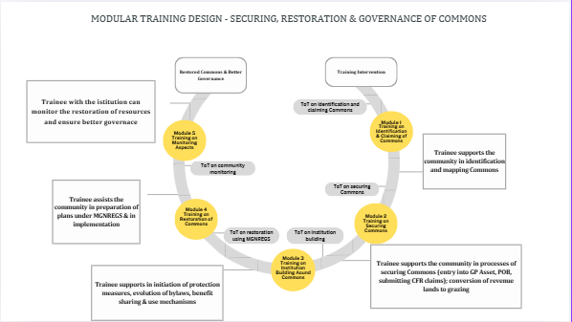
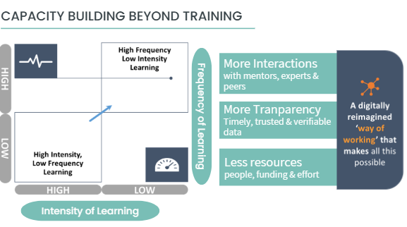
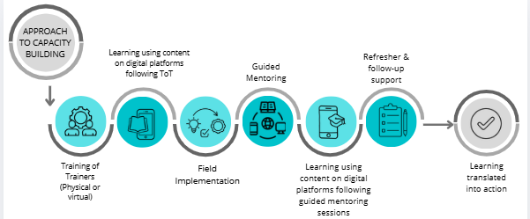
Modular Training Design
LOW DOSE HIGH FREQUENCY (LDHF)
Approach to Outcome based Learning

Slide 9
2. Commoning of Commons (concept + approach)
Home
Learning Approach
Commoning of Commons
Resource Systems and Themes
Resource Library
Search
WHAT DOES ‘COMMONING OF COMMONS’ MEAN? (Section explains what Commoning of Commons means in simple language)
WHY IS COMMONING IMPORTANT OR WHY IT MATTERS [Communities exercise custodianship and agency over shared natural resources; collective institutions make decisions and sustain action over time.]
APPROACH TO COMMONING OF COMMONS
(KEY PILLARS OF COMMONING)
INSTITUTION BUILDING & GOVERNANCE + TENURIAL SECURITY +RESTORATION & SUSTAINABLE MANAGEMENT
COMMUNITY AGENCY IS THE COMMON THREAD ACROSS ALL THREE: communities understand rights and responsibilities, deliberate collectively, make informed decisions, act, reflect and adapt.
(To link need and importance of capacity building to build agency, knowledge and capacity)
Notes:
This sections explains - before I use these resources, what exactly am I trying to facilitate?
Community Agency to be shown as a thread running through all three components of the Core Model.
The idea is that - Communities need the knowledge, confidence, institutional capacities and opportunities to understand, deliberate, decide, act and adapt.
This then creates a logical transition into the next page - how do we build this agency and capacity through facilitating learning?

Slide 10
5. Resource Systems And Themes
Home
Learning Approach
Commoning of Commons
Resource Systems and Themes
Resource Library
Search
SELECT THE COMMONS (RESOURCE-SYSTEM) OR THEME YOU ARE WORKING WITH [Each pathway explains the process first and then provides resources in the order they are likely to be used.]
PASTURELAND [Process - Image] [Link to Process Documents (of three States]
[Begin your Learning Journey/ Access Resource →]
FORESTS [Process - Image] [Link to Process Documents (of three States]
[Begin your Learning Journey/ Access Resource →]
WATER [Process - Image] [Link to Process Documents (of three States]
[Begin your Learning Journey/ Access Resource →]
MULTI-ACTOR PLATFORMS [Brief description] [Begin your Learning Journey/ Access Resource →]
LOCAL ECONOMIC OPPORTUNITIES [Brief description] [Begin your Learning Journey/ Access Resource →]
SUSTAINABLE AGRICULTURE PRACTICES [Begin your Learning Journey/ Access Resource →]

Slide 11
6. Resource-systems - Information Page
Use the same page logic for Pastureland, Forests and Water.
Home
Learning Approach
Commoning of Commons
Resource Systems and Themes
Resource Library
Search
FORESTS / PASTURELAND / WATER [Resource-system introduction + intended users + expected outcome]
Refer to Slide 10
COMMONING PATHWAY / PROCESS ]Key Steps of Process/ stages of Commoning Image : Understand context → Build institutions → Secure tenure → Plan → Restore/manage → Monitor & adapt
(Link To process Documents)
Learning Design and Materials
(1-2 lines of the training design, whether modular and LDHF – how the can be delivered.)
Refer to Slide 12
(DESIGN OF MODULAR LEARNING AND SUPPORTING RESOURCES PAGE)
Refer to Slide 11
(DESIGN OF ATOMISED COURSE CURRICULUM PAGE AND ATOMISED CONTENT)
Atomized Course Curriculum
(Low Dose High Frequency) and Learning Materials→
Modular Learning →
Supporting Resources →
ON SELECTION OF THE OPTION – DISPLAY THE RELEVANT TRAINING CONTENT? MATERIALS/ MODULES BELOW (With the resource card)
RESOURCE CARDS FOR All CONTENTS/ TRAINING RESOURCES
[Title] [Purpose] [For whom] [Format] [Language] [Download/View] Filters: stakeholder | format | language | stage
Notes:
clicking a resource should open a resource information page, rather than immediately downloading a file. That page can explain:
What is this resource? → When should I use it? → Who should use it? → What should happen before/after it? → How should I facilitate/use it? → What field action follows? → What other resources are connected to it?
Metadata that should accompany every resource—title, purpose, resource system, Commoning stage, intended user, learning design, type, language, duration, version/date and download/view option.
This metadata is what makes the search and filters on Slide 10 possible.

Slide 12
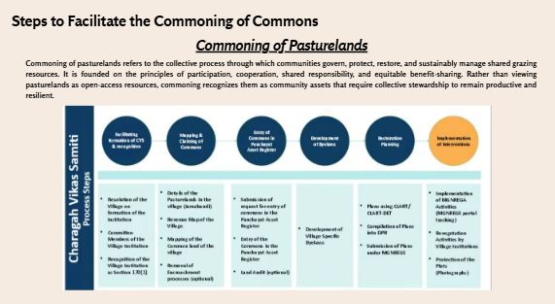
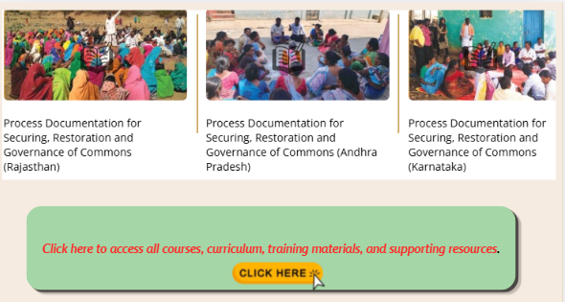

Slide 13
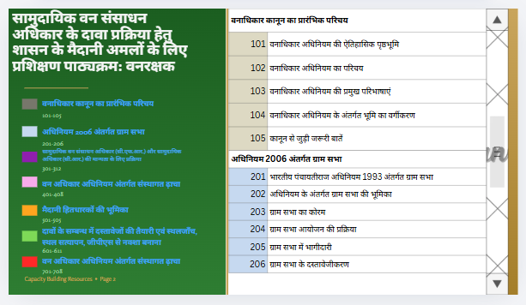
Atomized Course Curriculum
(Low Dose High Frequency) and Learning Materials→
DESIGN OF ATOMISED COURSE CURRICULUM PAGE AND ATOMISED CONTENT
Note: Clicking on the Topics or sub-topic - link should redirect user to the relevant content (on the repository page)

Slide 14
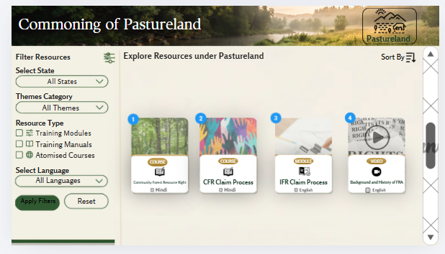
Modular Learning and Supporting Resources Materials→
DESIGN OF MODULAR LEARNING AND SUPPORTING RESOURCES PAGE
Note: Clicking on Modular Learning or Supporting Resources - link should redirect user to the relevant content (on the repository page).

Slide 15
6. Themes - Information Page
Use the same page logic for all themes.
Home
Learning Approach
Commoning of Commons
Resource Systems and Themes
Resource Library
Search
THEME [Purpose of working on this theme and it’s relevance Linking it to Commons + intended users + expected outcome]
Learning Design and Materials
(1-2 lines of the training design, whether modular and LDHF – how the can be delivered.)
Supporting Resources
(Such as
Handbooks,
Facilitators’ Guide,
SoPs, formats, etc.)
Course Curriculum Atomized Learning (Low Dose High Frequency) →
Modular Learning →
ON SELECTION OF THE OPTION – DISPLAY THE RELEVANT TRAINING CONTENT? MATERIALS/ MODULES BELOW (With the resource card)
RESOURCE CARDS FOR All CONTENTS/ TRAINING RESOURCES
[Title] [Purpose] [For whom] [Format] [Language] [Download/View] Filters: stakeholder | format | language | stage

Slide 16
7. Resource Library — find a specific resource
Home
Learning Approach
Commoning of Commons
Resource Systems and Themes
Resource Library
Search
SEARCH: [ Search by topic, process, tool or keyword… 🔍 ]
FILTERS Resource system □ Pastureland □ Forests □ Water Stage of Commoning Stakeholder Learning design Resource type Language
RESULTS Sort: Recommended / A–Z / Recently added
[RESOURCE TITLE] [1-line purpose] Tags: Forest | Tenure | Facilitator Guide | Hindi [View] [Download]
[RESOURCE TITLE] [1-line purpose] Tags: Forest | Tenure | Facilitator Guide | Hindi [View] [Download]
[RESOURCE TITLE] [1-line purpose] Tags: Forest | Tenure | Facilitator Guide | Hindi [View] [Download]
RESOURCE CARDS FOR All CONTENTS/ TRAINING RESOURCES [Resource Title] [Purpose] [For whom/ Intended User] [Resource Type] [Language] [Download/View] Filters: stakeholder | format | language | stage

Slide 17
8. Some additional points:
A consistent metadata structure will make the repository easier to navigate and maintain.
RESOURCE CARD For every resource uploaded — REQUIRED FIELDS • Resource title • 1-line purpose • Resource system or Theme • Commoning stage/process (display only if resource system selected) • Intended stakeholder/user • Learning design: Modular / LDHF / Both • Resource type • Language • Version/date • View / download
• Attribution to Contributor (For non-FES ecosystem actors)
NAVIGATION PRINCIPLES 1. Always show where the user is. 2. Keep the Commoning pathway visible on the resource system page. 3. Recommend the ‘next’ resource. 4. Use simple/ plain-language labels. 5. Keep search + filters available. 6. Use the same structure across all three resource systems. Similarly, keep the structure common for all the themes

