Slide 1
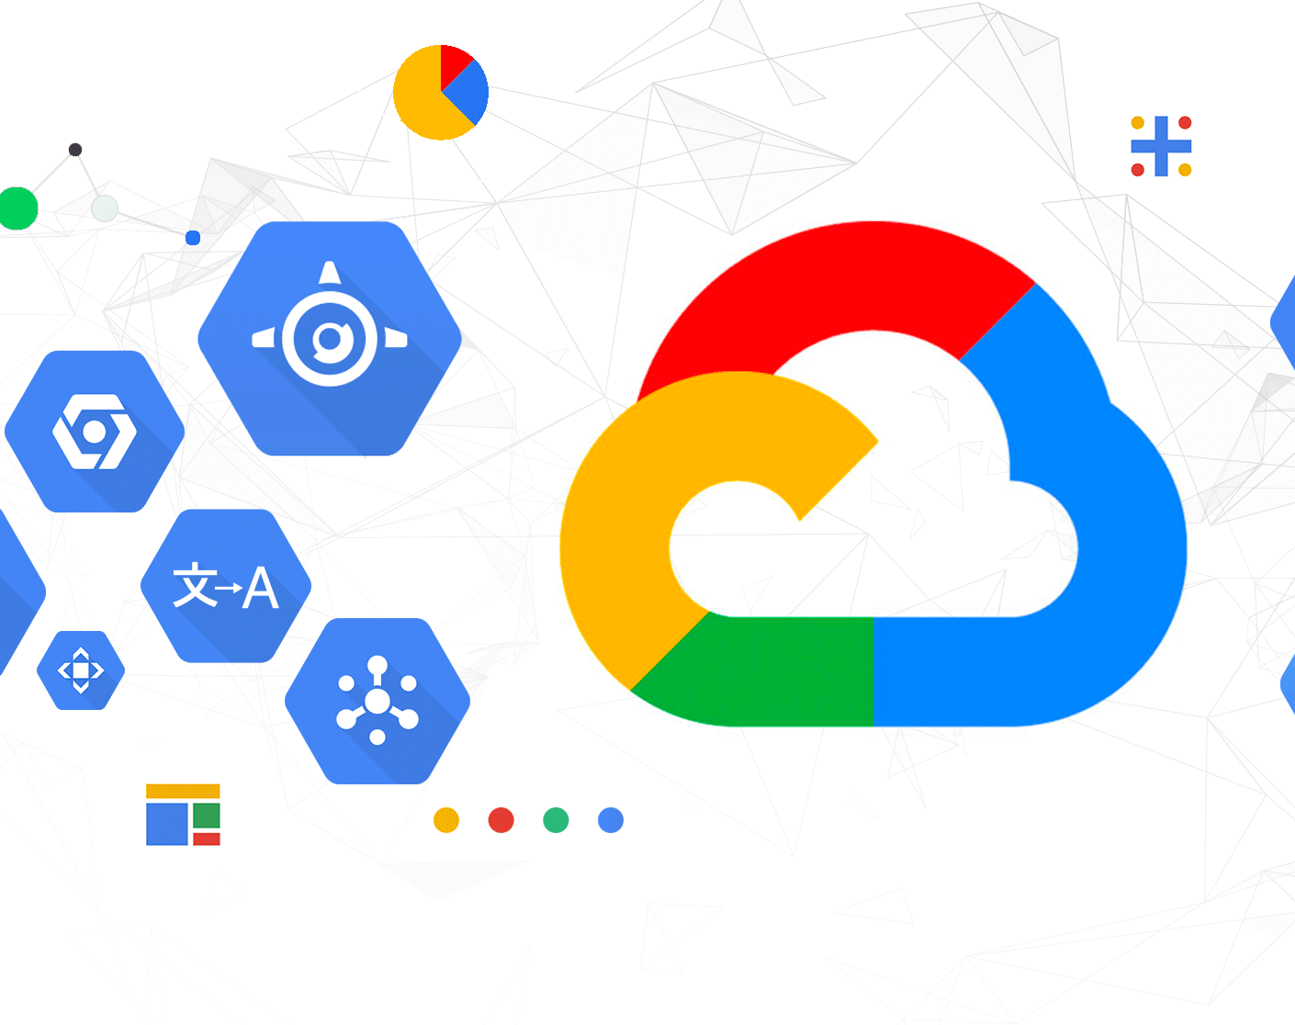
How to deploy Fast API python app to Google Cloud?

Slide 2
Prerequisites
Google Cloud account
gcloud CLI
Docker
Python

Slide 3
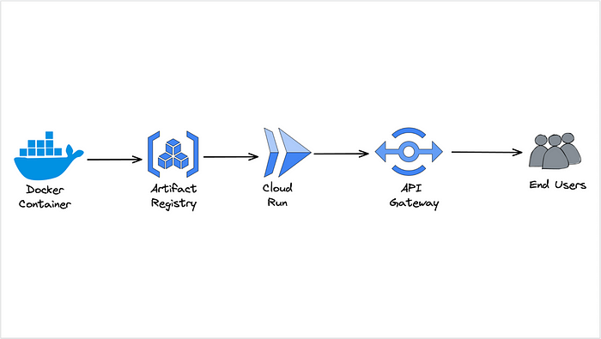

Slide 4
Step1: Creating the Fastapi Application and Dockerfile
Write code for fast application
Create a Dockerfile in the root directory
Build the Docker image
RUN Docker image
Push Docker image to hub

Slide 5
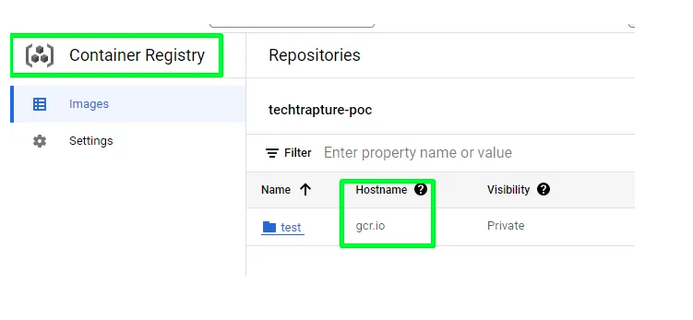
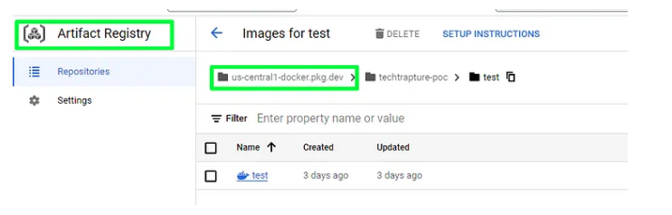
Step2: Host Docker to GCP
2 ways to host docker images on GCP
Google Container Registry
Google Artifact Registry
GAR | GCR
supports the creation of regional repositories, which allows you to put your artifacts and data directly in the location that they'll be used allowing for higher availability and speed | you’re limited to “multi-regions for example, the closest multi-region for Australia is Asia. However, with Artifact Registry’s regional support, you can create a repository directly in the Sydney data center.

Slide 6
Host docker to Google cloud Artifact Registry
we can push the image to Cloud Run, and then deploy it by using the following steps.
Prerequisites:
Install gcloud command line interface.
Set up our gcloud command line interface with project-specific data.
Have a project with billing correctly set up.
Enable the Cloud Run API.

Slide 7
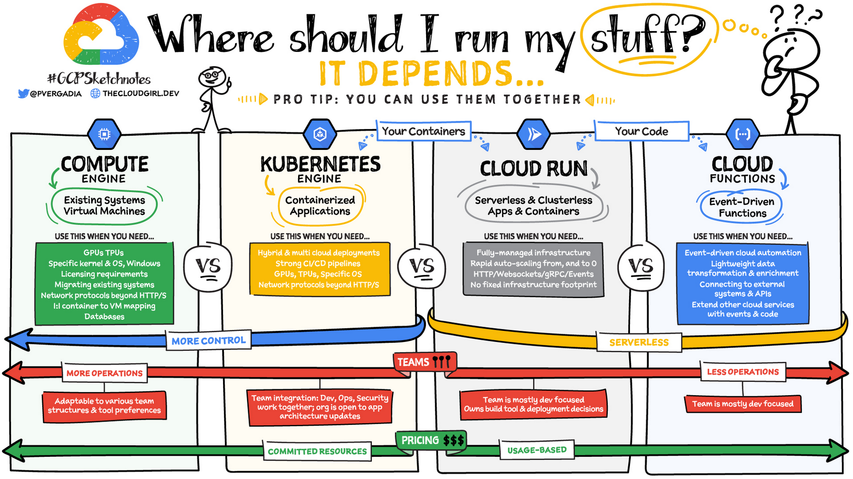
Step3: Deploy using Cloud Run

Slide 8
Commands Used:
docker build -t name .
docker push name
gcloud auth login
gcloud config set project project-id
gcloud artifacts repositories create demoregistry --repository-format=docker --location=us-central1 --description="fastapi”
gcloud builds submit --region=us-central1 --tag us-central1-docker.pkg.dev/project_id/demoregistry/name
gcloud run deploy --image=us-central1-docker.pkg.dev/project_id/demoregistry/name

Slide 9


Slide 10


