Slide 1
Defining Data Warehouse Concepts and Terminology
Chapter 3

Slide 2
Definition of a Data Warehouse
“ An enterprise structured repository of subject-oriented, time-variant, historical data used for information retrieval and decision support. The data warehouse stores atomic and summary data.”
Oracle Data Warehouse Method

Slide 3
Data Warehouse Properties
Subject
Oriented
Integrated
Data
Warehouse
Non Volatile
Time Variant

Slide 4
Subject-Oriented
Data is categorized and stored by business subject
rather than by application
OLTP Applications
Data Warehouse Subject
Equity
Plans
Customer
financial
information
Shares
Insurance
Savings
Loans

Slide 5




Integrated
Data on a given subject is defined and stored once.
Savings
Current
accounts
Loans
Customer
OLTP Applications
Data Warehouse

Slide 6
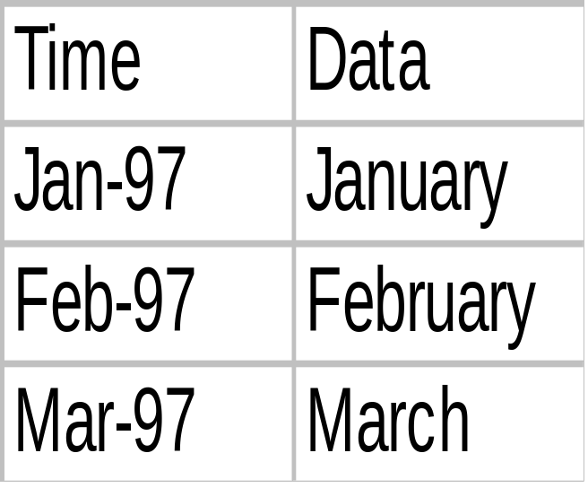
Time-Variant
Data is stored as a series of snapshots, each
representing a period of time

Slide 7
Nonvolatile
Typically data in the data warehouse is not updated or delelted.
Operational
Warehouse
Load
Insert
Update
Delete
Read
Read

Slide 8
Changing Data
First time load
Warehouse Database
Operational
Database
Refresh
Refresh
Refresh

Slide 9
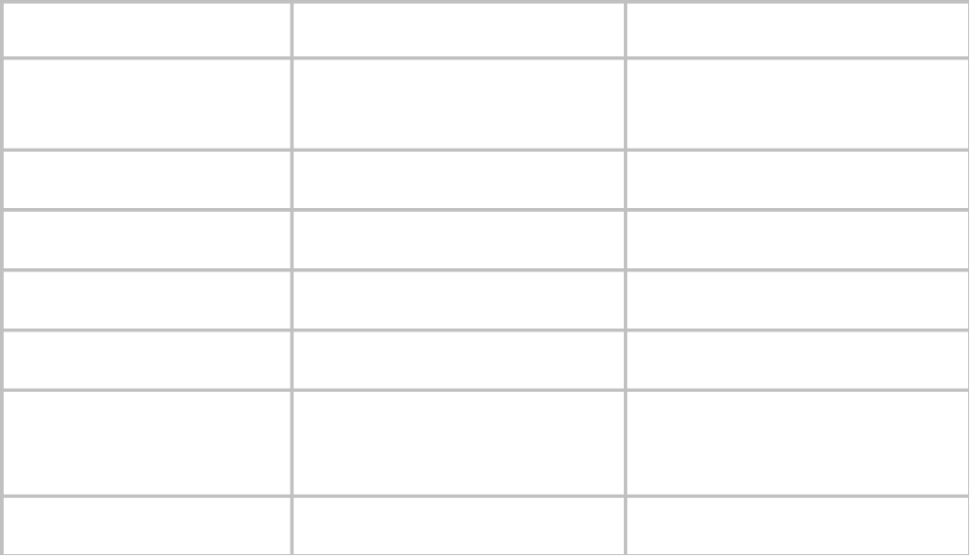
Data Warehouse Versus OLTP
Property
Operational
Data Warehouse
Response
Time
Sub seconds to
seconds
Seconds to hours
Operations
DML
Primarily read only
Nature of Data
30-60 days
Snapshots over time
Data Organization
Applications
Subject, time
Size
Small to large
Large to very large
Operational, Internal,
External
Data Source
Operational, Internal
Activities
Processes
Analysis

Slide 10
Usage Curves
Operational system is predictable
Data warehouse
- Variable
- Random

Slide 11
User Expectations
Control expectations
Set achievable targets for query response
Set SLAs
Educate
Growth and use is exponential

Slide 12
Enterprisewide Warehouse
Large scale implementation
Scope the entire business
Data from all subject areas
Developed incrementally
Single source of enterprisewide data
Single distribution point to dependent data marts

Slide 13
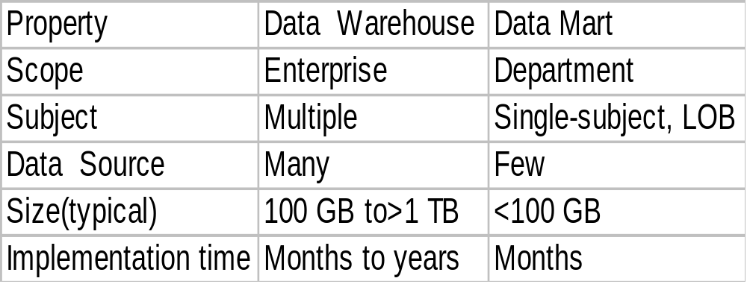
Data Warehouses Versus Data Marts
Data
Warehouse
Data
Mart

Slide 14

Dependent Data Mart
Flat Files
Marketing
Operational
Systems
Marketing
Sales
Finance
Human Resources
Marketing
Marketing
Data
Warehouse
External Data
Data Marts

Slide 15

Independent Data Mart
Flat Files
Operational
Systems
Sale or Marketing
External Data

Slide 16
Data Warehouse Terminology
Operational data store (ODS)
Stores tactical data from production systems that are subject-oriented and integrated to address operational needs
Metadata
Metadata

Slide 17
Data Warehouse Terminology
Enterprise data
warehouse
Architecture
Business
area
warehouse
Data
Integration
Source
data

Slide 18
Methodolgy
Ensures a successful data warehouse
Encourages incremental development
Provides a staged approach to an enterprisewide warehouse
- Safe
- Manageable
- Proven
- Recommended

Slide 19
Modeling
Warehouses differ from operational structures:
- Analytical requirements
- Subject orientation
Data must map to subject oriented information:
- Identify business subjects
- Define relationships between subjects
- Name the attributes of each subject
Modeling is iterative
Modeling tools are available

Slide 20
Extraction, Transformation, and Transportation
OLTP Databases
Staging File
Warehouse Database
Purchase specialist tools, or develop programs
Extraction-- select data using different methods
Transformation--validate, clean, integrate, and time stamp data
Transportation--move data into the warehouse

Slide 21
Data Management
Efficient database server and management tools for all aspects of data management
Imperatives
- Productive
- Flexible
- Robust
- Efficient
Hardware, operating system and network management

Slide 22


Data Access and Reporting
Simple Queries
Forecasting
Warehouse
Database
Drill-down
Tools that retrieve data for business analysis
Imperatives
- Ease of use
- Intuitive
- Metadata
- Training
More than one tool may be required

Slide 23
Oracle Warehouse Components
Any Source
Any Data
Any Access
Relational /
Multidimensional
Text, image Spatial
Web Audio
video
Relational
tools
Operational
data
OLAP
tools
External
data
Applications/Web

Slide 24
Oracle Data Mart Suite
Data Modeling
Oracle Data Mart Designer
OLTP
Databases
Data Mart
Database
Ware-
housing
Engines
OLTP
Engines
SQL*Plus
Data
Extraction
Oracle Data Mart
Builder
Data
Management
Oracle Enterprise
Manager
Data Access
& Analysis
Discoverer &
Oracle Reports

Slide 25
Data Mart Implementation with the Oracle Data Mart Suite
Oracle Enterprise Server
Oracle Enterprise Manager
Oracle Data Mart Builder
Oracle Data Mart Designer
Oracle Discoverer
Oracle Web Application Server
Oracle Reports

Slide 26
Oracle Warehouse Builder Architecture
Extraction
Facilities
Loader
Remotes SQL
Gateways
- OLE-DB/ODBC
- Mainframe
- Specialized
ERP Data
- SAP
- Peoplesoft
- Oracle
Sources
PL/SQL, Java
Transforms
Target
Tables
Filter
Transform
Transform
Driver
PL/SQL, Java
Wrapper
Oracle 8i
External
Functions

Slide 27



Oracle Business Intelligence Tools
IS develops
user’s Views
Business users
Analysis
Current
Tactical
Strategic
Oracle Reports
Oracle Discover
Oracle Express

Slide 28
The Tool for Each Task
Tool
Task
Question
Production
reporting
Ad hoc
query and
analysis
Advanced
analysis
What were sales by
region last quarter?
Oracle
Reports
What is driving the
increase in North
American sales?
Oracle
Discover
Given the rapid increase
in Web sales, what will
total sales be for the rest
of the year?
Oracle
Express

Slide 29

Oracle Warehouse Services
Oracle
Education
Oracle
Consulting
Customers
Oracle Support Services

Slide 30
Summary
This lesson covered the following topics:
Identifying a common, broadly accepted definition of the data warehouse
Distinguishing the differences between OLTP systems and analytical systems
Defining some of the common data warehouse terminology
Identifying some of the elements and processes in a data warehouse
Identifying and positioning the Oracle Warehouse vision, products, and services

