Slide 1

SQL Project On
Music Store Data Analysis
Presented by : RAVINDRA NADH
CHANDU NAYAK
ANIL RATHOD
Batch no : 403
INNOMATICS RESEARCH LABS
DISUKHNAGAR BRANCH

Slide 2


Slide 3
Introduction:
Project Overview:
1. Developed a comprehensive SQL database for a music store
2. Efficiently manages sales, customers, employees, and business operations
Key Entities & Tables:
Music Catalog: Genres, Media Types, Artists, Albums, Tracks
Business Operations: Customers, Employees, Invoices, InvoiceLine
Extras: Playlists,Playlist track
Business Insights & Analytics:
1. Identify top customers and revenue drivers
2. Determine best-selling genres and popular artists
3. Enable data-driven decision-making
Practical Application:
1. Foundation for reporting and analytics in music retail
2. Demonstrates real-world SQL querying for business needs

Slide 4
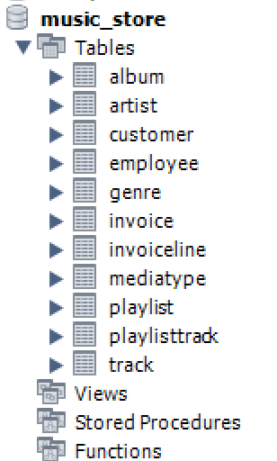
Creating Tables
The project starts by building structured tables to store data for the music store. These tables include details about genres, mediatype, employee, playlist, customer, artist, album, track, invoice, invoiceline,playlisttrack . To maintain data accuracy and establish clear relationships between different entities, both primary keys and foreign keys are implemented.

Slide 5
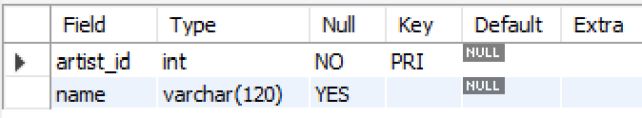
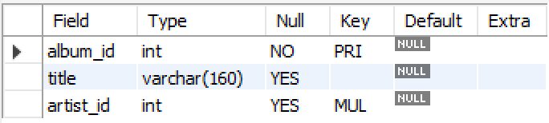
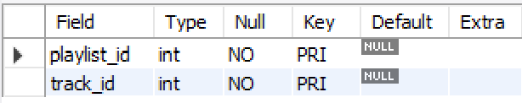
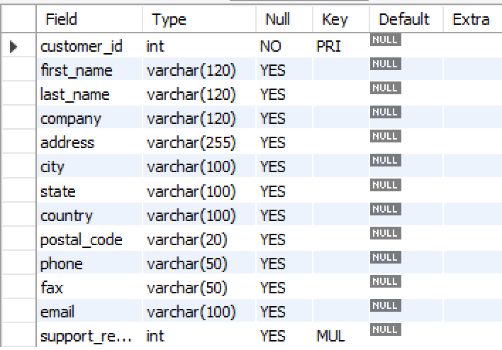
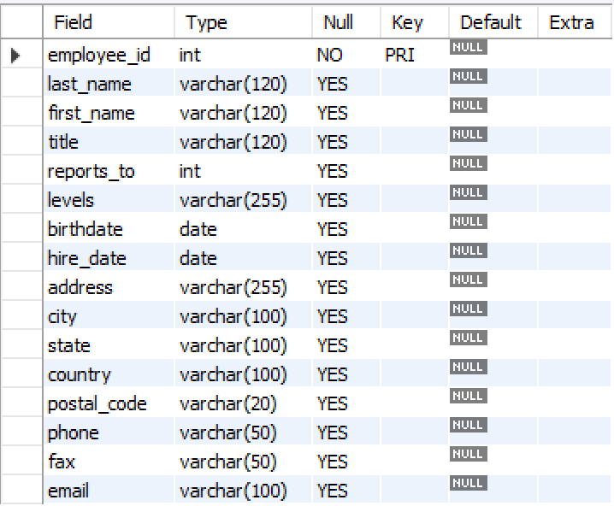
About tables
Artist table
Album table
Track table
Customer table
Employee table

Slide 6
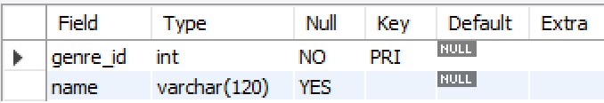
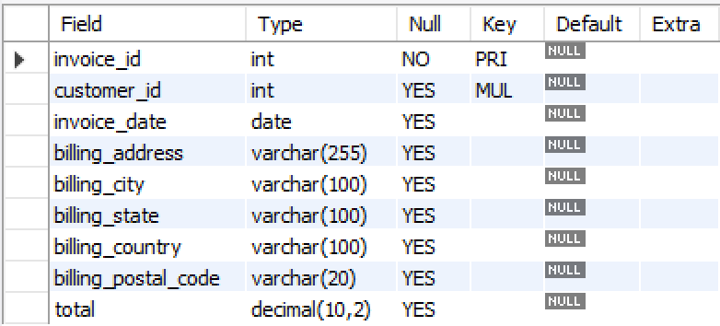
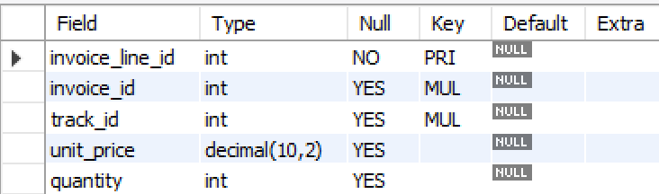
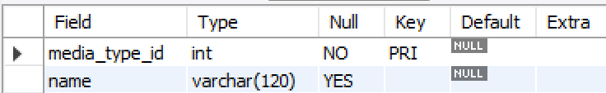
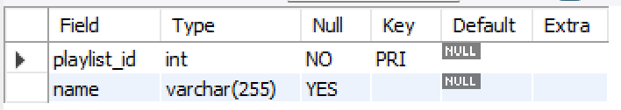
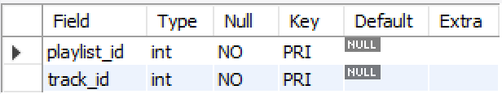
Genre table
Invoice table
Invoiceline table
Mediatype table
Playlist table
Playlist track table

Slide 7
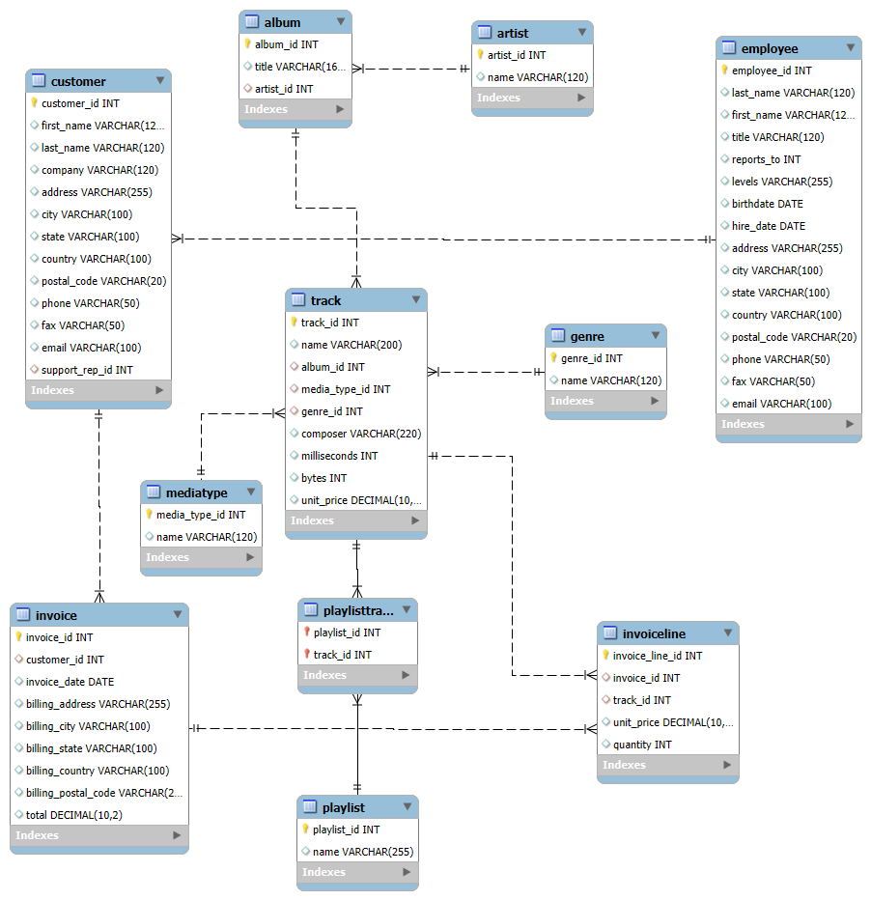
ER Diagram

Slide 8
ER DIAGRAM DESCRIPTION
Core Entities: 11 main tables including Customer, Employee, Artist, Album, Track, Genre, MediaType, Playlist, Invoice, and InvoiceLine.
Relational Structure: Foreign keys ensure data integrity and connect music catalog with business operations.
Sales Flow: Invoice records transactions; InvoiceLine details each purchased track with price and quantity.
Music Classification: Tracks linked to Genre, Media Type, Album, and Artist for detailed product categorization.
People Data: Customer and Employee tables capture buyer details, support reps, and organizational hierarchy.
Efficient Design: Use of data types (INT, VARCHAR, DECIMAL) ensures accuracy and optimized storage.

Slide 9
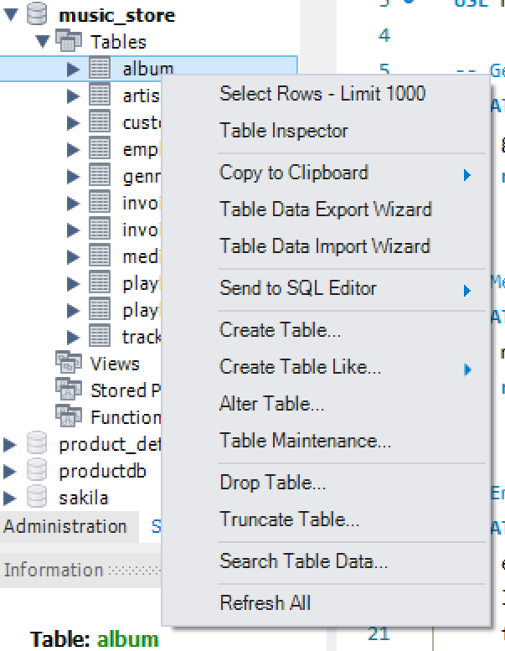
Importing data into the tables
Bulk Importing: Use LOAD DATA INFILE for fast loading of large datasets (e.g., tracks from CSV).
High Performance: Optimized for handling large volumes of data quickly and efficiently.
Structured Process: Ensures organized and systematic data insertion.
Guided Tools: Import wizards provide step-by-step assistance for easier workflow.
Accuracy & Flexibility: Supports customization and validation at each stage to maintain data quality.

Slide 10
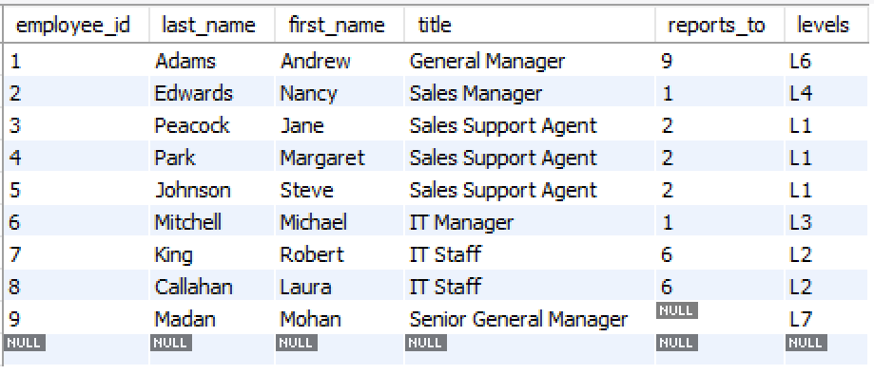
Challenges we gone through
Issue : The first employee in the CSV reported to the Senior General Manager, but theSGM’s record appeared at the end of the file.
Result: Import failed initially because the referenced manager record was not yet inserted.
Hierarchy Constraint: The reports_to column requires a manager to exist before assigning subordinates.
How We Resolved It
Disabled Constraints: Used SET FOREIGN_KEY_CHECKS = 0 to bypass hierarchy validation during bulk import.
Completed Import: Successfully loaded all employee records, even if managers appeared later in the file.
Post-Validation: Verified relationships after loading to ensure data integrity.
Learning Outcome: For hierarchical data, we can either load managers first or temporarily disable constraints, followed by validation.

Slide 11
Problem Statement:
The music store had a large collection of sales, customer, and catalog data stored in flat files (CSV format), but lacked a structured system to efficiently manage and analyze it. Without a proper relational database, the store faced challenges in:
Tracking customer purchases and identifying top customers.
Understanding which cities, countries, or genres generate the most revenue.
Managing hierarchical employee data and reporting structures.
Identifying best-selling tracks,albums, and artists to optimize inventory.
Enabling data-driven decisions for marketing campaigns and promotions.
To solve these problems, the project involved designing and implementing a SQL-based relational database for the music store, importing data into normalized tables with relationships, and writing analytical SQL queries to extract meaningful business insights.

Slide 12
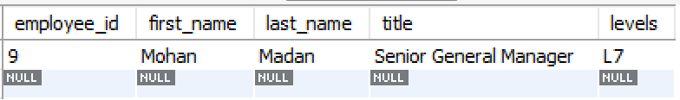
Queries
Basic Retrieval & Filtering
1. Who is the senior most employee based on job title?
Query:
SELECT employee_id, first_name, last_name, title, levels
FROM Employee
ORDER BY levels DESC
LIMIT 1;
Output:
Description: The query sorts employees by their job level in descending order and picks the top record. This gives the senior-most employee in the company, which is Mohan Madan – Senior General Manager (Level L7).

Slide 13
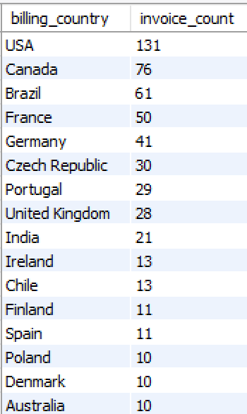
Aggregation & Grouping
2. Which countries have the most Invoices?
Output:
Query:
SELECT
billing_country,
COUNT(*) AS invoice_count
FROM Invoice
GROUP BY billing_country
ORDER BY invoice_count DESC;
Description: The query groups invoices by country, counts how many invoices each country has, and sorts them in descending order. The result shows that the USA has the most invoices (131), followed by Canada (76) and Brazil (61).

Slide 14
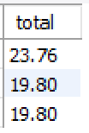

3. What are the top 3 values of total invoice?
4. Which city has the best customers? - We would like to throw a promotional Music Festival in the city we made the most money. Write a query that returns one city that has the highest sum of invoice totals. Return both the city name & sum of all invoice totals
Query:
Output:
SELECT total
FROM Invoice
ORDER BY total DESC
LIMIT 3;
Query:
SELECT billing_city, SUM(total) AS total_revenue
FROM Invoice
GROUP BY billing_city
ORDER BY total_revenue DESC
LIMIT 1;
Output:
Description:
The query for Q3 finds the top 3 highest invoice amounts (23.76, 19.80, 19.80). The query for Q4 identifies the city with the highest total revenue, which is Prague (273.24), showing it has the best customers.

Slide 15

5. Who is the best customer? - The customer who has spent the most money will be declared the best customer. Write a query that returns the person who has spent the most money
Query:
SELECT c.customer_id, c.first_name, c.last_name, SUM(i.total) AS total_spent
FROM Customer c
JOIN Invoice i ON c.customer_id = i.customer_id
GROUP BY c.customer_id, c.first_name, c.last_name
ORDER BY total_spent DESC
LIMIT 1;
Output:
Description: The query joins customers with their invoices, calculates the total money spent by each customer, and orders them in descending order. The customer who spent the most is František Wichterlová, with a total of 144.54, making them the best customer.

Slide 16
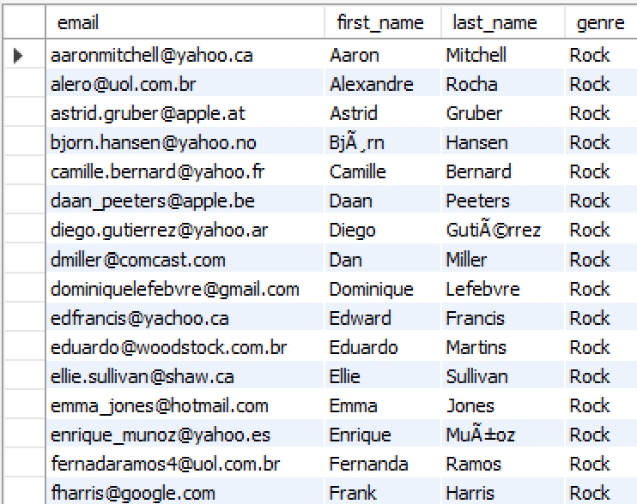
Joins + Filtering
6. Write a query to return the email, first name, last name, & Genre of all Rock Music listeners. Return your list ordered alphabetically by email starting with A
Query:
SELECT DISTINCT c.email, c.first_name, c.last_name, g.name AS genre
FROM Customer c
JOIN Invoice i ON c.customer_id = i.customer_id
JOIN InvoiceLine il ON i.invoice_id = il.invoice_id
JOIN Track t ON il.track_id = t.track_id
JOIN Genre g ON t.genre_id = g.genre_id
WHERE g.name = 'Rock'
ORDER BY c.email ASC;
Output:
Description: The query finds all customers who purchased Rock genre music by joining multiple tables (Customer, Invoice, InvoiceLine, Track, and Genre). It retrieves their email, first name, last name, and genre, removes duplicates, and orders the list alphabetically by email starting with A.

Slide 17
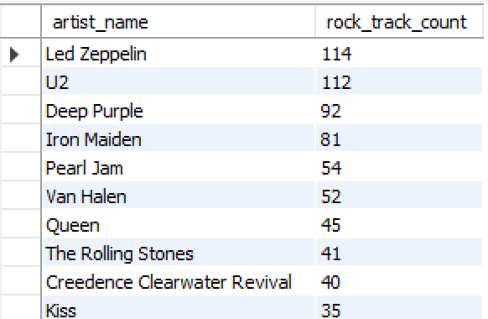
Joins + Aggregation
7. Let's invite the artists who have written the most rock music in our dataset. Write a query that returns the Artist name and total track count of the top 10 rock bands
Query:
SELECT ar.name AS artist_name, COUNT(t.track_id) AS rock_track_count
FROM Artist ar
JOIN Album al ON ar.artist_id = al.artist_id
JOIN Track t ON al.album_id = t.album_id
JOIN Genre g ON t.genre_id = g.genre_id
WHERE g.name = 'Rock'
GROUP BY ar.artist_id, ar.name
ORDER BY rock_track_count DESC
LIMIT 10;
Output:
Description:
This query identifies the top 10 artists who have created the most rock tracks. It joins the Artist, Album, Track, and Genre tables, filters by genre 'Rock', counts the number of tracks per artist, and orders them in descending order.

Slide 18
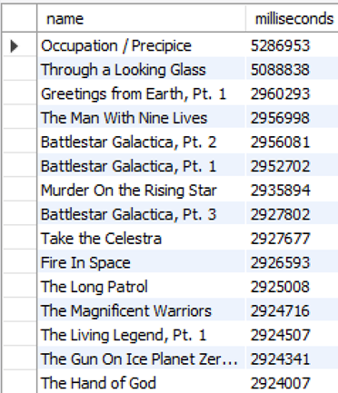
Subqueries
8. Return all the track names that have a song length longer than the average song length.- Return the Name and Milliseconds for each track. Order by the song length, with the longest songs listed first
Query:
Output:
SELECT name, milliseconds
FROM Track
WHERE milliseconds > (
SELECT AVG(milliseconds)
FROM Track
)
ORDER BY milliseconds DESC;
Description:
This query retrieves all tracks with a length greater than the average track length. It uses a subquery to calculate the average song length, filters tracks longer than that, and lists them in descending order by duration.

Slide 19
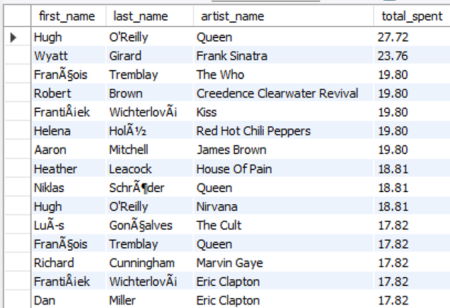
9. Find how much amount is spent by each customer on artists? Write a query to return customer name, artist name and total spent
Query:
SELECT c.first_name, c.last_name, ar.name AS artist_name, SUM(il.unit_price * il.quantity) AS total_spent
FROM Customer c
JOIN Invoice i ON c.customer_id = i.customer_id
JOIN InvoiceLine il ON i.invoice_id = il.invoice_id
JOIN Track t ON il.track_id = t.track_id
JOIN Album al ON t.album_id = al.album_id
JOIN Artist ar ON al.artist_id = ar.artist_id
GROUP BY c.customer_id, ar.artist_id
ORDER BY total_spent DESC;
Output:
Description:
This query calculates how much each customer spent on each artist. It joins Customer, Invoice, InvoiceLine, Track, Album, and Artist tables, multiplies price by quantity for total spent, groups by customer and artist, and orders by the total spent descending.

Slide 20
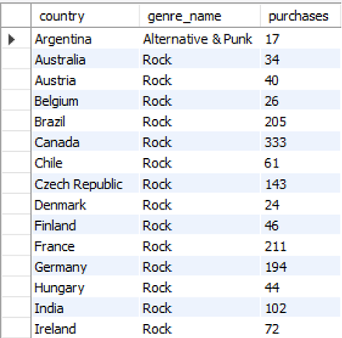
Advanced Grouping & Window Functions
10. We want to find out the most popular music Genre for each country. We determine the most popular genre as the genre with the highest amount of purchases. Write a query that returns each country along with the top Genre. For countries where the maximum number of purchases is shared, return all Genres
WITH GenrePopularity AS (
SELECT c.country, g.name AS genre_name, COUNT(il.invoice_line_id) AS purchases
FROM Customer c
JOIN Invoice i ON c.customer_id = i.customer_id
JOIN InvoiceLine il ON i.invoice_id = il.invoice_id
JOIN Track t ON il.track_id = t.track_id
JOIN Genre g ON t.genre_id = g.genre_id
GROUP BY c.country, g.genre_id
)
SELECT country, genre_name, purchases
FROM GenrePopularity gp
WHERE purchases = (
SELECT MAX(purchases)
FROM GenrePopularity
WHERE country = gp.country
)
ORDER BY country ASC, genre_name ASC;
Output:
Description:
This query determines the most purchased music genre for each country. It first counts purchases per genre per country, then selects the genre(s) with the maximum purchases per country. Countries with ties show all top genres.

Slide 21
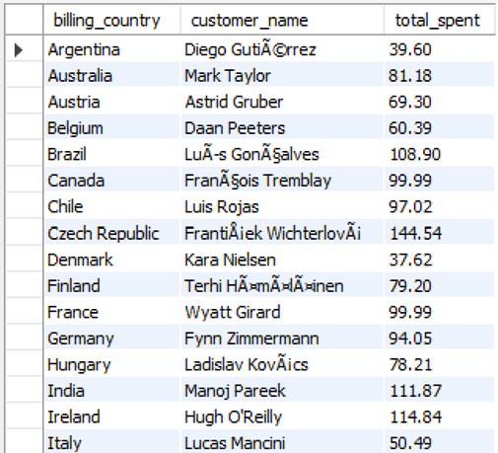
11. Write a query that determines the customer that has spent the most on music for each country. Write a query that returns the country along with the top customer and how much they spent. For countries where the top amount spent is shared, provide all customers who spent this amount
Query:
WITH customer_country_spending AS (
SELECT i.billing_country, CONCAT(c.first_name,’ ‘, c.last_name) AS customer_name,
SUM(i.total) AS total_spent,
RANK() OVER (PARTITION BY i.billing_country ORDER BY SUM(i.total) DESC) AS spending_rank
FROM Customer c
JOIN Invoice i ON c.customer_id = i.customer_id
GROUP BY i.billing_country, c.customer_id, c.first_name, c.last_name
)
SELECT billing_country, customer_name, total_spent
FROM customer_country_spending
WHERE spending_rank = 1
ORDER BY billing_country;
Output:
Description:
This query finds the customer who spent the most money on music in each country. It sums total spending per customer per country, uses RANK() to identify the top spender(s), and returns those customers with their total spent.

Slide 22
Project Insights
Understanding Customer Behavior: The analysis helps to identify the store's key markets and most valuable customers. The store now knows that
Prague is the city with the highest total revenue
USA has the most invoices. It has also identified its top individual customer,
František Wichterlová, who has spent the most money.
Actionable Intelligence for Inventory and Marketing: The project provides insights that directly impact business strategy. By determining that
Rock is the most popular genre
Track best-selling tracks and albums to forecast revenue.
Led Zeppelin has the most rock tracks, the store can optimize its inventory, focusing on best-selling items, and create targeted, genre-specific promotions.
Analyze playlist usage to identify trends in music consumption.
Highlight artists or albums driving the most sales.

Slide 23
Recommendations :
Targeted Marketing: Focus campaigns on key markets like Prague, the city with the highest revenue, and the USA, which has the most invoices
Customer Loyalty: Implement a loyalty program for top customers, such as František Wichterlová, to encourage repeat spending
Genre & Artist Promotions: Capitalize on the popularity of Rock music by featuring artists like Led Zeppelin in promotions and stocking more of their music
Inventory Optimization: Use data on best-selling genres and artists to guide purchasing decisions and maximize sales
Employee Development: Leverage the expertise of senior employees, like Mohan Madan, for internal training and mentorship

Slide 24
Conclusion :
This project demonstrates how SQL turns raw music store data into valuable business insights.
By using a relational database, you can easily find out who your top customers are, which cities generate the most revenue, and which genres and artists are most popular.
The insights gained support data-driven decisions for marketing, promotions, and inventory management.
The project also provided practical experience with advanced SQL techniques like joins, subqueries, and CTEs, going beyond basic queries.
This approach helps the business adapt quickly to customer preferences and market trends.

Slide 25
Any Question…..?

Slide 26
Thank you

