Slide 1

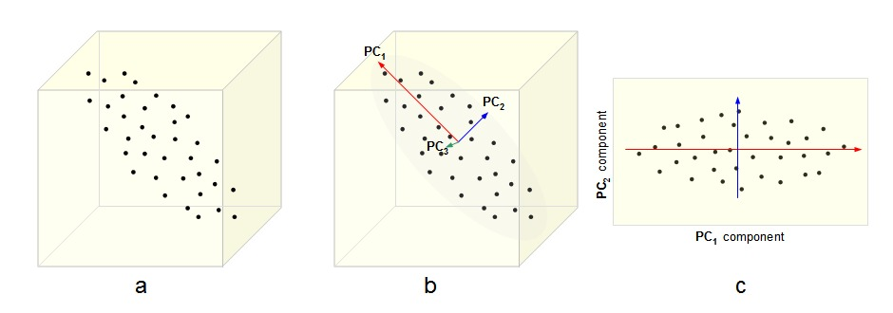
Dimensionality Reduction
By :- Ravi

Slide 2
Dimensionality Reduction
In machine learning and statistics, dimensionality reduction or dimension reduction is the process of reducing the number of random variables under consideration, via obtaining a set of principal variables. It can be divided into feature selection and feature extraction.
Dimension Reduction refers to the process of converting a set of data having vast dimensions into data with lesser dimensions ensuring that it conveys similar information concisely.

Slide 3
Dimensionality Reduction
One of the most common application of this technique is Image processing. You might have come across this Facebook application – “Which Celebrity Do You Look Like?“. But, have you ever thought about the algorithm used behind this?
Here’s the answer: To identify the matched celebrity image, we use pixel data and each pixel is equivalent to one dimension. In every image, there are high number of pixels i.e. high number of dimensions. And every dimension is important here. You can’t omit dimensions randomly to make better sense of your overall data set. In such cases, dimension reduction techniques help you to find the significant dimension(s) using various method(s).

Slide 4
Benefits of Dimension Reduction
It helps in data compressing and reducing the storage space required
It fastens the time required for performing same computations. Less dimensions leads to less computing, also less dimensions can allow usage of algorithms unfit for a large number of dimensions
It takes care of multi-collinearity that improves the model performance. It removes redundant features. For example: there is no point in storing a value in two different units (meters and inches).
Reducing the dimensions of data to 2D or 3D may allow us to plot and visualize it precisely. You can then observe patterns more clearly.

Slide 5
Methods to perform Dimension Reduction
Missing Values Ratio
Low Variance Filter
Random Forest
High Correlation Filter
Backward Feature Elimination
Forward Feature Construction
Principal Component Analysis
LDA
T-SNE

Slide 6
Methods to perform Dimension Reduction
Missing Values Ratio. Data columns with too many missing values are unlikely to carry much useful information. Thus data columns with number of missing values greater than a given threshold can be removed. The higher the threshold, the more aggressive the reduction.
Low Variance Filter. Similarly to the previous technique, data columns with little changes in the data carry little information. Thus all data columns with variance lower than a given threshold are removed. A word of caution: variance is range dependent; therefore normalization is required before applying this technique.

Slide 7
Methods to perform Dimension Reduction
Random Forests / Ensemble Trees. Decision Tree Ensembles, also referred to as random forests, are useful for feature selection in addition to being effective classifiers. One approach to dimensionality reduction is to generate a large and carefully constructed set of trees against a target attribute and then use each attribute’s usage statistics to find the most informative subset of features. Specifically, we can generate a large set (2000) of very shallow trees (2 levels), with each tree being trained on a small fraction (3) of the total number of attributes. If an attribute is often selected as best split, it is most likely an informative feature to retain. A score calculated on the attribute usage statistics in the random forest tells us ‒ relative to the other attributes ‒ which are the most predictive attributes.

Slide 8
Methods to perform Dimension Reduction
High Correlation Filter. Dimensions exhibiting higher correlation can lower down the performance of model. Moreover, it is not good to have multiple variables of similar information or variation also known as “Multicollinearity”. You can use Pearson (continuous variables) or Polychoric (discrete variables) correlation matrix to identify the variables with high correlation and select one of them using VIF (Variance Inflation Factor). Variables having higher value ( VIF > 5 ) can be dropped

Slide 9
Methods to perform Dimension Reduction
Backward Feature Elimination: In this method, we start with all n dimensions. Compute the sum of square of error (SSR) after eliminating each variable (n times). Then, identifying variables whose removal has produced the smallest increase in the SSR and removing it finally, leaving us with n-1input features.
Forward Feature Selection : In this method, we select one variable and analyse the performance of model by adding another variable. Here, selection of variable is based on higher improvement in model performance.

Slide 10
Methods to perform Dimension Reduction
Principal Component Analysis (PCA). In this technique, variables are transformed into a new set of variables, which are linear combination of original variables. These new set of variables are known as principle components. They are obtained in such a way that first principle component accounts for most of the possible variation of original data after which each succeeding component has the highest possible variance.

Slide 11
Principal Component Analysis
The main linear technique for dimensionality reduction, principal component analysis, performs a linear mapping of the data to a lower-dimensional space in such a way that the variance of the data in the low-dimensional representation is maximized.
With fewer variables, visualization also becomes much more meaningful. PCA is more useful when dealing with 3 or higher dimensional data.
It is always performed on a symmetric correlation or covariance matrix. This means the matrix should be numeric and have standardized data.

Slide 12
Kernel PCA
Principal component analysis can be employed in a nonlinear way by means of the kernel trick. The resulting technique is capable of constructing nonlinear mappings that maximize the variance in the data. The resulting technique is entitled kernel PCA.

Slide 13
Linear discriminant analysis (LDA)
Linear discriminant analysis (LDA) is a generalization of Fisher's linear discriminant, a method used in statistics, pattern recognition and machine learning to find a linear combination of features that characterizes or separates two or more classes of objects or events.

