Slide 1

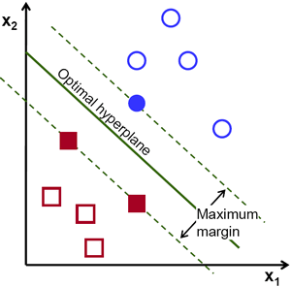
Support Vector Machines
By :- Ravi

Slide 2
Support Vector Machines
A Support Vector Machine (SVM) is a supervised machine learning algorithm that can be employed for both classification and regression purposes. SVMs are more commonly used in classification problems.
In this algorithm, we plot each data item as a point in n-dimensional space (where n is number of features you have) with the value of each feature being the value of a particular coordinate.
Then, we perform classification by finding the hyper-plane that differentiate the two classes very well.
Works well for classifying higher dimensional data (lots of features).

Slide 3
Support Vector Machines
Support Vectors
Support vectors are the data points nearest to the hyperplane, the points of a data set that, if removed, would alter the position of the dividing hyperplane. Because of this, they can be considered the critical elements of a data set.
What is a hyperplane?
For a classification task with only two features you can think of a hyperplane as a line that linearly separates and classifies a set of data.
The further from the hyperplane our data points lie, the more confident we are that they have been correctly classified. We want our data points to be as far away from the hyperplane as possible.

Slide 4
Support Vector Machines
An hyperplane is a generalization of a plane.
in one dimension, an hyperplane is called a point
in two dimensions, it is a line
in three dimensions, it is a plane
in more dimensions you can call it an hyperplane

Slide 5
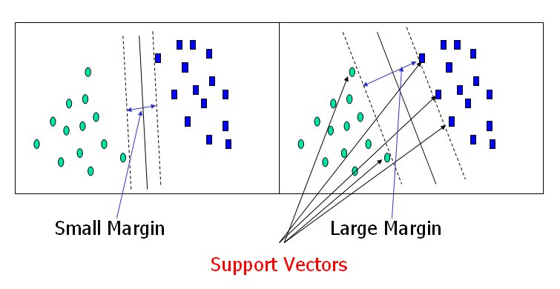
Support Vector Machines

Slide 6
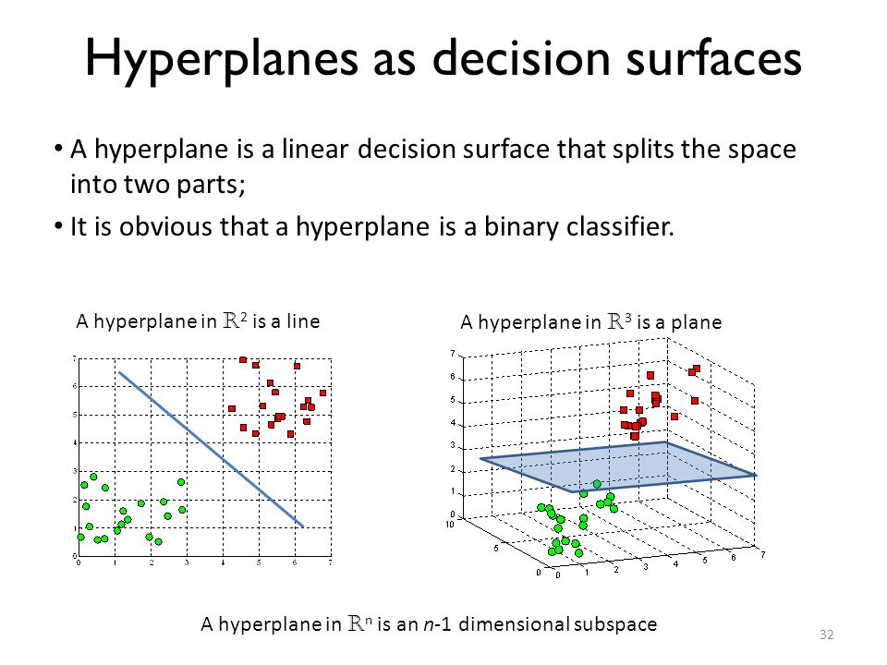
What is hyperplane ?

Slide 7
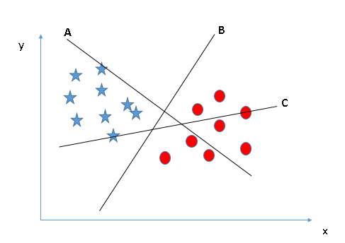
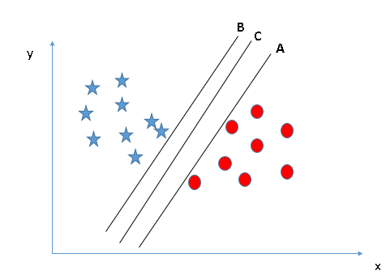
Support Vector Machines
How do we find right hyperplane ?
The distance between the hyperplane and the nearest data point from either set is known as the margin. The goal is to choose a hyperplane with the greatest possible margin between the hyperplane and any point within the training set, giving a greater chance of new data being classified correctly.

Slide 8
Linear vs nonlinear classification?
Sometimes our data is linearly seperable. That means for N classes with M features, we can learn a mapping that is a linear combination. (like y = mx + b). Or even a multidimensional hyperplane (y = x + z + b + q). No matter how many dimensions/features a set of classes have, we can represent the mapping using a linear function.
But sometimes its not. Like if there was a quadratic mapping. Luckily for us SVMs can efficiently perform a non-linear classification using what is called the kernel trick.

Slide 9
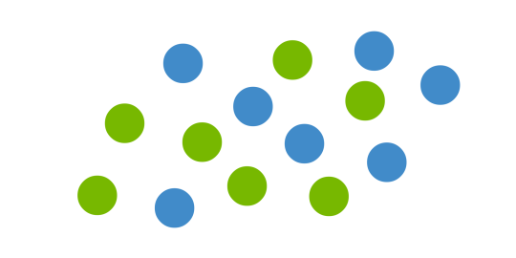
Linear vs nonlinear classification
But what happens when there is no clear hyperplane?

Slide 10
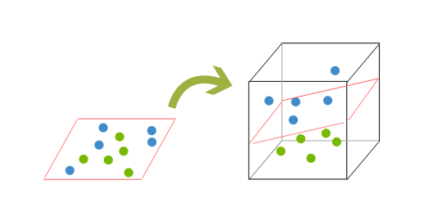
Support Vector Machines
In order to classify a dataset like the previous one it’s necessary to move away from a 2d view of the data to a 3d view. Explaining this is easiest with another simplified example. Imagine that our two sets of colored balls above are sitting on a sheet and this sheet is lifted suddenly, launching the balls into the air. While the balls are up in the air, you use the sheet to separate them. This ‘lifting’ of the balls represents the mapping of data into a higher dimension. This is known as kernelling

Slide 11
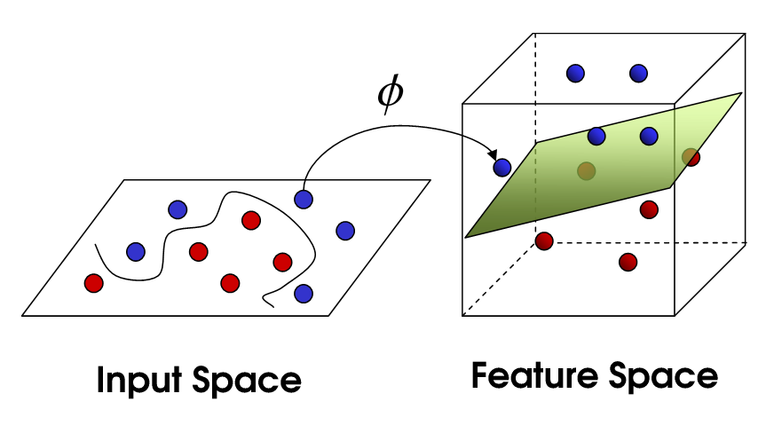
Kernel Trick
The SVM algorithm is implemented in practice using a kernel.
So what is the kernel trick?
The kernel trick takes the data you give it and transforms it. In goes some great features which you think are going to make a great classifier, and out comes some data that you don't recognize anymore.

Slide 12
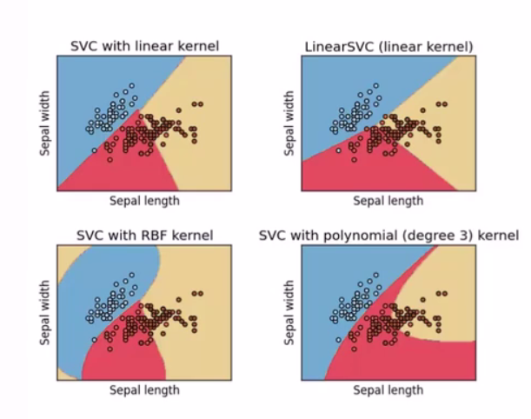
Kernel Trick
Linear Kernel SVM
Polynomial Kernel SVM
Radial Kernel SVM

Slide 13
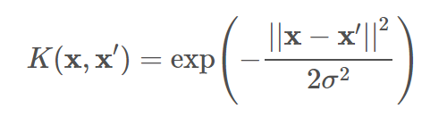
Gaussian RBF Kernel
Gaussian RBF(Radial Basis Function) is another popular Kernel method used in SVM models. Gaussian Kernel is of the following format :
where ||x−x′||2||x−x′||2 is the squared Euclidean distance between two data points xx and x′x′.

Slide 14
Gaussian RBF Kernel
There are 2 important hyperparameters in an SVM model :
C Parameter
C is a parameter of the SVC learner and is the penalty for misclassifying a data point.
The C parameter decides the margin width of the SVM classifier. For large values of C, the model will choose a smaller-margin hyperplane if that hyperplane does a better job of getting all the training points classified correctly. Conversely, a very small value of C will cause the model to look for a larger-margin separating hyperplane, even if that hyperplane misclassifies more points. For very tiny values of C, you should get misclassified examples, often even if your training data is linearly separable.

Slide 15
Gaussian RBF Kernel
Gamma
Gamma is a parameter of the RBF kernel and can be thought of as the spread of the kernel and therefore the decision region. When Gamma is low the ‘curve’ of the decision boundary is very low and thus the decision region is very broad.
When Gamma is high, the ‘curve’ of the decision boundary is high, which creates islands of decision-boundaries around data points. We will see this very clearly below.

Slide 16

Polynomial Kernel
Adding polynomial features is very simple to implement. But a low polynomial degree cannot deal with complex datasets, and with high polynomial degree it will create huge number of features, making the model too slow. In these situations we can use a polynomial kernel to avoid this problem. Polynomial kernel is of the following format :
Where d is the degree of polynomial

Slide 17

Math of SVM
Let's define our loss function (what to minimize) and our objective function (what to optimize)
Loss function
We'll use the Hinge loss. This is a loss function used for training classifiers. The hinge loss is used for "maximum-margin" classification, most notably for support vector machines (SVMs).
c is the loss function, x the sample, y is the true label, f(x) the predicted label.

Slide 18
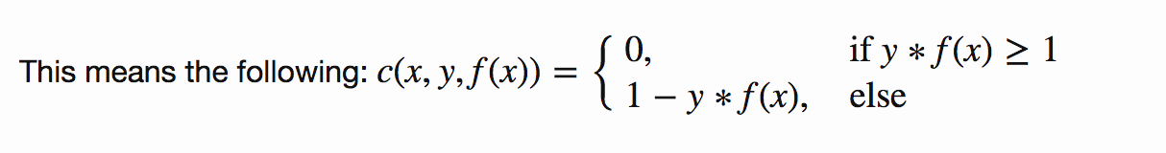
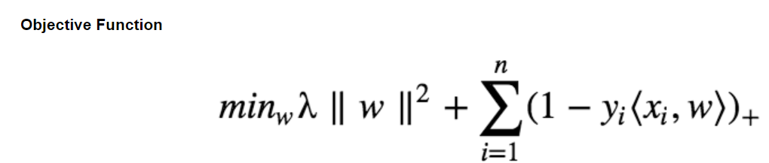
Math of SVM

Slide 19
Math of SVM
Our objective of a SVM consists of two terms. The first term is a regularizer, the heart of the SVM, the second term the loss. The regularizer balances between margin maximization and loss. We want to find the decision surface that is maximally far away from any data points.
How do we minimize our loss/optimize for our objective (i.e learn)?
We have to derive our objective function to get the gradients! Gradient descent : As we have two terms, we will derive them seperately using the sum rule in differentiation.

Slide 20
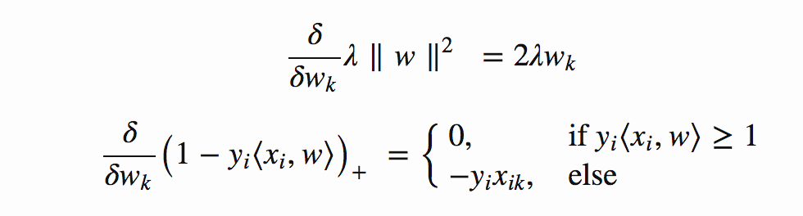
Math of SVM
This means, if we have a misclassified sample, we update the weight vector w using the gradients of both terms, else if classified correctly, we just update w by the gradient of the regularizer.

Slide 21


Math of SVM
Misclassification condition
Update rule for our weights (misclassified)
including the learning rate η and the regularizer λ The learning rate is the length of the steps the algorithm makes down the gradient on the error curve.

Slide 22
Math of SVM
Learning rate too high? The algorithm might overshoot the optimal point.
Learning rate too low? Could take too long to converge. Or never converge.
The regularizer controls the trade off between the achieving a low training error and a low testing error that is the ability to generalize your classifier to unseen data. As a regulizing parameter we choose 1/epochs, so this parameter will decrease, as the number of epochs increases.
Regularizer too high? overfit (large testing error)
Regularizer too low? underfit (large training error)

Slide 23

Math of SVM
Update rule for our weights (correctly classified) :

Slide 24
SVM Formulation
Linear Kernel SVM
The dot-product is called the kernel and can be re-written as:
K(x, xi) = sum(x * xi)
The kernel defines the similarity or a distance measure between new data and the support vectors. The dot product is the similarity measure used for linear SVM or a linear kernel because the distance is a linear combination of the inputs.

Slide 25
SVM Formulation
Polynomial Kernel SVM
Instead of the dot-product, we can use a polynomial kernel, for example:
K(x, xi) = 1 + sum(x * xi)^d
Where the degree of the polynomial must be specified by hand to the learning algorithm. When d=1 this is the same as the linear kernel. The polynomial kernel allows for curved lines in the input space.

Slide 26
SVM Formulation
Radial Kernel SVM
Finally, we can also have a more complex radial kernel. For example:
K(x,xi) = exp(-gamma * sum((x – xi^2))
Where gamma is a parameter that must be specified to the learning algorithm. A good default value for gamma is 0.1, where gamma is often 0 < gamma < 1. The radial kernel is very local and can create complex regions within the feature space, like closed polygons in two-dimensional space.

Slide 27
SVM Applications
SVM Uses
SVM is used for text classification tasks such as category assignment, detecting spam and sentiment analysis. It is also commonly used for image recognition challenges, performing particularly well in aspect-based recognition and color-based classification. SVM also plays a vital role in many areas of handwritten digit recognition, such as postal automation services.

