Slide 1
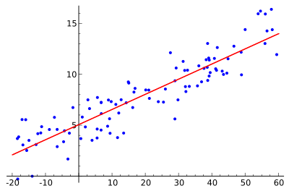
Regression Analysis with Python
Ravikant Tyagi

Slide 2
Index
What is Regression Analysis?
Why do we use Regression Analysis?
What are the types of Regressions?
Linear Regression
Logistic Regression
Polynomial Regression
Stepwise Regression
Ridge Regression
Lasso Regression
Elastic Net Regression
How to select the right Regression Model?

Slide 3
Regression Analysis
Regression analysis is a form of predictive modeling technique which investigates the relationship between a dependent (target) and independent variable (s) (predictor). This technique is used for forecasting, time series modeling and finding the causal effect relationship between the variables. For example, relationship between rash driving and number of road accidents by a driver is best studied through regression.

Slide 4
Why Regression Analysis
Regression analysis estimates the relationship between two or more variables
Let’s say, you want to estimate growth in sales of a company based on current economic conditions. You have the recent company data which indicates that the growth in sales is around two and a half times the growth in the economy. Using this insight, we can predict future sales of the company based on current & past information.

Slide 5
Benefits of Regression Analysis
It indicates the significant relationships between dependent variable and independent variable.
It indicates the strength of impact of multiple independent variables on a dependent variable.

Slide 6
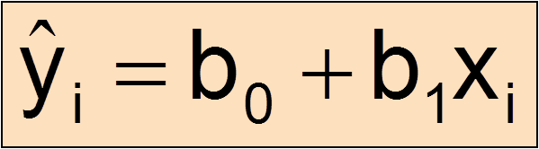
Linear Regression
Before we dive into the details of linear regression, you may be asking yourself why we are looking at this algorithm.
Isn’t it a technique from statistics?

Slide 7
Linear Regression
Machine learning, more specifically the field of predictive modeling is primarily concerned with minimizing the error of a model or making the most accurate predictions possible, at the expense of explainability. In applied machine learning we will borrow, reuse and steal algorithms from many different fields, including statistics and use them towards these ends.

Slide 8
Linear Regression
As such, linear regression was developed in the field of statistics and is studied as a model for understanding the relationship between input and output numerical variables, but has been borrowed by machine learning. It is both a statistical algorithm and a machine learning algorithm.

Slide 9
Many Names of Linear Regression
When you start looking into linear regression, things can get very confusing.
The reason is because linear regression has been around for so long (more than 200 years). It has been studied from every possible angle and often each angle has a new and different name.
Linear regression is a linear model, e.g. a model that assumes a linear relationship between the input variables (x) and the single output variable (y). More specifically, that y can be calculated from a linear combination of the input variables (x).

Slide 10
Continue….
When there is a single input variable (x), the method is referred to as simple linear regression. When there are multiple input variables, literature from statistics often refers to the method as multiple linear regression.
Different techniques can be used to prepare or train the linear regression equation from data, the most common of which is called Ordinary Least Squares. It is common to therefore refer to a model prepared this way as Ordinary Least Squares Linear Regression or just Least Squares Regression.

Slide 11

Now Linear Regression Begins…

Slide 12
Linear Regression Begins
It is one of the most widely known modeling technique.
In this technique, the dependent variable is continuous, independent variable(s) can be continuous or discrete and nature of regression line is linear.
Linear Regression establishes a relationship between dependent variable (Y) and one or more independent variables (X) using a best fit straight line (also known as regression line).

Slide 13
Linear Regression…
The difference between simple linear regression and multiple linear regression is that, multiple linear regression has (>1) independent variables, whereas simple linear regression has only 1 independent variable.

Slide 14
Linear Regression Learning Model
Learning a linear regression model means estimating the values of the coefficients used in the representation with the data that we have available.
There are many more techniques because the model is so well studied…

Slide 15
Linear Regression Models
Simple Linear Regression
Ordinary Least Squares
Gradient Descent
Regularization

Slide 16
Simple Linear Regression
With simple linear regression when we have a single input, we can use statistics to estimate the coefficients.
This requires that you calculate statistical properties from the data such as means, standard deviations, correlations and covariance. All of the data must be available to traverse and calculate statistics.

Slide 17
Ordinary Least Squares
When we have more than one input we can use Ordinary Least Squares to estimate the values of the coefficients.
The Ordinary Least Squares procedure seeks to minimize the sum of the squared residuals. This means that given a regression line through the data we calculate the distance from each data point to the regression line, square it, and sum all of the squared errors together. This is the quantity that ordinary least squares seeks to minimize.

Slide 18
Ordinary Least Squares
This approach treats the data as a matrix and uses linear algebra operations to estimate the optimal values for the coefficients. It means that all of the data must be available and you must have enough memory to fit the data and perform matrix operations.

Slide 19
Gradient Descent
When there are one or more inputs you can use a process of optimizing the values of the coefficients by iteratively minimizing the error of the model on your training data.
This operation is called Gradient Descent and works by starting with random values for each coefficient. The sum of the squared errors are calculated for each pair of input and output values. A learning rate is used as a scale factor and the coefficients are updated in the direction towards minimizing the error. The process is repeated until a minimum sum squared error is achieved or no further improvement is possible.

Slide 20
Gradient Descent
Gradient descent is often taught using a linear regression model because it is relatively straightforward to understand. In practice, it is useful when you have a very large dataset either in the number of rows or the number of columns that may not fit into memory.

Slide 21
Regularization
There are extensions of the training of the linear model called regularization methods. These seek to both minimize the sum of the squared error of the model on the training data (using ordinary least squares) but also to reduce the complexity of the model (like the number or absolute size of the sum of all coefficients in the model).

Slide 22
Regularization
Two popular examples of regularization procedures for linear regression are:
Lasso Regression: where Ordinary Least Squares is modified to also minimize the absolute sum of the coefficients (called L1 regularization).
Ridge Regression: where Ordinary Least Squares is modified to also minimize the squared absolute sum of the coefficients (called L2 regularization).
These methods are effective to use when there is co-linearity in your input values and ordinary least squares would over fit the training data.

Slide 23
Making Predictions
Making predictions is as simple as solving the equation for a specific set of inputs.
Let’s make this concrete with an example. Imagine we are predicting weight (y) from height (x). Our linear regression model representation for this problem would be:
y = B0 + B1 * x1
or
weight =B0 +B1 * height

Slide 24
Making Predictions…
Where B0 is the bias coefficient and B1 is the coefficient for the height column. We use a learning technique to find a good set of coefficient values. Once found, we can plug in different height values to predict the weight.
For example, lets use B0 = 0.1 and B1 = 0.5. Let’s plug them in and calculate the weight (in kilograms) for a person with the height of 182 centimeters.

Slide 25
Making Predictions…
weight = 0.1 + 0.05 * 182
weight = 91.1
The above equation could be plotted as a line in two-dimensions. The B0 is our starting point regardless of what height we have. We can run through a bunch of heights from 100 to 250 centimeters and plug them to the equation and get weight values, creating our line.

Slide 26
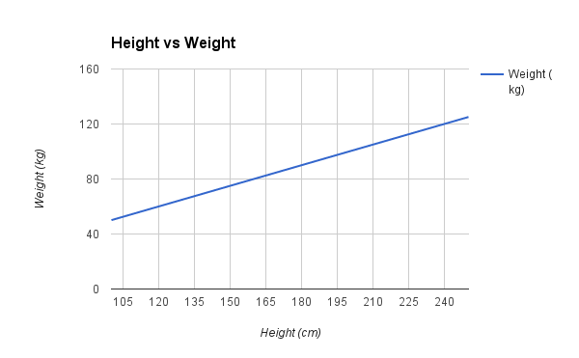
Making Predictions…

Slide 27
Steps to find:
With simple linear regression we want to model our data as follows:
y = B0 + B1 * x
This is a line where y is the output variable we want to predict, x is the input variable we know and B0 and B1 are coefficients that we need to estimate that move the line around.

Slide 28
Steps Continues…
Technically, B0 is called the intercept because it determines where the line intercepts the y-axis. In machine learning we can call this the bias, because it is added to offset all predictions that we make. The B1 term is called the slope because it defines the slope of the line or how x translates into a y value before we add our bias.
The goal is to find the best estimates for the coefficients to minimize the errors in predicting y from x.

Slide 29
Steps Continues…
We can start off by estimating the value for B1 as:
B1 = sum((xi-mean(x)) * (yi-mean(y))) / sum((xi – mean(x))^2)
Where mean() is the average value for the variable in our dataset. The xi and yi refer to the fact that we need to repeat these calculations across all values in our dataset and i refers to the i’th value of x or y

Slide 30
Steps Continues…
We can calculate B0 using B1 and some statistics from our dataset, as follows:
B0 = mean(y) – B1 * mean(x)
Estimating The Slope (B1):-
calculate the mean value of x and y
calculate the error of each variable from the mean:
x - mean(x)
y - mean(y)

Slide 31
Steps Continues…
multiple the error for each x with the error for each y and calculate the sum of these multiplications.
Sum the final column.(numerator)
calculate the bottom part of the equation for calculating B1, or the denominator. This is calculated as the sum of the squared differences of each x value from the mean.
We have already calculated the difference of each x value from the mean, all we need to do is square each value and calculate the sum.(denominator)

Slide 32
Steps Continues…
calculate the value of our slope:
B1 = numerator/denominator
Estimating The Intercept (B0):
B0 = mean(y) – B1 * mean(x)

Slide 33
Making Predictions
We now have the coefficients for our simple linear regression equation.
y = B0 + B1 * x

Slide 34
Estimating Error
We can calculate a error for our predictions called the Root Mean Squared Error or RMSE.
RMSE = sqrt( sum( (pi – yi)^2 )/n )
Where sqrt() is the square root function, p is the predicted value and y is the actual value, i is the index for a specific instance, n is the number of predictions, because we must calculate the error across all predicted values.

Slide 35
Measuring Error with r-squared
How do we measure how well our line fits our data ?
R-squared (aka coefficient of determination) measures:
The fraction of the total variation in Y that is captured by the model

Slide 36
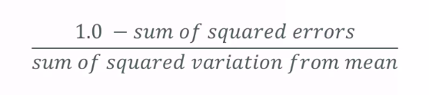
Computing r-squared

Slide 37
Interpreting r-squared
Ranges from 0 to 1
0 is bad (none of the variance is captured), 1 is good (all of the variance is captured).

Slide 38
R-squared and p-value
R-square value tells you how much variation is explained by your model. So 0.1 R-square means that your model explains 10% of variation within the data. The greater R-square the better the model.
p-value tells you about the F statistic hypothesis testing of the "fit of the intercept-only model and your model are equal". So if the p-value is less than the significance level (usually 0.05) then your model fits the data well.

Slide 39
R-squared and p-value
Thus you have four scenarios:
low R-square and low p-value (p-value <= 0.05)
low R-square and high p-value (p-value > 0.05)
high R-square and low p-value
high R-square and high p-value

Slide 40
Polynomial Regression

Slide 41
Polynomial Regression
Not all relationships are linear.
Linear formula: y = mx + b
This is a “first order” or “first degree” polynomial, as the power of x is 1
Second order polynomial: y = ax² + bx + c
Third order polynomial: y = ax³ + bx² + cx +d
Higher order produce more complex curves

Slide 42
Beware
Don’t use more degrees than you need
Visualize the data first to see how complex curve it might be
Visualize the fit – is your curve going out of its way to accommodate outliers ?
A high r-squared simply means your curve fits your training data well

Slide 43
Multiple Linear Regression
Multiple Linear Regression is a type of Linear Regression when the input has multiple features(variables).
Model Representation
Similar to Simple Linear Regression, we have input variable(X) and output variable(Y). But the input variable has n features. Therefore, we can represent this linear model as follows

Slide 44
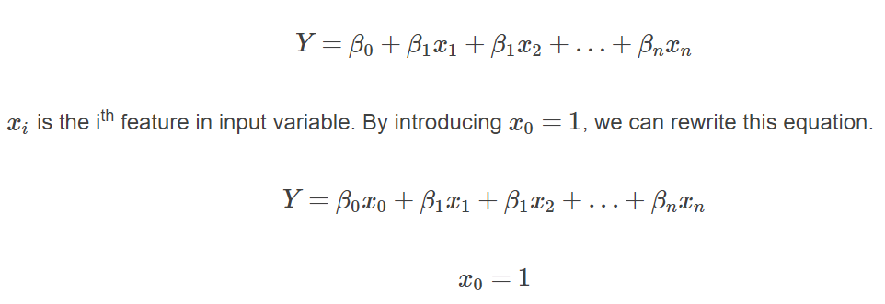
Multiple Linear Regression

Slide 45
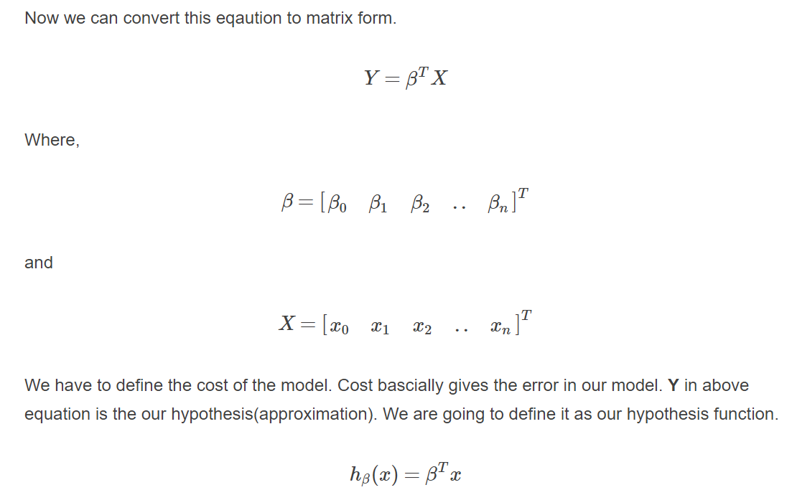
Multiple Linear Regression

Slide 46
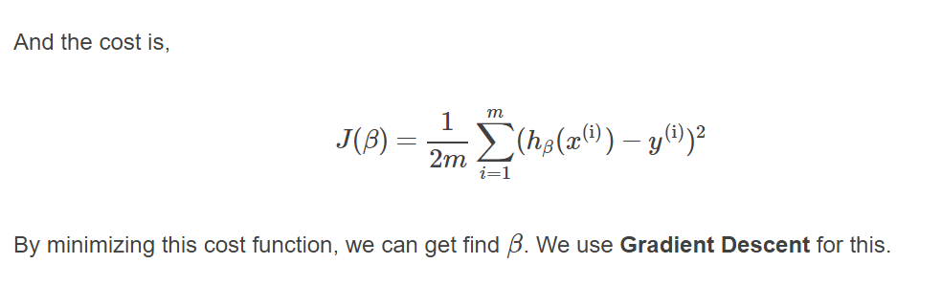
Multiple Linear Regression

Slide 47
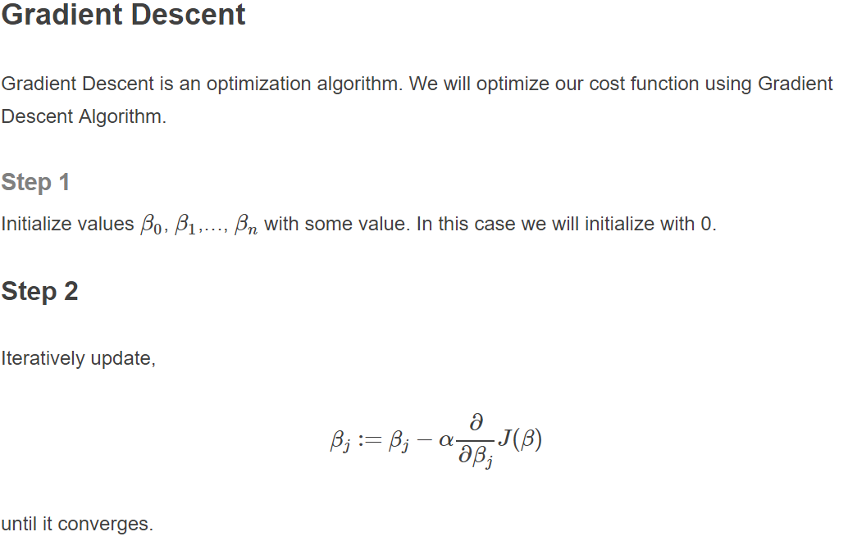
Multiple Linear Regression

Slide 48
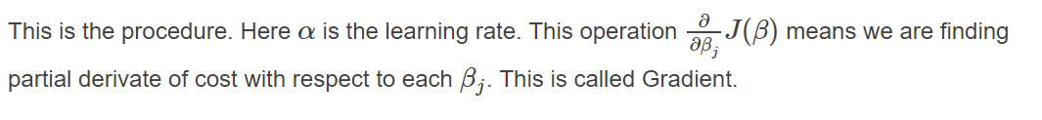
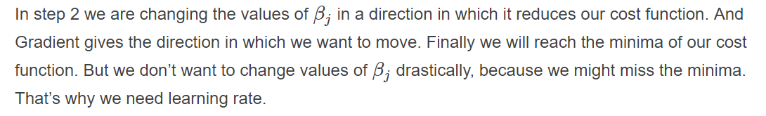
Multiple Linear Regression

Slide 49
Multiple Linear Regression

Slide 50
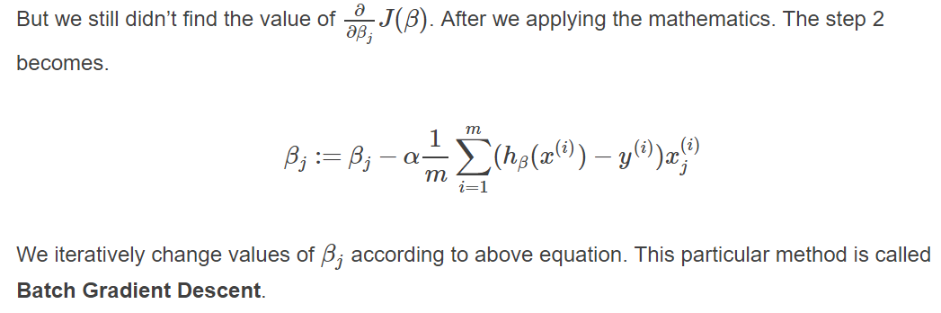
Multiple Linear Regression

Slide 51
Cost Function Derivative
Why does gradient descent use the derivative of the cost function? Finding the slope of the cost function at our current Ѳ value tells us two things.
The first is the direction to move theta in. When you look at the plot of a function, a positive slope means the function goes upward as you move right, so we want to move left in order to find the minimum. Similarly, a negative slope means the function goes downward towards the right, so we want to move right to find the minimum.

Slide 52
Cost Function Derivative
The second is how big of a step to take. If the slope is large we want to take a large step because we’re far from the minimum. If the slope is small we want to take a smaller step. Note in the example above how gradient descent takes increasingly smaller steps towards the minimum with each iteration.

Slide 53
The Learning Rate
The learning rate gives us some additional control over how large of steps we make.
Selecting the right learning rate is critical. If the learning rate is too large, you can overstep the minimum and even diverge. For example, think through what would happen if we use a learning rate of 2. Each iteration would take us farther away from the minimum!
The only concern with using too small of a learning rate is that you will need to run more iterations of gradient descent, increasing your training time.

Slide 54

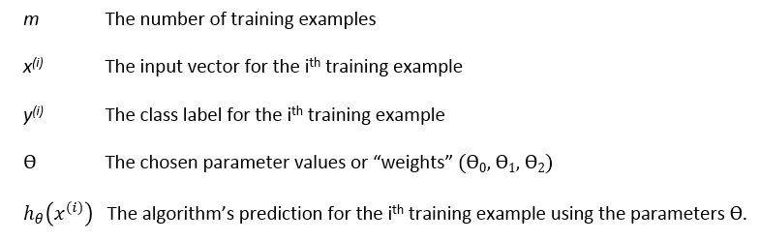
Gradient Descent of MSE
The cost function J for a particular choice of parameters Ѳ is the mean squared error (MSE):

Slide 55
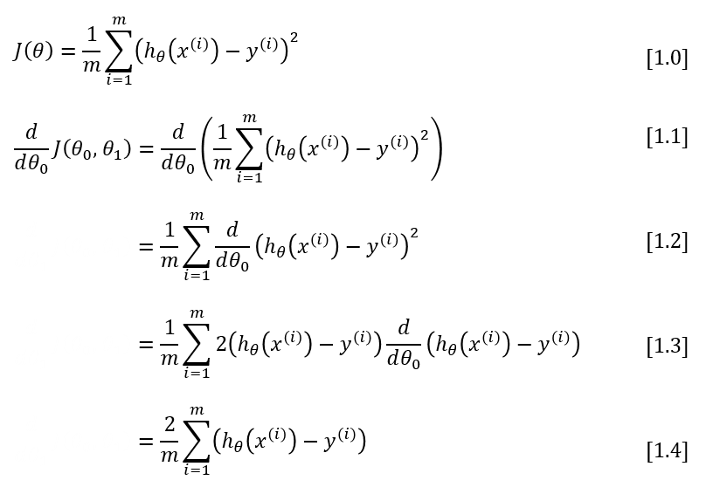
Gradient Descent of MSE
Gradient Descent of MSE

Slide 56
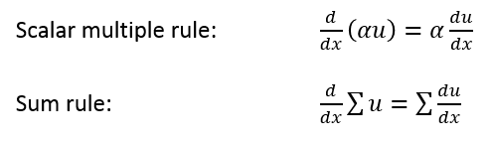
Gradient Descent of MSE
To move from equation [1.1] to [1.2], we need to apply two basic derivative rules:

Slide 57

Gradient Descent of MSE
Moving from [1.2] to [1.3], we apply both the power rule and the chain rule:

Slide 58
One Half Mean Squared Error
We multiply our MSE cost function by 1/2 so that when we take the derivative, the 2s cancel out. Multiplying the cost function by a scalar does not affect the location of its minimum, so we can get away with this.
Alternatively, you could think of this as folding the 2 into the learning rate. It makes sense to leave the 1/m term, though, because we want the same learning rate (alpha) to work for different training set sizes (m).

Slide 59
