Slide 1

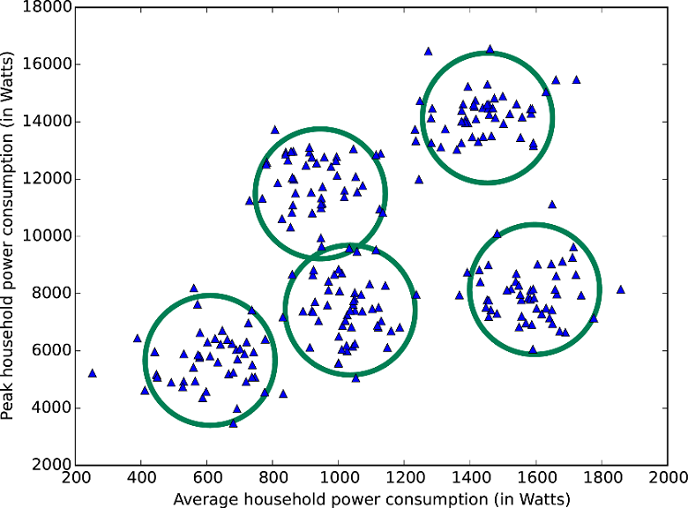
Clustering
By :- Ravi

Slide 2
Clustering
Clustering is the task of dividing the population or data points into a number of groups such that data points in the same groups are more similar to other data points in the same group than those in other groups. In simple words, the aim is to segregate groups with similar traits and assign them into clusters.
Clustering, or cluster analysis, is used for analyzing data which does not include pre-labeled classes. Data instances are grouped together using the concept of maximizing intraclass similarity and minimizing the similarity between differing classes.
Unsupervised Learning technique.

Slide 3
K-Means Clustering
K means is an iterative clustering algorithm that aims to find local maxima in each iteration.
Attempts to split data into K groups that are closest to K centroids.
- Randomly pick K centroids.
- Assign each data point to the centroid it’s closest to
- Recompute the centroids based on the average position of each centroid’s points.
If you want to predict the cluster for new points, just find the centroid they are closest to.

Slide 4
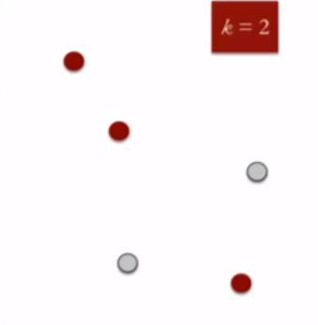
K-Means Clustering Working
This algorithm works in these 5 steps :
Specify the desired number of clusters K : Let us choose k=2 for these 5 data points in 2-D space.

Slide 5
K-Means Clustering Working
Randomly assign each data point to a cluster : Let’s assign three points in cluster 1 shown using red color and two points in cluster 2 shown using grey color.

Slide 6
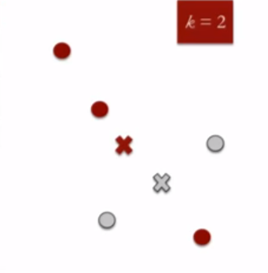
K-Means Clustering Working
Compute cluster centroids : The centroid of data points in the red cluster is shown using red cross and those in grey cluster using grey cross.

Slide 7
K-Means Clustering Working
Re-assign each point to the closest cluster centroid : Note that only the data point at the bottom is assigned to the red cluster even though its closer to the centroid of grey cluster. Thus, we assign that data point into grey cluster

Slide 8
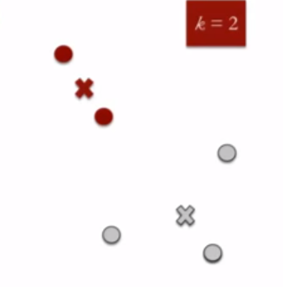
K-Means Clustering Working
Re-compute cluster centroids : Now, re-computing the centroids for both the clusters.

Slide 9
Hierarchical Clustering
Hierarchical clustering, as the name suggests is an algorithm that builds hierarchy of clusters. This algorithm starts with all the data points assigned to a cluster of their own. Then two nearest clusters are merged into the same cluster. In the end, this algorithm terminates when there is only a single cluster left.

Slide 10
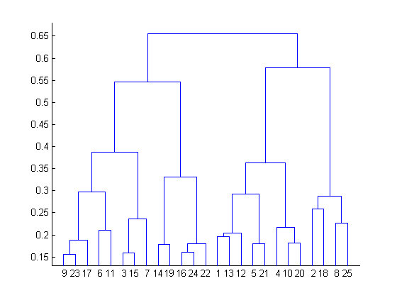
Hierarchical Clustering
The results of hierarchical clustering can be shown using dendrogram. The dendrogram can be interpreted as:

Slide 11
Difference between K Means and Hierarchical clustering
Hierarchical clustering can’t handle big data well but K Means clustering can. This is because the time complexity of K Means is linear i.e. O(n) while that of hierarchical clustering is quadratic i.e. O(n²).
In K Means clustering, since we start with random choice of clusters, the results produced by running the algorithm multiple times might differ. While results are reproducible in Hierarchical clustering.
K Means is found to work well when the shape of the clusters is hyper spherical (like circle in 2D, sphere in 3D).
K Means clustering requires prior knowledge of K i.e. no. of clusters you want to divide your data into. But, you can stop at whatever number of clusters you find appropriate in hierarchical clustering by interpreting the dendrogram

Slide 12
Applications of Clustering
Recommendation engines
Market segmentation
Social network analysis
Search result grouping
Medical imaging
Image segmentation
Anomaly detection

