Slide 1

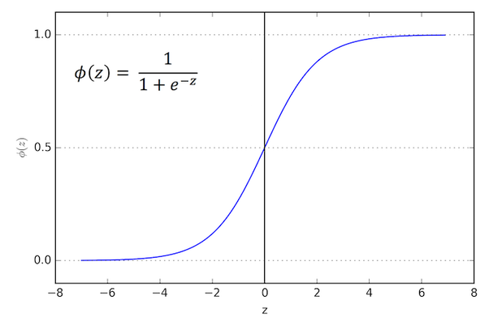
Logistic Regression
By :- Ravi

Slide 2

Logistic Regression
Let us take few real world examples to understand
Logistic Regression
Will it rain today?
Will I reach office on time today?
Would I wear blue, black, red outfit today?
What grade a student would get in an exam?

Slide 3
Logistic Regression
In statistics, logistic regression, or logit regression, or logit model is a regression model where the dependent variable (DV) is categorical. That is, where the output can take only two values, "0" and "1", which represent outcomes such as pass/fail, win/lose, alive/dead or healthy/sick.
It is mainly a classification technique.

Slide 4
Why Logistic Regression ?
In case of Linear Regression Model, the predicted outcome of the dependent variable will always be a real value which could range from –ꝏ to +ꝏ.
Unlike Regression problems, in Classification problems, the outcome value is either 0 or 1 or any other discrete value.

Slide 5
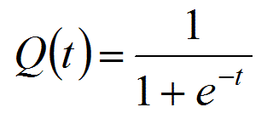
Logistic Function
Also known as Sigmoid Function
It will take any value as input and those input values may be categorical dummy variables or they may be continuous.
It creates a S-shaped curve that can take any real-valued number and map it into a value between 0 and 1.

Slide 6
Logistic Regression Example
Example: Probability of passing an exam versus hours of study
A group of 20 students spend between 0 and 6 hours studying for an exam. How does the number of hours spent studying affect the probability that the student will pass the exam?
The reason for using logistic regression for this problem is that the dependent variable pass/fail represented by “1” and “0”. If the problem was changed so that pass/fail was replaced with the grade 0–100 (cardinal numbers), then simple regression analysis could be used.

Slide 7
The table shows the number of hours each student spent studying, and whether they passed (1) or failed (0).

Slide 8
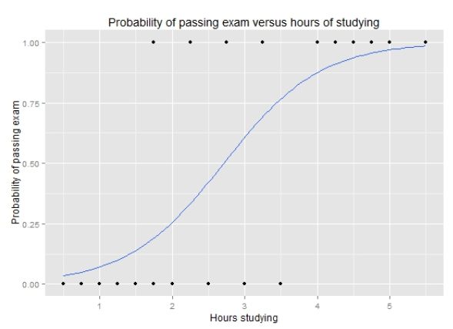
The graph shows the probability of passing the exam versus the number of hours studying, with the logistic regression curve fitted to the data.

Slide 9
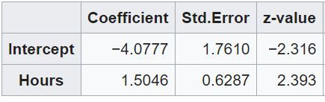
The logistic regression analysis gives the following output.
The output provides the coefficients for Hours = 1.5046 and Intercept = -4.0777
These coefficients are entered in the logistic regression equation to estimate the probability of passing the exam

Slide 10
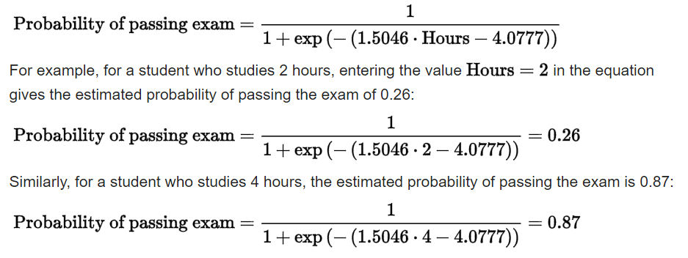
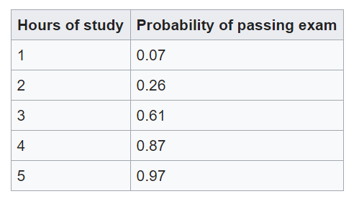

Slide 11
Logistic Regression Equation
y^ = e^(b0 + b1*x) / (1 + e^(b0 + b1*x))
This can be simplified as:
y^ = 1.0 / (1.0 + e^(-(b0 + b1 * x1)))
Where y is the predicted output, b0 is the bias or intercept term and b1 is the coefficient for the single input value (x). Each column in your input data has an associated b coefficient (a constant real value) that must be learned from your training data

Slide 12
Logistic Regression Implementation
Logistic regression uses an equation as the representation, very much like linear regression. Input values (X) are combined linearly using weights or coefficient values to predict an output value (y).
A key difference from linear regression is that the output value being modeled is a binary value (0 or 1) rather than a numeric value.
yhat = e^(b0 + b1 * x1) / (1 + e^(b0 + b1 * x1))
This can be simplified as:
yhat = 1.0 / (1.0 + e^(-(b0 + b1 * x1)))

Slide 13
Logistic Regression Implementation
Where e is the base of the natural logarithms (Euler’s number), yhat is the predicted output, b0 is the bias or intercept term and b1 is the coefficient for the single input value (x1).
The y^ prediction is a real value between 0 and 1, that needs to be rounded to an integer value and mapped to a predicted class value.
Each column in your input data has an associated b coefficient (a constant real value) that must be learned from your training data. The actual representation of the model that you would store in memory or in a file are the coefficients in the equation (the beta value or b’s).
The coefficients of the logistic regression algorithm must be estimated from your training data

Slide 14
Stochastic Gradient Descent
The word ‘stochastic‘ means a system or a process that is linked with a random probability. Hence, in Stochastic Gradient Descent, a few samples are selected randomly instead of the whole data set for each iteration.
In Gradient Descent, there is a term called “batch” which denotes the total number of samples from a dataset that is used for calculating the gradient for each iteration. In typical Gradient Descent optimization, like Batch Gradient Descent, the batch is taken to be the whole dataset.
Although, using the whole dataset is really useful for getting to the minima in a less noisy or less random manner, but the problem arises when our datasets get really huge.

Slide 15
Stochastic Gradient Descent
Suppose, you have a million samples in your dataset, so if you use a typical Gradient Descent optimization technique, you will have to use all of the one million samples for completing one iteration while performing the Gradient Descent, and it has to be done for every iteration until the minima is reached. Hence, it becomes computationally very expensive to perform.
This problem is solved by Stochastic Gradient Descent. In SGD, it uses only a single sample, i.e., a batch size of one, to perform each iteration. The sample is randomly shuffled and selected for performing the iteration.

Slide 16
Stochastic Gradient Descent
Gradient Descent is the process of minimizing a function by following the gradients of the cost function.
This involves knowing the form of the cost as well as the derivative so that from a given point you know the gradient and can move in that direction, e.g. downhill towards the minimum value.
In machine learning, we can use a technique that evaluates and updates the coefficients every iteration called stochastic gradient descent to minimize the error of a model on our training data.
The way this optimization algorithm works is that each training instance is shown to the model one at a time. The model makes a prediction for a training instance, the error is calculated and the model is updated in order to reduce the error for the next prediction.

Slide 17
Stochastic Gradient Descent
This procedure can be used to find the set of coefficients in a model that result in the smallest error for the model on the training data. Each iteration, the coefficients (b) in machine learning language are updated using the equation:
b = b - learning_rate * (yhat - y) * x
Where b is the coefficient or weight being optimized, learning_rate is a learning rate that you must configure (e.g. 0.01), (y – yhat) is the prediction error for the model on the training data attributed to the weight, yhat is the prediction made by the coefficients and x is the input value.

