Slide 1

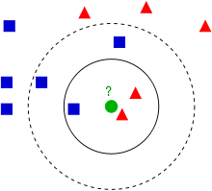
K-Nearest Neighbors
By :- Ravi

Slide 2
What is K-Nearest Neighbor ?
K-Nearest Neighbors (K-NN) is one of the simplest machine learning algorithms. As the name itself suggest that we are looking for the nearest neighbor of a data point.
KNN is a model which try to learn from its neighbors. It is classification as well as regression technique but mainly used for classification i.e., “1” or “0”, True or False.
k-NN is often used in search applications where you are looking for “similar” items, that is, when your task is some form of “find items similar to this one”. You’d call this a k-NN search.

Slide 3
Understanding K-Nearest Neighbor
Suppose in a cricket match team A required 36 runs to win in last over. While the match is going, you’ve made the prediction that the team A will lose the match. But how can you be so sure.
Because you have seen similar situations before. And while the situation might not be exactly the same, we know that it’s not a impossible task but no team has ever won is this situation. Giving you a high level of confidence that will be the outcome.

Slide 4
Understanding K-Nearest Neighbors
But what about when team A is required 6 runs in 10 balls ? Have you experienced this as well? We can see that the runs and balls both play a role in the outcome.
This is the same reasoning the K-NN algorithm is using. When a new situation occurs, it scans through all past experiences and looks up the k closest experiences. Those experiences (or: data points) are what we call the k nearest neighbors.

Slide 5
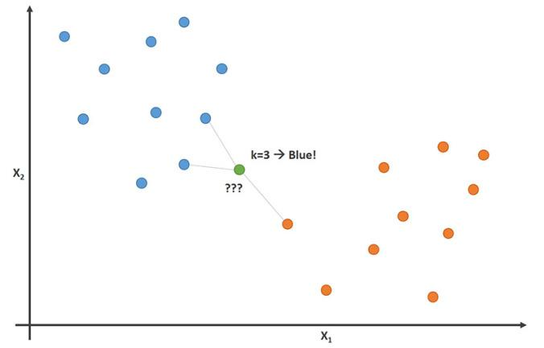
Understanding K-Nearest Neighbors
If you have a classification task, for example you want to predict if the team will win, you take the majority vote of all k neighbors. If k=5 and in 3 or more of your most similar experiences the team won, it will go with the prediction “yes, it will win”.

Slide 6
Making predictions with KNN
KNN makes predictions using the training dataset directly.
To determine which of the K instances in the training dataset are most similar to a new input a distance measure is used. For real-valued input variables, the most popular distance measure is Euclidean distance.
Euclidean distance is calculated as the square root of the sum of the squared differences between a new point (x) and an existing point (xi) across all input attributes j.
Euclidean Distance(x, xi) = sqrt( sum( (xj – xij)^2 ) )

Slide 7
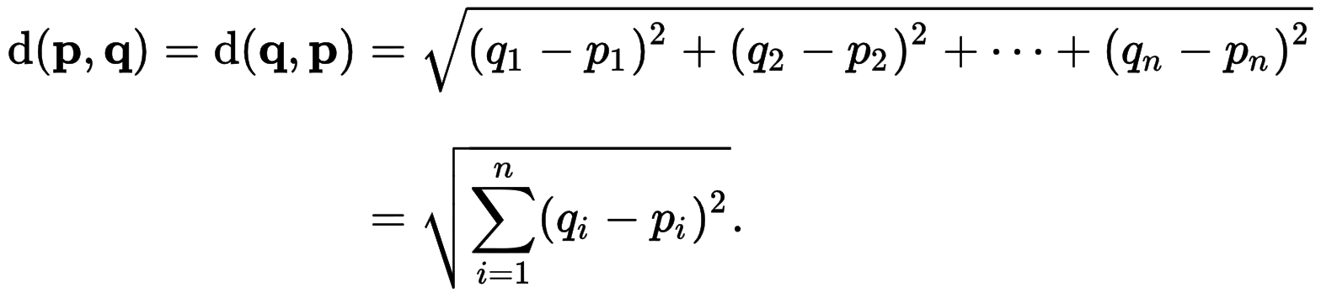
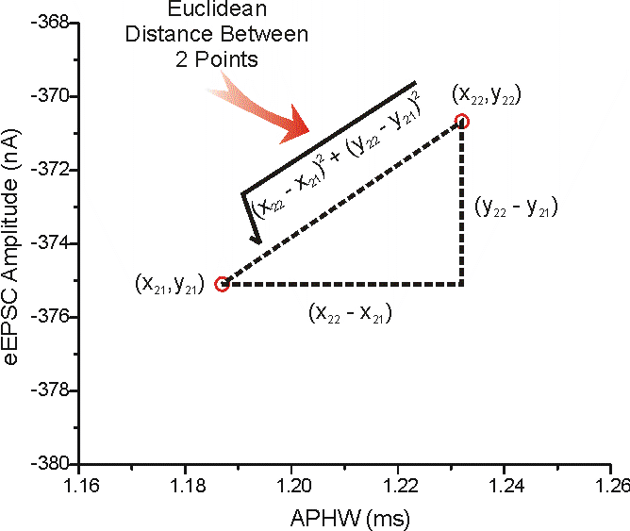
Euclidean Distance

Slide 8
Other Distance Measures
Hamming Distance: Calculate the distance between binary vectors.
Manhattan Distance: Calculate the distance between real vectors using the sum of their absolute difference. Also called City Block Distance.
Minkowski Distance: Generalization of Euclidean and Manhattan distance.

Slide 9
Different Names of KNN
Instance-Based Learning: The raw training instances are used to make predictions. As such KNN is often referred to as instance-based learning or a case-based learning (where each training instance is a case from the problem domain).
Lazy Learning: No learning of the model is required and all of the work happens at the time a prediction is requested. As such, KNN is often referred to as a lazy learning algorithm.
Non-Parametric: KNN makes no assumptions about the functional form of the problem being solved. As such KNN is referred to as a non-parametric machine learning algorithm.

Slide 10
Curse of Dimensionality
KNN works well with a small number of input variables (p), but struggles when the number of inputs is very large.
Each input variable can be considered a dimension of a p-dimensional input space. For example, if you had two input variables x1 and x2, the input space would be 2-dimensional.
As the number of dimensions increases the volume of the input space increases at an exponential rate.
In high dimensions, points that may be similar may have very large distances. All points will be far away from each other and our intuition for distances in simple 2 and 3-dimensional spaces breaks down. This might feel unintuitive at first, but this general problem is called the “Curse of Dimensionality”.

Slide 11
Applications of KNN
Optical Character Recognition (OCR)
Facial Recognition
Recommender System (Movies + Products + Videos)
Identifying patterns in genetic data

