Slide 1

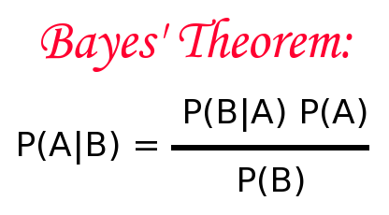
Naïve Bayes
By :- Ravi

Slide 2
Bayes’ Theorem
Bayes’ theorem (alternatively Bayes’ law or Bayes' rule) describes the probability of an event, based on prior knowledge of conditions that might be related to the event.
Alternatively, Bayes’ Theorem is a way of finding a probability when we know certain other probabilities.
For example, if cancer is related to age, then, using Bayes’ theorem, a person’s age can be used to more accurately assess the probability that they have cancer, compared to the assessment of the probability of cancer made without knowledge of the person's age.

Slide 3
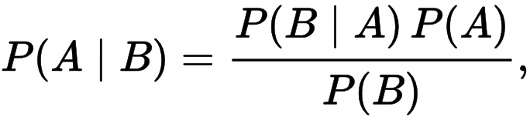
Bayes’ Theorem Formula
P(A) and P(B) is Probability of A and B
P(A|B) is "Probability of A given B", the probability of A given that B happens
P(B|A) is "Probability of B given A", the probability of B given that A happens.

Slide 4
Bayes’ Theorem Formula
In terms of statistics Bayes’ Theorem is stated as:
P(h | d) = (P(d | h) * P(h)) / P(d)
Where
P(h | d) is the probability of hypothesis h given the data d. This is called the posterior probability.
P(d | h) is the probability of data d given that the hypothesis h was true.
P(h) is the probability of hypothesis h being true (regardless of the data). This is called the prior probability of h.
P(d) is the probability of the data (regardless of the hypothesis).

Slide 5
Bayes’ Theorem Example
You are planning a picnic today, but the morning is cloudy
50% of all rainy days start off cloudy!
But cloudy mornings are common (about 40% of days start cloudy)
And this is usually a dry month (only 3 of 30 days tend to be rainy, or 10%)
What is the chance of rain during the day?

Slide 6

Bayes’ Theorem Example
We can use Rain to mean rain during the day, and Cloud to mean cloudy morning.
The chance of Rain given Cloud is written P(Rain | Cloud)
So let's put that in the formula.

Slide 7

Bayes’ Theorem Example
P(Rain) is Probability of Rain = 10%
P(Cloud | Rain) is Probability of Cloud, given that Rain happens = 50%
P(Cloud) is Probability of Cloud = 40%
Or a 12.5% chance of rain. Not too bad, let's have a picnic!

Slide 8
Naïve Bayes
It is a classification technique based on Bayes’ Theorem with an assumption of independence among predictors. In simple terms, a Naive Bayes classifier assumes that the presence of a particular feature in a class is unrelated to the presence of any other feature.
Naive Bayes has been studied extensively since the 1950s.

Slide 9
Naïve Bayes Models
There are three types of Naive Bayes model under scikit learn library:
Gaussian: It is used in classification and it assumes that features follow a normal distribution.
Multinomial: It is used for discrete counts. For example, let’s say, we have a text classification problem. Here we can consider bernoulli trials which is one step further and instead of “word occurring in the document”, we have “count how often word occurs in the document”, you can think of it as “number of times outcome number x_i is observed over the n trials”.
Bernoulli: The binomial model is useful if your feature vectors are binary (i.e. zeros and ones). One application would be text classification with ‘bag of words’ model where the 1s & 0s are “word occurs in the document” and “word does not occur in the document” respectively.

Slide 10
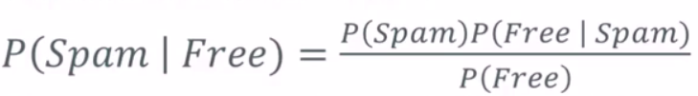
Implementing Naïve Bayes
Using Naïve Bayes’ for spam classification
How would we express the probability of an email being spam if it contains the word “free” ?
The numerator is the probability of a message being spam and containing the word “free”.
The denominator is the overall probability of an email containing the word “free”.
Equivalent to P(Free | Spam)P(Spam) + P(Free | Not Spam)P(Not Spam)
So together – the ratio is the % of emails with the word “free ” that are spam.

Slide 11
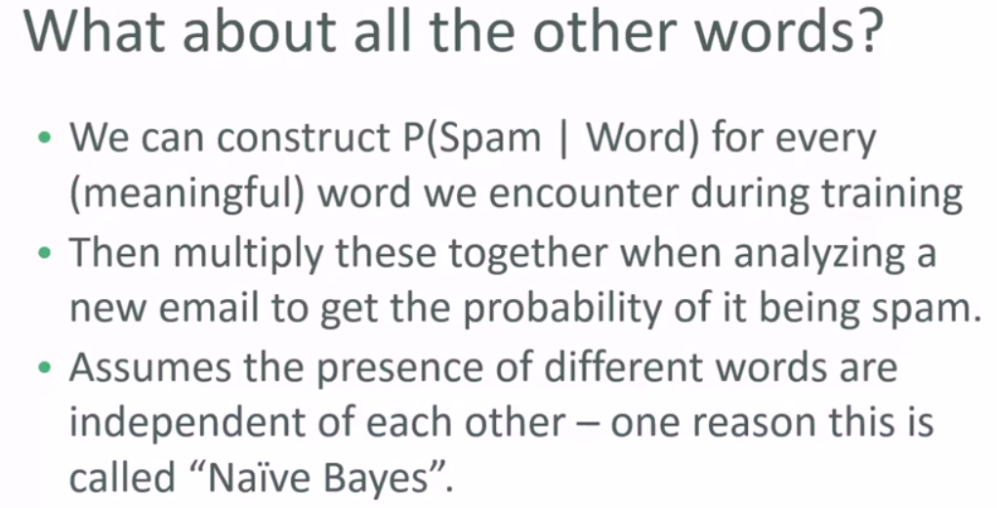
Implementing Naïve Bayes

Slide 12
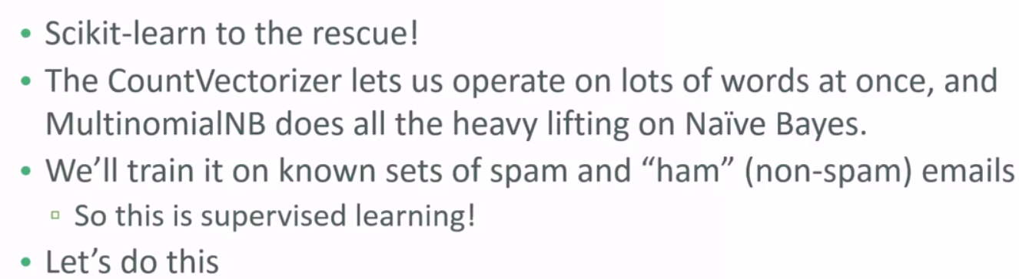
Implementing Naïve Bayes
Sounds like a lot of work but :-

Slide 13
Example of Naïve Bayes
Spam Filtering - Mark an email as spam or not
Sentiment Analysis – Checking whether user gave a positive feedback or negative feedback.
Text Classification - Classify a news article about technology, politics or sports.
Also used for face recognition

Slide 14
Naive Bayes Classifier from scratch

Slide 15
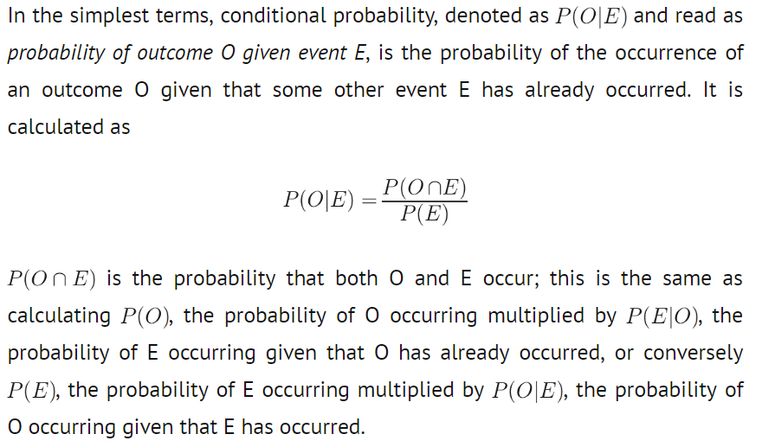
Conditional Probability and Bayes’ Theorem

Slide 16
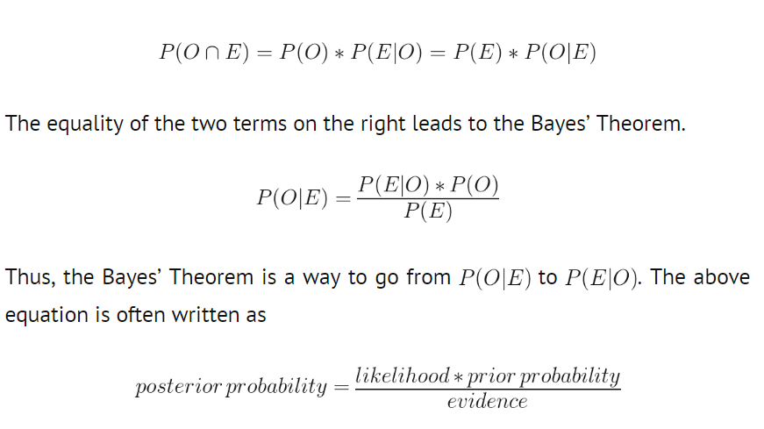
Conditional Probability and Bayes’ Theorem

Slide 17
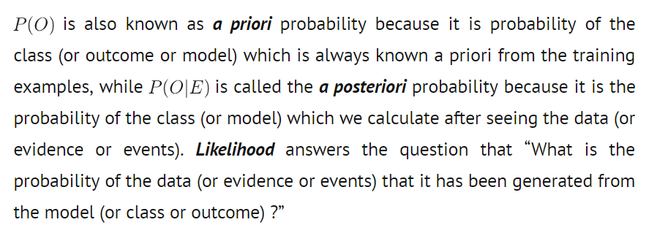
Conditional Probability and Bayes’ Theorem

Slide 18

Why is it called “Naive”?
So far, we have only talked about the effect of a single event E on the occurrence of outcome O. In reality however, the probability of outcome O’s occurrence is governed by more than one already occurred event. The mathematics behind such a scenario gets very complicated and is made simple by assuming that the various governing events are independent of each other. Mathematically expressing, if an outcome O depends on events E1, E2, ….En then assuming E1, E2, …En do not depend on each other.

Slide 19
Why is it called “Naive”?
Thus, the model is very naively believing that the effect of the occurrence of any of the events is completely independent of the occurrence of other events. This is obviously not the case with most of the real world problems and the predictor features are known to influence and be influenced by other features. Still, naive Bayes is known to provide results at par and sometimes even better than highly complex and computationally expensive classification models.

