Slide 1
Apache Tomcat
Representation and Management of Data on the Web

Slide 2
What is Tomcat?
A Web server is a program that receives HTTP requests and returns HTTP responses
Tomcat is a Web Server created by Apache
Tomcat supports Servlets!

Slide 3
Installing Tomcat
Create a directory for installation (tomcat_home)
Inside the directory, type "tomcat setup"
The following directories will be created:
  conf
  lib
  logs
  my-webapps-template-dir
  webapps

Slide 4
Running Tomcat
Go to the installation directory
Use the command "tomcat start" to start the server
Use the command "tomcat stop" to stop the server
You get to the server by requesting on a web browser http://<host>:port/
  Host is the machine on which you started tomcat
  Port is the port number according to the configuration (default = 8080)

Slide 5
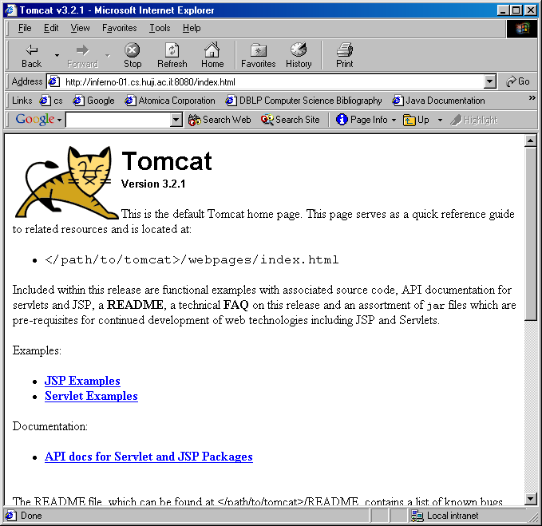
Note: Examples of Servlets (and JSP) are available here
Note: You may have to disable the proxies of your web browser in order for this to work

Slide 6
Important Note
Tomcat runs in the background.
Tomcat has started and you can try to access it after you see at your prompt something like:
  2003-05-04 12:02:29 - PoolTcpConnector: Starting HttpConnectionHandler on 8383
  2003-05-04 12:02:31 - PoolTcpConnector: Starting Ajp12ConnectionHandler on 8007

Slide 7
Extremely Important Note
When you run tomcat, it causes many processes to be created
By order of the system: Do not run tomcat on pita, mangal, inferno, etc. Do run tomcat on your local workstation
Remember to stop tomcat before logging off!!!

Slide 8
Changing the Default Port
Open the file server.xml in the directory conf of the tomcat installation
<!-- Normal HTTP -->
<Connector className=
"org.apache.tomcat.service.PoolTcpConnector">
<Parameter name="handler"
value="org.apache.tomcat.service.
http.HttpConnectionHandler"/>
<Parameter name="port"
value="8080"/>
</Connector>

Slide 9
The Directory Structure of a Web Application (1)
Web applications are located in the webapps directory
Each web application has its own subdirectory.
The web application subdirectory is built in a standard fashion
Note: After creating the subdirectory you must restart Tomcat, for tomcat to recognize it!

Slide 10
The Directory Structure of a Web Application (2)
/dbi: The root directory of the dbi web application. Store here HTML and JSP files
/dbi/WEB-INF: All resources for the web application that are not in the root directory. Store here web.xml (which describes your servlets)
/dbi/WEB-INF/classes: Servlet and utility classes
/dbi/WEB-INF/lib: Utility JAR files

Slide 11
Referring to your Files in the Browser
To open a page called a.html in the ROOT directory of the dbi web application:
  http://<host>:<port>/dbi/a.html
To open a servlet called HelloWorld.class of the dbi web application
  http://<host>:<port>/dbi/servlet/HelloWorld
Ugh! Do we really need to specify directory "servlet" in order to reference the servlet?

Slide 12
Configuring Servlet Information
If you simply put the Servlet class file in the dbi/WEB-INF/classes directory, it will be known to Tomcat by its class name
You can configure the tomcat name and other things in the web.xml file, which should go in the dbi/WEB-INF directory.

Slide 13
The web.xml File
Use the web.xml file to:
  configure the way the servlet is called in the browser
  give it initialization parameters
  set session timeout
An example web.xml file can be found here and is on the following slides

Slide 14
<?xml version="1.0" encoding="ISO-8859-1"?>
<!DOCTYPE web-app
PUBLIC "-//Sun Microsystems, Inc.//DTD Web Application 2.2//EN" "http://java.sun.com/j2ee/dtds/web-app_2_2.dtd">
<web-app>
<session-timeout>30</session-timeout>
<servlet>
<servlet-name>hi</servlet-name>
<servlet-class>HelloWorld</servlet-class>
<init-param>
<param-name>login</param-name>
<param-value>snoopy</param-value>
</init-param>
</servlet>
HTTPServlet object will become invalid after 30 minutes of inactivity

Slide 15
<?xml version="1.0" encoding="ISO-8859-1"?>
<!DOCTYPE web-app
PUBLIC "-//Sun Microsystems, Inc.//DTD Web Application 2.2//EN" "http://java.sun.com/j2ee/dtds/web-app_2_2.dtd">
<web-app>
<session-timeout>30</session-timeout>
<servlet>
<servlet-name>hi</servlet-name>
<servlet-class>HelloWorld</servlet-class>
<init-param>
<param-name>login</param-name>
<param-value>snoopy</param-value>
</init-param>
</servlet>
Name of HelloWorld servlet is hi. Can be accessed at:
http://<host>:<port>/dbi/servlet/hi

Slide 16
<?xml version="1.0" encoding="ISO-8859-1"?>
<!DOCTYPE web-app
PUBLIC "-//Sun Microsystems, Inc.//DTD Web Application 2.2//EN" "http://java.sun.com/j2ee/dtds/web-app_2_2.dtd">
<web-app>
<session-timeout>30</session-timeout>
<servlet>
<servlet-name>hi</servlet-name>
<servlet-class>HelloWorld</servlet-class>
<init-param>
<param-name>login</param-name>
<param-value>snoopy</param-value>
</init-param>
</servlet>
Initialize the parameter "login" with value "snoopy

Slide 17
<servlet-mapping>
<servlet-name>hi</servlet-name>
<url-pattern>/hi</url-pattern>
</servlet-mapping>
<servlet-mapping>
<servlet-name>hi</servlet-name>
<url-pattern>*.hi</url-pattern>
</servlet-mapping>
<error-page>
<error-code>404</error-code>
<location>/servlet/NotFound</location>
</error-page>
</web-app>
Associate Servlet hi with given url pattern.
Can be accessed at:
http://<host>:<port>/dbi/hi
Associate Servlet hi with extension .hi
Can be accessed at:
http://<host>:<port>/dbi/a.hi
http://<host>:<port>/dbi/b.hi
etc.

Slide 18
<servlet-mapping>
<servlet-name>hi</servlet-name>
<url-pattern>/hi</url-pattern>
</servlet-mapping>
<servlet-mapping>
<servlet-name>hi</servlet-name>
<url-pattern>*.hi</url-pattern>
</servlet-mapping>
<error-page>
<error-code>404</error-code>
<location>/servlet/NotFound</location>
</error-page>
</web-app>
Associate the error code of 404 with the servlet NotFound

Slide 19
Deploying your Web Application
Go to the root directory of your application (e.g., dbi)
Archive the distribution: jar -cvf dbi.war
Move the war file to tomcat_home/webapps
Remove the directory dbi
Restart Tomcat
Note: When you run tomcat, the war file is unpacked, so the directory dbi will be created

Slide 20
Think About it?
When you change the web.xml file you have to restart Tomcat. Why?
Where do you put your .java files?
How do you get your class files where they belong?

Slide 21
Working with Apache:
A Recommendation

Slide 22
Recommendation
Develop you java code outside of the tomcat directories
Compile to the correct directories
Use ant to organize the process

Slide 23
Setting up your Directories
Choose a directory to work in (e.g., ~/dbi/project)
Create the directory with the following subdirectories:
  etc: will contain the file web.xml
  src: will contain your source files (your *.java files)
  lib: will contain any jar files you need
  web: will contain HTML and JSP pages for your site

Slide 24
Build File: Properties
Here is an ant build file
You need to change the values for the following properties:
  <property name="tomcat.home" value="complete-path-to-tomcat-home"/>
  <property name="app.name" value="your-app-name"/>

Slide 25
Build File: Targets
The build file has 5 targets:
prepare: Creates the directory hierarchy in the webapps directory for the application + copies web.xml file
clean: Deletes the directory hierarchy created in prepare
compile: Compiles the files from src to the proper directory under tomcat (which directory?)

Slide 26
Build File: Targets
all: does clean, prepare and compile
dist: creates a war file from the web application and a jar file from the web application

