Slide 1
C++ Genie
LOCAL STORAGE SYSTEM
Nikesh D.C. (075BCT052)
Ravi Pandey (075BCT065)
Rohan Chhetry (075BCT066)

Slide 2
INTRODUCTION
C++ Genie is a local storage system
Its primary feature is that it stores files
Its is personal for each user
It also consists of a to-do list
Users can also find a clock showing them current date and time

Slide 3
Features of C++ GENIE
Login feature that ensures privacy for each user
Search engine and synonym for easy searching words in files
A clock to view date and time
A To-do list for adding tasks to be done

Slide 4
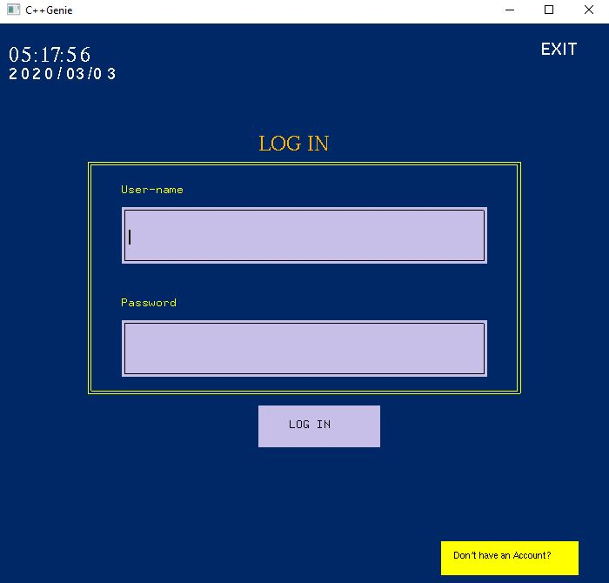
Login window
Exit from program button
Date and Time
( clock )
Username input
Validate login
Password input
Redirect to signup page

Slide 5
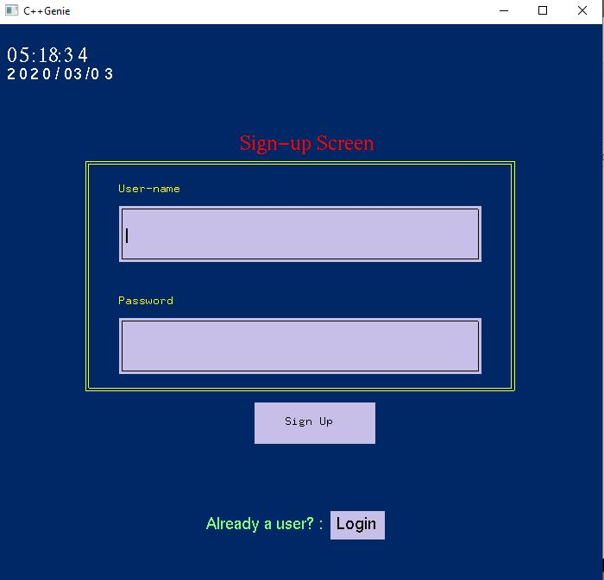
Signup window
Make a new account with given credentials
Redirect to login page

Slide 6
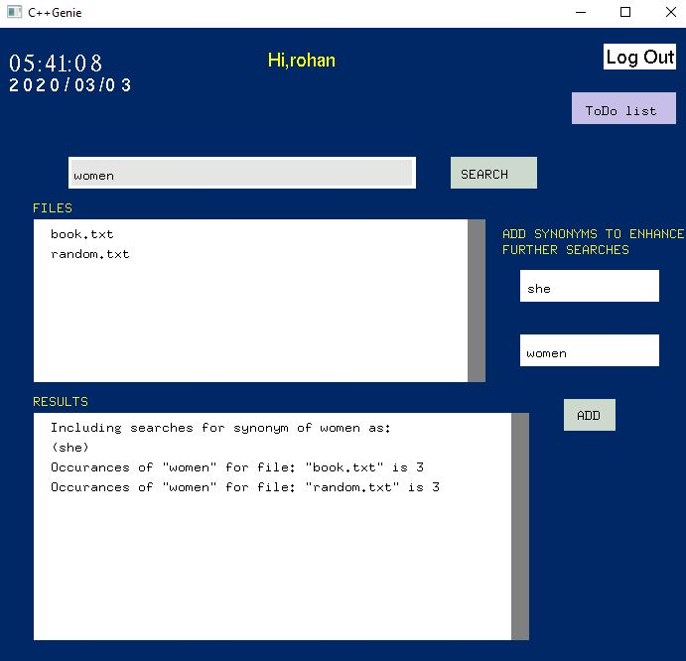
File window
User Logout
Hi, username
Redirect to to-do list page
Search engine textbox
Search engine performs search
Files of user
Synonym
textboxes
Search engine result
Adds the synonym

Slide 7
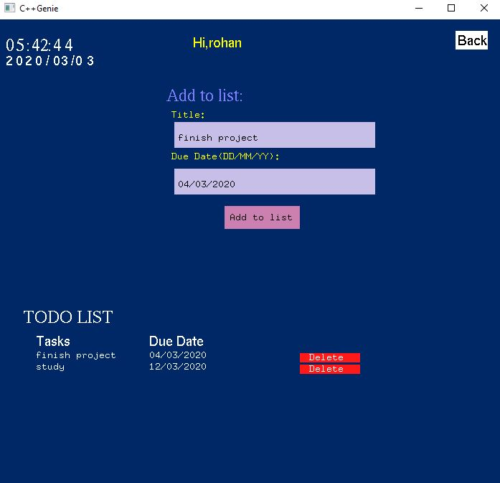
To-do window
Tasks textbox
Redirect to file window
Due date textbox
Adds to-do task
Tasks display
Delete done task
Due date display

Slide 8
Problems faced
Learning C++ OpenGL (GLUT) library
More features of C++ such as directory handling, file handling, etc.
Managing work division between group members and merging individual work
Debugging errors faced

Slide 9
Conclusion
Main objective (i.e. making a functioning project) in C++ fulfilled
Learned more features of C++
Learned how to use OpenGL (GLUT) library

Slide 10
Thank you!! Any questions

