Slide 1
SysML Modelica Integration
Working Group Meeting 8/12/09
Chris Paredis
Notes:
Make note of web-sites that Sandy included.
Talk to Peter Fritzson – align both short-term and long-term perspectives.
Issue: causality into parametrics – propose a solution
(for this RTF: officially on May 25; work something out and discuss with Russell)
Create a plan for a face-to-face meeting: decide whether we need it and then decide
We are not trying to align terminology –
Read-only as property to reflect “constant”

Slide 2
Constructs discussed in Costa Rica
Equations
Connections
Functions
Algorithms

Slide 3
Modelica Equations
Organized in sections delimited by “equation” keyword
Equations are declarative and acausal
Order of equations does not matter
“initial equation” sections contain equations that are only enforced at the start of the simulation
Similar to SysML constraints
Stereotype constraints to «modelicaEquation»

Slide 4
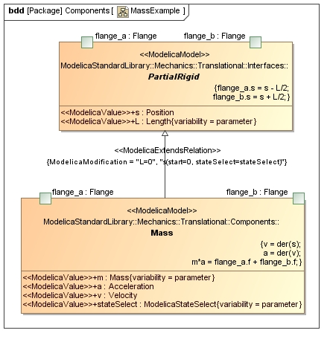
Modelica Equation
model Mass "Sliding mass with inertia"
[…]
equation
v = der(s);
a = der(v);
m*a = flange_a.f + flange_b.f;
end Mass;
In SysML4Modelica:
  Constraint with «ModelicaEquation» as stereotype
  «ModelicaInitialEquation» exists to indicate “initial equation” sections

Slide 5
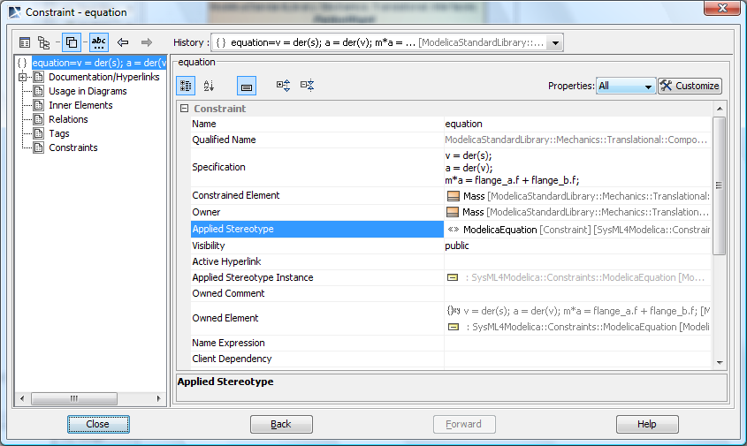
Modelica Equation in MD

Slide 6
Modelica Connections
Are contained in equation sections:
model Oscillator
Modelica.Mechanics.Translational.Components.Mass mass1;
Modelica.Mechanics.Translational.Components.Spring spring1;
Modelica.Mechanics.Translational.Components.Fixed fixed1;
equation
connect(spring1.flange_b, fixed1.flange);
connect(mass1.flange_b, spring1.flange_a);
end Oscillator;

Slide 7
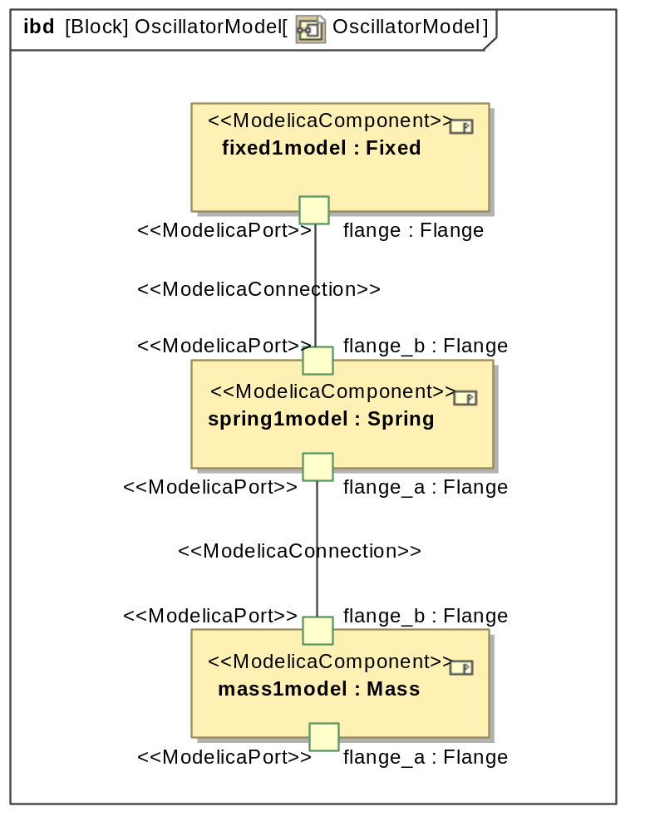
Modelica Connections
Are removed from the equation section in SysML and replaced by explicit «modelicaConnection»’s
«modelicaConnection»
is stereotyped from UML4SysML::Connector

Slide 8
Modelica Functions
can only have inputs and outputs; no connectors – inout is also possible
does not have a connectable interface but instead needs to be called
can be called recursively
is more dynamic; the arguments are computed at run-time
does not have internal state
can have only one algorithm section and no equation section; is always imperative
becomes part of the equation system as black boxes only; the internals are not manipulated symbolically by the solver
can potentially be differentiated
→ Similar to a FunctionBehavior in UML/SysML

Slide 9
Function Example
function limitValue
input Real pMin;
input Real pMax;
input Real p;
output Real pLim;
algorithm
pLim := if p>pMax then pMax
else if p<pMin then pMin
else p;
end limitValue;

Slide 10
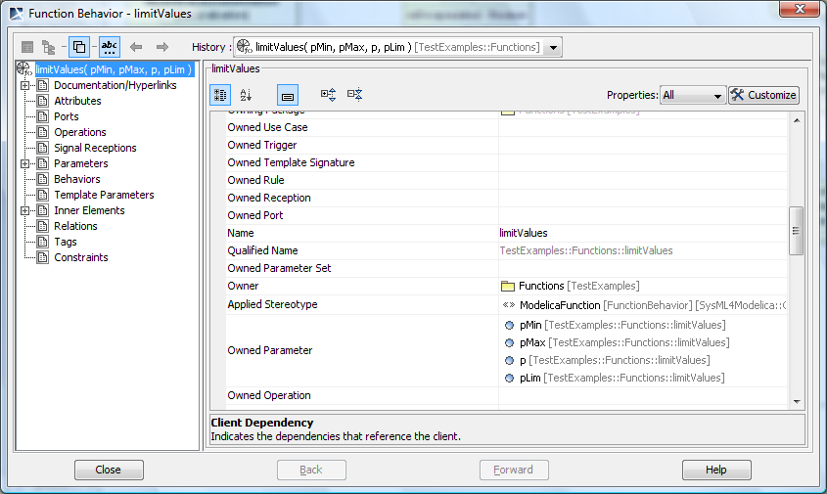
Function Example

Slide 11
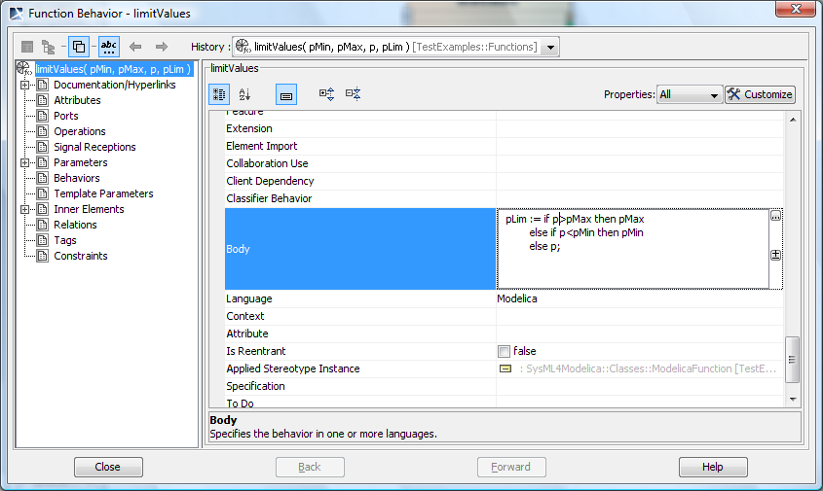
Function Example

Slide 12
Comments
Since «modelicaFunction» does not specialize Block as do all the other Modelica classes, we need to create a counterpart for «modelicaValue» namely «modelicaFunctionParameter»
Rather than specializing Property, this additional stereotype specializes Parameter
A function does not need to be opaque, as long as there are no external interactions,… (we need to be explicit about these constraints)

Slide 13
Calling Functions
Functions can be used in either algorithm or equation sections
For now, we will represent function calls as text in Modelica syntax (just like the rest of the equations or statements), but we should consider mechanisms such as MARTE’s Value Specification Language (VSL) to allow the semantics to be represented more explicitly

Slide 14
Modelica Algorithms
Structured similarly to equations into algorithm sections
Is always imperative
Multiple algorithm sections can exist in one model
Similar to functions but are not named and thus not reusable
→ Similar to SysML Behavior

Slide 15
Algorithm Example
block TimeTable
"Generate a (possibly discontinuous) signal by linear interpolation in a table"
[…]
algorithm
when {time >= pre(nextEvent),initial()} then
(a,b,nextEvent,last) :=
getInterpolationCoefficients(table, offset,
startTime, time, last,
100*Modelica.Constants.eps);
end when;
equation
y = a*time + b;
end TimeTable;

Slide 16
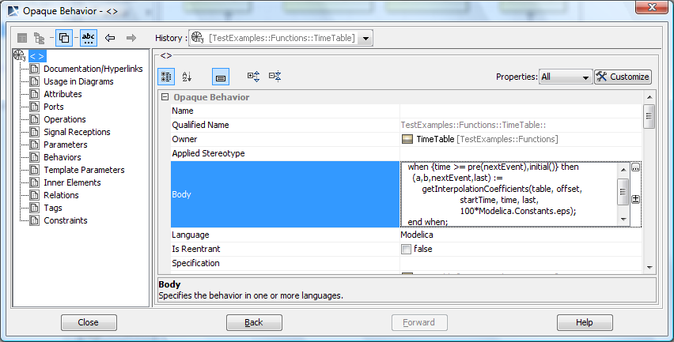
Algorithm Example

Slide 17
Comments
Equations sections in Modelica have no name → behavior without name
Does not need to be opaque
→ future extension: see PhD work of Wladimir Schamai

