Slide 1
CRM for Admission (Team ID : 54594)
Chachapara Jay (160890107004)
Dhaduk Jenish (160890107007)
Hingrajeeya Hemal (160890107010)
Palaliya Raviraj (160890107017)

Slide 2
Week 1(24/6 to 28/6)
Team registration
Project Definition and approval
Introductory analysis

Slide 3
Week 2 (01/07 to 05/07)
Complete and finalize the design and flow for the admission module
Fields requires for it also defined
Visit to receptionist

Slide 4
Admission Module
Call inquiry or individual visit
Fields :
Name
Contact Details
Date
City
Result
Previous School / College
Faculty Name (Visit Handler)
Department(Interested to get admit)
Remarks
Admission Type(VQ / ACPC / ACPDC)

Slide 5
Admission Module (Flow)
Either receptionist or the faculty (visit handler) uploads the data into the database
Admission coordinator will leads these data to heads of the department
Heads will leads it / distribute among faculty members under them
Faculties has to take the remark or need to forward to the other departmental head (If departmental interest changes)

Slide 6
Admission Module (Remark)
Next call ? / Are they going to visit?
If yes then take the date and set the reminder
If no then end it with negative response
If departmental interest changes then leads the data to the other department head
Final response admission review (Positive / Negative)

Slide 7
Admission Module(Unknown Source)
Flow will be same as above
Only fields are changes
Fields :
Contact(Already have)
Response
If positive then add the details to previous table
Take the remark (Join to the remark module)
Date

Slide 8
Week 3 (08/07 to 12/07)
Visit to admission coordinator
Expense module design
School data entry design
If printed -> data entry into portal
If excel -> convert it into proper accepted format and then direct entry into portal
Then continue with admission module (distribution and etc.)

Slide 9
Data fields
School data :
Name
City
Address
Reference

Slide 10
Data Fields
Employee Table
Name
ID
Department
Contact Number
Email id
Address
City
Designation / Post

Slide 11
Users
Principal sir (Full authentication)
Admission Coordinator (Some restriction)
Head of the departments (Partial access)
Faculty members (require-mental access)

Slide 12
Expense Module
Team leader will upload the expense details with picture of bills(for prove)
It will be forwarded to the admission coordinator
He/she verifies it and took the print out of the receipt
Further offline process principal sir’s signature and approval of the receipt

Slide 13
Week 4 (15/07 to 19/07)
Designing complete web flow
Searching for the template
Access privileges among all users

Slide 14
Data Dictionary (Employee Table)
Field Name | Field Type | Field Constraints
Emp_Id | Long Int | Primary + Foreign key
Name | String | -
Contact | Decimal | -
Email | Email | -
Department | String | -
City | String | -
Address | Varchar | -
Designation | String | -
Password | Password | -

Slide 15
Data Dictionary (Student Table)
Field Name | Field Type | Field Constraints
Student_ID | Long int | Primary + foreign key
Name | String | -
Contact | Decimal | Nullable
Cast | String | Nullable
Income | Float | Nullable
Date | Date | -
City | String | Nullable
Response | Boolean | -
Result | Float | Nullable
Remark | Text | -
Emp_Id | Long int | Foreign key to employee table
School / College | String | Nullable
Admission Type | String | Nullable

Slide 16
Data Dictionary (Expense Table)
Field Name | Field Type | Field Constraints
Emp_Id | Long int | Foreign key to employee table
Date | Date | -
Details | Text | -
Amount | Float | -
Picture(3) | BLOB | -

Slide 17
Data Dictionary (Call Table)
Field Name | Field Type | Field Constraints
Emp_Id | Long int | Foreign key to employee table
Contact | Decimal | -
Date | Date | -
Response | Boolean | -

Slide 18
Data Dictionary (Gift Table)
Field Name | Field Type | Field Constraints
Emp_Id | Long int | Foreign key to employee table
Date | Date | -
Broacher | Int | -
Beg | Int | -
Other | Ints | -

Slide 19
Data Dictionary (School Table)
Field Name | Field Type | Field Constraints
School_Name | String | -
Address | Varchar | -
City | String | -
Contact_Person_Name | String | -
Contact | Decimal | -
Emp_Id(Reference Faculty) | Long int | Foreign key to employee table

Slide 20
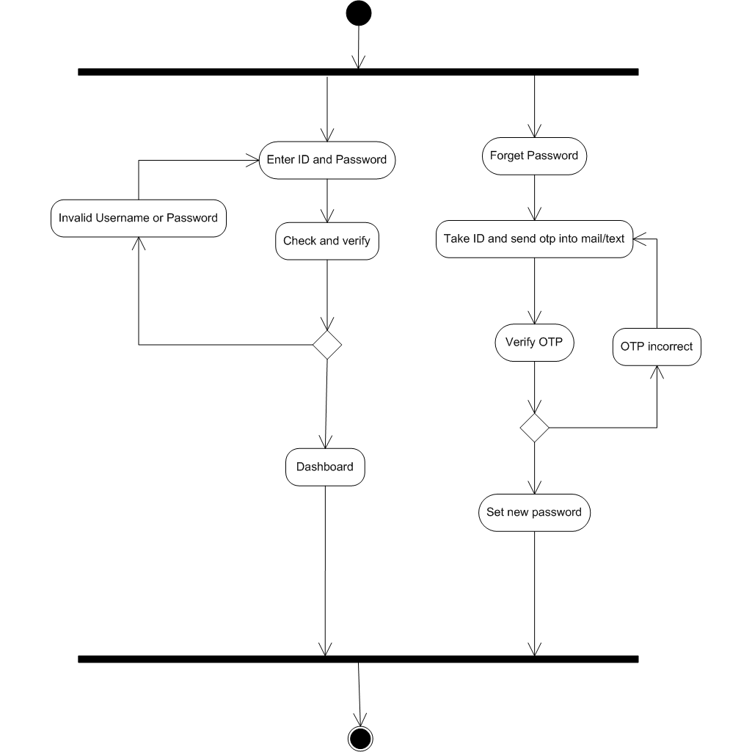
Activity Diagram (Login)

Slide 21
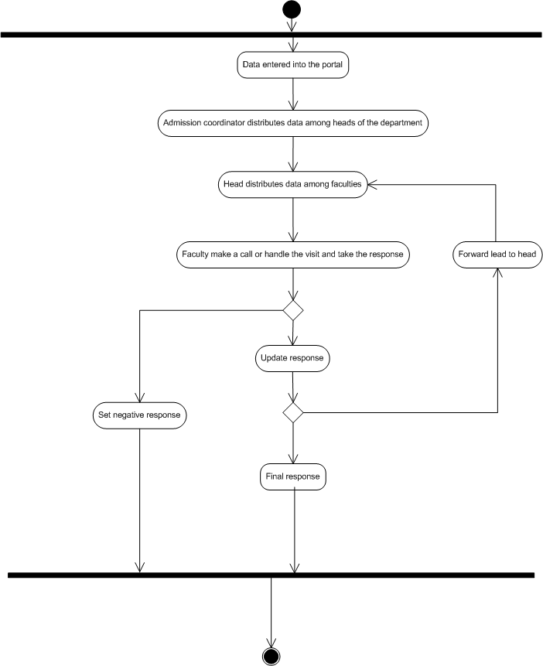
Activity Diagram (Admission)

Slide 22
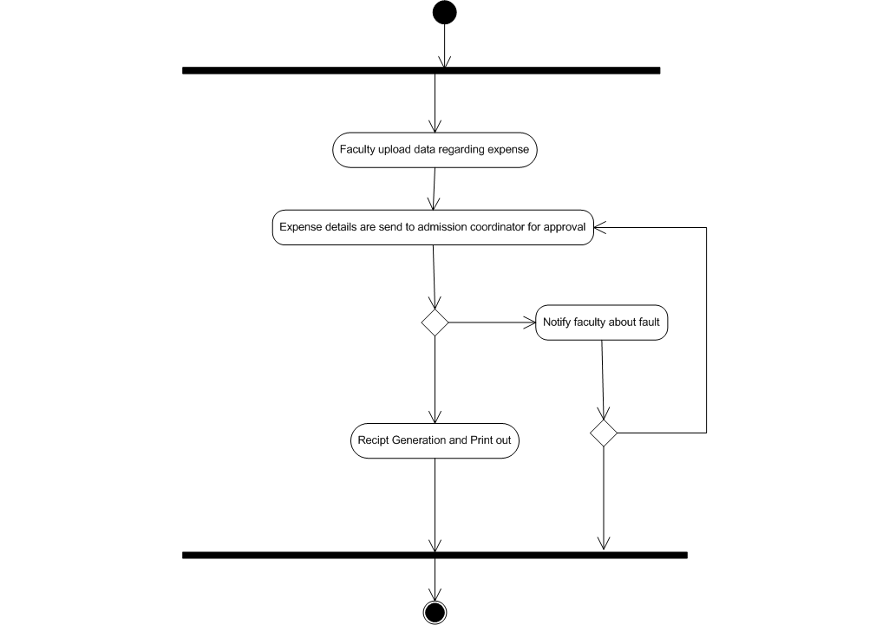
Activity Diagram (Expense)

Slide 23
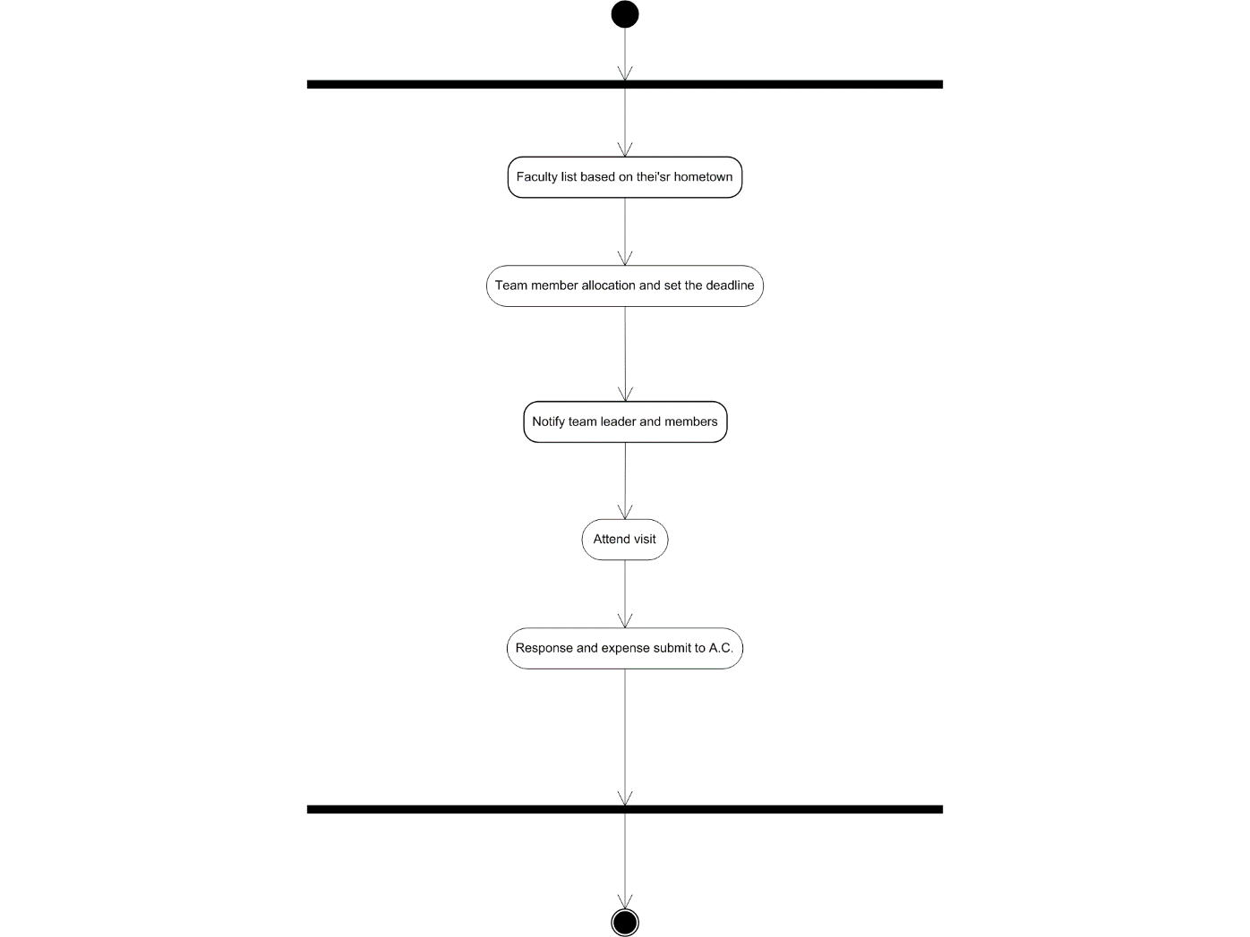
Activity Diagram (Team Generation)

Slide 24
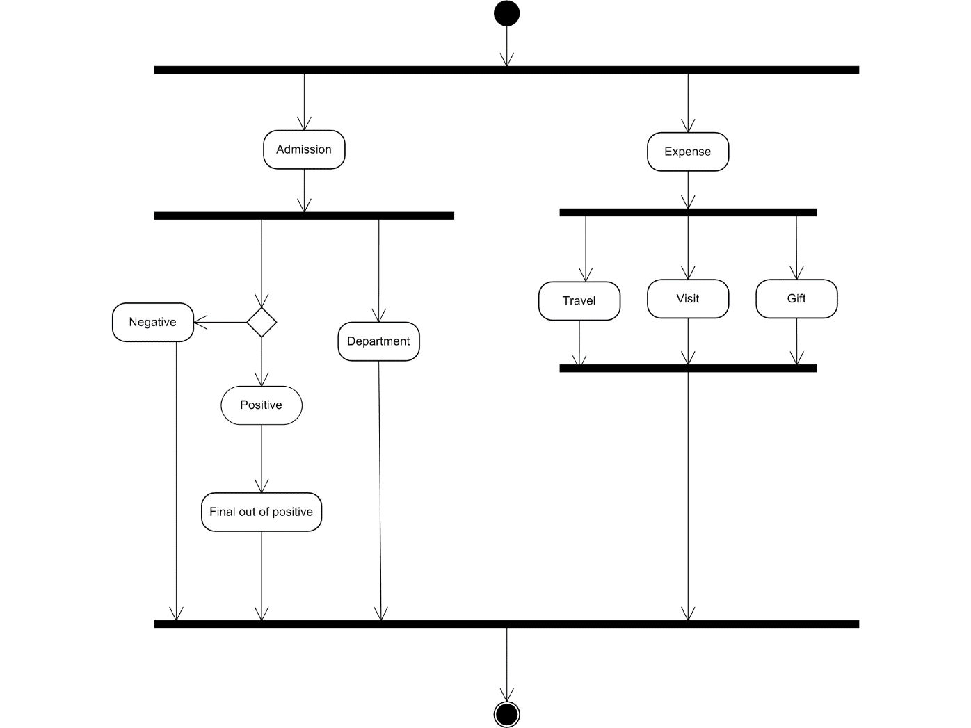
Activity Diagram (Report Generation)

Slide 25
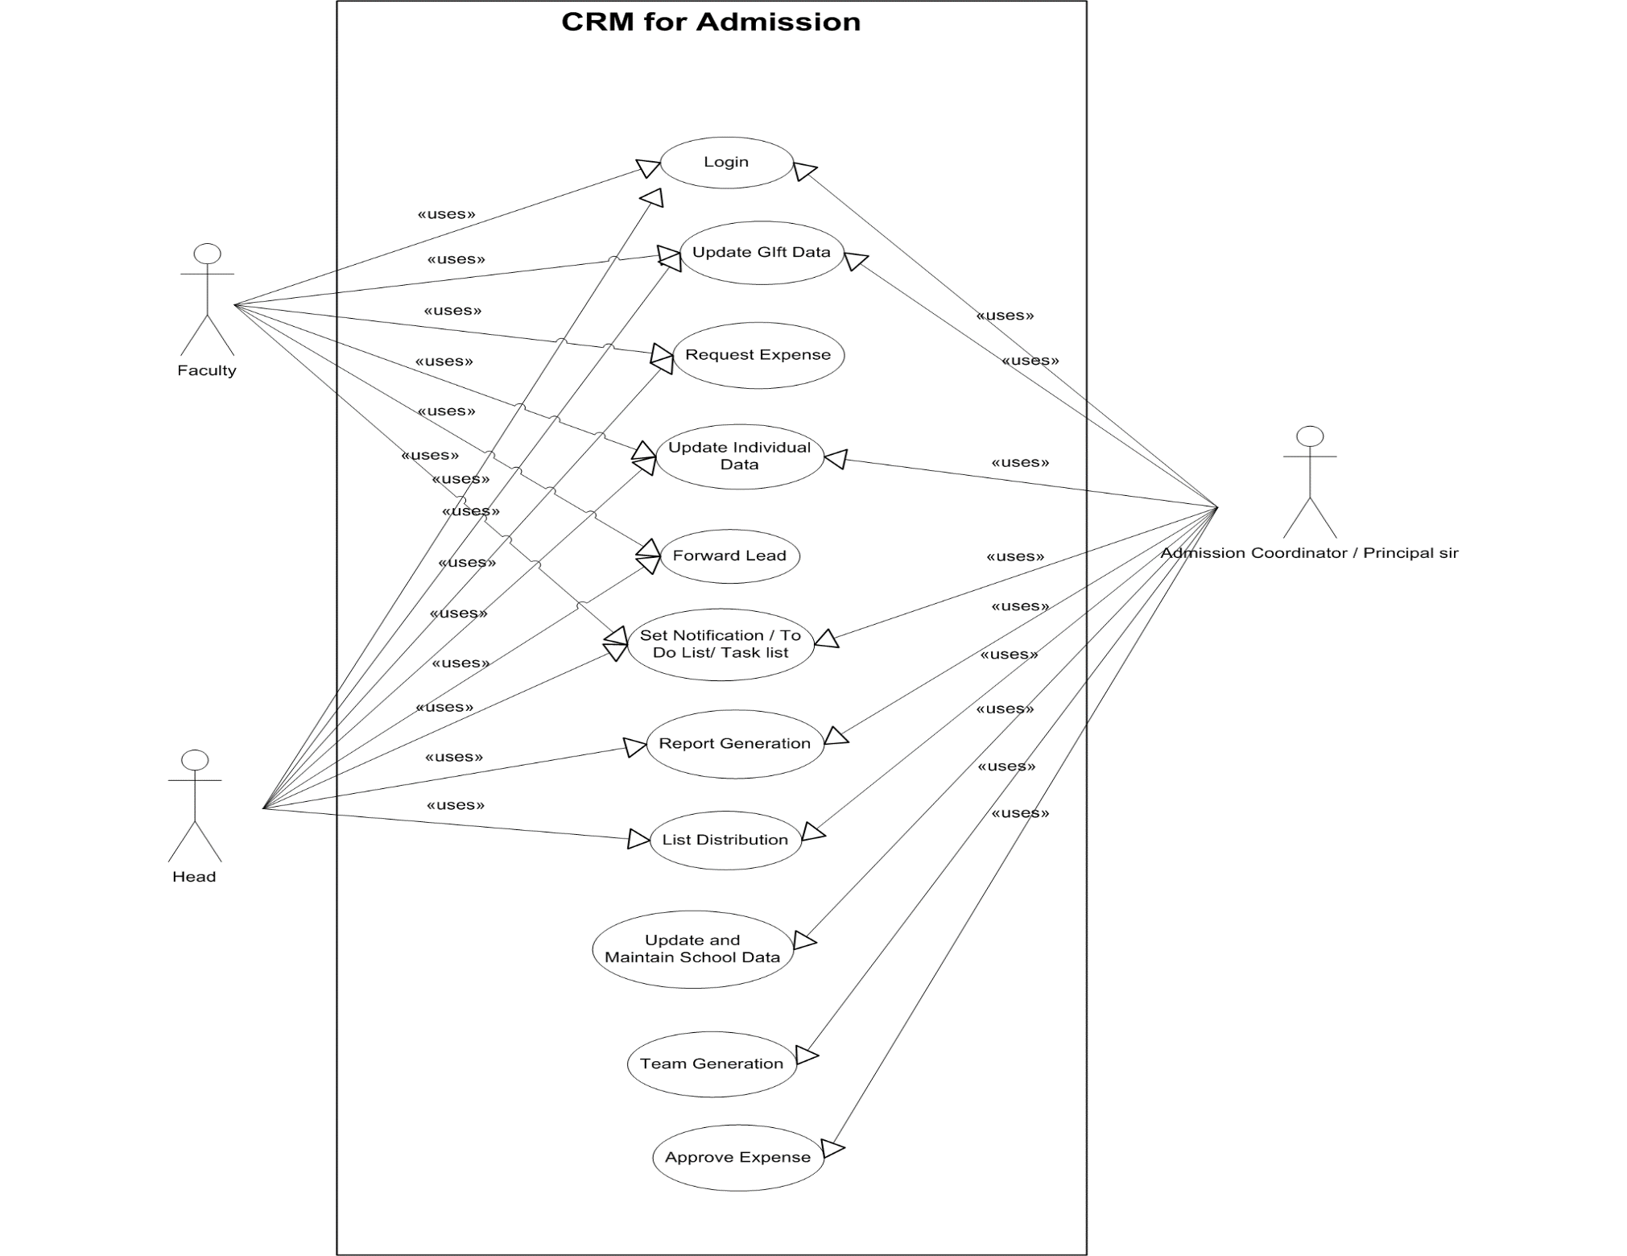
Use Case Diagram

Slide 26
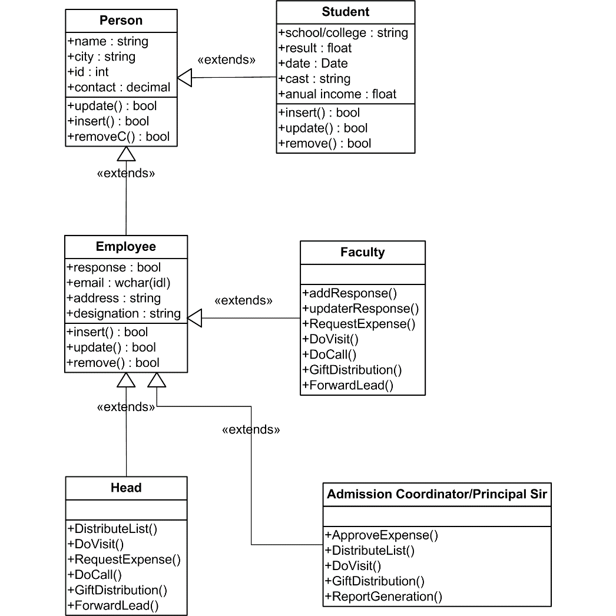
Class Diagram

Slide 27
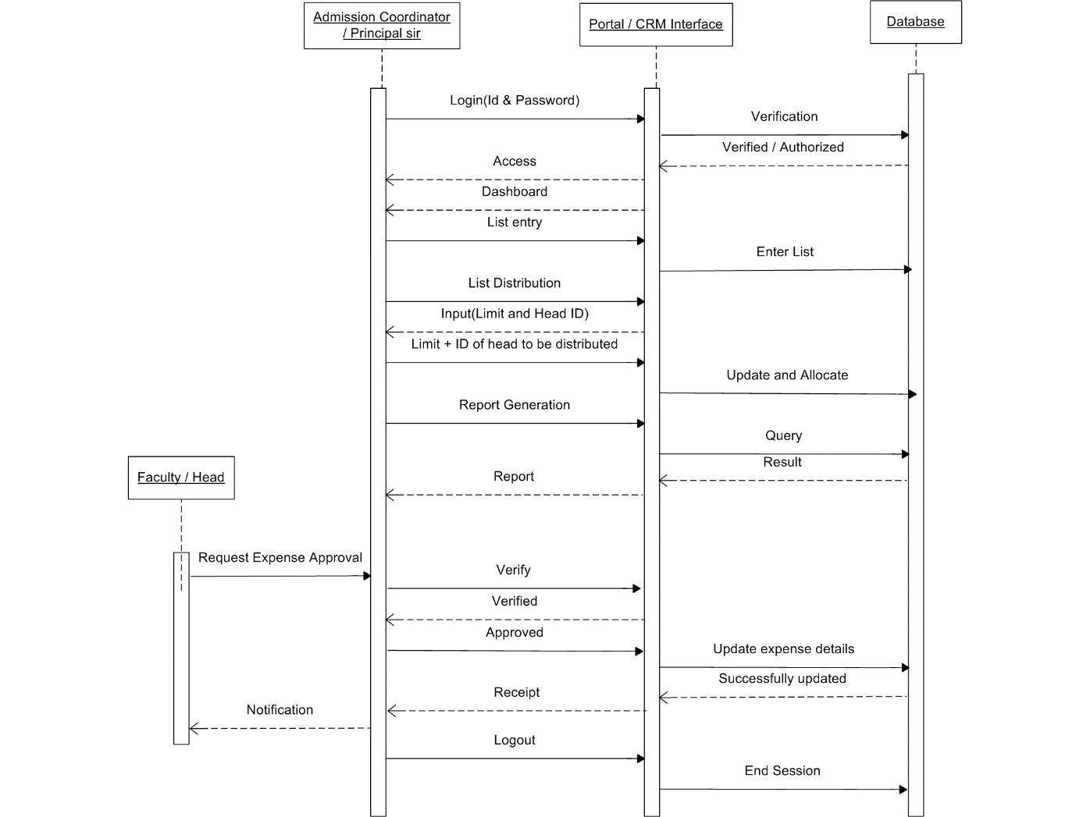
Sequence Diagram (Admission Coordinator)

Slide 28
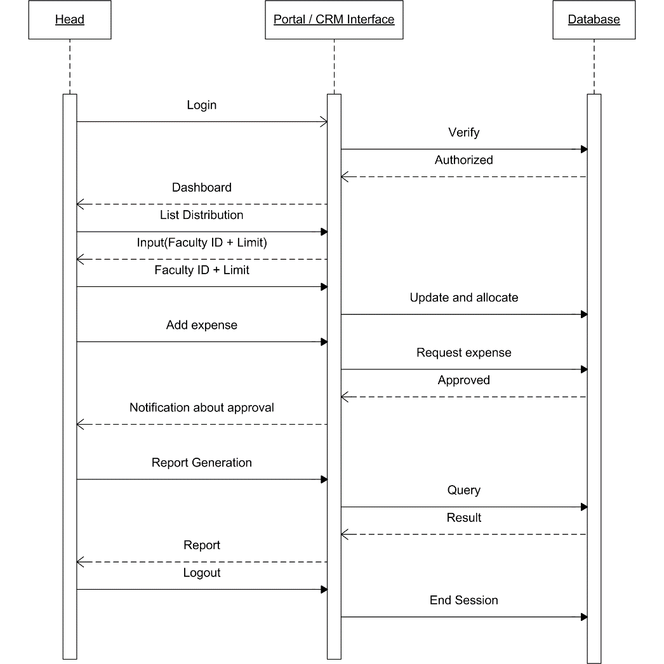
Sequence Diagram (Head of the department)

Slide 29
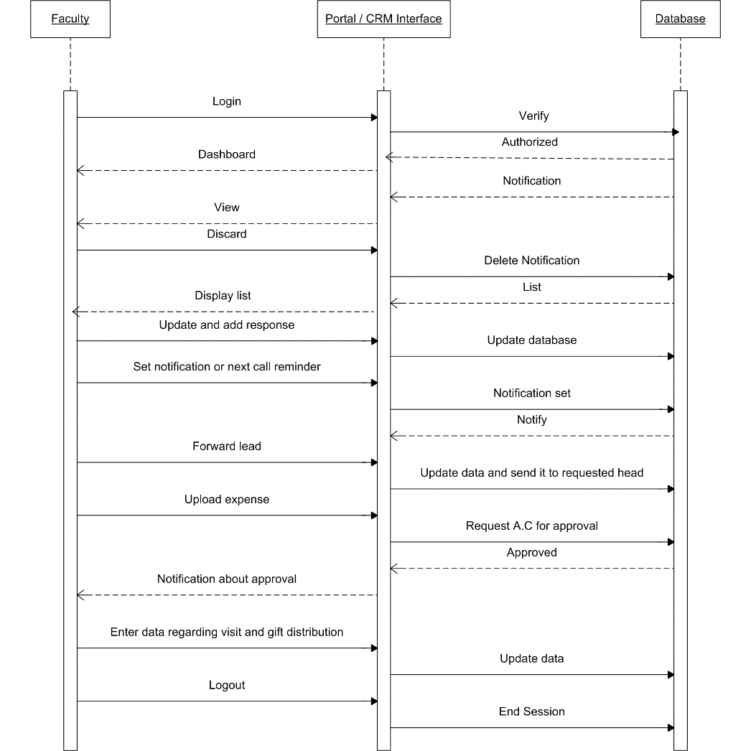
Sequence Diagram (Faculty)

Slide 30
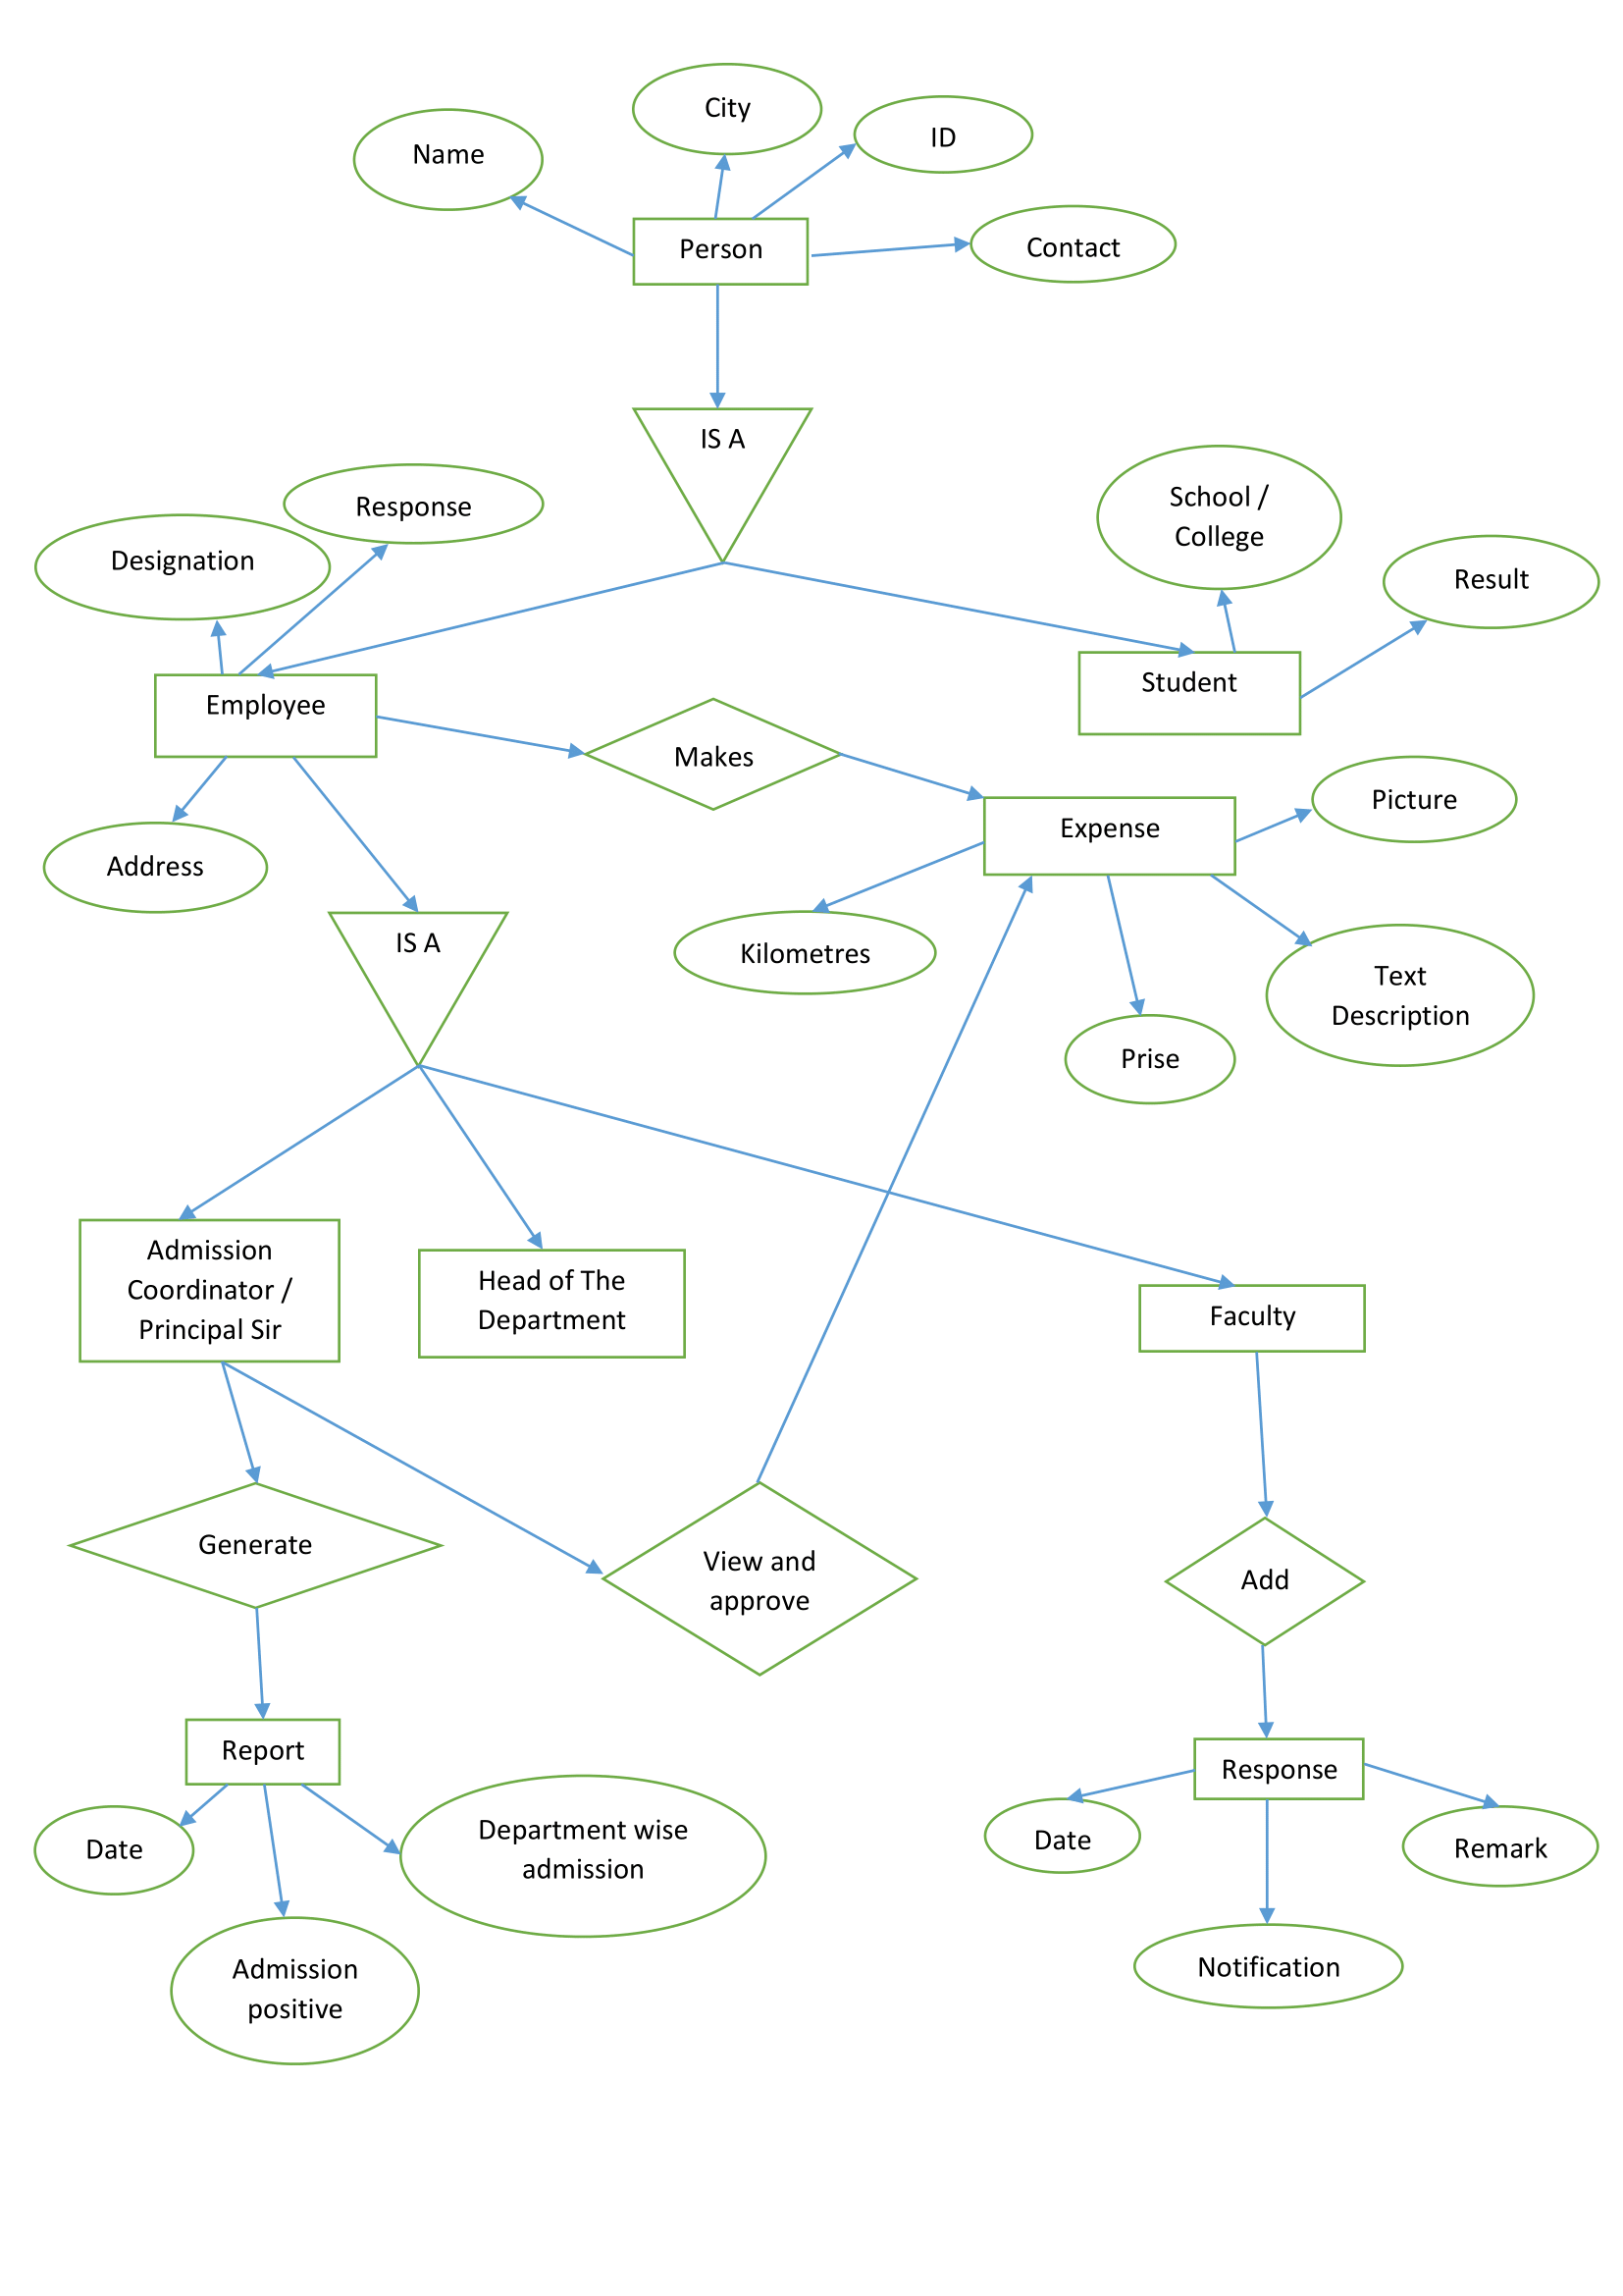
E-R Diagram

Slide 31
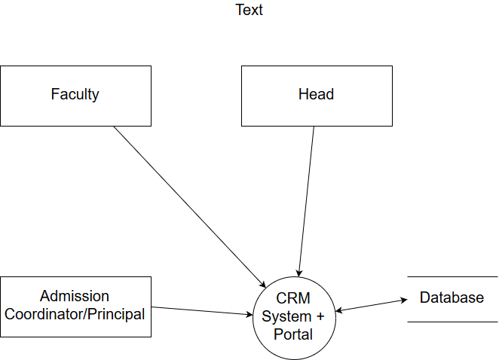
DFD (Level - 0)

Slide 32
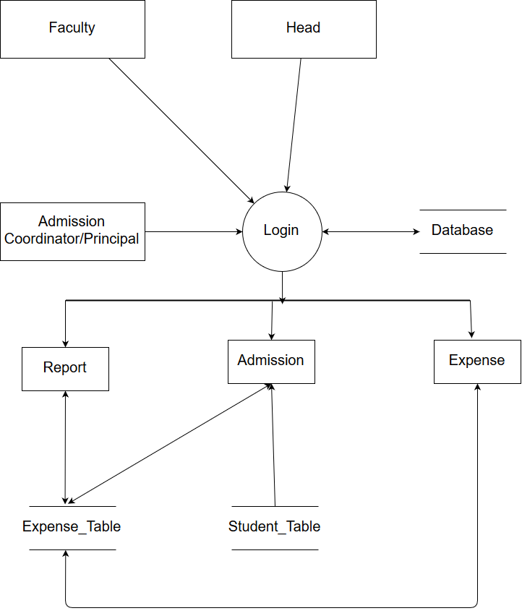
DFD (Level - 1)

Slide 33
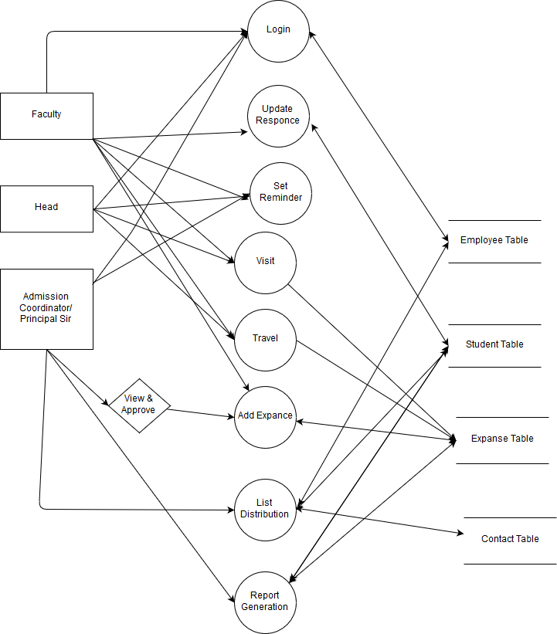
DFD (Level - 2)

