Slide 2
Problem Statement
Inconsistent reliability, struggling with multiple maintenance windows with multiple reboots
No orchestration (critical systems patched “by hand” (with pre-steps, post steps))
Grouping based on workloads is difficult / need ability to leverage existing groups
Error handling and troubleshooting is time consuming / need better reporting and detailed tracing
Update deployments is rarely zero downtime
Update co-ordination / communication across application and infrastructure teams is very difficult

Slide 3
Azure Update Management
It is a free offering from Microsoft in your Azure Automation account which can be used to manage Operating System Updates for your Windows and Linux Virtual Machines deployed in Azure, on-premises environment, or other cloud solution providers
Think of it as a WSUS setup back in the day that everybody used to or still uses to manage their Operating System Updates in your IT infrastructure. But WSUS is only available for Windows machines and cannot be used with Linux Machines, whereas Azure Update Management can be used with both
quickly assess the status of available updates and manage the process of installing required updates for your machines reporting to Update Management

Slide 4
Update Management Components/Services
Log Analytics workspace: A Log Analytics workspace is a data repository for log data that's collected from resources that run in Azure, on-premises, or in another cloud provider.
Automation Hybrid Worker solution: Create Hybrid Runbook Workers to run Azure Automation runbooks on your Azure and non-Azure computers.
Automation account: This is a cloud service that automates configuration and management across your Azure and non-Azure environments.
Hybrid Runbook Worker: This is a computer that's configured with the Hybrid Runbook Worker feature and can run runbooks directly on the computer and against the resources in the local environment.
Hybrid Runbook Worker group: It's a group of Hybrid Runbook Workers used for high availability.
Runbook: This is a collection of one or more linked activities that together automate a process or operation.
On-premises computers and VMs: These are on-premises computers and VMs with Windows or Linux operating systems that reside on-premises.
Azure VMs: Azure VMs include Windows or Linux VMs that are hosted in Azure

Slide 5
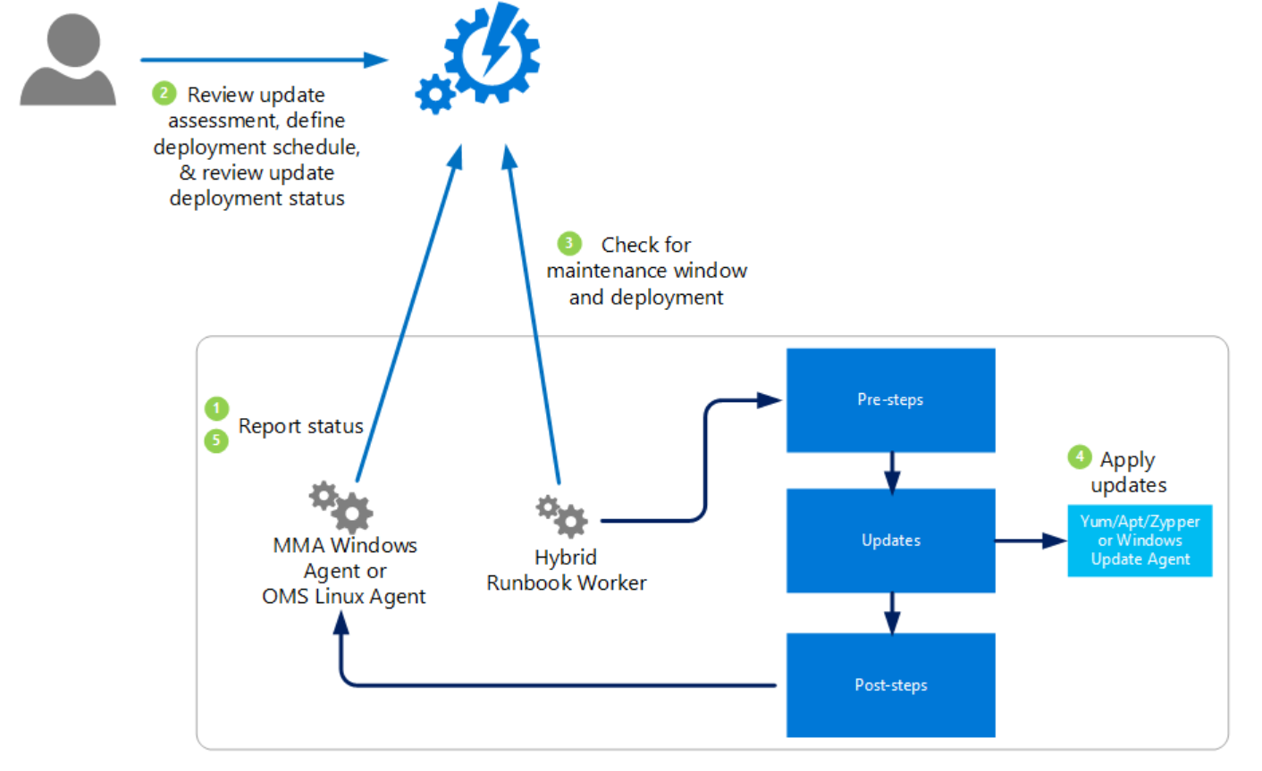
Azure Auto Update Patching
Key Features
Update Insights
Detailed reporting / compliance across Windows and Linux distros
Domain or non joined servers
Leverages native Windows and Linux tools
Rich search capabilities cross updates
Supports
WS 2008 R2 & above.
Redhat, CentOS, Ubuntu, SuSE
Update Deployments
Windows 2012 & above initially
Update targeting leveraging existing WSUS/AD/OMS custom groups
Flexible scheduling options (onetime/weekly/monthly)
Enhanced troubleshooting
Support for proxy environments
Dependent on WSUS/MU for Update curation
Linux coming in next few months

Slide 6
Azure Update Management Prerequisites
Virtual Machines should be part of the region where Log Analytics workspace is supported
Ensure Virtual Machines are always powered-on, because powered-off virtual machines cannot be enrolled or reported
Define virtual machine groups based on application/environments to schedule security patching. (For example: teams app servers, AD infra, dev environment, production)
Ensure necessary permissions or delegations configured for engineers to manage update management solution
Meeting recommended Operating system versions based on Microsoft recommendations
Implement network requirements based on Microsoft recommendations

Slide 7
Azure Update Management Solution Highlights
Now that we understand how Update Management assesses and applies the update. Let us look at how often the scans happen.
A Windows machine performs a compliance scan every 12 hours by default, whereas for Linux Machines perform a scan once in every 3 hours.
In addition to these regular scans, both Windows and Linux machines perform an additional scan within 15 minutes if the Microsoft Monitoring Agent (MMA) is restarted.
After a machine completes the update compliance, the logs are forwarded to Log Analytics Workspace (which is a requirement) by the MMA agent.
Once a CVE is released, it can take 2-3 hours for the patch to show up for Linux machines for assessment and for Windows machines, it can take 12-15 hours.

Slide 8
Network Requirements
The below addresses are required for the Azure Update Management solution work properly and communication happens securely over port 443.
Azure Public
*.ods.opinsights.azure.com
*.oms.opinsights.azure.com
*.blob.core.windows.net
*.azure-automation.net

Slide 9
Supported Operating System Versions
Operating system | Notes
Windows Server 2016/2019/ (Datacenter/Datacenter Core/Standard)
Windows Server 2012/2012 R2(Datacenter/Standard)
Windows Server 2008 R2 (RTM and SP1 Standard) | Update Management only supports performing assessments for this operating system, patching is not supported as the Hybrid Runbook Worker is not supported for Windows Server 2008 R2.
CentOS 6 (x86/x64) and 7 (x64) | Linux agents require access to an update repository. Classification-based patching requires yum to return security data that CentOS doesn’t have in its RTM releases. For more information on classification-based patching on CentOS, see Update classifications on Linux.
Red Hat Enterprise 6 (x86/x64) and 7 (x64), SUSE Linux Enterprise Server 11 (x86/x64) and 12 (x64), Ubuntu 14.04 LTS, 16.04 LTS, and 18.04 (x86/x64) | Linux agents require access to an update repository.
Un-supported Operating System Versions
Operating system | Notes
Windows client | Client operating systems (such as Windows 7 and Windows 10) aren’t supported.
Windows Server 2016 Nano Server | Not supported.
Azure Kubernetes Service Nodes | Not supported. Use the patching process described in Apply security and kernel updates to Linux nodes in Azure Kubernetes Service (AKS)

Slide 10
Useful Links
Supported Regions : https://docs.microsoft.com/en-us/azure/automation/how-to/region-mappings
Role Permissions: https://docs.microsoft.com/en-us/azure/automation/automation-role-based-access-control#update-management-permissions
Security Best Practices: https://docs.microsoft.com/en-us/azure/automation/automation-security-guidelines
Compliance Documentation: https://docs.microsoft.com/en-us/azure/compliance/

Slide 11
Current State
Subscriptions | No. Of Azure VM's
AppInte-nonprod-001 | 2
fos-lab-001 | 3
landing-zone-trial | 2
pcme-nonprod-001 | 61
pcme-prod-001 | 13
Platform-identity-prod | 3
Platform-management-prod | 1
platform-services-prod-001 | 1
Total | 86

Slide 12
Manage updates for Azure VMs
Create schedule for updates deployment on virtual machines.
Follow the standard (as per MS) guidelines to configure the schedule for deploying the patches.
Create multiple schedules for different environments/applications as per need
Run "Azure Automation jobs that are Completed" task under Logs to know the status of the schedule update deployment job

