Slide 1

Useless Glowing Button Game
Presented To: Adams Thomas
Presented By: Ravi Kumar
Student ID: N01719809

Slide 2
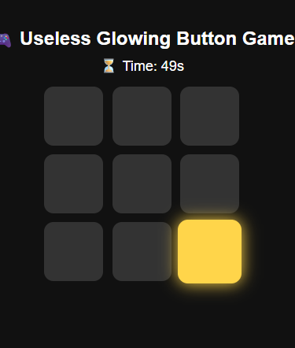
Game Idea
9 buttons appear on screen
One button glows at a time ✨
Player clicks glowing button
New glowing button appears randomly
60-second countdown

Slide 3
How It Works
HTML creates button grid
CSS handles glowing animation
JavaScript picks random button
Score updates after every correct click
Timer ends game automatically

Slide 4
Funny End Messages
🐢 Slow and mysterious
😄 Random clicking champion
🔥 Fast fingers unlocked
👑 Button Master Supreme

Slide 5
Thankyou

