Slide 1
Big Data Hadoop
Introduction

Slide 2
Contents
Big Data
Definition
Business Significance

Slide 3
What is Big Data
A catch-phrase used to describe a massive volume of both structured and unstructured data that is so large that it's difficult to process using traditional database and software techniques.
“Big data is high volume, high velocity, and high variety information assets that require new forms of processing to enable enhanced decision making, insight, discovery, and process optimization.”
Amazon was averaging about 26.5 million transactions per day, over a million transactions per hour that translates into roughly 2.5 peta bytes an hour.
Flipkart was averaging 45,000 transactions a day.
Google processes 20 PB’s of information per day.

Slide 4
Why Big Data?
Businesses have thrived on their ability to derive insights from information or data.
It has helped them make better, smarter, real time, and fact-based decisions.
Today data is being used to extract more valuable and business-critical information thanks to analytics.
Big data analytics, enables us to accomplish business benefits such as:
Predicting payment default propensity
Fraud detection
Credit scoring and next-best offers
Predicting customer churn
Recommending tailored and timely offerings to customers

Slide 5
Why Big Data?
With standard reports we can get information such as:
What was the default rate in the loans portfolio last quarter?
Going beyond, with data analytics we can get answers to questions like:
What will be the default rate next month?
This demand for intensity of knowledge is what has fueled the growth of “big data.”
Data has grown exponentially with the advent of social media and mobile technology, analytics and cloud computing.
There is hardly any field that is not likely to be benefited by “big data” initiatives.
Big data is laying the foundation for advancements in health care, medicine, data analysis, scientific research, education, energy, transportation, financial services, retail, and the telecommunications industry.

Slide 6
Why Big Data?
Competitive advantage:
Amazon has better recommendation system because of user data.
For LinkedIn, Facebook – analysis of networking data is the competitive advantage.
Better User Experience:
Telecom services improve network by analysis call data
Facebook/Whatsapp improves product by analyzing logs
Companies prefer implicit feedback rather than explicit feedback
Less churn – Predicting customer loyalty
Necessity:
Companies need to be prepared from day-1
A new application can go viral overnight, users increase from a few dozens to thousands or millions

Slide 7
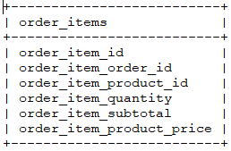
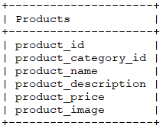
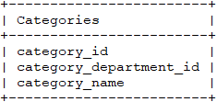
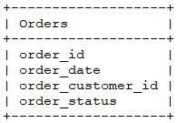
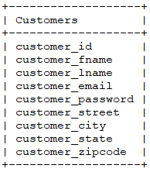
Why New Tools?
RDBMS
Highly structured data
Organized into flat tables of rows and columns
Normalized and relationships defined across tables
Drawbacks
Scaling
Supporting large number of concurrent users
Performance slows down and response times deteriorate
Vertical scaling is possible and not designed for horizontal scaling
Variety aspect of data – Cannot handled semi-structured and unstructured data

Slide 8
Hadoop – History
In 2002-04 Doug Cutting with Mike Cafarella started working on Nutch – an open source project
In 2003-04 Google published papers on Google File System and MapReduce which are implemented in Nutch
In 2006 they formed Hadoop project; around the same time Doug Cutting joined Yahoo! which provided him a team for full-fledged development of Hadoop
In January 2008, Hadoop was made its own top-level project at Apache

Slide 9
What is Hadoop?
Apache Hadoop is a software framework that allows for the distributed processing of large data sets across clusters of computers using simple programming models.
Designed to scale up from single servers to thousands of machines, each offering local computation and storage.
Designed to detect and handle failures at the application layer, so delivering a highly-available service on top of a cluster of computers, each of which may be prone to failures.
Hadoop provides – a reliable, scalable platform for storage and analysis of large amounts of data on clusters of commodity machines.
These machines typically run Linux operating system (OS).
Built using the Java language; any cluster of machines that supports Java can run Hadoop.

Slide 10
What is Hadoop?
Components of Hadoop
Hadoop 1.0
HDFS – Distributed storage
MapReduce – Distributed processing
Hadoop 2.0
HDFS - Distributed storage
Distributed Processing
YARN - Resource management
MapReduce - Distributed computation

Slide 11
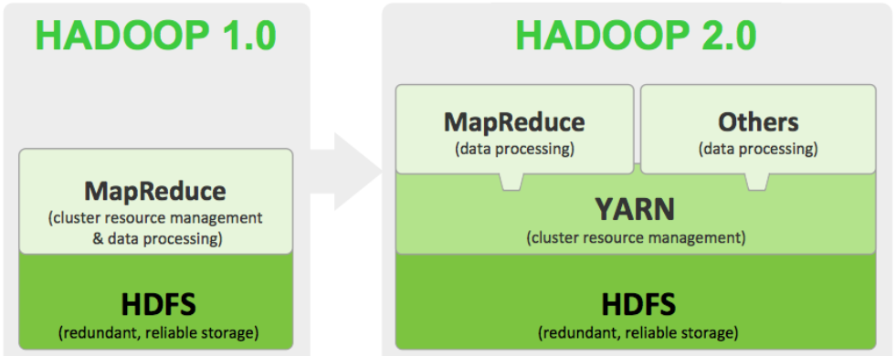
What is Hadoop?
Hadoop 1.0 and Hadoop 2.0

Slide 12
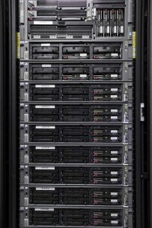
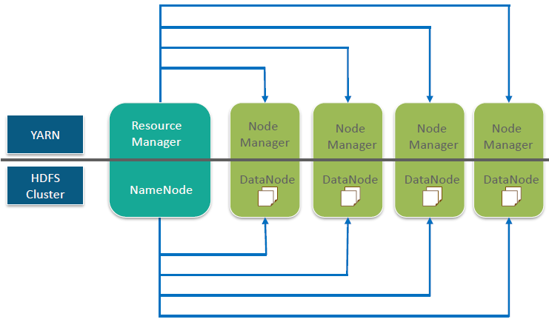
Hadoop Architecture
HDFS has master/slave architecture.
For HDFS (Storage) and For YARN (Processing)

Slide 13
Hadoop Distributed File System (HDFS)
HDFS is a highly fault-tolerant file system designed to run on clusters of commodity hardware.
Provides high throughput access to application data and is suitable for applications that have large data sets.
HDFS is designed more for batch processing rather than interactive use by users.
HDFS is built for write-once, read-many-times pattern of data processing.
Files in HDFS are divided into blocks and written across the cluster nodes by a single writer. Writes are always made at the end of the file, in append-only fashion.
Each block is 128 MB by default; block size is configurable.
Every block is replicated 3 times by default on different nodes of the cluster. Replication factor is configurable.
Replication provides fault-tolerance to the system.

Slide 14
Hadoop Distributed File System (HDFS)
root directory /
hbase
tmp
user
hbase.id
hadoop-yarn
hive
hduser
warehouse
mrdata
retail
data
hbase.version
hive

Slide 15
HDFS Architecture
HDFS has a master/slave architecture.
On master node runs the background process NameNode. On slave nodes the background called DataNode runs.
The NameNode and DataNode are pieces of software designed to run on commodity machines. These machines typically run a GNU/Linux operating system (OS).
Master server or NameNode manages the file system namespace and regulates access to files by clients.
DataNode which are the workhorses of the cluster stores the actual data which is divided into blocks.
HDFS supports a traditional hierarchical file organization. A user or an application can create directories and store files inside these directories.
The file system namespace hierarchy is similar to other existing file systems; one can create and remove files, move a file from one directory to another, or rename a file.
HDFS supports access permissions and user quotas.

Slide 16
HDFS Architecture
HDFS Master
Namenode
Edit Log
Datanode
Data Blocks
Datanode
Data Blocks
Datanode
Data Blocks
Datanode
Data Blocks
Datanode
Data Blocks
Datanode
Data Blocks
Datanode
Data Blocks
Datanode
Data Blocks
Datanode
Data Blocks
Datanode
Data Blocks
Datanode
Data Blocks
Datanode
Data Blocks

Slide 17
HDFS – NameNode
NameNode maintains the file system tree and the metadata for all the files and directories in the tree.
This information is stored persistently on the local disk in the form of two files: the namespace image and the edit log.
The namenode also knows the datanodes on which all the blocks for a given file are located; however, it does not store block locations persistently, because this information is reconstructed from datanodes when the system starts.
Executes file system namespace operations like opening, closing, and renaming files and directories.
It determines mapping of blocks to DataNodes.

Slide 18
HDFS – DataNodes
Datanodes are the work-horses of the filesystem and store the actual data.
Responsible for serving read and write requests from the file system’s clients.
Also perform block creation, deletion, and replication upon instruction from the NameNode.
Periodically send a Heartbeat and a Blockreport to NameNode.
Heartbeat indicates that the DataNode is functioning properly. A Blockreport contains a list of all blocks on a DataNode.
A client accesses the filesystem on behalf of the user by communicating with the namenode and datanodes.

Slide 19
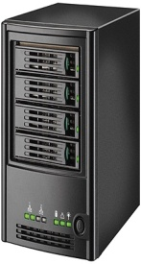
Hadoop Distributed File System (HDFS)
Worker
Datanode
Worker
Datanode
2
5
5
2
4
1
1
Master
Namenode
Worker
Datanode
2
1
3
HDFS
4
4
3
5
Worker
Datanode
Worker
Datanode
4
3
3
1
2
5

Slide 20
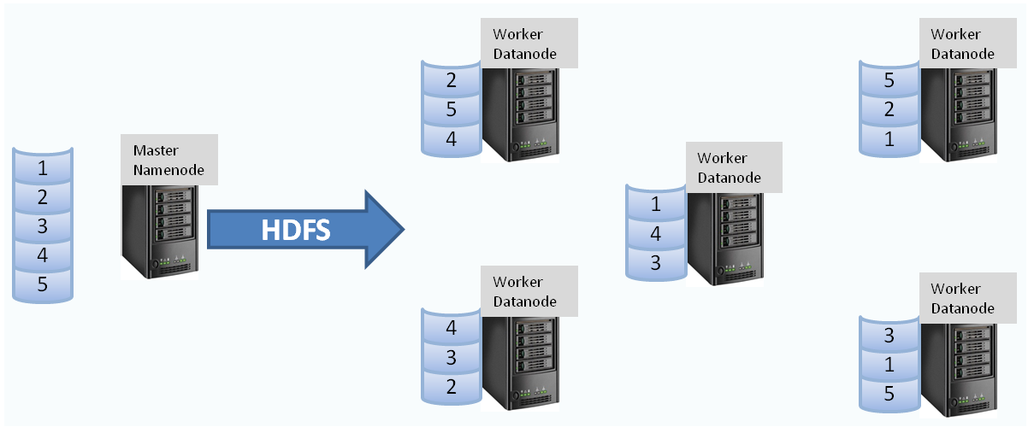
Hadoop Distributed File System (HDFS)

Slide 21
HDFS – Secondary NameNode
A secondary namenode, is run whose main role is to periodically merge the namespace image with the edit log to prevent the edit log from becoming too large.
The secondary namenode usually runs on a separate physical machine because it requires plenty of CPU and as much memory as the namenode to perform the merge. It keeps a copy of the merged namespace image, which can be used in the event of the namenode failing.
The namenode is still a single point of failure (SPOF) in Hadoop 1.0
Each cluster had a single NameNode, and if that machine or process became unavailable, the cluster as a whole would be unavailable until the NameNode was either restarted or brought up on a separate machine.
To recover from a failed namenode in this situation, an administrator starts a new primary namenode with one of the filesystem metadata replicas and configures datanodes to use this new namenode.

Slide 22
HDFS – High Availability
Prior to Hadoop 2.0 NameNode was a Single Point Of Failure. This has been remedied in Hadoop 2.0 and above by adding support for HDFS High Availability.
HDFS High Availability feature provides the option of running two (or more, as of Hadoop 3.0.0) redundant NameNodes in the same cluster in a standby configuration.
Datanodes send block reports to both namenodes because the block mappings are stored in a namenode’s memory, and not on disk.
The namenodes use highly available shared storage to share the edit log.
There are two choices for the highly available shared storage: an NFS filer, or a quorum journal manager (QJM).
If the active namenode fails, the standby can take over very quickly (in a few tens of seconds) because it has the latest state available in memory: both the latest edit log entries and an up-to-date block mapping.
Automatic failover is enabled by two additional components – Zookeeper quorum and ZooKeeper Failover Controller which monitor the health of NamaNodes and elect another Namenode as failover alternative if the active one goes down.

Slide 23
HDFS – High Availability
Zookeeper
Zookeeper
Zookeeper
Secondary Namenode (Optional)
Active Namenode
Standby Namenode
Shared Storage
Edit Log
Datanode
Datanode
Datanode
Datanode

Slide 24
HDFS – Commands
Web UI of HDFS:
https://<ip address>:50070
Commands:
$ hadoop
$ hadoop fs
$ hdfs
$ hdfs dfs
For a full list of HDFS user commands refer
https://hadoop.apache.org/docs/r2.9.1/hadoop-project-dist/hadoop-hdfs/HDFSCommands.html
For a full list of Hadoop file system commands refer
https://hadoop.apache.org/docs/r2.9.1/hadoop-project-dist/hadoop-common/FileSystemShell.html

Slide 25
HDFS – Commands
$ hadoop version
$ hadoop fs -ls /
$ hadoop fs –ls
$ hadoop fs –ls /user/<loginid>/ ➔ is the same as the above
$ hadoop fs -mkdir <directory name>
$ hadoop fs -copyFromLocal <filename>
$ hadoop fs -put <directory>/<file name>
$ hadoop fs –copyToLocal <file name>
$ hadoop fs –get <directory>/<file name>
$ hadoop dfs -cat test2.txt
$ hadoop dfs -tail test3.txt ➔ Displays last KB of file

Slide 26
HDFS – Commands
$ hadoop fs –rm <file name>
$ hadoop fs –rm -r <directory>
$ hadoop fs –mv <dir1/filename1> <dir2/filename2>
$ hadoop fs –cp <dir1/filename1> <dir2/filename2>
$ hadoop fs -expunge
$ hadoop fs -chmod a+r test3.txt → Give read permissions to all for the file test3.txt
$ hadoop fs –chmod go-w test3.txt → Remove write permissions to group and others for the file test3.txt
$ hdfs fsck <directory> / -files → Checks and prints out files being checked
$ hdfs fsck <directory> / -blocks → Checks and prints out blocks being checked

Slide 27
HDFS – Commands
$ hdfs
$ hdfs fsck /user/hduser
$ hdfs fsck /user/hduser -files
$ hdfs fsck /user/hduser -files -blocks
$ hdfs dfs (File System shell)
$ hdfs dfsadmin
$ hdfs dfsadmin -report
$ hdfs dfsadmin -safemode enter
$ hdfs dfsadmin -safemode leave
$ hdfs namenode -format

Slide 28
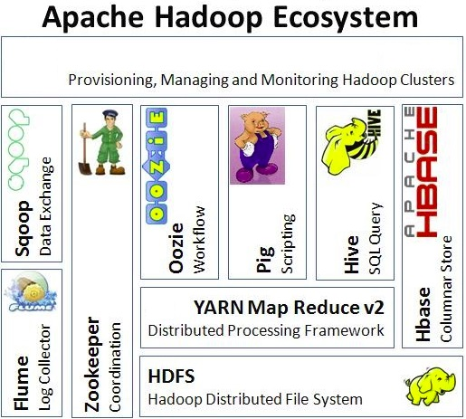
Hadoop Ecosystem Components

Slide 29






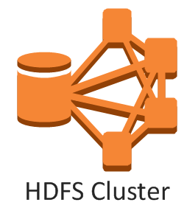


A Hadoop-based Analytics Project
Data Ingestion
Data Transformation
Existing Data source
1
4
Scoring
Engine
2
5
Scored
Data
3
6

Slide 30
Hadoop Configuration Files
Configuration File | Description and Purpose of the file
hadoop-env.sh | Environment variables used by Hadoop
core-site.xml | Settings that are common across the core components i.e. HDFS and MapReduce
hdfs-site.xml | Configuration setting for HDFS daemons i.e. NameNode, DataNode, and Secondary NameNode
mapred-site.xml | Configuration settings required by MapReduce applications
yarn-site.xml | Configuration settings for Yarn daemons – ResourceManager and NodeManager
master | List of nodes (IP addresses or Hostnames) that are masters
slaves | List of nodes that are slaves i.e. which run DataNode and NodeManager etc daemons

Slide 31
Different Distributions
Hadoop and the components in its eco system are open source software as we are aware
However we have several firms offering their distributions of Hadoop today
Major advantages in using these distributions is:
Ease of installation and configuration
Support and training provided
Lesser administration overheads
Additional, in some cases proprietary tools helpful in maintenance
Most well-known players are:
Cloudera
Hortonworks
MapR

Slide 32
Different Distributions
Cloudera | Hortonworks | MapR
Oldest vendor in the field; established in 2008 by big data industry leaders like Google, Facebook, Google, and Oracle | Founded in 2011 as an independent company spun-off from Yahoo | MapR is founded in 2009 with additional rounds of finance in 2011 and 2014. MapR is a technology partner and has agreements with firms like EMC Corporation Amazon EMR and Google
CDH has a user friendly interface with many features and useful tools like ClouderaManager which is a spohisticated cluster admin tool, Impala – a faster query interface and Hue a web-based tool | Offers free open source software and charges only for technical support and training Also offers Ambari for cluster management and Stingr – a faster query handling interface | It is one of the fastest hadoop distribution with multi node direct access.
Standard Edition: Free download with limited features. Includes Cloudera Manager. Enterprise Edition: Cloudera Manager with extensive features, includes support services. | 100% open source Enterprise version. Eliminates the risk of vendor lock-in to a large extent. It is the only Hadoop Distribution that supports Windows platform. | Replaces standard HDFS with its own proprietary storage layer known as MapRFS which is 100% API compatible with Apache Hadoop

Slide 33
HDFS Hands-on: Linux commands
From your host OS (MS-Windows) make sure that the following files are available in C:\sharedfolder.
mrinput1.txt
mrinput2.txt
products1.txt
customers1.txt
In the VM, open a command-line terminal and make sure the sharedfoder is mounted and Hadoop daemons are started.
Give cd command to change directory to your home directory which is /home/hduser.
Copy the above files to your home directory. Command: cp Downloads/sharedfolder/* $HOME
Make the following sub-directories in your login (home)
mapred Command: mkdir mapred
retail Command: mkdir retail
Move the files mrinput*.txt to mapred sub-dir. Command: mv mrinput* mapred
Move the files *1.txt to retail subdir. Command: mv *1.txt retail
Change directory to retail cd retail
Remove the header (first) line from the files products1.txt and customers1.txt using tail command and redirect the rest of the lines (from line no.2 onwards) to the files products1.tsv and customers1.tsv
tail –n +2 products1.txt > products1.tsv
tail –n +2 customers1.txt > customers1.tsv

Slide 34
HDFS Hands-on: HDFS Commands
Make sure you are working from your home directory. Commands: cd and pwd
It should display /home/hduser
Create two sub-directories mrdata and retail in your hadoop home or hadoop default directory
Command to be used hadoop fs –mkdir mrdata
Command to be used hadoop fs –mkdir retail
Put the files mrinput1.txt and mrinput2.txt into the hdfs sub-dir mrdata
Note: these files are available in mapred sub-dir of your local home location
hadoop fs –put mapred/mrinput?.txt mrdata
Put the files products1.tsv and customers1.tsv into the hdfs sub-dir retail
Note: these files are available in retail sub-dir in your local home location
hadoop fs –put retail/*1.txt retail

