Slide 1
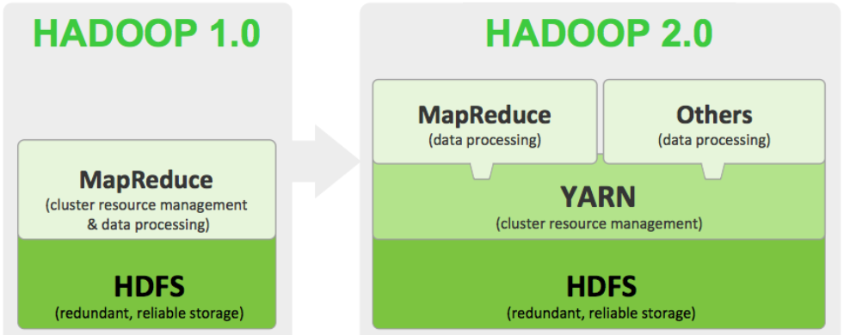
Hadoop - Recap
Hadoop 1.0 and Hadoop 2.0

Slide 2

HDFS - Recap
Worker
Datanode
Worker
Datanode
2
5
5
2
4
1
1
Master
Namenode
Worker
Datanode
2
1
3
HDFS
4
4
3
5
Worker
Datanode
Worker
Datanode
4
3
3
1
2
5

Slide 3
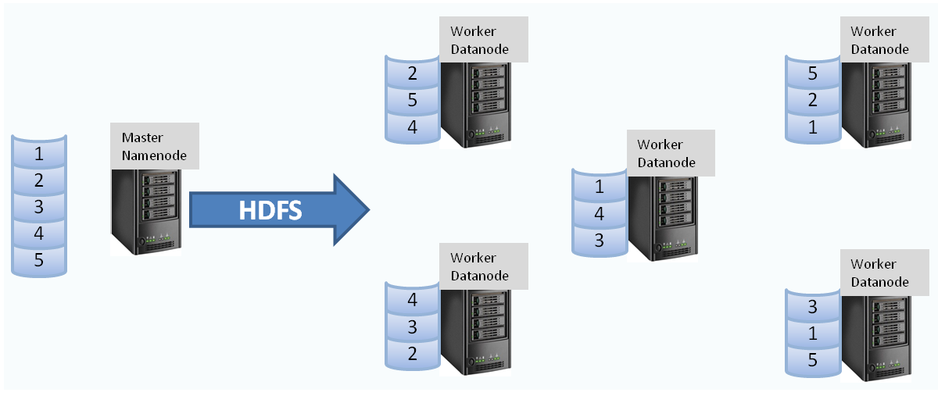
Hadoop Distributed File System (HDFS)

Slide 4
MapReduce Architecture
Hadoop MapReduce is a software framework for developing applications that process Big Data in-parallel on large clusters in a reliable, fault-tolerant manner.
A MapReduce job has 2 phases – Map phase and Reduce phase.
MapReduce job divides the input data-set into independent chunks called input splits or simply splits which are processed by the map tasks in a completely parallel manner.
The framework sorts the outputs of the maps, which are then input to the reduce tasks which produces the final output.
The framework takes care of scheduling tasks, monitoring them and re-executes the failed tasks.
YARN (Yet Another Resource Negotiator) was introduced in Hadoop 2 to improve the MapReduce implementation.
This data computation framework in Hadoop 2 consists of ResourceManager and NodeManager as master and slave respectively.
(In Hadoop 1 the master and slave daemons are named JobTracker and TaskTracker respectively.)

Slide 5
MapReduce Architecture
NameNode
Resource Manager
Data Node
Node Manager
Data Node
Node Manager
Data Node
Node Manager
Data Node
Node Manager
Data Node
Node Manager
Data Node
Node Manager
Data Node
Node Manager
Data Node
Node Manager
Data Node
Node Manager

Slide 6
MapReduce Architecture
ResourceManager determines the resources to be allocated among all the applications submitted in the system.
It has two main components: Scheduler and ApplicationsManager.
Scheduler is responsible for allocating resources to the various running applications based on availability and other conditions.
It performs its scheduling function based on the resource requirements of the applications.
It uses an abstract notion of a resource Container which basically comprises of memory, cpu, disk, network etc.
ApplicationsManager is responsible for accepting job-submissions.

Slide 7
MapReduce Architecture
ApplicationsManager is responsible for accepting job-submissions.
It gets a container for running ApplicationMaster which is a process that is specific to each application/job submitted.
ApplicationsManager also provides the service for restarting the ApplicationMaster container in case of any failure.
ApplicationMaster has the responsibility of negotiating appropriate resource containers from the Scheduler, tracking their status and monitoring for progress for the specific application/job.
NodeManager is process that runs on the worker nodes or slave nodes.
It is responsible for its containers, monitoring their resource usage and reporting the same to ApplicationMaster.
Thus ApplicationMaster in effect, is tasked with negotiating resources from the Scheduler and working with the NodeManagers to execute and monitor the tasks.

Slide 8
MapReduce Architecture
Client submits the job to Resource Manager
RM through its Application Manager finds a Node Manager and launches Application Master in a Container
Application Master negotiates for Containers with Scheduler on other cluster-nodes to run the tasks of the job
Application Master starts the Containers under respective Node Managers to run the tasks of the job
1
Job client
1
Resource Manager
2
3
2
Node Manager
Container
4
Application Master
3
Node Manager
Node Manager
Container
Container
MapReduce Task
MapReduce Task
4
Node Manager
Node Manager
Container
Container
MapReduce Task
MapReduce Task

Slide 9
MapReduce Architecture
As mentioned earlier, MapReduce framework creates one map task for each input split and all of them are run in parallel
Typically datanodes on which the input split is stored and the nodes on which the tasks are executed are the same
This configuration allows the framework to schedule tasks where data resides i.e. ensures data locality
The framework tries its best to run map tasks on same node where the corresponding data resides
If map slots are not available on the node then the task will be scheduled on a node in the same rack
Only when this is also not possible then the map task will be scheduled on any other node
The input split size normally is equal to the block size
If the split size is too small then managing the splits and map task creation will be an overhead
If the split size is larger than the block size then part of the split may reside in a different node which needs to be transferred across network which decreases the performance

Slide 10
MapReduce Architecture
MapReduce framework operates exclusively on <key, value> pairs.
It views the input to the job as a set of <key, value> pairs.
It produces the output as a set of <key, value> pairs.
The input key & value and output key & value could be of different data types.
So, each phase has key-value pairs as input and output, the types of which may be chosen by the programmer as per requirements.
Input and Output types of a MapReduce job:
(input) <k1, v1> → map → <k2, v2> →
→ reduce → <k3, v3> (output)

Slide 11
MapReduce Architecture
Hadoop can process many different types of data formats, from flat text files to databases.
TextInputFormat is the default InputFormat and each record is a line of the input file.
The key is the byte offset within the file from the beginning of the line and is of type LongWritable. The value is the contents of the line.
Other InputFormats include:
KeyValueTextInputFormat in which the first field is the key and rest of the line is the value
SequenceFileInputFormat stores sequences of binary key-value pairs
FixedLengthInputFormat is used for reading fixed-width binary records from a file
DBInputFormat is an input format for reading data from a relational database
RecordReader, a pre-defined class generates the record key-value pairs and passes to the map function.
In our example, we will use a test data-set with 10 lines (records) each having 4 tab separated fields
These are trouble tickets or complaints raised for a software system by different companies that use the system
Our objective is to develop a MapReduce program that outputs the list of companies and the number of complaints raised by each company

Slide 12
MapReduce Architecture
Input
Splits
Complaint # Module/Product Company State
1861452 Mortgage "Bayview Loan Servicing, LLC" MN
1859891 Debt collection "Convergent Resources, Inc." IL
1861161 Consumer Loan Ally Financial Inc. TX
1861175 Bank account or service Ally Financial Inc. TN
1860329 Consumer Loan Ally Financial Inc. OH
1860803 Debt collection Transworld Systems Inc. DC
1859886 Consumer Loan Ally Financial Inc. NY
1860496 Debt collection "Convergent Resources, Inc." OH
1857949 Consumer Loan Ally Financial Inc. CT
1858253 Credit reporting First Advantage Corporation NC
1861452 Mortgage "Bayview Loan Servicing, LLC" MN
1859891 Debt collection "Convergent Resources, Inc." IL
1861161 Consumer Loan Ally Financial Inc. TX
1861175 Bank account or service Ally Financial Inc. TN
1860329 Consumer Loan Ally Financial Inc. OH
1860803 Debt collection Transworld Systems Inc. DC
1859886 Consumer Loan Ally Financial Inc. NY
1860496 Debt collection "Convergent Resources, Inc." OH
1857949 Consumer Loan Ally Financial Inc. CT
1858253 Credit reporting First Advantage Corporation NC
Map
Shuffle and Sort
Reduce
"Bayview Loan Servicing, LLC" 1
"Convergent Resources, Inc." 1
Ally Financial Inc. 1
"Bayview Loan Servicing, LLC" [1]
"Convergent Resources, Inc." [1, 1]
Ally Financial Inc. [1, 1, 1, 1, 1]
First Advantage Corporation [1]
Transworld Systems Inc. [1]
"Bayview Loan Servicing, LLC" 1
"Convergent Resources, Inc." 2
Ally Financial Inc. 5
First Advantage Corporation 1
Transworld Systems Inc. 1
Ally Financial Inc. 1
Ally Financial Inc. 1
Transworld Systems Inc. 1
Ally Financial Inc. 1
"Convergent Resources, Inc." 1
Ally Financial Inc. 1
First Advantage Corporation 1

Slide 13
MapReduce Internals
Mapper:
The map function is represented by the Mapper class, which declares an abstract map() method.
The Mapper class is a generic type, with four type parameters that specify the input key, input value, output key, and output value types of the map function.
Hadoop provides its own set of basic data types that are optimized for network serialization rather than using built-in Java data types.
In our example we use LongWritable, which corresponds to a Java Long, Text (like Java String), and IntWritable (like Java Integer)
In our code the input key is a long integer offset, the input value is a line of text, the output key is company name (text string) and the output value is the count (integer).
In Mapper we convert the input value into a Java String, then use its split() method to extract the column we are interested in.
The map() method also provides an instance of OutputCollector to collect the output. In this case, we write the company name as a Text object (since we are just using it as a key) and we hard-code 1 an IntWritable.

Slide 14
MapReduce Internals
Reducer:
Reduce function is similarly defined using Reducer with four type parameters to specify the input and output types
Input types of reduce function should match the output types of map function: Text and IntWritable
Output types of reduce function are also Text and IntWritable, for company name and the total complaints raised by them which we find by iterating through the values (hard-coded 1s) and summing them up

Slide 15
More MapReduce Internals
Hadoop can process many different types of data formats, from flat text files to databases.
Each map processes a single split. Each split is divided into records, and the map processes each record — a key-value pair — in turn.
Splits and records are logical: there is nothing that requires them to be tied to files.
In a database context, a split might correspond to a range of rows from a table and a record to a row in that range.
For example in the case of DBInputFormat, which is an input format for reading data from a relational database.
Input splits are represented by the class "InputSplit" which is in the org.apache.hadoop.mapreduce package.
An "InputSplit" has a length in bytes and a set of storage locations, which are just hostname strings.
Note that a split doesn’t contain the input data; it is just a reference to the data.
The storage locations are used by the MapReduce system to place map tasks as close to the split’s data as possible, and the size is used to order the splits so that the largest get processed first, since it may minimize the job runtime.

Slide 16
More MapReduce Internals
While writing an application we don’t need to deal with InputSplits directly, as they are created by InputFormat (an InputFormat is responsible for creating the input splits and dividing them into records using the methods getSplits and createRecordReader respectively).
The client running the job calculates the splits for the job by calling getSplits(), then sends them to the application master, which uses their storage locations to schedule map tasks that will process them on the cluster.
The map task passes the split to the createRecordReader() method on InputFormat to obtain a RecordReader for that split.
The RecordReader object generates record as a key-value pair and it passes to the map function.

Slide 17
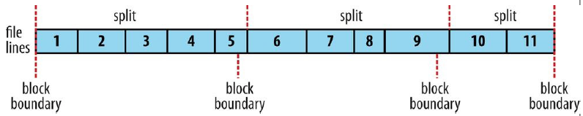
More MapReduce Internals
The logical records that FileInputFormats define usually do not fit neatly into HDFS blocks.
For example, a TextInputFormat’s logical records are lines. The lines may cross HDFS boundaries often i.e. one line may be broken across two blocks with part of the line in previous block and remaining part of the line in next block.
This has no bearing on the functioning of the application because the mapper will perform remote reads wherever part of the line is in other block on another worker-node as the storage location is given while getting the InputSplits. The slight overhead this causes is not normally significant.

Slide 18
More MapReduce Internals
The data processing example we have seen is to solve a fairly simple problem.
When the processing gets more complex, this complexity is to be handled by having more MapReduce jobs, rather than having more complex map and reduce functions.
In other words, as a rule of thumb, think about adding more jobs, rather than adding complexity to jobs.
For more complex problems, it is worth considering a higher-level language than MapReduce, such as Hive or Spark.
One immediate benefit is that it frees you from having to do the translation into MapReduce jobs, allowing you to concentrate on the analysis you are performing.

Slide 19
Running MapReduce Job
Hadoop streaming is a utility that comes with the Hadoop distribution.
The utility allows us to create and run Map/Reduce jobs with any executable or script as the mapper and/or the reducer.
For example:
mapred streaming -file ./mrmapper.py -mapper ./mrmapper.py -file ./mrreducer.py -reducer ./mrreducer.py -input mrinput -output mrout1
Most clusters would specify multiple number of reducers by default.
We can specify the number of reducers with an option as below:
mapred streaming -D mapreduce.job.reduces=1 -file ./mrmapper.py -mapper ./mrmapper.py -file ./mrreducer.py -reducer ./mrreducer.py -input mrinput -output mrout1

Slide 20
Running MapReduce Job - Exercise
Using the HDFS commands:
Create a directory in HDFS named mrinput
Put the files mrinput1.txt and mrinput2.txt into the above HDFS directory
Run the mapreduce job as given above.
And check the output location (i.e. directory).

Slide 21
YARN Commands
The jobs executed on the Hadoop cluster run as YARN applications.
Several YARN commands are available to list or track the applications on the cluster.
Commands:
$ yarn → prints the description for all commands
$ yarn application -list -appStates FINISHED
$ yarn application -list -appStates FAILED, KILLED
$ yarn application -list -appStates ALL
$ yarn application -status <application_id>
$ yarn logs -applicationId <application_id>
For a full lst of YARN commands refer:
https://hadoop.apache.org/docs/r2.9.1/hadoop-yarn/hadoop-yarn-site/YarnCommands.html

Slide 22
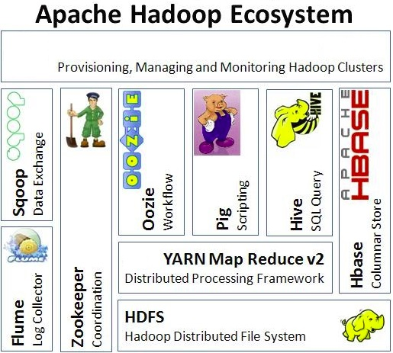
Hadoop Ecosystem Components

