Slide 1
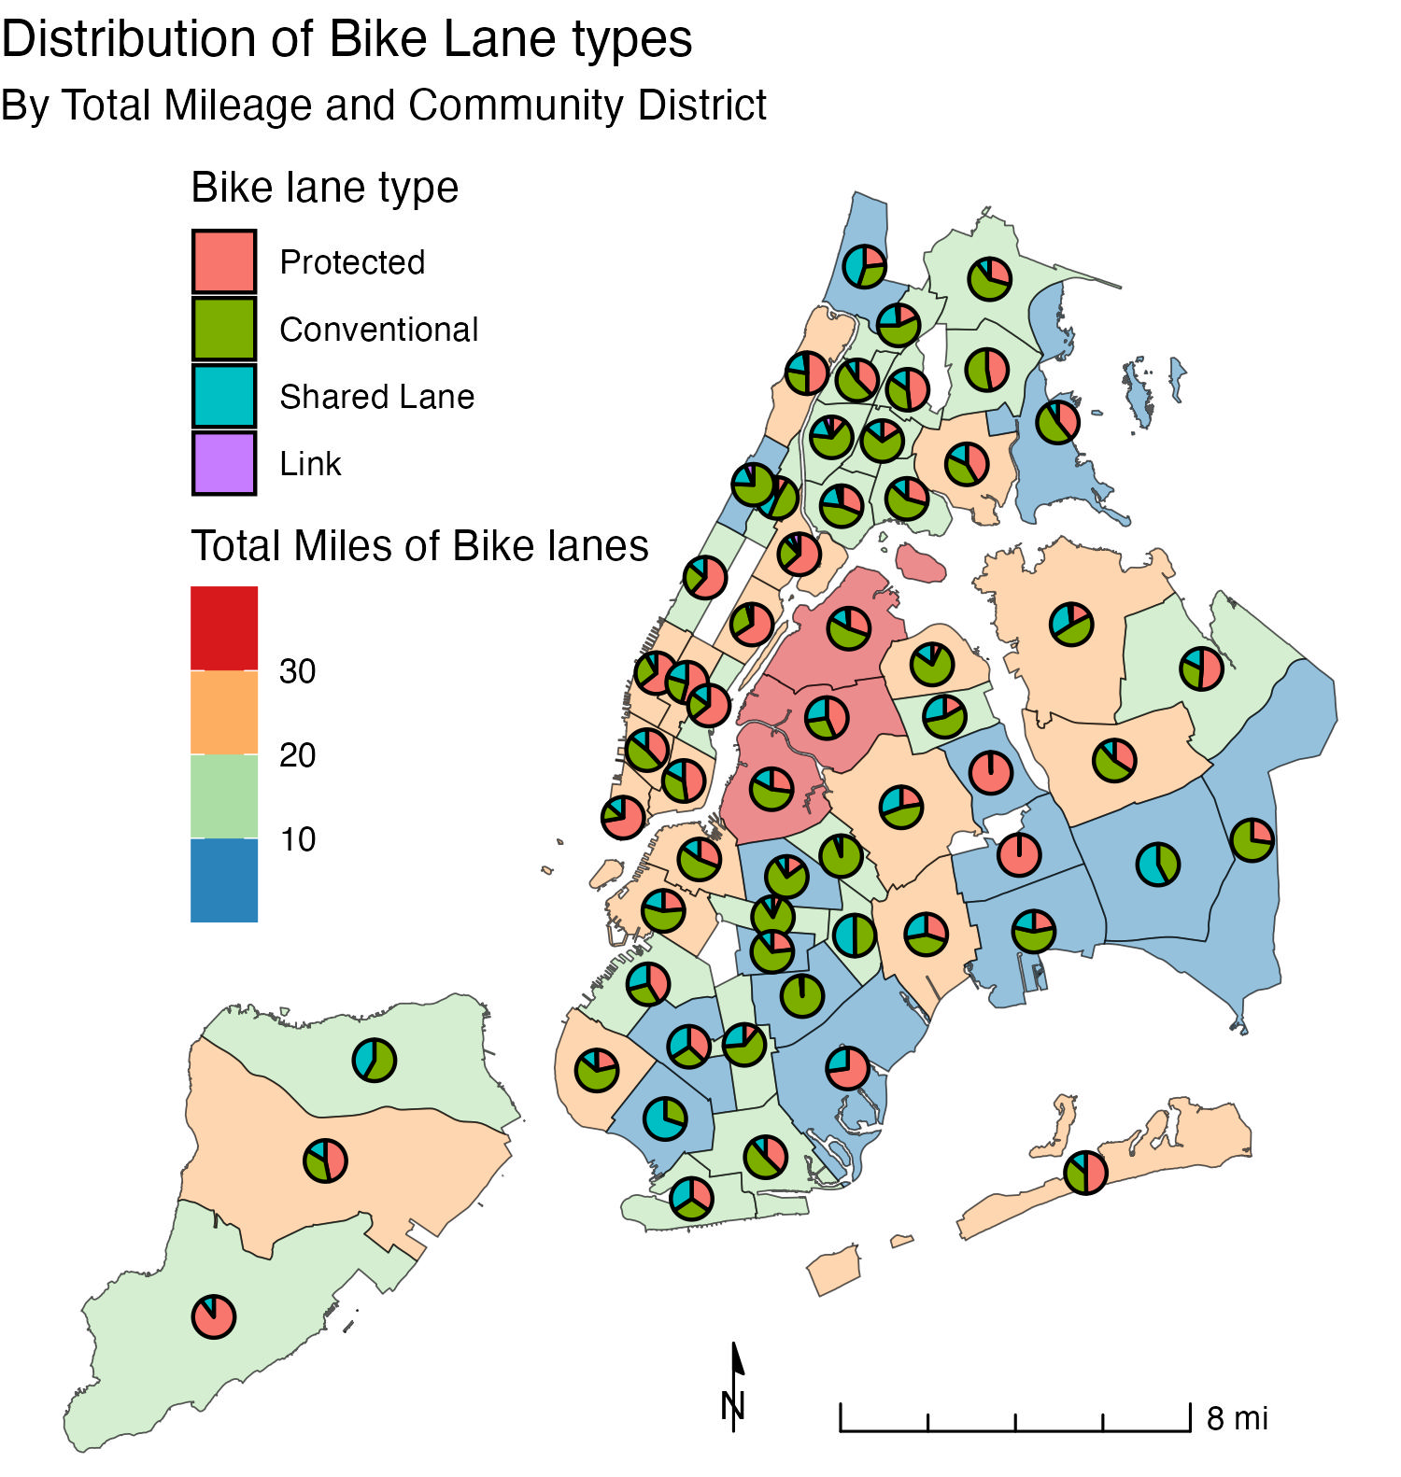
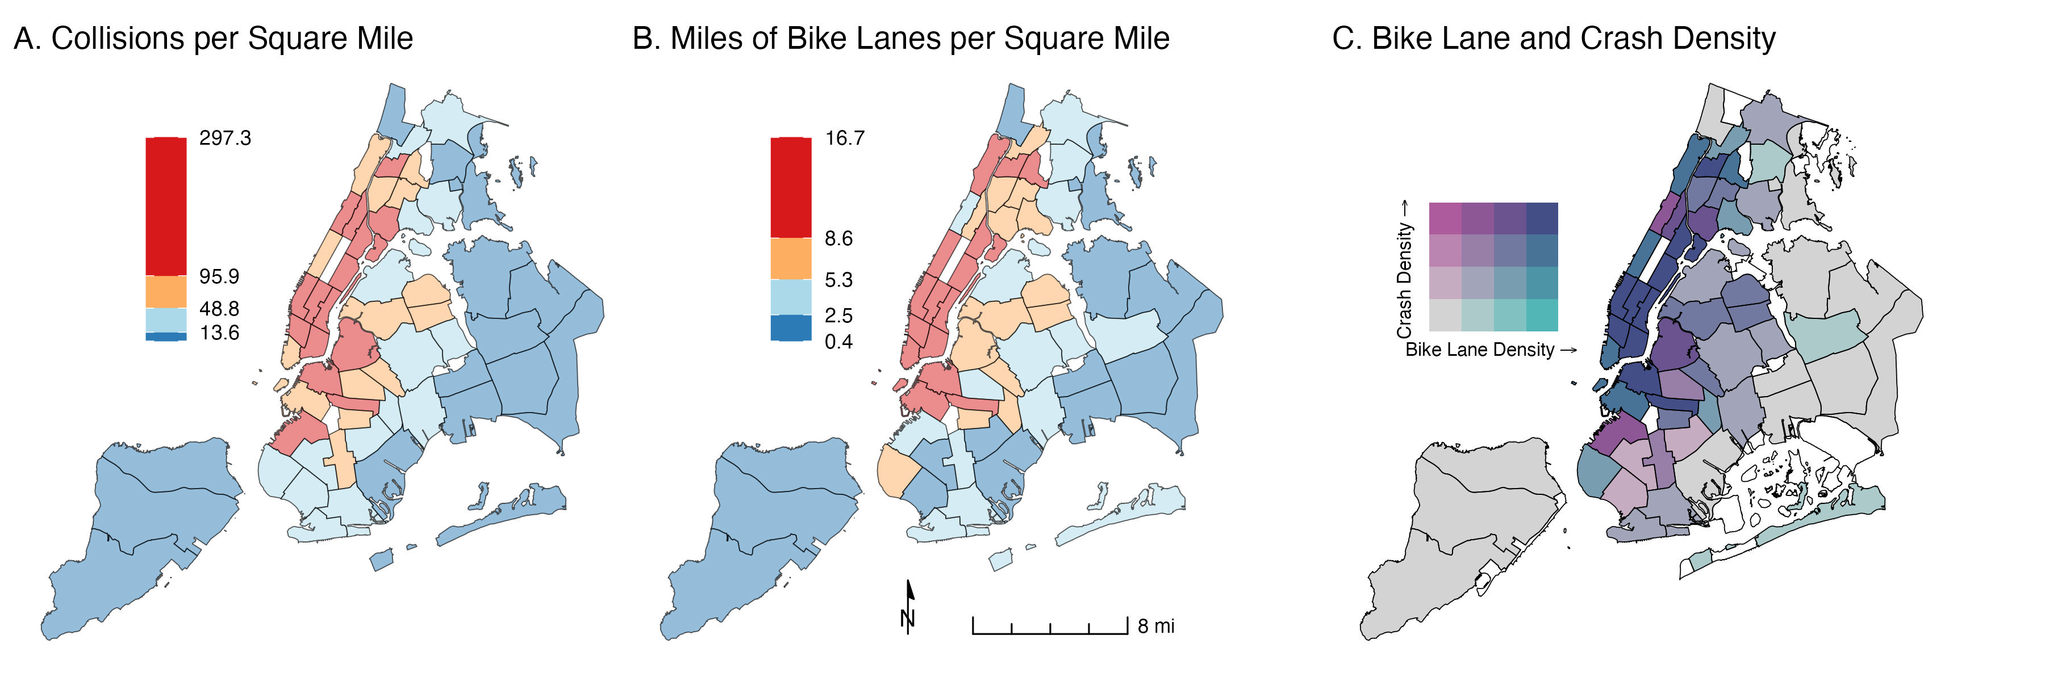
Bike Lanes and Bike Collisions by Community District in New York City, 2024
Ravi Brenner
Columbia University
Abstract/Background
Cycling is a popular form of transit in New York City, with thousands of bike trips taking place every day. Previous studies in New York City have found that physically protected bike lanes were associated with 23% fewer injuries, while conventional separate painted lanes reduce injury risk by 90% compared to non-bicycle routes [1]. Other studies have found that conventional bike lanes are associated with a higher incidence of crashes [2].
Previous studies of bicycle crashes and lanes have found that bicycle-involved crashes may increase following bike lane installation, largely due to an increased traffic volume of cyclists [3]
This analysis aimed to understand the distribution of bike collisions and bike lanes across community districts in New York City, and to assess if there is any relationship between collisions and the type of bike lane.
Methods
Map 1. Bike lane type distribution and total length by community district
All data were acquired from NYC Open Data [4-6].
Each bike collision was assigned to the nearest bike lane within 100 feet of the crash, or no bike lane if there were none within 100 feet. All crashes and bike lane segments were categorized based on the community district in which they fell. Bike lane lengths in miles and community district land areas in square miles were calculated. Bike lane type was determined based on the highest bike lane class available: (1) Protected bike lanes; (2) Conventional bike lanes; (3) shared lanes; (4) Link segments.
While granular bike traffic data was not available, crash and bike lane density was calculated by dividing the number of crashes or number of bike lanes by the land area of a given community district.
R was used for all analyses, including the packages sf and biscale for spatial analysis. Chloropleth, bivariate, and multilayer maps were used, and spatial joins were needed to construct the datasets used in analysis.
Results
The amount and types of bike lanes varied substantially by community district (Map 1). Protected and conventional lanes comprised most of the mileage (Table 1), although this varied by community district. Many CDs in Manhattan had mostly protected lanes, while many in Brooklyn had more conventional lanes.
Crashes per mile were similar in protected and conventional lanes and higher in shared lanes (Table 1). However, this does not adjust for the possibility that shared lanes are also used more, resulting in more crashes.
Crashes were most dense across Manhattan, as well as parts of Brooklyn and the Bronx, likely reflecting high usage. These areas also have a high density of bike lanes (Map 2). There is a high degree of correlation between bike lane density and crash density. In Map 2C, areas highlighted in purple had more crashes than expected, and those in light green had fewer than expected given this correlation.
Discussion
Overall, it is likely that there is a cyclical relationship between bike traffic volume, bike lane presence, and crashes. Bike lanes are installed where there are more riders, riders preferentially use those bike lanes, and crashes result as volume increases. The lack of comprehensive bike traffic data is a major limitation of this analysis.
Additional interventions beyond bike lanes are likely needed to reduce accidental injury from cycling; focus areas in purple in Map 2C should be prioritized. Still, building additional protected and conventional lanes may provide better protection compared to shared lanes.
Map 2. Bike Collision and Bike Lane Density By Community District, 2024
Bike Lane Type | Number of Collisions | Length (Miles) | Crashes per Mile
Protected | 3090 | 430.3 | 7.18
Conventional | 3170 | 447.5 | 7.08
Shared Lane | 1445 | 180.5 | 8.01
Table 1. Collisions by bike lane type and length
Contact
References
Ravi Brenner
Columbia University Mailman School of Public Health
Email: irb2118@cumc.columbia.edu
Wall SP, Lee DC, Frangos SG, et al. The Effect of Sharrows, Painted Bicycle Lanes and Physically Protected Paths on the Severity of Bicycle Injuries Caused by Motor Vehicles. Safety (Basel). 2016;2(4):26. doi:10.3390/safety2040026
Garber MD, Watkins KE, Flanders WD, et al. Bicycle infrastructure and the incidence rate of crashes with cars: A case-control study with Strava data in Atlanta. J Transp Health. 2023;32:101669. doi:10.1016/j.jth.2023.101669
Chen L, Chen C, Srinivasan R, McKnight CE, Ewing R, Roe M. Evaluating the safety effects of bicycle lanes in New York City. Am J Public Health. 2012;102(6):1120-1127. doi:10.2105/AJPH.2011.300319
NYC Open Data. Community Districts. Accessed November 17, 2025. https://data.cityofnewyork.us/City-Government/Community-Districts/5crt-au7u/about_data
NYC Open Data. Motor Vehicle Collisions - Crashes. Accessed November 17, 2025. https://data.cityofnewyork.us/Public-Safety/Motor-Vehicle-Collisions-Crashes/h9gi-nx95/about_data
NYC Open Data. New York City Bike Routes. Accessed November 17, 2025. https://data.cityofnewyork.us/dataset/New-York-City-Bike-Routes/mzxg-pwib/about_data

