Slide 1
BDD + TFD + UADD with Kanban
Presented
By
Ravichandran J V

Slide 2
BDD + TFD + UADD
BDD
TFD
UADD
User stories
Scenario Tests
Code
Unit Tests
UAC
Scenarios
Scenario Tests
UI
Functional
Code
Additional Scenarios
Defects
Refactor
Slim
fitnesse
Mocha
NodeJs
Slim
fitnesse
Tools

Slide 3
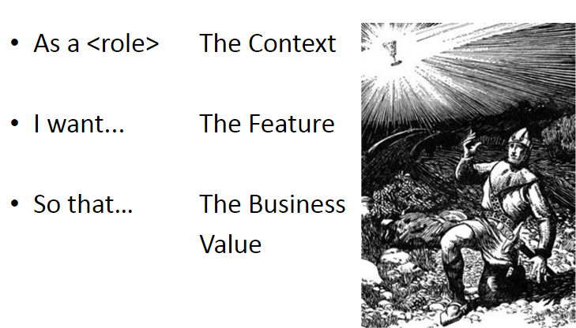
Given, when, then … the holy grail

Slide 4
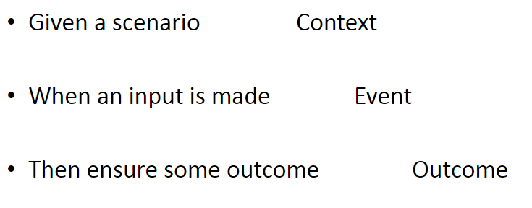
Given, when, then … the holy grail

Slide 5
Given, when, then … in action!
Requirement
User types some English sentence that must comply to a supplied drill line of text.
If user misses or adds any additional words from the drill text, then the words must be highlighted as errors for the user to correct.

Slide 6
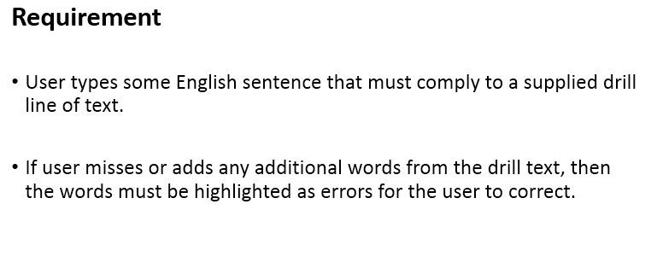
Given, when, then … in action!
Given
when
then

Slide 7
Identify Scenarios (Behavior)
Scenario 1 – if user misses words
Scenario 2 – if user adds words

Slide 8
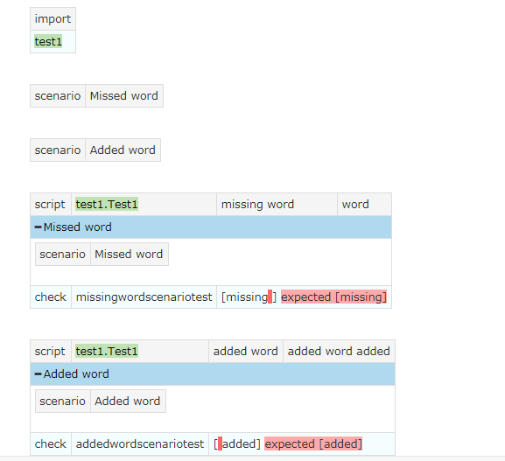
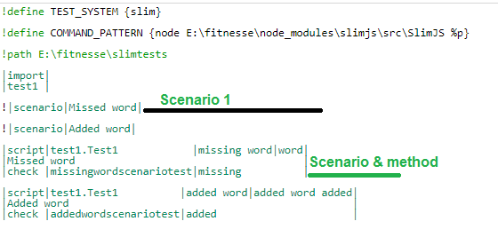
Scenario testing

Slide 9
Thank you!

